Slide 1
Multiple Sequence Alignment
Tandy Warnow
Grainger Distinguished Chair in Engineering
The University of Illinois at Urbana-Champaign
http://tandy.cs.illinois.edu

Slide 2
Indels (insertions and deletions)
Deletion
Mutation
…ACGGTGCAGTTACCA…
…ACCAGTCACCA…
Notes:
2

Slide 3
Deletion
Substitution
…ACGGTGCAGTTACCA…
Insertion
…ACGGTGCAGTTACC-A…
…AC----CAGTCACCTA…
…ACCAGTCACCTA…
The true multiple alignment
  Reflects historical substitution, insertion, and deletion events
  Defined using transitive closure of pairwise alignments computed on edges of the true tree
Notes:
3
Homology = nucleotides lined up since they come from a common ancestor.
Indel = dash.

Slide 4
Phylogenomic pipeline
Select taxon set and markers
Gather and screen sequence data, possibly identify orthologs
Compute multiple sequence alignments for each locus, and construct gene trees
Compute species tree or network:
  Combine the estimated gene trees, OR
  Estimate a tree from a concatenation of the multiple sequence alignments
Get statistical support on each branch (e.g., bootstrapping)
Estimate dates on the nodes of the phylogeny
Use species tree with branch support and dates to understand biology

Slide 5
Phylogenomic pipeline
Select taxon set and markers
Gather and screen sequence data, possibly identify orthologs
Compute multiple sequence alignments for each locus, and construct gene trees
Compute species tree or network:
  Combine the estimated gene trees, OR
  Estimate a tree from a concatenation of the multiple sequence alignments
Get statistical support on each branch (e.g., bootstrapping)
Estimate dates on the nodes of the phylogeny
Use species tree with branch support and dates to understand biology

Slide 6
What makes MSA difficult?
Large numbers of sequences
High evolutionary rates
Sequence length heterogeneity (e.g., fragmentary sequences)
Very long sequences (e.g., genome-scale)
Rearrangement events

Slide 7
What makes MSA difficult?
Large numbers of sequences
High evolutionary rates
Sequence length heterogeneity (e.g., fragmentary sequences)
Very long sequences (e.g., genome-scale)
Rearrangement events

Slide 8
This talk
Challenges and progress
  Addressing large numbers of sequences: PASTA and MAGUS
  Addressing sequence length heterogeneity: UPP
Discussion about statistical alignment (e.g., BAli-Phy)

Slide 9
This talk
Challenges and progress
  Addressing large numbers of sequences: PASTA and MAGUS
  Addressing sequence length heterogeneity: UPP
Discussion about statistical alignment (e.g., BAli-Phy)

Slide 10
Simulation Studies
S1 = AGGCTATCACCTGACCTCCA
S2 = TAGCTATCACGACCGC
S3 = TAGCTGACCGC
S4 = TCACGACCGACA
Unaligned Sequences
S1 = -AGGCTATCACCTGACCTCCA
S2 = TAG-CTATCAC--GACCGC--
S3 = TAG-CT-------GACCGC--
S4 = -------TCAC--GACCGACA
S1 = -AGGCTATCACCTGACCTCCA
S2 = TAG-CTATCAC--GACCGC--
S3 = TAG-C--T-----GACCGC--
S4 = T---C-A-CGACCGA----CA
S1
S2
S1
S4
Compare
S4
S3
S2
S3
True tree and alignment
Estimated tree and alignment

Slide 11
Two-phase estimation
Alignment methods
Clustal
POY (and POY*)
Probcons (and Probtree)
Probalign
MAFFT
Muscle
Di-align
T-Coffee
Prank (PNAS 2005, Science 2008)
Opal (ISMB and Bioinf. 2007)
FSA (PLoS Comp. Bio. 2009)
Infernal (Bioinf. 2009)
Etc.
Phylogeny methods
Bayesian MCMC
Maximum parsimony
Maximum likelihood
Neighbor joining
FastME
UPGMA
Quartet puzzling
Etc.
RAxML: heuristic for large-scale ML optimization
Notes:
11

Slide 12
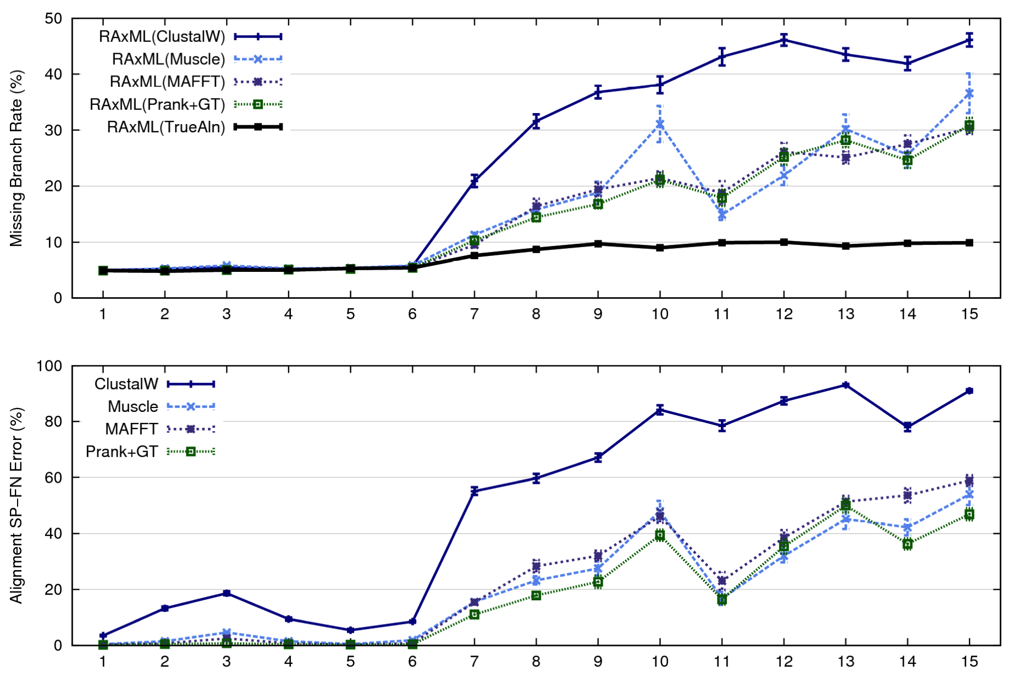
1000-taxon models, ordered by difficulty (Liu et al., 2009)
Notes:
12
1. 2 classes of MC: easy, moderate-to-difficult
2. true alignment
3. 2 classes: ClustalW, everything else
Alignment error, measured this way, isn't a perfect predictor of tree error, measured this way.

Slide 13
Re-aligning on a tree
A
C
Decompose dataset
A
B
C
D
B
D
Align subsets
A
B
C
D
Estimate ML tree on merged alignment
ABCD
Merge
sub-alignments
Notes:
Comment on subset size

Slide 14
SATé, PASTA, and MAGUS Algorithms
Obtain initial alignment and estimated ML tree
Tree
Use tree to compute new alignment
Estimate ML tree on new alignment
Alignment
Repeat until termination condition, and
return the alignment/tree pair with the best ML score

Slide 15
Improvement over time
SATe-1 (Science 2009): up to about 8,000
SATe-2 (Syst Biol 2012): up to 50,000
PASTA (J Comp Biol 2014): up to 1,000,000
MAGUS (Bioinformatics 2021): more accurate than PASTA (and one iteration suffices)
Each method improved on the previous with respect to accuracy, speed, and scalability

Slide 17
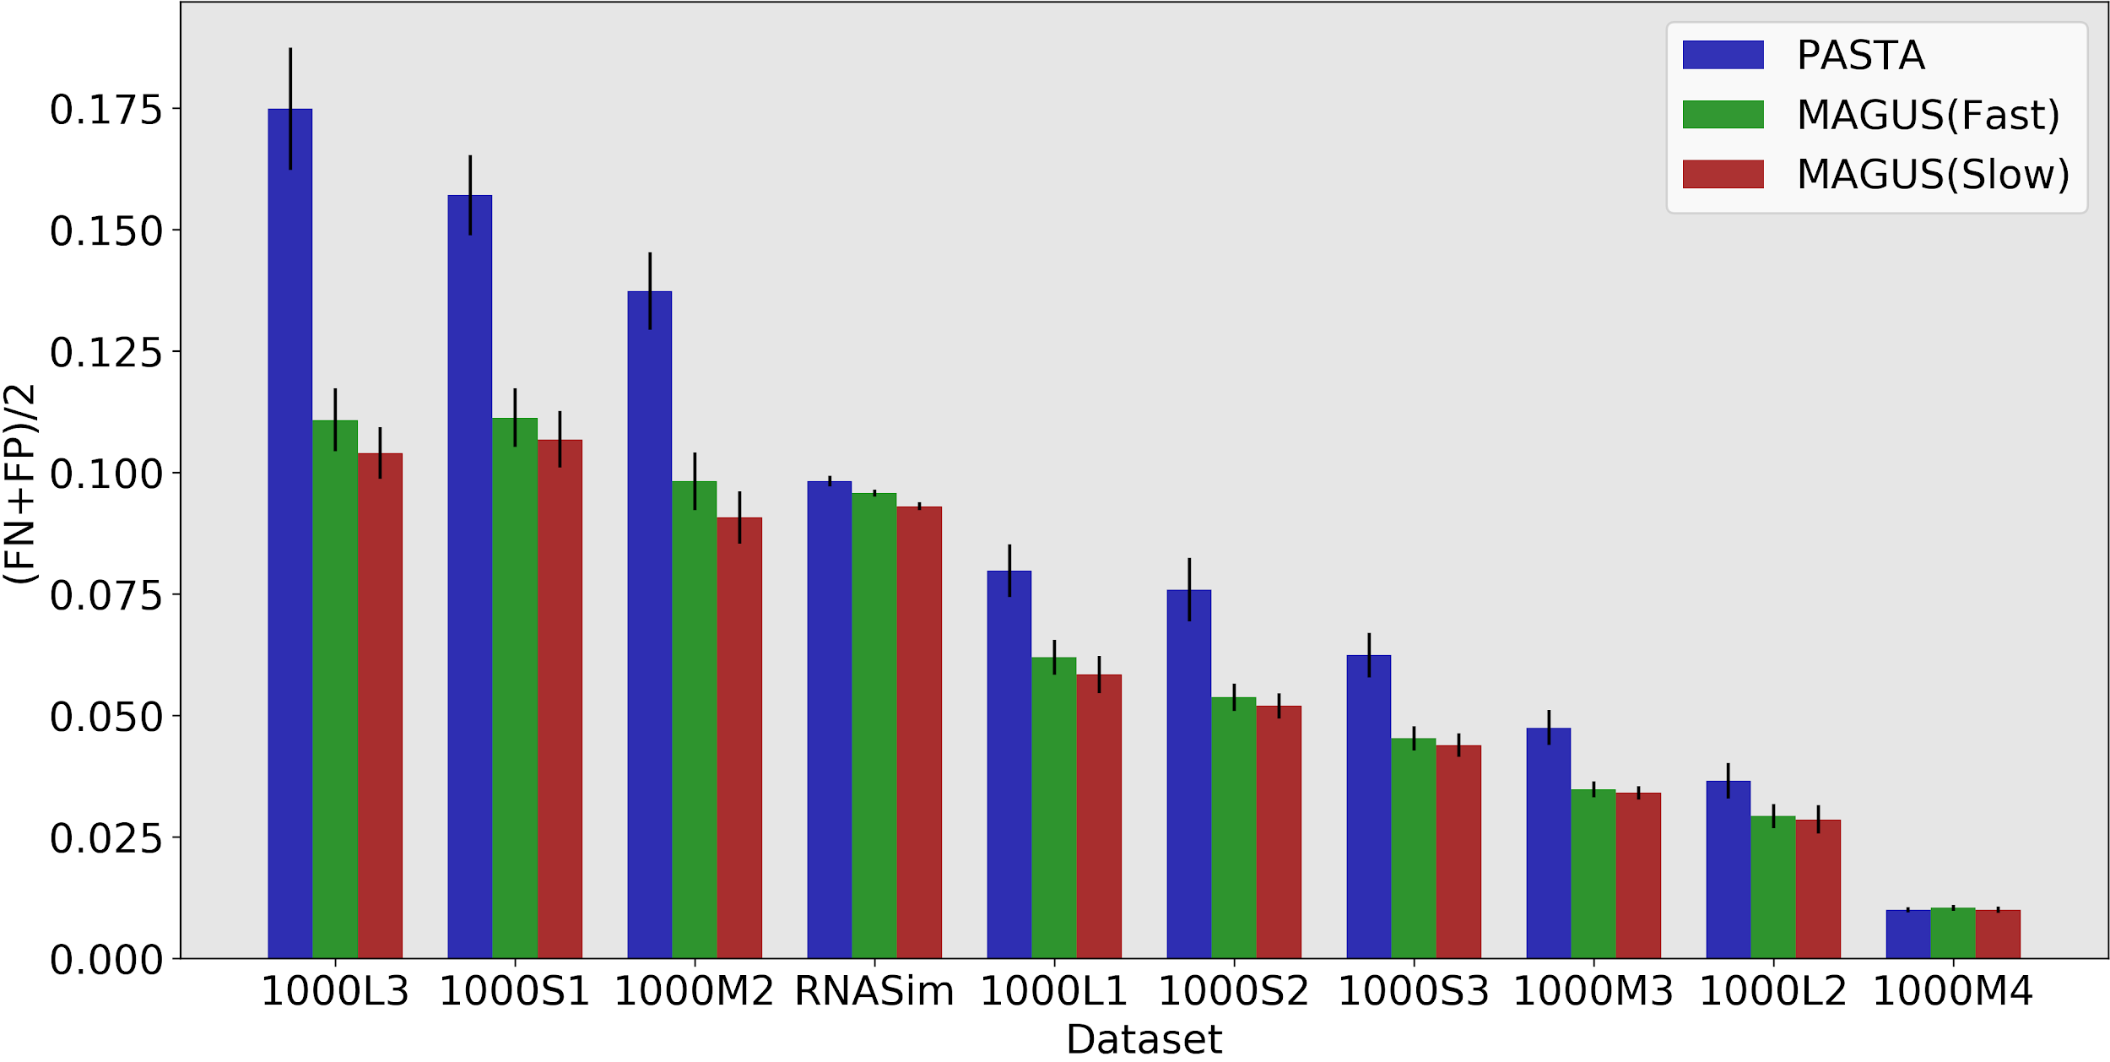
MAGUS: More Accurate than PASTA
MAGUS
Department of Computer Science
GRAINGER ENGINEERING

Slide 18
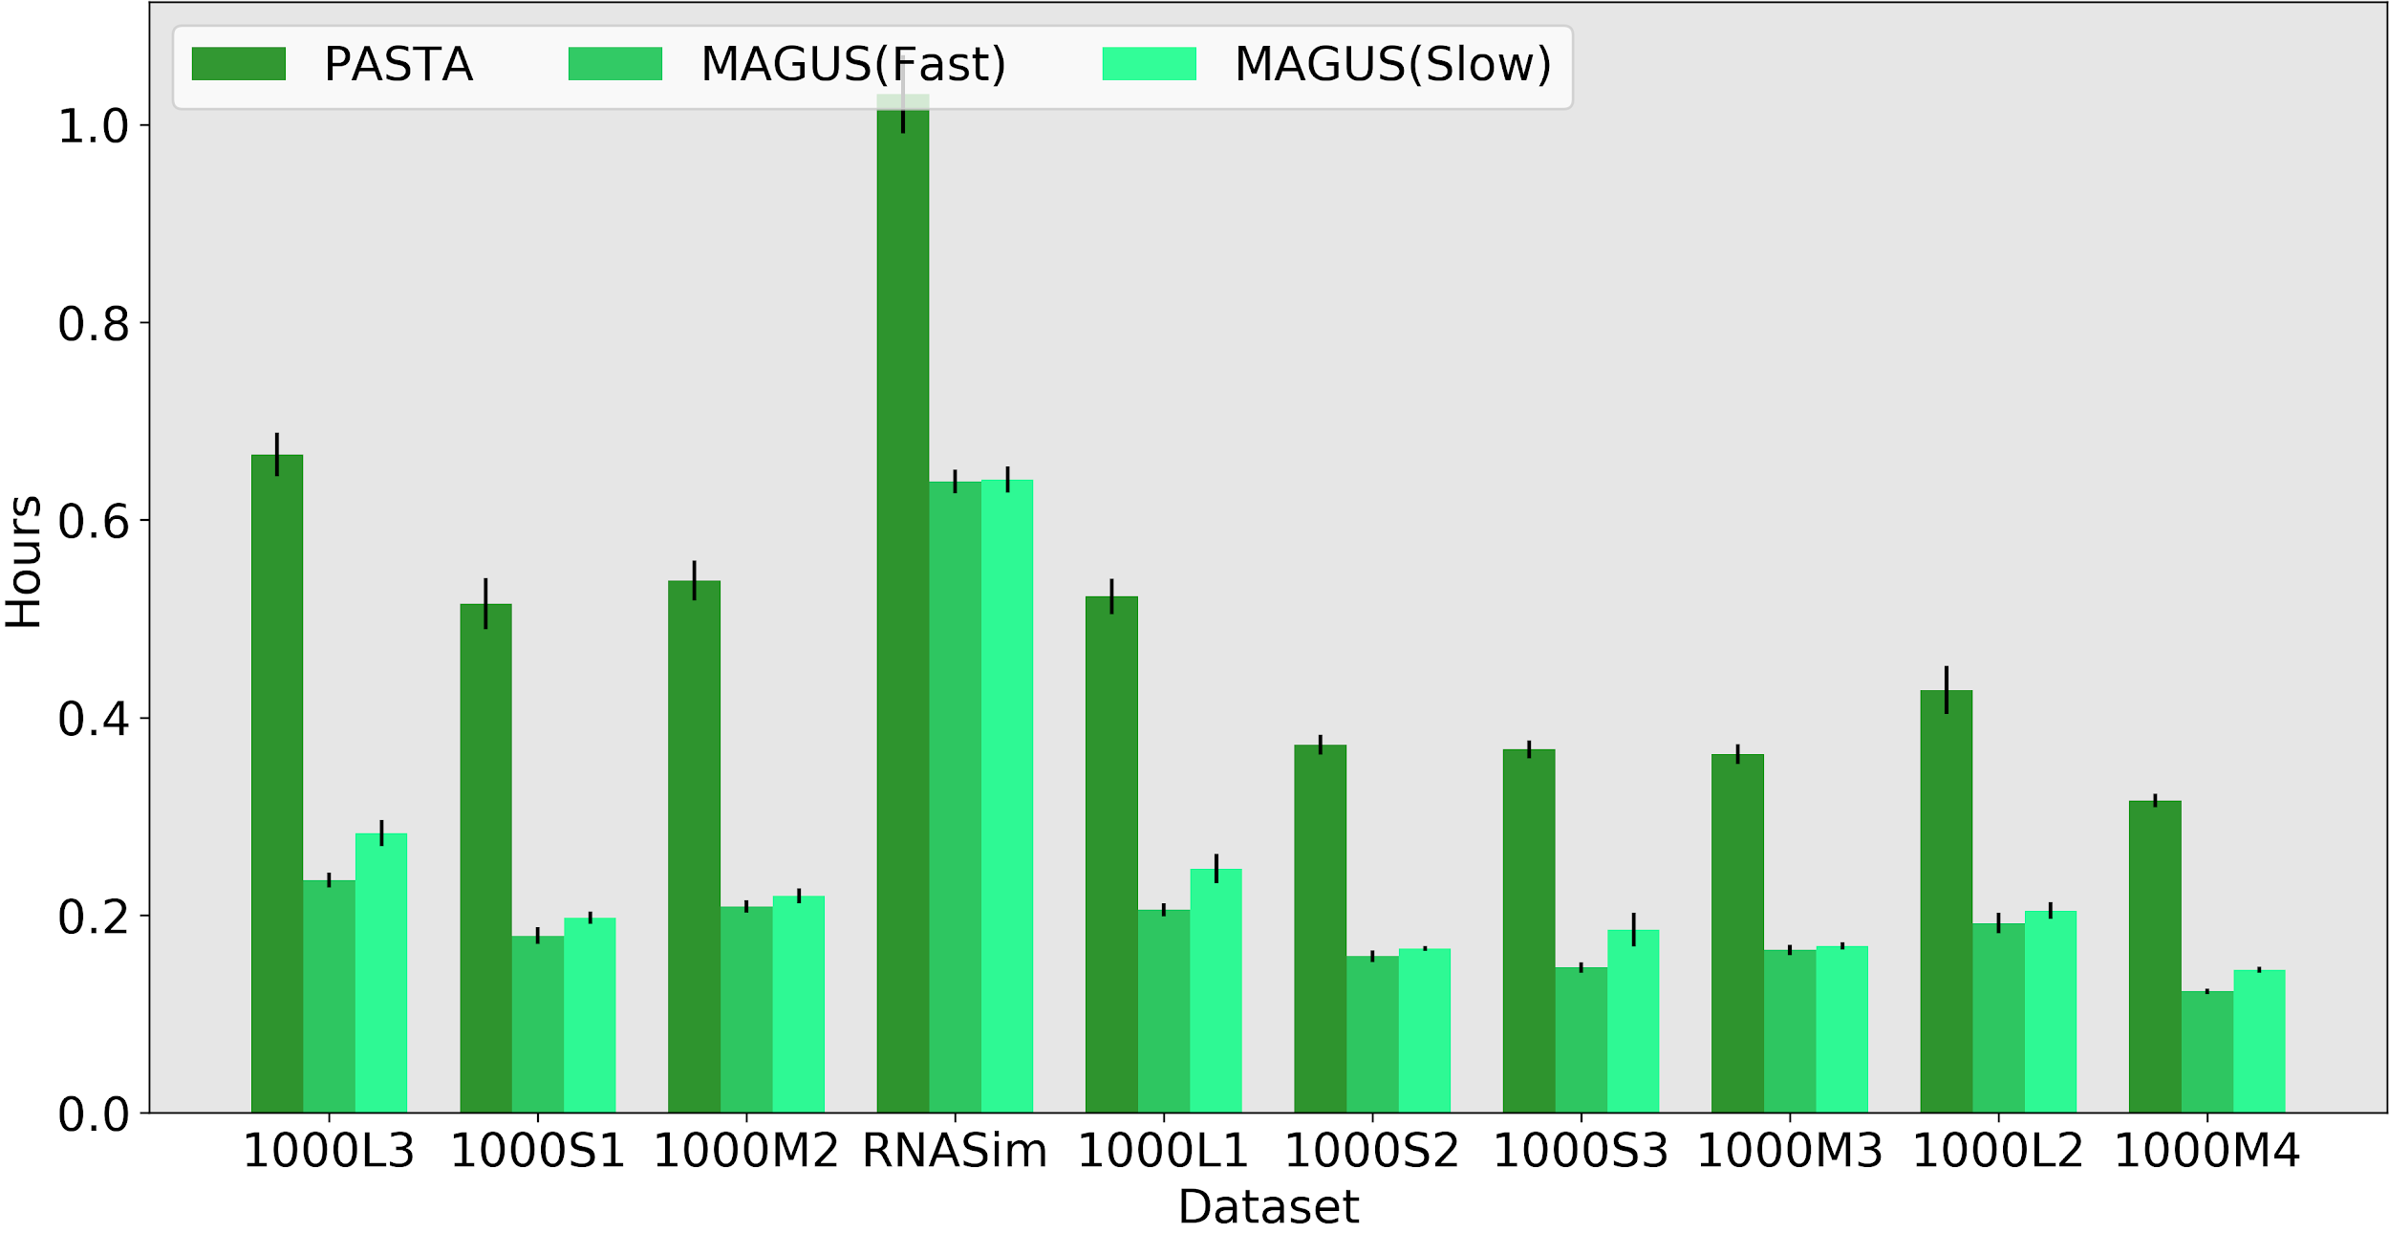
MAGUS: FASTER than PASTA
MAGUS
GRAINGER ENGINEERING

Slide 19
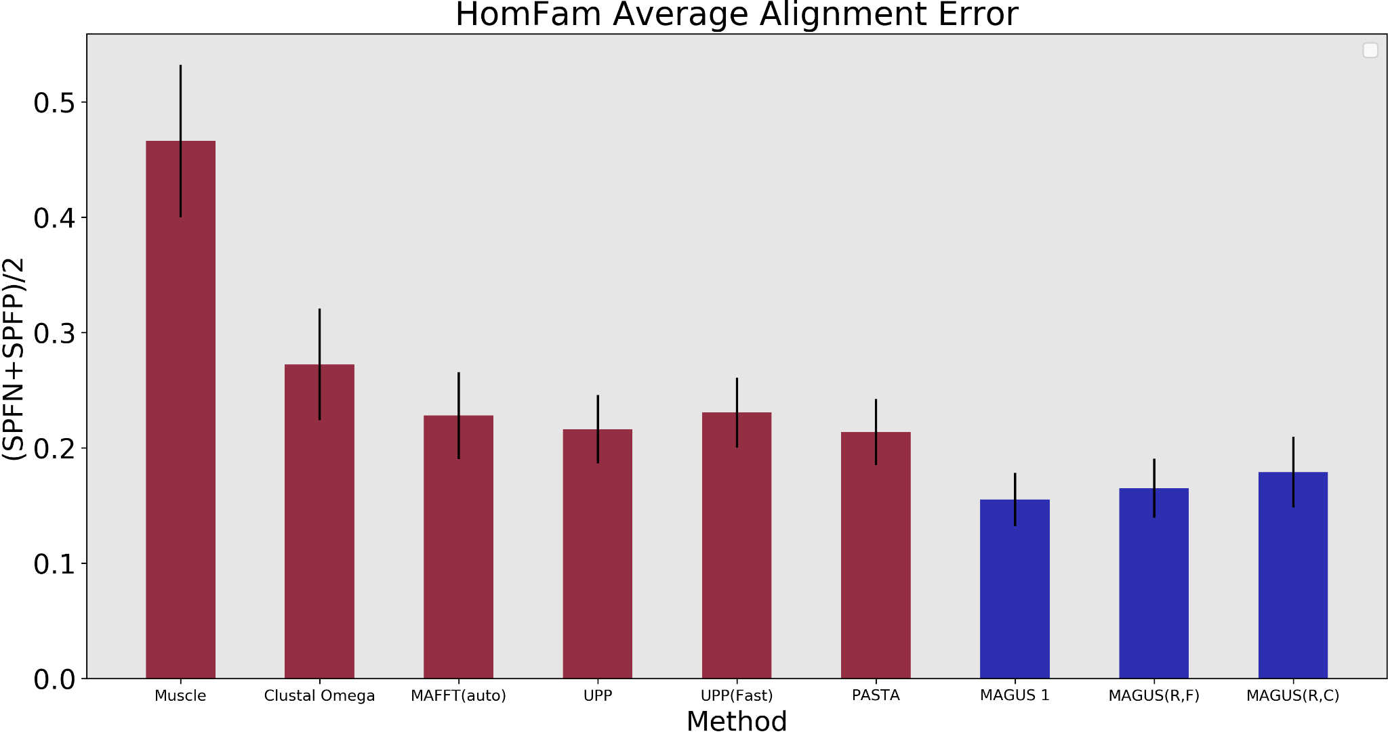
MAGUS: excellent on protein benchmarks. too
Recursive MAGUS
GRAINGER ENGINEERING

Slide 20
This talk
Challenges and progress
  Addressing large numbers of sequences: PASTA and MAGUS
  Addressing sequence length heterogeneity: UPP
Discussion about statistical alignment (e.g., BAli-Phy)

Slide 21

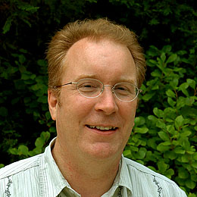





1kp: Thousand Transcriptome Project
G. Ka-Shu Wong
U Alberta
J. Leebens-Mack
U Georgia
N. Wickett
Northwestern
N. Matasci
iPlant
T. Warnow, S. Mirarab, N. Nguyen,
UIUC UT-Austin UT-Austin
Plus many many other people…
First study (Wickett, Mirarab, et al., PNAS 2014) had ~100 species and ~800 genes, gene trees and alignments estimated using SATé, and a coalescent-based species tree estimated using ASTRAL
Second study: Plant Tree of Life based on transcriptomes of ~1200 species, and more than 13,000 gene families (most not single copy)
Gene Tree Incongruence
Challenges:
Species tree estimation from conflicting gene trees
Gene tree estimation of datasets with > 100,000 sequences

Slide 22
1KP dataset: more than
100,000 p450 amino-acid
sequences, many fragmentary
All standard multiple
sequence alignment
methods we tested
performed poorly on
datasets with fragments.

Slide 23
1kp: Thousand Transcriptome Project
G. Ka-Shu Wong
U Alberta
J. Leebens-Mack
U Georgia
N. Wickett
Northwestern
N. Matasci
iPlant
T. Warnow, S. Mirarab, N. Nguyen
UIUC UT-Austin UT-Austin
Plus many many other people…
Plant Tree of Life based on transcriptomes of ~1200 species
More than 13,000 gene families (most not single copy)
Gene Tree Incongruence
Challenge:
Alignment of datasets with > 100,000 sequences
with many fragmentary sequences

Slide 24
UPP
UPP = “Ultra-large multiple sequence alignment using Phylogeny-aware Profiles”
Nguyen, Mirarab, and Warnow. Genome Biology, 2014.
Purpose: highly accurate large-scale multiple sequence alignments, even in the presence of fragmentary sequences.

Slide 25
UPP
UPP = “Ultra-large multiple sequence alignment using Phylogeny-aware Profiles”
Nguyen, Mirarab, and Warnow. Genome Biology, 2014.
Purpose: highly accurate large-scale multiple sequence alignments, even in the presence of fragmentary sequences.
Uses an ensemble of HMMs

Slide 26
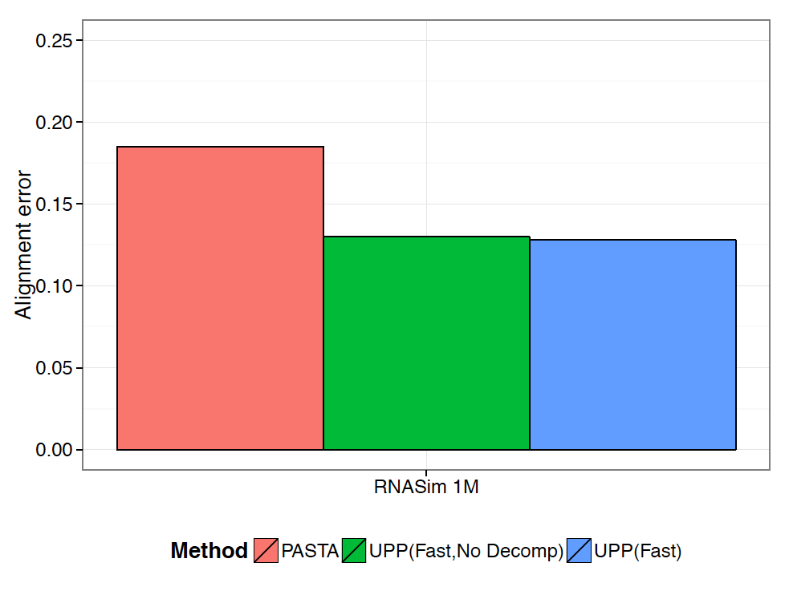
RNASim Million Sequences: alignment error
Notes:
We show alignment error using average of SP-FN and SP-FP.
UPP variants have better alignment scores than PASTA.
(Not shown: Total Column Scores – PASTA more accurate than UPP)
No other methods tested could complete on these data
PASTA under-aligns: its alignment is 43 times wider than true alignment (~900 Gb of disk space). UPP alignments were closer in length to true alignment (0.93 to 1.38 wider).

Slide 27
UPP vs. PASTA: impact of fragmentation
Under high rates of evolution,
PASTA is badly impacted
by fragmentary sequences (the
same is true for other methods).
Under low rates of evolution,
PASTA can still be highly accurate
(data not shown).
UPP continues to have good
accuracy even on datasets
with many fragments under
all rates of evolution.
Performance on fragmentary datasets of the 1000M2 model condition

Slide 28
Summary (so far)
Large number sequences: PASTA, MAGUS, UPP
  Datasets with 1,000,000 sequences can be aligned with high accuracy
  Can use your preferred “base method”
Datasets with fragmentary sequences: UPP
  Ensemble of profile HMMs is a powerful machine learning technique

Slide 29
This talk
Challenges and progress
  Addressing large numbers of sequences: PASTA and MAGUS
  Addressing sequence length heterogeneity: UPP
Discussion about statistical alignment (e.g., BAli-Phy)

Slide 30
What about BAli-Phy?
BAli-Phy (Redelings and Suchard): leading method for statistical co-estimation of alignments and trees
Like Bayesian phylogeny estimation, it is expected to be the most rigorous and accurate technique for estimating trees and alignments!

Slide 31
BAli-Phy: Better than PASTA!
Alignment Accuracy (TC score)
40%
30%
20%
10%
0%
# Taxa:
MAFFT
PASTA
BAli-Phy
Total-Column Score
100
Indelible (DNA)
200
100
RNAsim (RNA)
200
Simulator
Simulated nucleotide datasets with 100 or 200 sequences (unpublished data from Mike Nute’s PhD dissertation).
*Averages over 10 replicates

Slide 32
But: BAli-Phy is limited to small datasets
From www.bali-phy.org/README.html, 5.2.1. Too many taxa?
“BAli-Phy is quite CPU intensive, and so we recommend using 50 or fewer taxa in order to limit the time required to accumulate enough MCMC samples. (Despite this recommendation, data sets with more than 100 taxa have occasionally been known to converge.) We recommend initially pruning as many taxa as possible from your data set, then adding some back if the MCMC is not too slow.”

Slide 33
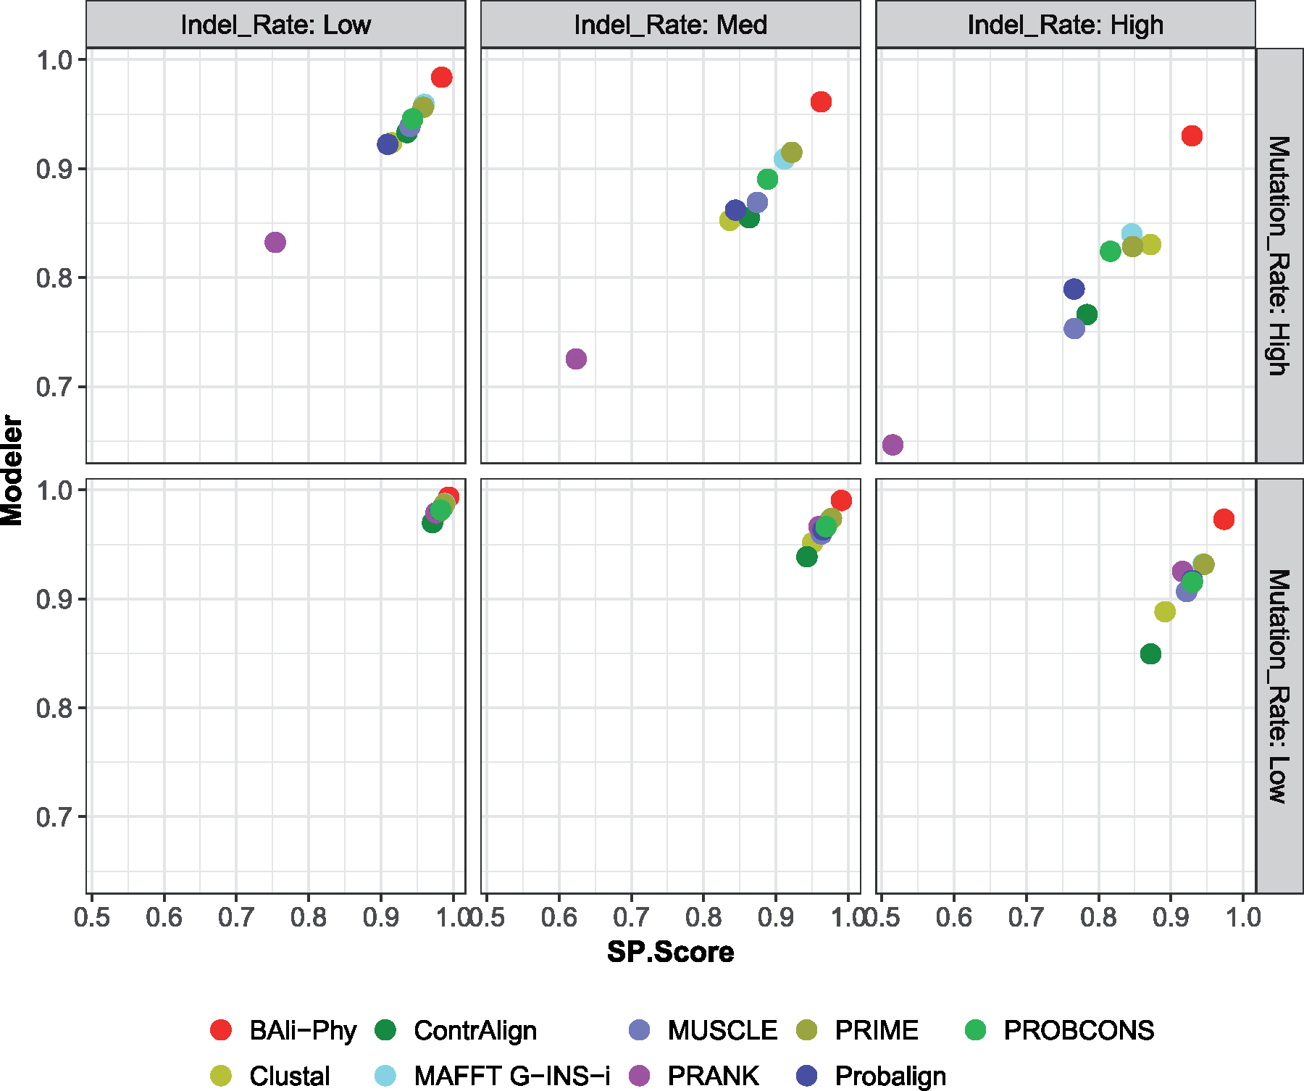

Modeler vs SP-Score on 120 Simulated Datasets
BAli-Phy is best!
Notes:
Figure 6. Modeler score (i.e., precision) versus SP-Score (i.e., recall) for MSA methods on simulated amino acid data sets with 27 sequences for 6 different model conditions that vary by the substitution rate and indel rate; averages over 20 replicates are shown. See Supplementary Excel File available on Dryad for actual numeric values.
Unless provided in the caption above, the following copyright applies to the content of this slide: © The Author(s) 2018. Published by Oxford University Press, on behalf of the Society of Systematic Biologists.This is an Open Access article distributed under the terms of the Creative Commons Attribution License (http://creativecommons.org/licenses/by-nc/4.0/), which permits unrestricted re-use, distribution, and reproduction in any medium, provided the original work is properly cited. For commercial re-use, please contactjournals.permissions@oup.com

Slide 34
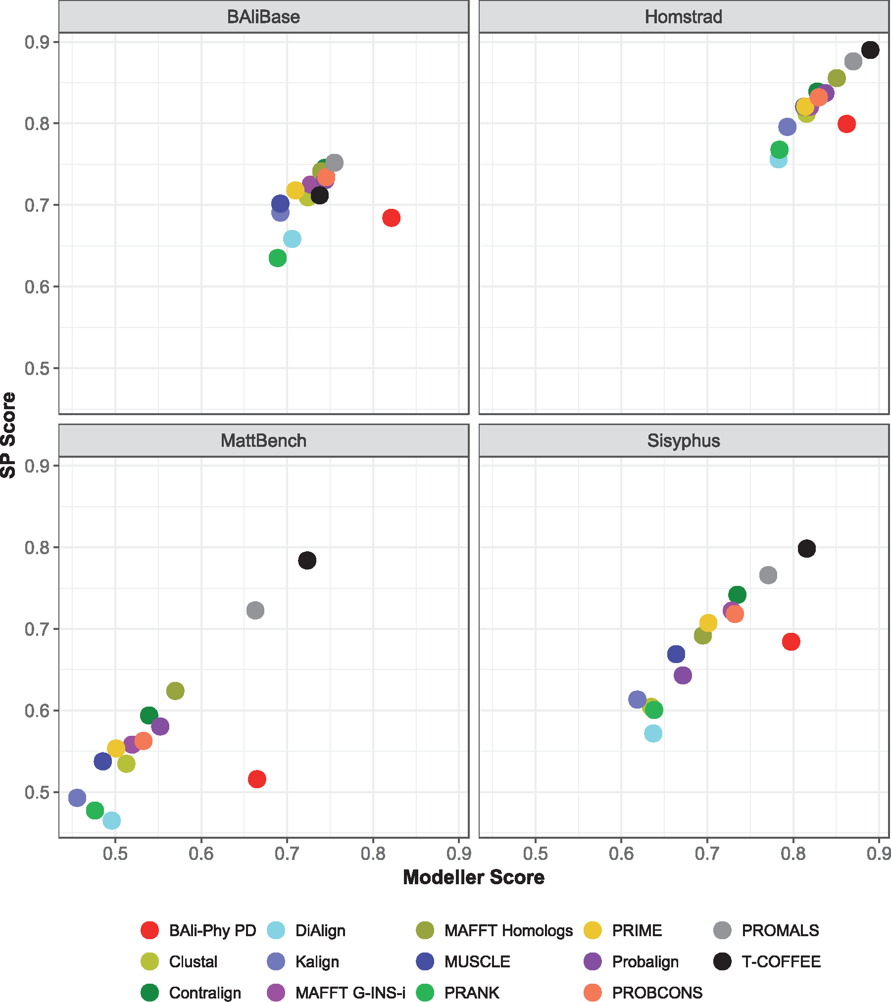
Modeler score vs SP-score on 1192 biological datasets
T-Coffee and PROMALS
are best!
BAli-Phy good for
Modeler score, but not
so good for SP-Score
(e.g., MAFFT better)
Notes:
Figure 2. Average Modeler Score (i.e., precision) versus SP-Score (i.e., recall) of all alignment methods on the individual biological benchmarks. Results shown are for 1192 data sets from the four benchmark collections (658 from BAliBase, 231 from Homstrad, 202 from Mattbench, and 101 from Sisyphus) See Supplementary Table S2 and Excel File available on Dryad for actual numeric values.
Unless provided in the caption above, the following copyright applies to the content of this slide: © The Author(s) 2018. Published by Oxford University Press, on behalf of the Society of Systematic Biologists.This is an Open Access article distributed under the terms of the Creative Commons Attribution License (http://creativecommons.org/licenses/by-nc/4.0/), which permits unrestricted re-use, distribution, and reproduction in any medium, provided the original work is properly cited. For commercial re-use, please contactjournals.permissions@oup.com

Slide 35
Observations
Simulated data: Bali-Phy is the best!
Protein benchmarks: BAli-Phy in middle
  Good for Modeler score (so low false positives)
  Not good for SP-score (so high false negatives)
BAli-Phy under-aligns on biological datasets, but not on simulated datasets

Slide 36
What is going on?
Most likely not an issue of failure of the MCMC analyses to converge (48 hours, 32 processors, < 30 sequences).
Possible explanations:
Model misspecification (i.e., BAli-Phy model not appropriate)
Structural alignments and evolutionary alignments different
The structural alignments are not correct
All these explanations are likely true, but the relative contributions are unknown.

Slide 37
Final comments
MSA is challenging, but algorithmic techniques can improve accuracy and scalability:
  Dataset size can be addressed using good divide-and-conquer approaches.
  Heterogeneity in sequence length can be addressed using “local alignment” approaches, such as profile HMMs, with ensembles of profile HMMs providing improved accuracy.
Yet the differences between performance on biological and simulated datasets is very troubling – and depending on the resolution, there are potential implications for phylogeny estimation as well.

Slide 38
Multiple Sequence Alignment (MSA): a scientific grand challenge¹
S1 = AGGCTATCACCTGACCTCCA
S2 = TAGCTATCACGACCGC
S3 = TAGCTGACCGC
…
Sn = TCACGACCGACA
S1 = -AGGCTATCACCTGACCTCCA
S2 = TAG-CTATCAC--GACCGC--
S3 = TAG-CT-------GACCGC--
…
Sn = -------TCAC--GACCGACA
Novel techniques needed for scalability and accuracy
NP-hard problems and large datasets
Current methods do not provide good accuracy
Few methods can analyze even moderately large datasets
Many important applications besides phylogenetic estimation
¹ Frontiers in Massive Data Analysis, National Academies Press, 2013

Slide 39



Acknowledgments
PASTA and UPP: Nam Nguyen and Siavash Mirarab
Evaluating BAli-Phy: Mike Nute and Ehsan Saleh
Current NSF grants: ABI-1458652 (multiple sequence alignment)
Grainger Foundation (at UIUC), and UIUC
TACC, UTCS, Blue Waters, and UIUC campus cluster
PASTA, UPP, SEPP, and TIPP are available on github at https://github.com/smirarab/
PASTA+BAli-Phy at http://github.com/MGNute/pasta
MAGUS: at https://github.com/vlasmirnov/MAGUS
Papers available at http://tandy.cs.illinois.edu/MSAproject.html

Slide 40
Expansion Ratio on 1192 Biological datasets
BAli-Phy under-aligns

Slide 41
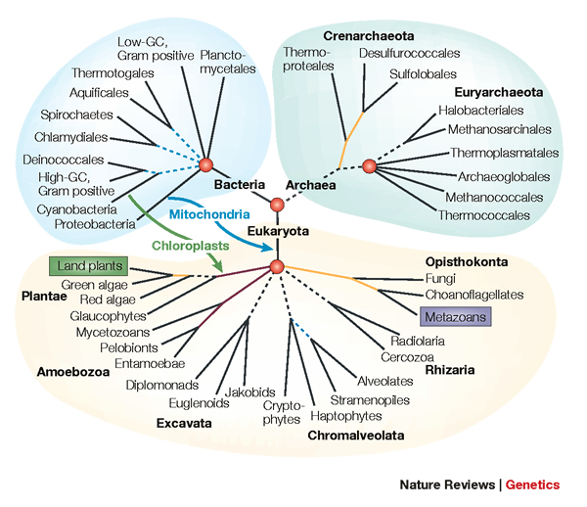
The Tree of Life: Multiple Challenges
Scientific challenges:
Ultra-large multiple-sequence alignment
Gene tree estimation
Metagenomic classification
Alignment-free phylogeny estimation
Supertree estimation
Estimating species trees from many gene trees
Genome rearrangement phylogeny
Reticulate evolution
Visualization of large trees and alignments
Data mining techniques to explore multiple optima
Theoretical guarantees under Markov models of evolution
Techniques: applied probability theory, graph theory, supercomputing, and heuristics
Testing: simulations and real data

Slide 42
Study design
Goal: Evaluate Bali-Phy (Redelings and Suchard) on both biological and simulated datasets, in comparison to leading alignment methods on small protein sequence datasets (at most 27 sequences)
Metrics: Modeller score (precision), SP-score (recall), Expansion ratio (normalized alignment length), and running time
Datasets: 120 simulated datasets (6 model conditions) and 1192 biological datasets (4 biological benchmarks)
Specific note: For each dataset, Bali-Phy was run independently on 32 processors for 48 hours, the burn-in was discarded, and the posterior decoding (PD) alignment was then computed. These Bali-Phy analyses used 230 CPU years on Blue Waters (supercomputer at NCSA).

Slide 43
Expansion Ratios on 120 Simulated Datasets
BAli-Phy is best!

Slide 44
Running Time on 4 biological datasets with 17 sequences each
BAli-Phy benefits from
a long running time.
Therefore, we used >2
months for each dataset.

Slide 45
Modeler Score on 1192 Biological datasets
BAli-Phy has the best modeler score

Slide 46
SP-score on 1192 Biological datasets
BAli-Phy not competitive for SP-score
(but best method depends on % ID)

