Slide 1
Phylogenetic Network Estimation for Wolbachia
Paul Zaharias, Danny Rice, Tandy Warnow, and Irene Newton

Slide 2
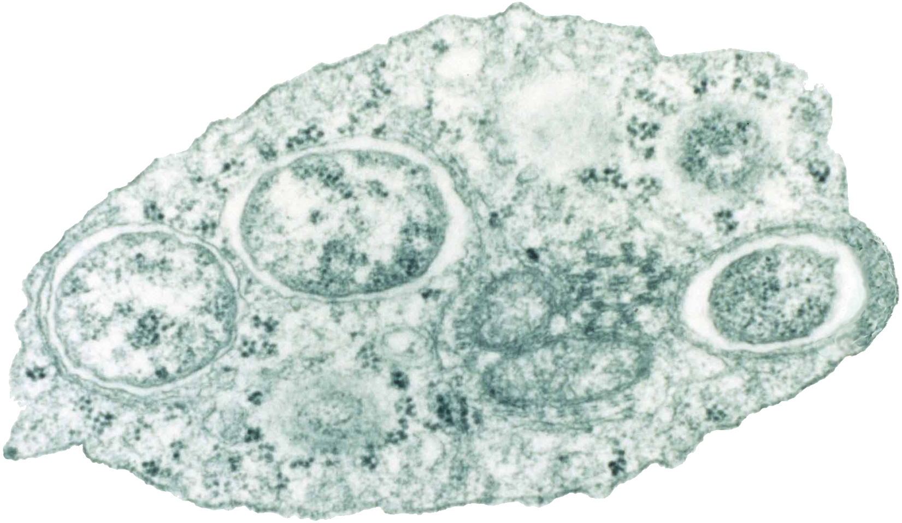
The parasitic bacteria Wolbachia
Infects the reproductive tracts of arthropods and nematods
25 to 70% of all insect species are potential hosts
Impacts on human health (e.g., Dengue fever)
Insect cell
Wolbachia
Wolbachia
Wolbachia
Scott O'Neill — Genome Sequence of the Intracellular Bacterium Wolbachia. PLoS Biol 2/3/2004: e76. doi:10.1371/journal.pbio.0020076

Slide 3
Questions of interest
What genes are under selection?
Can we improve species delimitation?
What is the percentage of horizontally-transferred genes in Wolbachia?

Slide 4
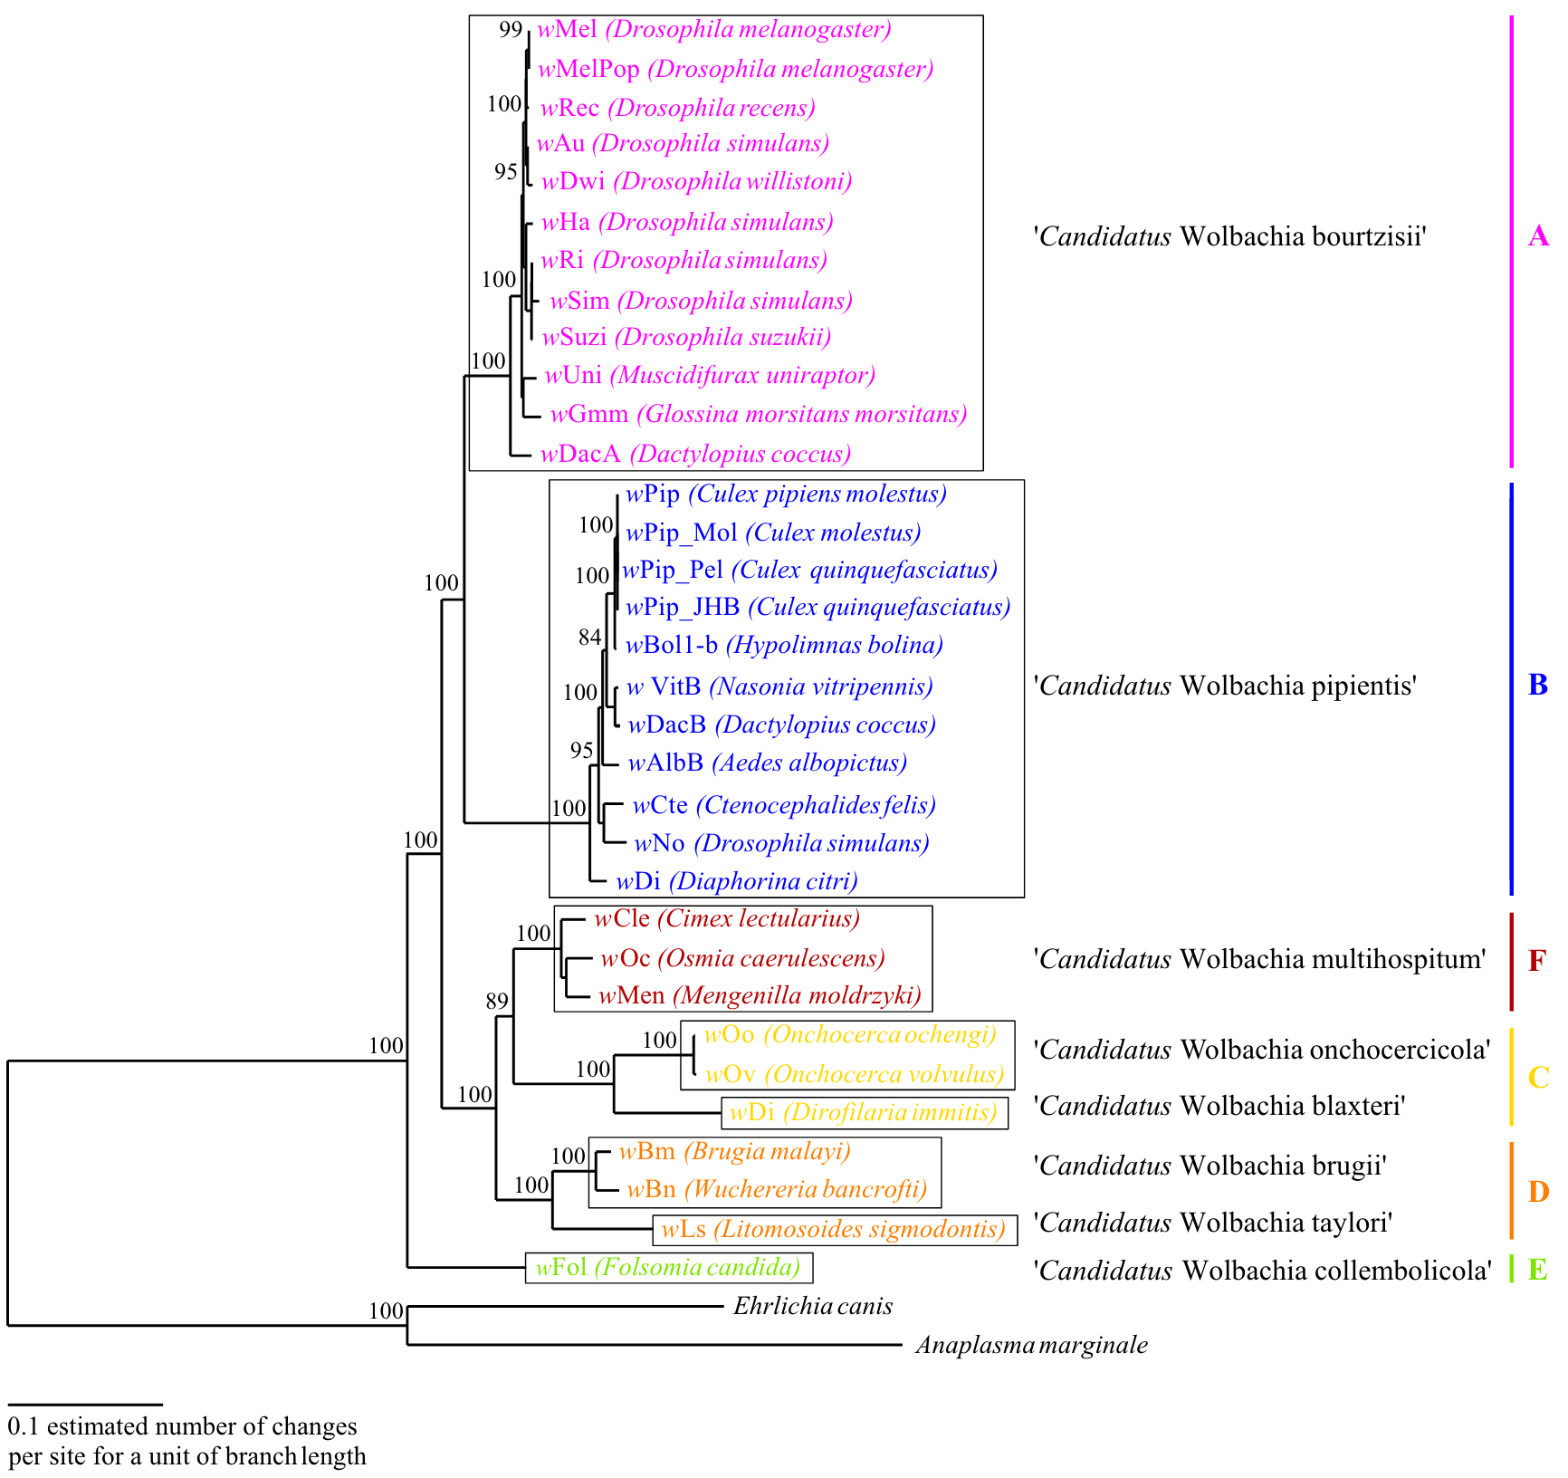
One of the trees from the literature
Ramírez-Puebla et al.,
Syst. and Appl. Microbiology, 2016
Ramírez-Puebla, Shamayim T., et al. "A response to Lindsey et al." Wolbachia pipientis should not be split into multiple species: A response to Ramírez-Puebla et al."." Systematic and applied microbiology 39.3 (2016): 223-225.
Notes:
Phylogenomic tree showing evolutionary relationships between Wolbachia strains inferred with PhyML based on a concatenated alignment of 31 marker proteins detected with AMPHORA2 and analyzed with the JTT substitution model.

Slide 5
Species tree estimation options
From orthologs:
  Concatenation using maximum likelihood: statistically inconsistent, computationally intensive, can be accurate
  Summary methods (that combine gene trees), such as ASTRAL, ASTRID: faster than concatenation, statistically consistent if given true gene trees, can be accurate
  Site-based methods, such as LilyQ and SVDquartets/SVDquest: statistically consistent, limited to perhaps 100 leaves due to computational challenges
The choice between methods depends on the data

Slide 6
Species tree estimation options
From homologs:
  Construct gene family trees and combine
    ASTRAL-Pro (variant of ASTRAL to handle gene family trees)
    DISCO+ASTRID (decomposes gene family trees into single copy trees, then runs ASTRID)
    FastMulRFS (supertree method applied to MUL-trees)
  Variant of concatenation
    Construct gene family trees, decompose using DISCO, then use concatenation
Statistical consistency without knowing orthology is achieved in some cases
The choice between methods depends on the data

Slide 7
What we did: genomes to species trees
Protein alignment then
convert back to nucleotides.
Complete-linkage clustering
ML gene tree estimation
‘Species tree methods
(Astral-III
Astrid, etc.)
Ortholog groups
(+ in-paralogs)
Ortholog alignments
Ortholog trees
69
Wolbachia genomes
Extract proteins + all-vs.-all blast
List of reciprocal best blast hits
Concatenation + ML
Species
tree
Homolog alignments
Homolog gene family trees
Homolog groups
Uclust
CdHit
etc.
Protein alignment then
convert back to nucleotides.
‘Species tree methods that do not require orthology
(Astral-Pro, FastMulRFS, etc.)
ML gene family tree (MUL-tree) estimation

Slide 8
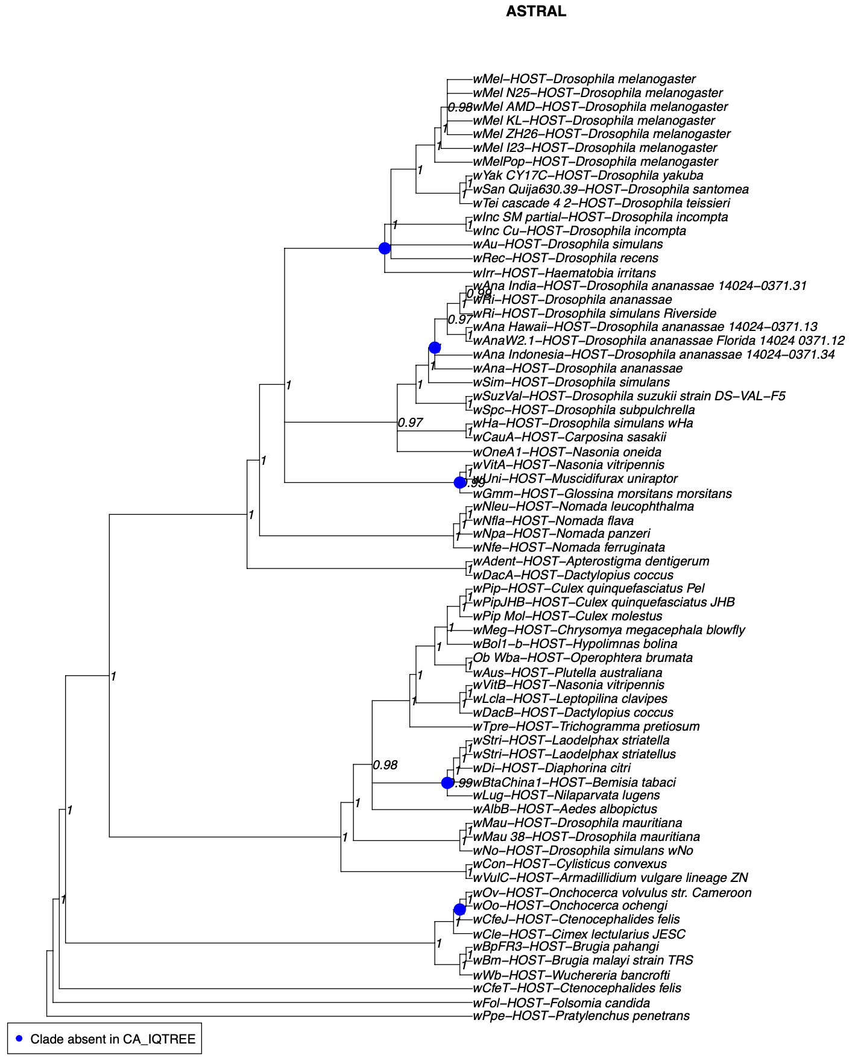
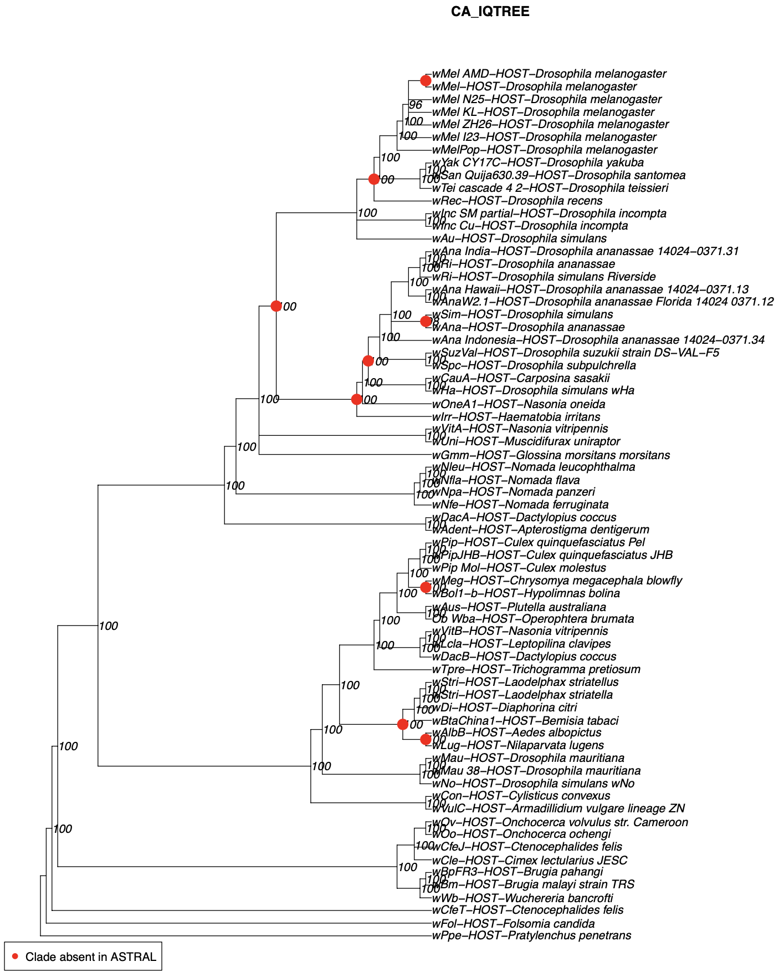
ASTRAL and Concatenation-IQTree: very similar
Astral
CA (IQ-TREE)
Collapsed pp < 0.95 for Astral
Collapsed UfBoot < 95 for CA
Both trees are very well supported, but with some differences (marked in figure)
Are this incompatibilities the result of HGT events or something else?

Slide 9
Reticulation events
Consensus tree
Between supergroups ( = ‘species’) ? In particular, between supergroup A and B (most studied)
Within ‘species’ ?
→ Phylogenetic network methods
B
A

Slide 10
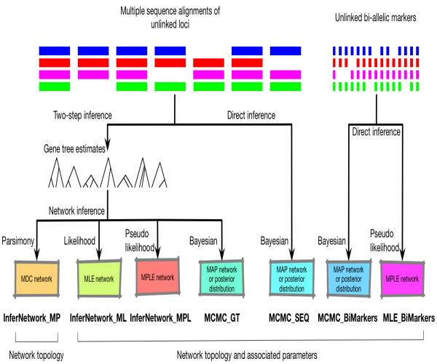
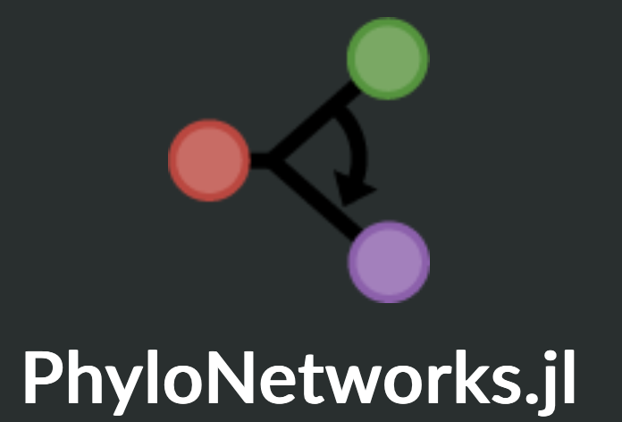

Phylonet (Nakhleh) and PhyloNetworks (Solis-Lemus)
Phylonet (Luay Nakhleh)
PhyloNetworks (Claudia Solís-Lemus)

Slide 11
Phylogenetic Network Pipeline
In all analyses, assumption is you have gene trees and you are seeking a phylogenetic network
Three variants of the problem:
  Given an underlying species tree, add reticulations (extra edges) to create network (easier)
  Given an underlying species tree, add reticulations and allow tree to change (a bit harder)
  Construct the phylogenetic network directly (much harder)

Slide 12
Phylogenetic Network Pipeline
In all analyses, assumption is you have gene trees and you are seeking a phylogenetic network
Three variants of the problem:
  Given an underlying species tree, add reticulations (extra edges) to create network (easier)
  Given an underlying species tree, add reticulations and allow tree to change (a bit harder)
  Construct the phylogenetic network directly (much harder)

Slide 13
How do you proceed?
Maximum Parsimony, Maximum Likelihood, Maximum Pseudo-Likelihood:
  Fix a maximum number of ‘hybridization’ events and optimize a criterion
  Choosing between different networks with different numbers of hybridization events is not well solved
  Knowing the number of hybridization events is also not well solved
Bayesian approaches: deal with the model complexity but limited to very small datasets (maybe 4 or 5 leaves)
  MCMC_GT : input rooted gene trees
  MCMC_SEQ : input alignments (direct inference)

Slide 14
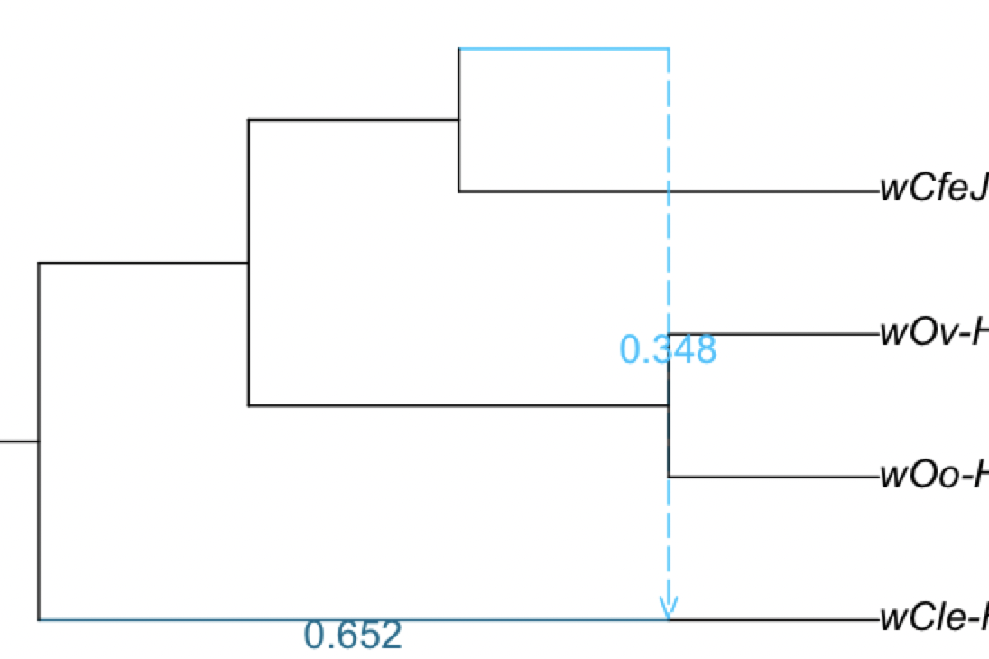
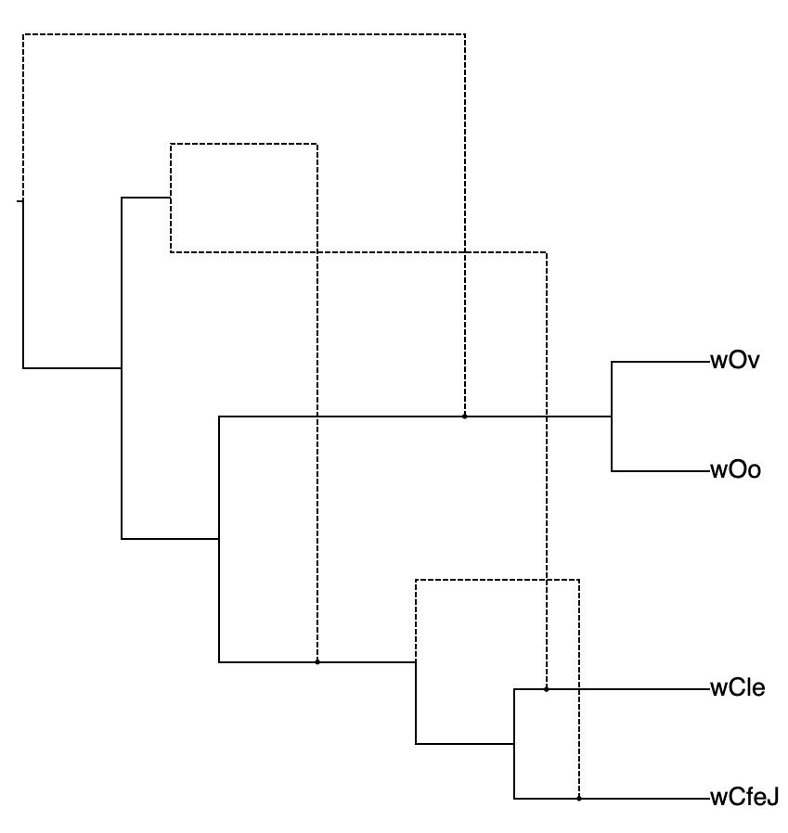
Problem n°1 : different methods return different number of reticulations
Only considering one 4-taxon ‘species’:
  SNaQ → 1 reticulation
  (too conservative?)
  MCMC_SEQ (direct Bayesian inference) →
  converges to 4 reticulations
  (too aggressive?)

Slide 15
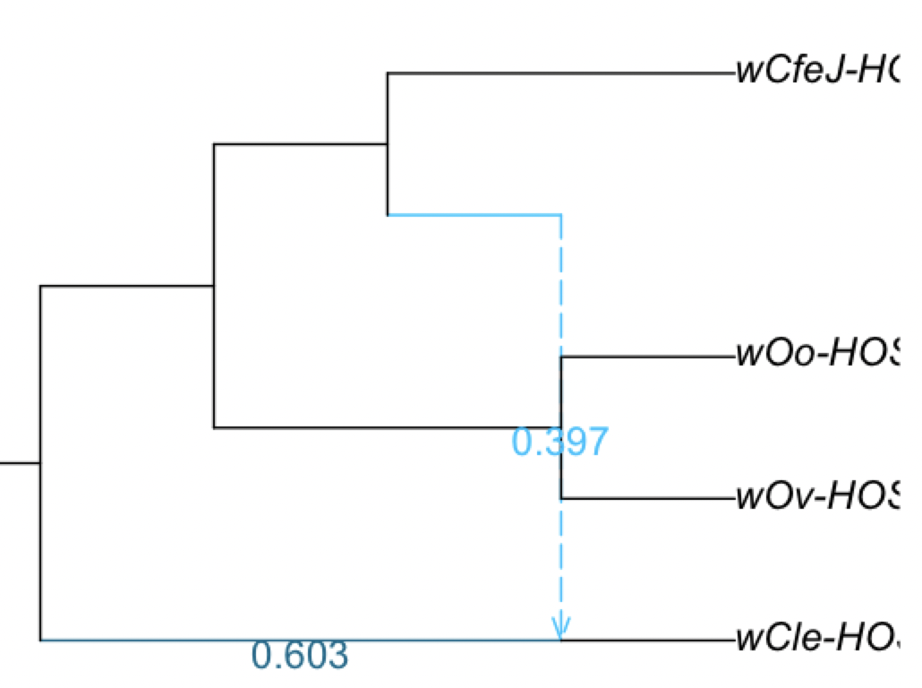
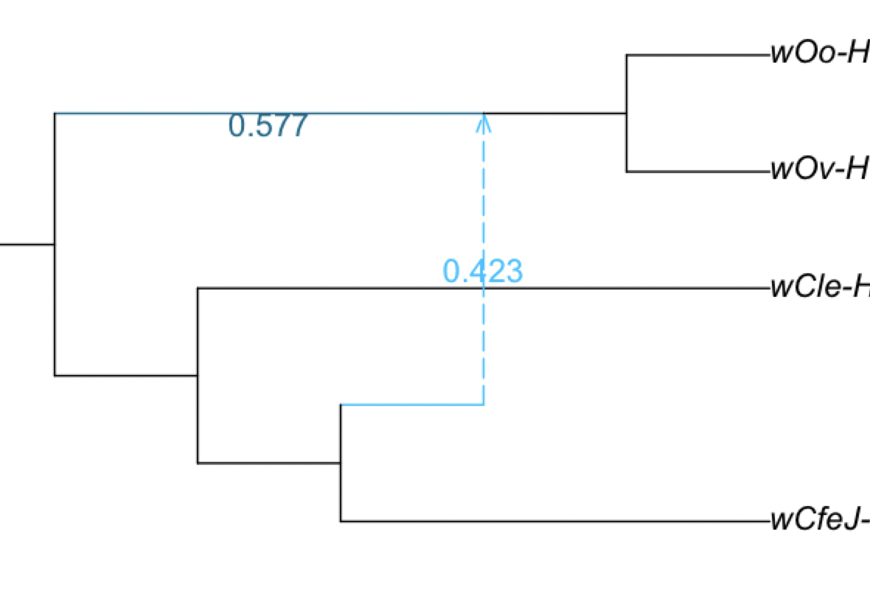
Problem n°2: For fixed number of reticulations, different methods return different networks
SNaQ
PhyloNet ML
PhyloNet MPL
→ How do you score networks?

Slide 16
Problem n°3: how to choose number of reticulations?
Hybrid = 2
Hybrid = 3
SNaQ analysis with 2 vs. 3 hybridization events
Notes:
SNaQ analysis with 2 vs. 3 hybridization events

Slide 17
(Pseudo) Log-likelihood improves as you increase the number of reticulation events
Risk of falsely detecting extra reticulations
Choice of “best” number of hybridization events usually done in a hand-wavy way (i.e. within the greyzone hereafter)
Few statistical tests available (but see Cai & Ané, 2020)

Slide 18
Conclusion
Species tree inference is hard, as it requires careful processing of the genomes (assembly pipeline), alignment procedure and tree estimation
Phylogenetic network inference is much harder, as we are limited by the number of methods and most of them are highly time-consuming
Wolbachia seems to have a limited amount of major hybridization events but we cannot quantify it with certainty

