Slide 1
Introduction to Profile HMMs
Tandy Warnow

Slide 2
Profile Hidden Markov Models
Basic tool in sequence analysis
Look more complicated than they really are
Used to model a family of sequences
Can be built from a multiple sequence alignment
Algorithms using profile HMMs are based on dynamic programming (much like Needleman-Wunsch)

Slide 3
Profile
Given a gap-less multiple sequence alignment, we can build a profile describing what we see:
S1 = A C T A G
S2 = A C A A G
S3 = A T T T G
S4 = G T T C G
1 2 3 4 5
A 0.75 0.0 0.25 0.50 0.0
C 0.00 0.5 0.00 0.25 0.0
T 0.00 0.5 0.75 0.25 0.0
G 0.25 0.0 0.00 0.00 1.0

Slide 4
Dealing with zero-probability emissions
Note that our profiles had some letters that had zero probability.
Most profile HMMs don’t allow zero-probability emissions for letters in the alphabet.
One way of dealing with this is the “add-one” rule (see Mona Singh’s lecture), but there are others.
When you don’t modify your empirical distribution at all to create the emission probabilities, this is called an “unadjusted profile”.

Slide 5
Using a profile
1 2 3 4 5
A 0.75 0.0 0.25 0.50 0.0
C 0.00 0.5 0.00 0.25 0.0
T 0.00 0.5 0.75 0.25 0.0
G 0.25 0.0 0.00 0.00 1.0
0.75
0.0
0.0
0.25
0.0
0.5
0.5
0.0
0.25
0.0
0.75
0.0
0.50
0.25
0.25
0.0
0.0
0.0
0.0
1.0
End
1.0
1.0
1.0
1.0
1.0
1.0
Start
➔
➔
➔
➔
➔
➔
End
The profile yields a probability distribution of sequences – here, all of the
same length.

Slide 6
What is the probability of generating s = ATATG?
1 2 3 4 5
A 0.75 0.0 0.25 0.50 0.0
C 0.00 0.5 0.00 0.25 0.0
T 0.00 0.5 0.75 0.25 0.0
G 0.25 0.0 0.00 0.00 1.0
0.75
0.0
0.0
0.25
0.0
0.5
0.5
0.0
0.25
0.0
0.75
0.0
0.50
0.25
0.25
0.0
0.0
0.0
0.0
1.0
End
1.0
1.0
1.0
1.0
1.0
1.0
Start
➔
➔
➔
➔
➔
➔
End
The profile yields a probability distribution of sequences – here, all of the
same length.

Slide 7
What is the probability of generating s = AAAAA?
1 2 3 4 5
A 0.75 0.0 0.25 0.50 0.0
C 0.00 0.5 0.00 0.25 0.0
T 0.00 0.5 0.75 0.25 0.0
G 0.25 0.0 0.00 0.00 1.0
0.75
0.0
0.0
0.25
0.0
0.5
0.5
0.0
0.25
0.0
0.75
0.0
0.50
0.25
0.25
0.0
0.0
0.0
0.0
1.0
End
1.0
1.0
1.0
1.0
1.0
1.0
Start
➔
➔
➔
➔
➔
➔
End
The profile yields a probability distribution of sequences – here, all of the
same length.

Slide 8
What are the most probable sequences for this model?
1 2 3 4 5
A 0.75 0.0 0.25 0.50 0.0
C 0.00 0.5 0.00 0.25 0.0
T 0.00 0.5 0.75 0.25 0.0
G 0.25 0.0 0.00 0.00 1.0
0.75
0.0
0.0
0.25
0.0
0.5
0.5
0.0
0.25
0.0
0.75
0.0
0.50
0.25
0.25
0.0
0.0
0.0
0.0
1.0
End
1.0
1.0
1.0
1.0
1.0
1.0
Start
➔
➔
➔
➔
➔
➔
End
The profile yields a probability distribution of sequences – here, all of the
same length.

Slide 9
How would you compute the probability of generating a sequence s?
1 2 3 4 5
A 0.75 0.0 0.25 0.50 0.0
C 0.00 0.5 0.00 0.25 0.0
T 0.00 0.5 0.75 0.25 0.0
G 0.25 0.0 0.00 0.00 1.0
0.75
0.0
0.0
0.25
0.0
0.5
0.5
0.0
0.25
0.0
0.75
0.0
0.50
0.25
0.25
0.0
0.0
0.0
0.0
1.0
End
1.0
1.0
1.0
1.0
1.0
1.0
Start
➔
➔
➔
➔
➔
➔
End
The profile yields a probability distribution of sequences – here, all of the
same length.

Slide 10
Notes
Each profile generates strings of exactly the same length. This is not very useful for dealing with biological data.
If you are given a sequence that is generated by the profile, then you know exactly what path was used to generate the sequence. That is, none of the states are hidden.

Slide 11
Insertions and Deletions (Indels)
Insertions: events that increase the sequence length, such as:
AAAAA -> AATCGAAA
AAAAA -> AAAAATCGATTA
Deletions: events that decrease the sequence length, such as:
ATCGA -> AGA
AAAAA -> AA

Slide 12
Allowing for sequence length heterogeneity
The profile shown in the previous slides only had match states (indicated by rectangles). It doesn’t allow any insertions or deletions.
To model indels, we just have to add additional states to the graphical model.
Insertion states: Diamonds (have non-zero emission probabilities)
Deletion states: Circles (nothing emitted)

Slide 13
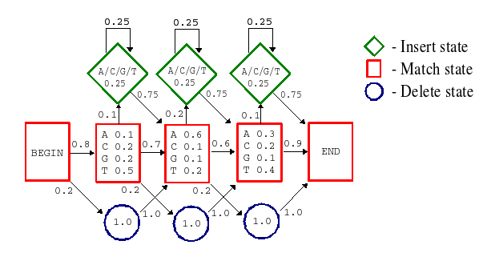
From http://www.cbs.dtu.dk/~kj/bioinfo_assign2.html

Slide 14
How many paths can generate s = AAA?
From http://www.cbs.dtu.dk/~kj/bioinfo_assign2.html

Slide 15
How many paths can generate s = AA?
From http://www.cbs.dtu.dk/~kj/bioinfo_assign2.html

Slide 16
How many paths can generate the empty string?
From http://www.cbs.dtu.dk/~kj/bioinfo_assign2.html

Slide 17
Can you find a string for which only one path can generate it?
From http://www.cbs.dtu.dk/~kj/bioinfo_assign2.html

Slide 18
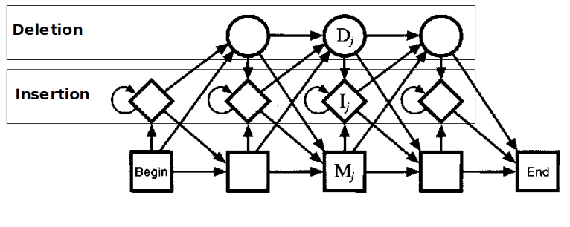
A more general topology for a profile HMM
From http://codecereal.blogspot.com/2011/07/protein-profile-with-hmm.html

Slide 19
What has changed between this model
and the previous one?
From http://codecereal.blogspot.com/2011/07/protein-profile-with-hmm.html

Slide 20
HMMER
http://hmmer.janelia.org
One of the most popular collection of tools to perform analyses based on profile HMMs.
HMMER web server: interactive sequence similarity searching, NAR 2011, http://nar.oxfordjournals.org/content/39/suppl_2/W29
See PFAM, http://pfam.xfam.org, for how profile HMMs are used to represent groups of functionally and structurally related proteins.

Slide 21
Building Profile HMMs
Profile HMMs can be built from a given multiple sequence alignment – this is not too difficult.
Profile HMMs can also be built from unaligned sequences. This is a bit complicated, and often uses the Baum-Welch algorithm.

Slide 22
Using Profile HMMs
Given a Profile HMM computed for a multiple sequence alignment, you can use it to
Classify new sequences into families (e.g., protein families and superfamilies)
Infer function of new sequences
Add related sequences into the multiple sequence alignment
Compute multiple sequence alignments for groups of related sequences

Slide 23
Using profile HMMs for Protein Family Classification
Given two profile HMMs (H1 and H2), and a sequence s, you can determine which one is more likely to generate s using dynamic programming.
Computing Pr(s|H) can be done using dynamic programming (the “forward algorithm”).
Given a set of protein families, compute profile HMMs for each, and then find the family whose profile HMM is most likely to generate s.

Slide 24
What is the probability of generating s = AAA?
From http://www.cbs.dtu.dk/~kj/bioinfo_assign2.html

Slide 25
What paths can generate s = AAA?
From http://www.cbs.dtu.dk/~kj/bioinfo_assign2.html

Slide 26
For each path that can generate s = AAA, what is its probability?
From http://www.cbs.dtu.dk/~kj/bioinfo_assign2.html

Slide 27
Computing Pr(AAA|H) is not trivial
From http://www.cbs.dtu.dk/~kj/bioinfo_assign2.html

Slide 28
What about Pr(A|H)?
From http://www.cbs.dtu.dk/~kj/bioinfo_assign2.html

Slide 29
Hidden states
For some sequences, there is no path through the profile HMM that can generate the sequence.
For some other sequences, there is exactly one path.
And then for some others, there is more than one path… and you can’t tell which one generated the sequence! More generally, you can’t tell which state generated each letter in the sequence – so the states are said to be “hidden”.

Slide 30
What path is most likely to generate sequence AA?
From http://www.cbs.dtu.dk/~kj/bioinfo_assign2.html

Slide 31
Can we compute the maximum probability
path for the general case?
From http://codecereal.blogspot.com/2011/07/protein-profile-with-hmm.html

