Slide 1
Inferring Species Trees in the Presence of HGT: A Simulation Study
CS581 Project
Leah Weber
April 28, 2020 DC (During Coronavirus)

Slide 2
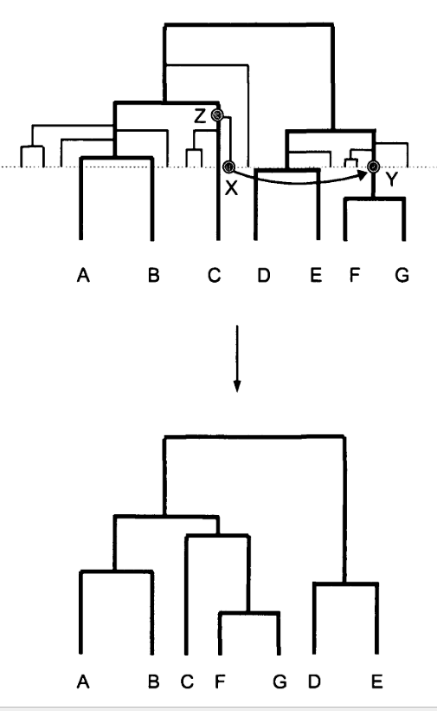
Recall
The transfer of genetic material between two living species is referred to as horizontal gene transfer (HGT)
Galtier (2007) showed that under “moderate amounts” of random HGT (donors and recipients selected at random from contemporaneous time points) that it is still possible to infer a species tree
Galtier, N. (2007). A Model of Horizontal Gene Transfer and the Bacterial Phylogeny Problem. Systematic Biology, 56(4), 633–642. https://doi.org/10.1080/10635150701546231

Slide 3
My Project
What are the impacts of species tree estimation when HGT is non-random?
What if species that are more closely related have a higher probability of an HGT event?
What is the impact of varying transfer rates/preference simultaneously?
How does ASTRAL-III compare to CA-ML in the presence of HGT?

Slide 4
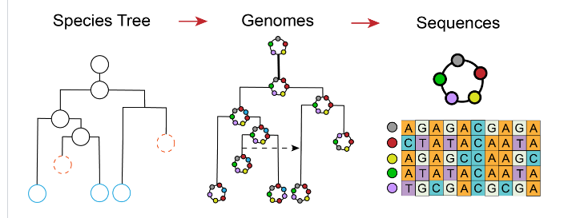
Zombi: A phylogenetic simulator of trees, genomes and sequences that accounts for dead lineages
https://github.com/AADavin/ZOMBI

Slide 5
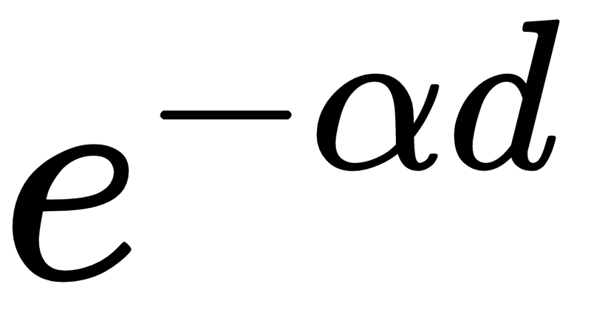
Key Parameters of Interest
Transfer Rate - transfer events per genome per unit of time
Assortative Transfer -If True, the recipient lineage is chosen according to a probability proportional to , where d is the normalized phylogenetic distance.
Alpha - How much preference there is for transfer between closely related lineages
Replacement Transfer - whether or not the transfer the gene is replace an orthologous gene (always true for my project)
https://github.com/AADavin/ZOMBI

Slide 6
Simulation Design
40 Species
500 Genes
500 Nucleotides per gene (no indels)
JC69
25 Replications
Condition | Transfer Rates* | Assortative Transfer | Alpha
1 (random) | Low (2% of genes) | False | na
2 (random) | High (6% of genes) | False | na
3 (preferential) | Low (2% of genes) | True | Low (20)
4 (preferential) | High (6% of genes) | True | High (100)
5 (preferential) | Low (2% of genes) | True | Low (20)
6 (preferential) | High (6% of genes) | True | High (100)
*Ge F, Wang LS, Kim J. The cobweb of life revealed by genome-scale estimates of horizontal gene transfer. PLoS biology. 2005 Oct;3(10).

Slide 7
Pipeline
Species Tree
Evaluation
(FN Rate)
Gene Sequence Alignment
raxml-ng
ASTRAL-III
Concatenate Sequences
Simulated Data
CA-ML Pipeline
ASTRAL-III Pipeline

Slide 8
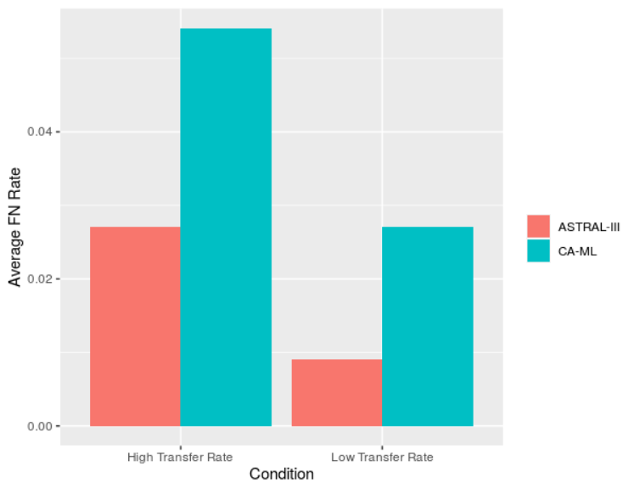
Preliminary Results (Dry Run)
40 species
3 replications
High =5% of genes
Low = 2% of genes
Alpha =100
50 Genes
100 Nucleotides
JC69

Slide 9
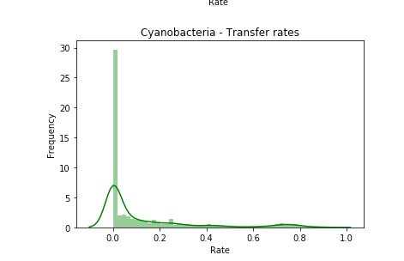
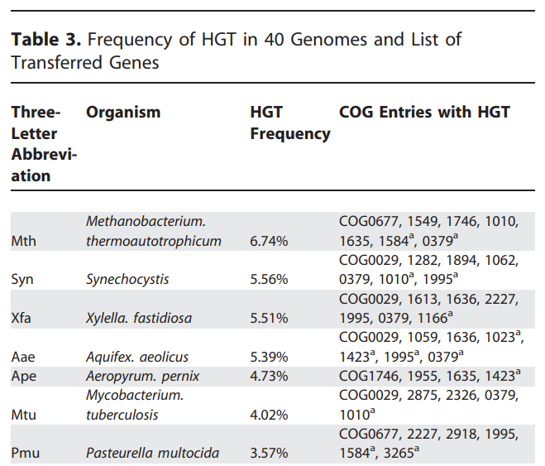
Estimated Transfer Rates
Current study design does not consider variation in transfer rates across genomes
Previous work by Davín (2018) resulted in estimated transfer rates for Cyanobacteria
Use published transfer rates from the 40 bacterial species in Ge, Wang and Kim (2005)
+Ge F, Wang LS, Kim J. The cobweb of life revealed by genome-scale estimates of horizontal gene transfer. PLoS biology. 2005 Oct;3(10).
*Davín AA, Tannier E, Williams TA, Boussau B, Daubin V, Szöllősi GJ. Gene transfers can date the tree of life. Nature ecology & evolution. 2018 May;2(5):904-9.

Slide 10
Questions, Feedback, Suggestions?

