Slide 1

Computing and Updating Large Alignments and Trees
Tandy Warnow
Support: NSF grant - #2006069
Sandia National Laboratories LDRD

Slide 2

Overview – Large alignments and trees
Constructing MSA or tree:
  Datasets can be very large (hundreds of thousands of sequences, even 1,000,000).
  Some sequences are very short, or perhaps very long
  Species trees instead of gene trees
  Uncertain homology
Updating an alignment or tree
  Add sequences to an alignment or tree instead of recomputing from scratch

Slide 3
Our methods for computing very large alignments or trees
Methods for computing very large alignments
  SATé, PASTA, and MAGUS: best when there is limited sequence length heterogeneity
  WITCH, WITCH-ng, and HMMerge: best when there is sequence length heterogeneity (especially lots of very short sequences)
Methods for computing very large maximum likelihood trees
  GTM pipelines (Park et al.) – improves RAxML, IQ-TREE2

Slide 4
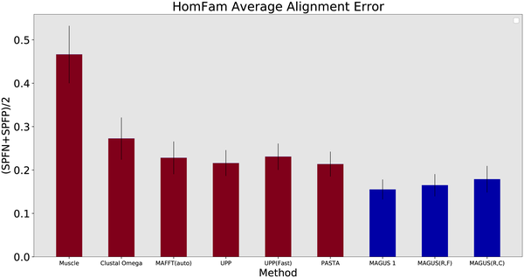
MAGUS – Highly Accurate Multiple Sequence Alignment for large datasets
Smirnov V (2021) Recursive MAGUS: Scalable and accurate multiple sequence alignment. PLOS Computational Biology 17(10): e1008950. https://doi.org/10.1371/journal.pcbi.1008950
https://journals.plos.org/ploscompbiol/article?id=10.1371/journal.pcbi.1008950

Slide 5


GTM pipelines: Improving Large-scale Maximum Likelihood Tree Search
Trends
On RNASim10k: GTM most accurate topology
On RNASim50K:
  IQTree failed
  RAxML had nearly 100% error
  GTM most accurate
Figure 2 from “Disjoint Tree Mergers for
Large-Scale Maximum Likelihood Tree Estimation”,
Park, Zaharias, and Warnow, Algorithms 2021

Slide 6


Methods for updating very large alignments or trees
Methods for adding sequences to alignments
  MAFFT-add and MAFFT-linsi-add (no HMM)
  UPP-add, WITCH-ng-add (HMM-based)
  EMMA (Chengze Shen et al.)
Methods for adding sequences to very large trees (phylogenetic placement)
  pplacer (Matsen et al., 2010) and EPA-ng (Barbera et al, 2019)
  SCAMPP: scaling pplacer to large trees (Wedell et al., 2022)
  BSCAMPP: scaling EPA-ng to large trees (Wedell et al., 2023)

Slide 7
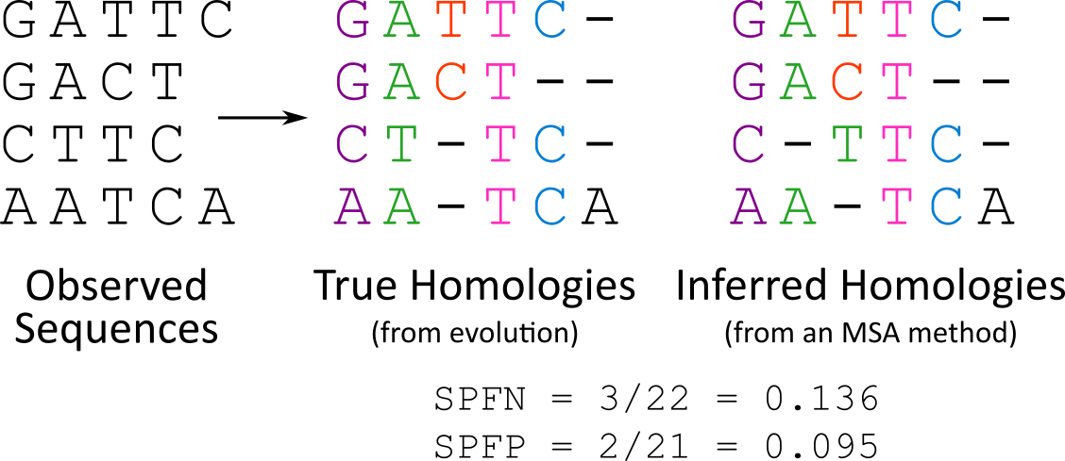
Multiple Sequence Alignment
The input to Multiple Sequence Alignment (MSA) is a set of unaligned sequences (e.g., strings that consist of letters of nucleotides or amino acids).
The output is an alignment of the sequences, adding gaps if necessary.
“True homologies” are pairs of aligned letters that come from the same ancestor.

Slide 8
Multiple Sequence Alignment Accuracy
To measure the accuracy of an MSA (compared to reference)
  Sum-of-pairs false negatives (SPFN) → fraction of missed true homologies
    i.e., 1 - recall
  Sum-of-pairs false positives (SPFP) → fraction of falsely recovered homologies
    i.e., 1 - precision

Slide 9
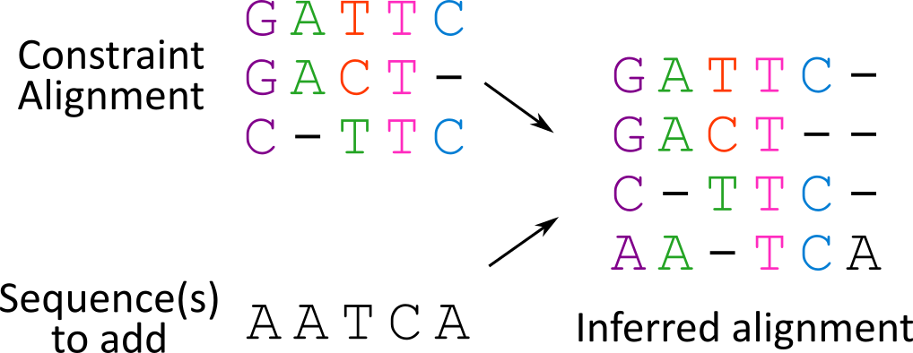
Intro to EMMA: Adding sequences into a constraint alignment
Adding sequences to a constraint alignment useful for:
De novo alignment
Updating an existing alignment
the constraint alignment is preserved
Notes:
De novo – selecting a set of sequences to align first then adding in the remaining ones

Slide 10
Existing solutions - methods
Inputs: an existing/constraint alignment and a set of query sequences to add
Output: an alignment on all sequences
Method | HMM? | Pros | Cons
MAFFT --add | No | Very fast | Less accurate and memory hungry with a lot of sequences
MAFFT-linsi --add | No | Accurate | Very slow, memory hungry, and not scalable with more than 1000 sequences
UPP-add | Yes | Accurate, fast and scalable to many sequences (1,000,000) | Query sequences are added independent to each other
WITCH/WITCH-ng-add | Yes | More accurate than UPP, also scalable to many sequences | Same as UPP
Notes:
Say the issue: HMMs cannot detect homologies between added queries

Slide 11
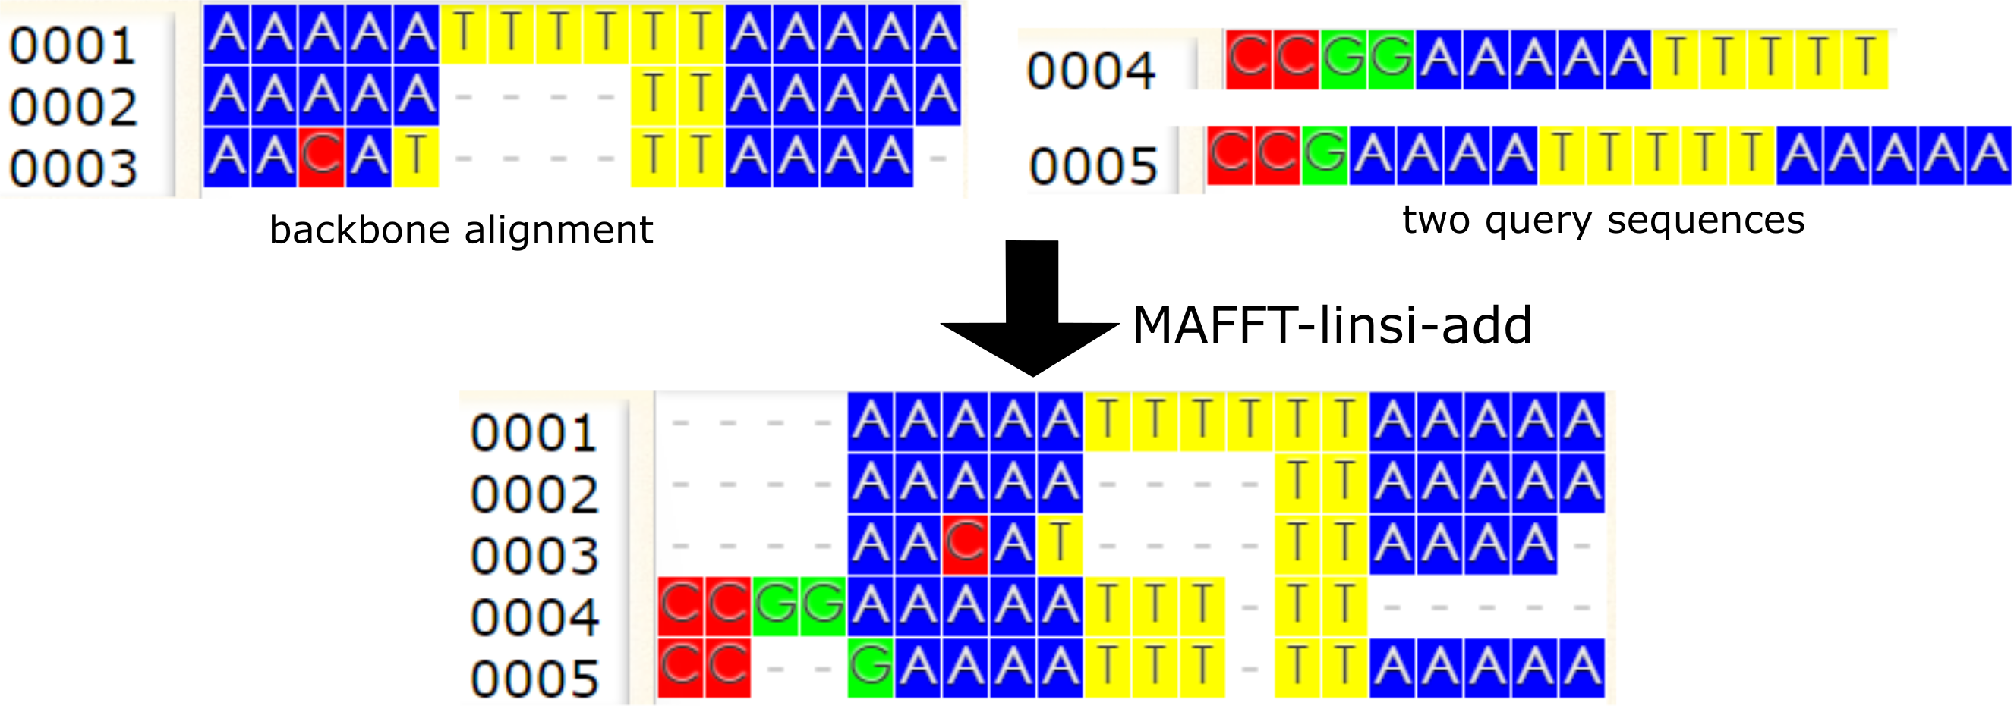
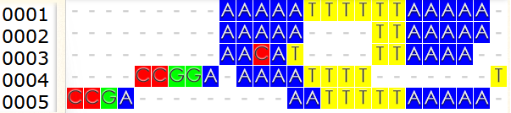
MAFFT-linsi --add vs. HMM-based methods
HMM-based alignment
HMM-based methods (UPP, WITCH, etc.):
  Can only find homologous pairs to the existing columns in the constraint alignment.
MAFFT-linsi --add can find the two homologous pairs “C-C” in the first two columns.
Notes:
The essence is a divide-and-conquer approach to divide the original problem (i.e., adding all queries to the constraint alignment) to a set of sub-problems (i.e., adding assigned queries to each sub-alignment), and merging the solutions back to form the final answer.

Slide 12
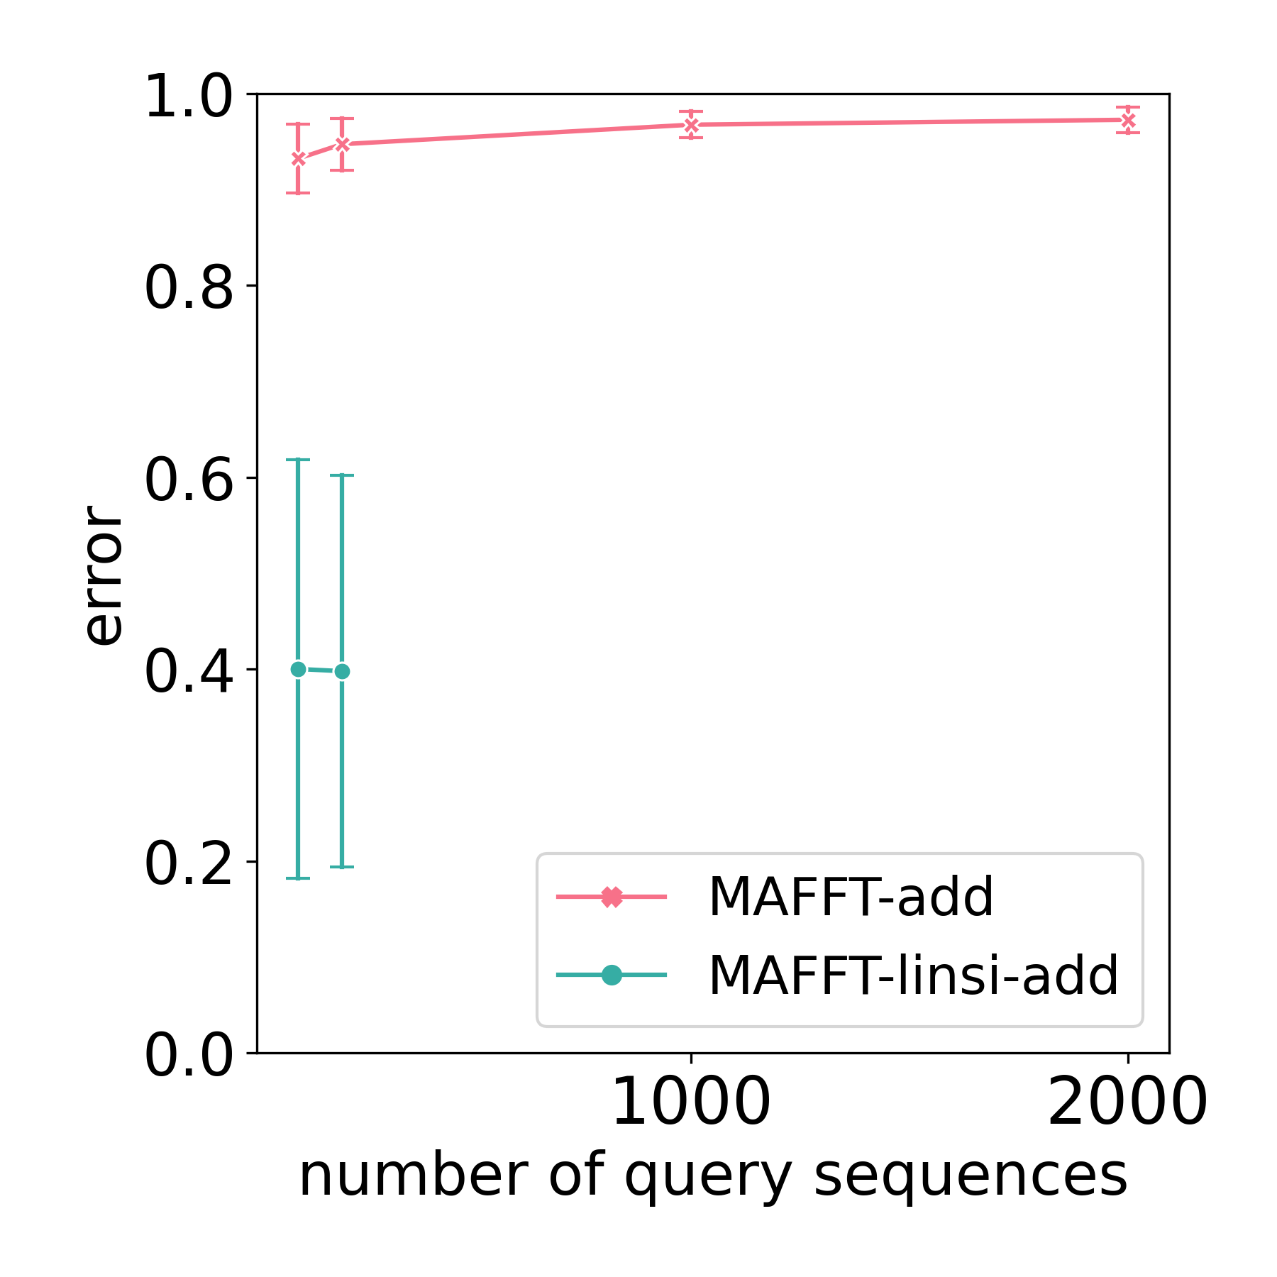
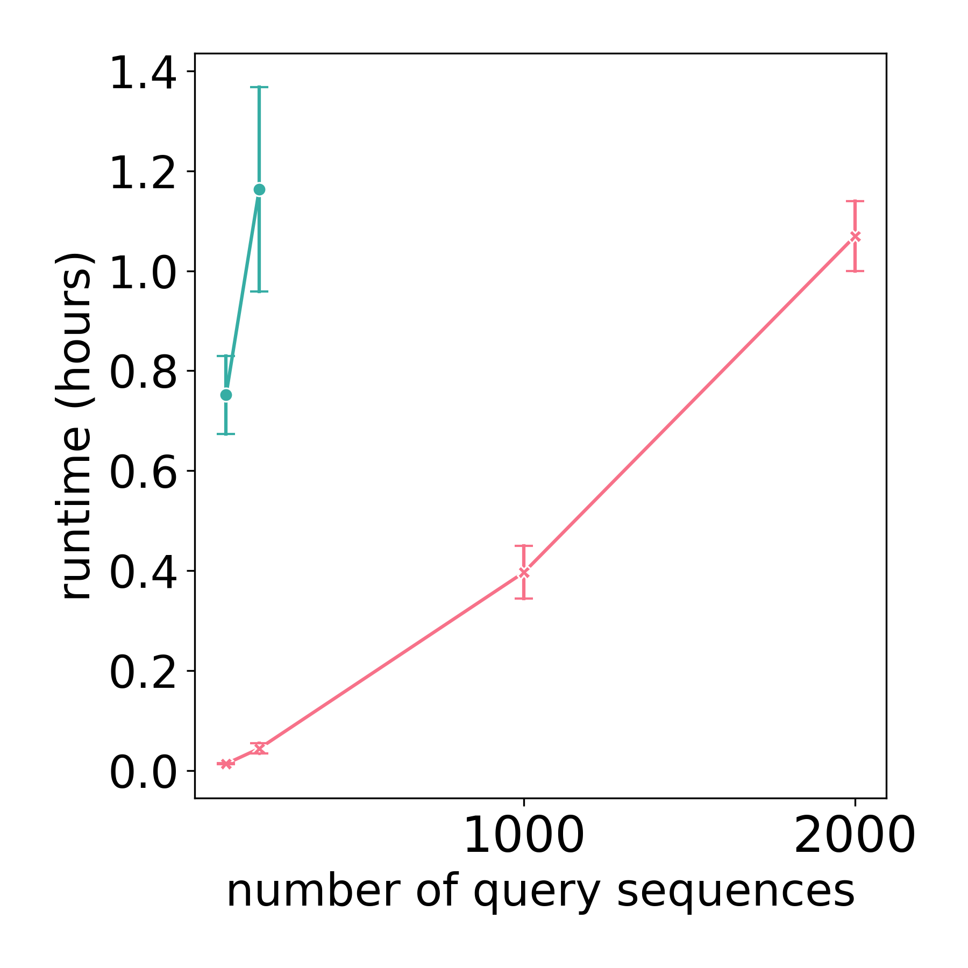
Why scaling MAFFT-linsi --add
MAFFT-linsi --add more accurate than default MAFFT --add, but slower and less scalable.
MAFFT-linsi failures due to OOM.
Error: Average SPFN+SPFP
Backbone: 1000-sequence constraint alignment (dataset is INDELible 5000M2 averaged over 9 replicates).
Notes:
MAFFT-linsi-add encountered out-of-memory issue or cannot complete within 12 hours for 1000, 2000 query sequences.

Slide 13
Overview - EMMA
Note: MAFFT-linsi --add cannot run on datasets >1000 sequences (query+constraint)
EMMA Approach: divide-and-conquer so that MAFFT-linsi --add is applied to sub-problems
  With at most 500 sequences for each sub-problem (query+constraint)
  Uses HMMs for assignment to sub-problems
We show that EMMA
  Has good scalability and runtime
  Is more accurate than UPP/WITCH/MAFFT-linsi --add under challenging conditions

Slide 14
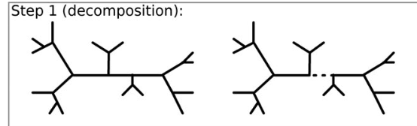
EMMA pipeline
Build a tree on the constraint alignment.
Decompose the tree into subsets as in PASTA.
  subsets have induced sub-alignments
Select subsets with L to U sequences (from constraint).
Construct HMMs on alignments of these selected subsets.
Modified Figure 1 from PASTA.

Slide 15
EMMA pipeline
Build a tree on the constraint alignment.
Decompose the tree into subsets as in PASTA.
  subsets have induced sub-alignments
Select subsets with L to U sequences (from constraint).
Construct HMMs on alignments of these selected subsets.
Assign query sequences to subsets based on adjusted HMM bit-scores.
Align queries to alignments of the assigned subsets with MAFFT-linsi --add.
  Further divide into smaller sub-problems if too many queries are assigned to the same subset.
Merge all extended sub-alignments using transitivity.
Modified Figure 1 from PASTA.
Query sequences
Notes:
The essence is a divide-and-conquer approach to divide the original problem (i.e., adding all queries to the constraint alignment) to a set of sub-problems (i.e., adding assigned queries to each sub-alignment), and merging the solutions back to form the final answer.

Slide 16
EMMA - performance study
Biological data
  Comparative Ribosomal Website (CRW) - a collection of nucleotide datasets with curated alignments based on secondary structures.
    16S.3, 16S.T, and 16S.B.ALL (6,323, 7,350, and 27,643 sequences)
  “10AA” - a set of 10 curated protein alignments ranging from 320 to 807 sequences (BAliBASE and Homfam).
  Serine Recombinases (Rec and Res) - a collection of protein sequences collected from GenBank bacterial/archaeal genome assemblies for the two domains of serine recombinases.
    Rec and Res (96,773 and 186,802 sequences)
Simulated data (all nucleotide)
  ROSE - 1000-sequence simulated nucleotide alignments with various rates of evolution.
    1000M1 (high) to 1000M4 (low)
  RNASim - a set of subsampled (10,000) sequences.
  new INDELible simulation (“het”) - 5000-sequence nucleotide alignments newly simulated for this study, with various rates of evolution and indel lengths.
    5000M2-het (high), 5000M3-het (medium), and 5000M4-het (low)

Slide 17
EMMA - performance study
We compare EMMA to the following sequence-adding methods:
  MAFFT --add (not shown in the following figures due to high error)
  MAFFT-linsi --add
  WITCH-ng add
Measuring alignment accuracy:
  We compute SPFN and SPFP on the added query sequences only.

Slide 18
EMMA - performance study
Different constraint alignment scenarios:
  Large random constraint
    A random subset of the reference alignment, with 25% of all sequences, up to 1000.
    E.g., 1000-sequence dataset, 250-sequence constraint, 750 query sequences.
  Small random constraint
    A random subset of the reference alignment, with 10% of all sequences, minimum 10 and up to 100.
  Large clade-based constraint (extreme case)
    A subset based on a clade of the reference alignment, with ~25% of all sequences, up to 1000.
Large random constraint
Small random constraint
Clade-based constraint

Slide 19
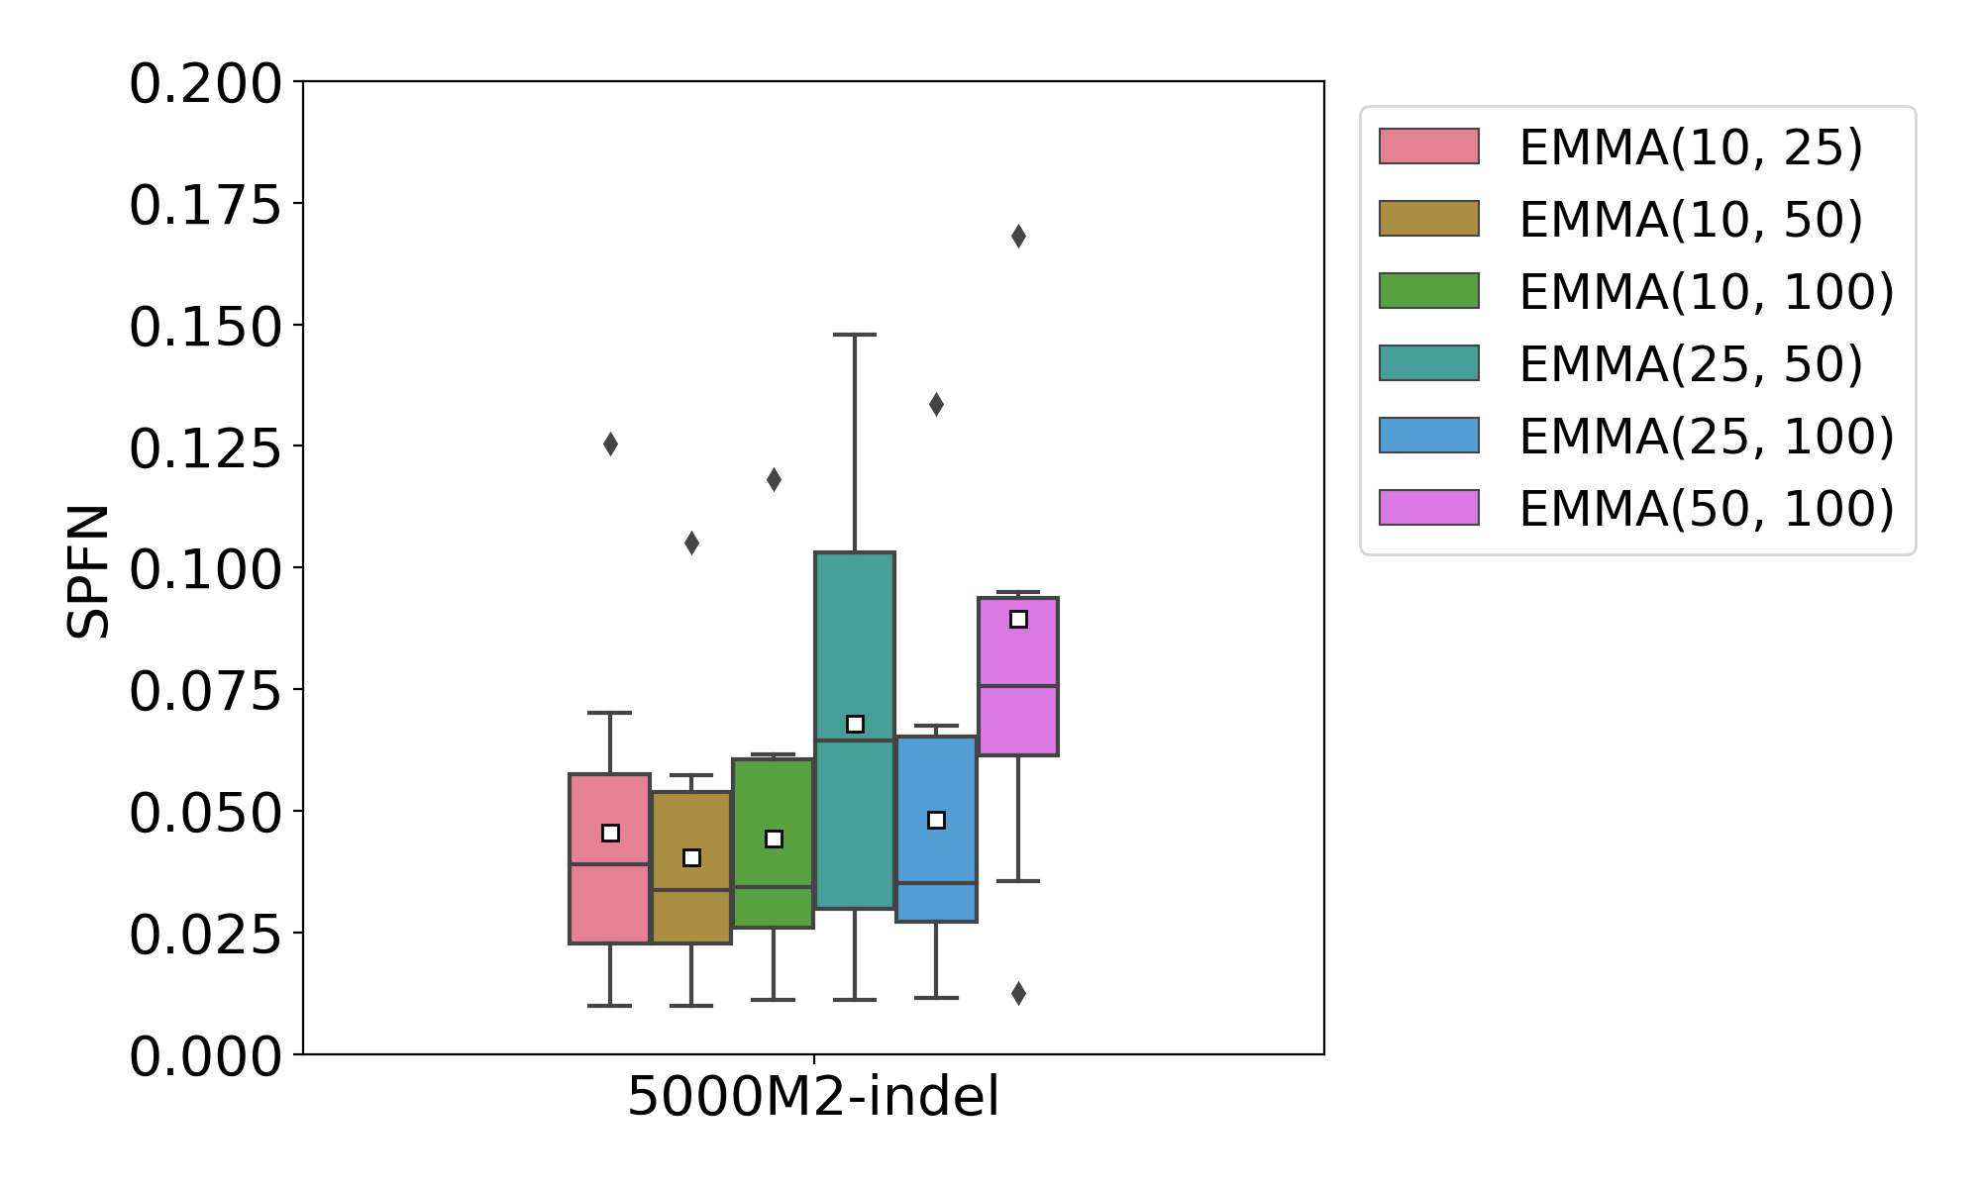
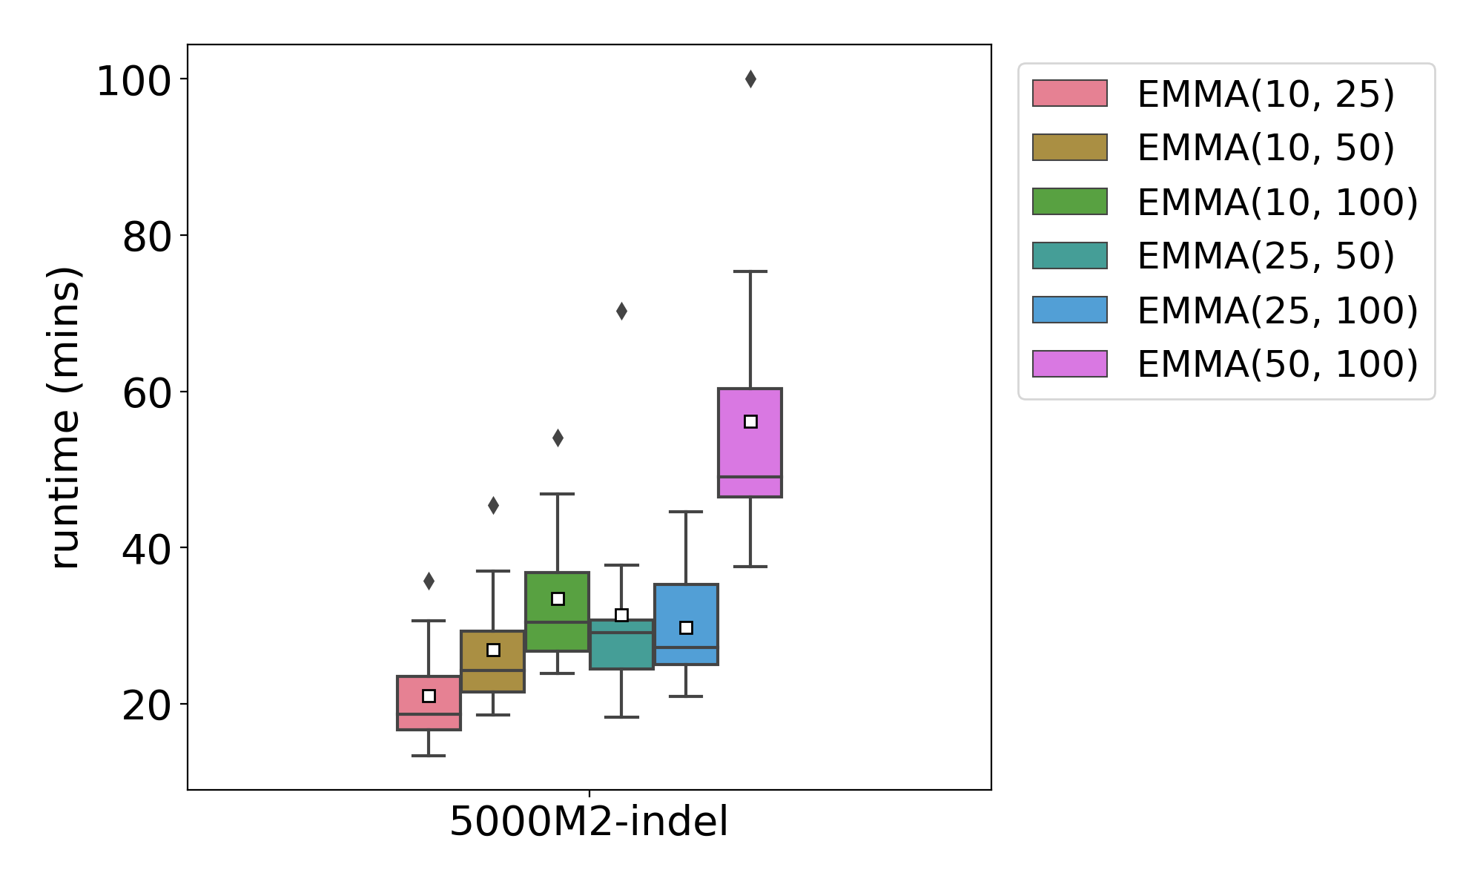
EMMA - algorithm design (selecting L and U)
On the new INDELible simulation 5000M2-het.
For selecting the two parameters: L and U (lower and upper bounds for sub-alignments)
L=10 -> most reliable for accuracy
L=10, U=25 -> fastest
Notes:
L=10 most reliable for accuracy
L=10, U=25 -> fastest

Slide 20
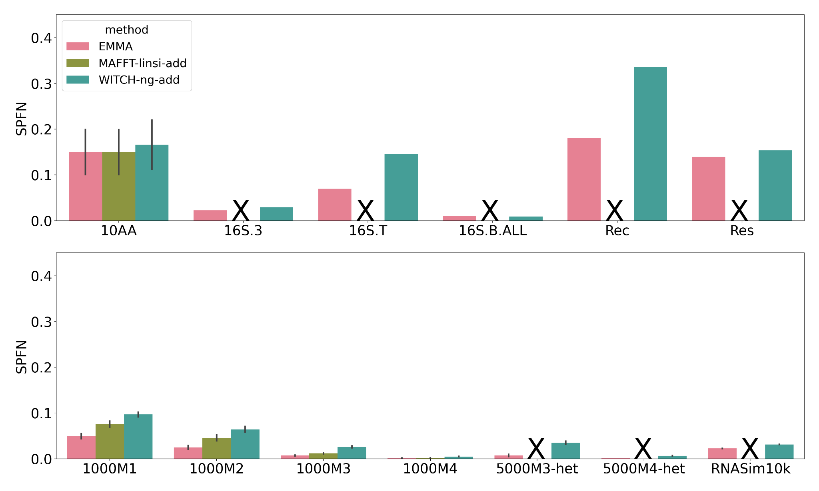
EMMA - experimental results - large random constraint
Large random constraint
Both NT and AA datasets
“MAFFT-add had poor accuracy, and is omitted
X” - failed to run
Observations:
EMMA is the most accurate method, and can scale to the largest dataset with 186,802 AA sequences
MAFFT-linsi-add had high accuracy but only completed on one dataset
320 - 807
6,323
7,350
27,643
96,773
186,802
# sequences
Notes:
MAFFT-linsi --add failed to finish on 5000M-series data within 24 hours and was not attempted on larger ones.

Slide 21
EMMA - experiment results - large random constraint
Large random constraint
Simulated data
“X” - failed to run
All methods generally have higher error on datasets with higher rates of evolution
EMMA is still the most accurate
Higher rates of evolution
Notes:
MAFFT-linsi --add failed to finish on 5000M-series data within 24 hours and was not attempted on larger ones.

Slide 22
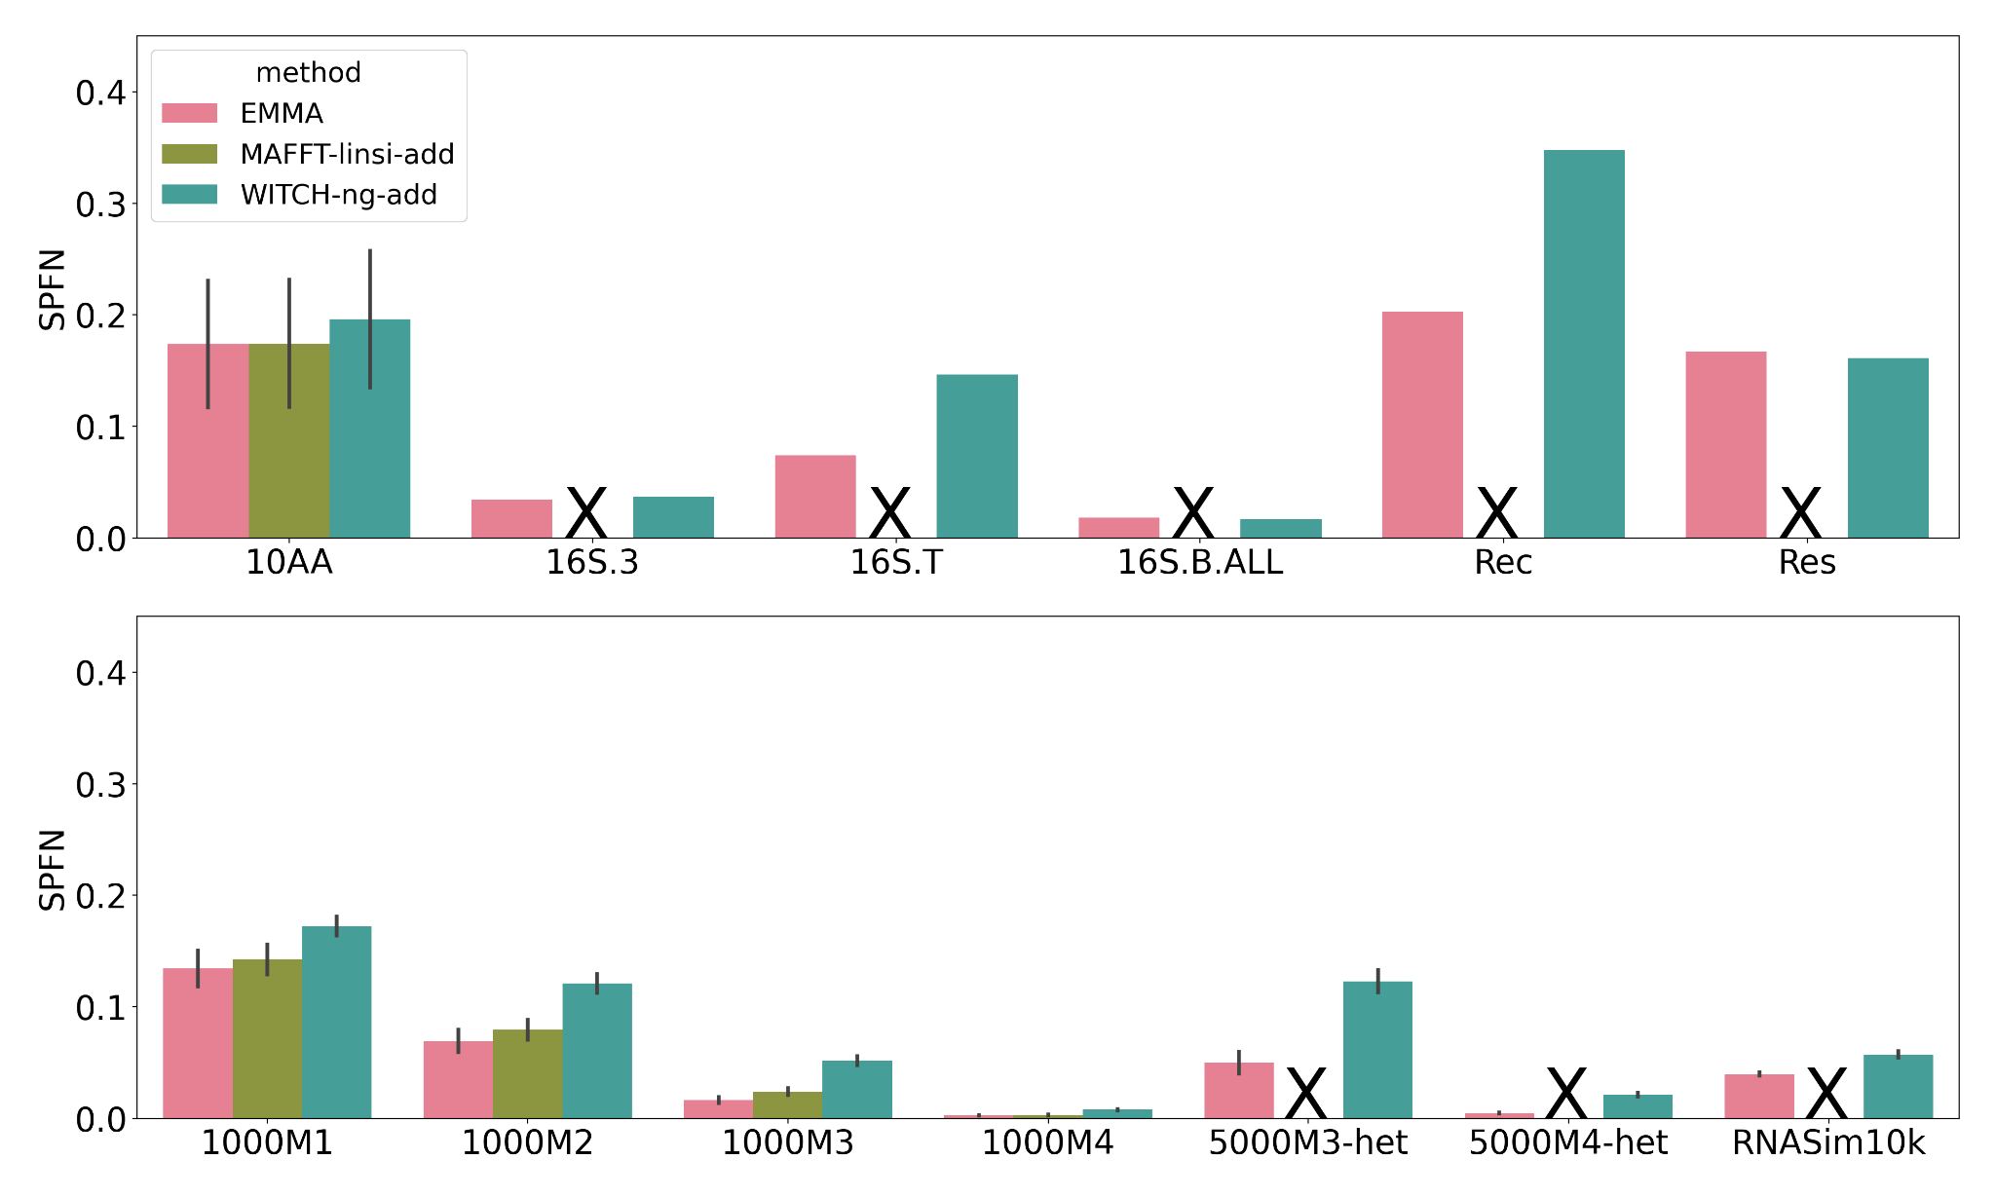
EMMA - experiment results - small random constraint
Small random constraint
Biological data
“X” - failed to run
EMMA ties for best with MAFFT-linsi --add (when it can run)
320 - 807
6,323
7,350
27,643
96,773
186,802
# sequences

Slide 23
EMMA - experiment results - small random constraint
Small random constraint
Simulated data
“X” - failed to run
Alignment error increased compared to large random constraint
EMMA is still the most accurate method
Higher rates of evolution

Slide 24
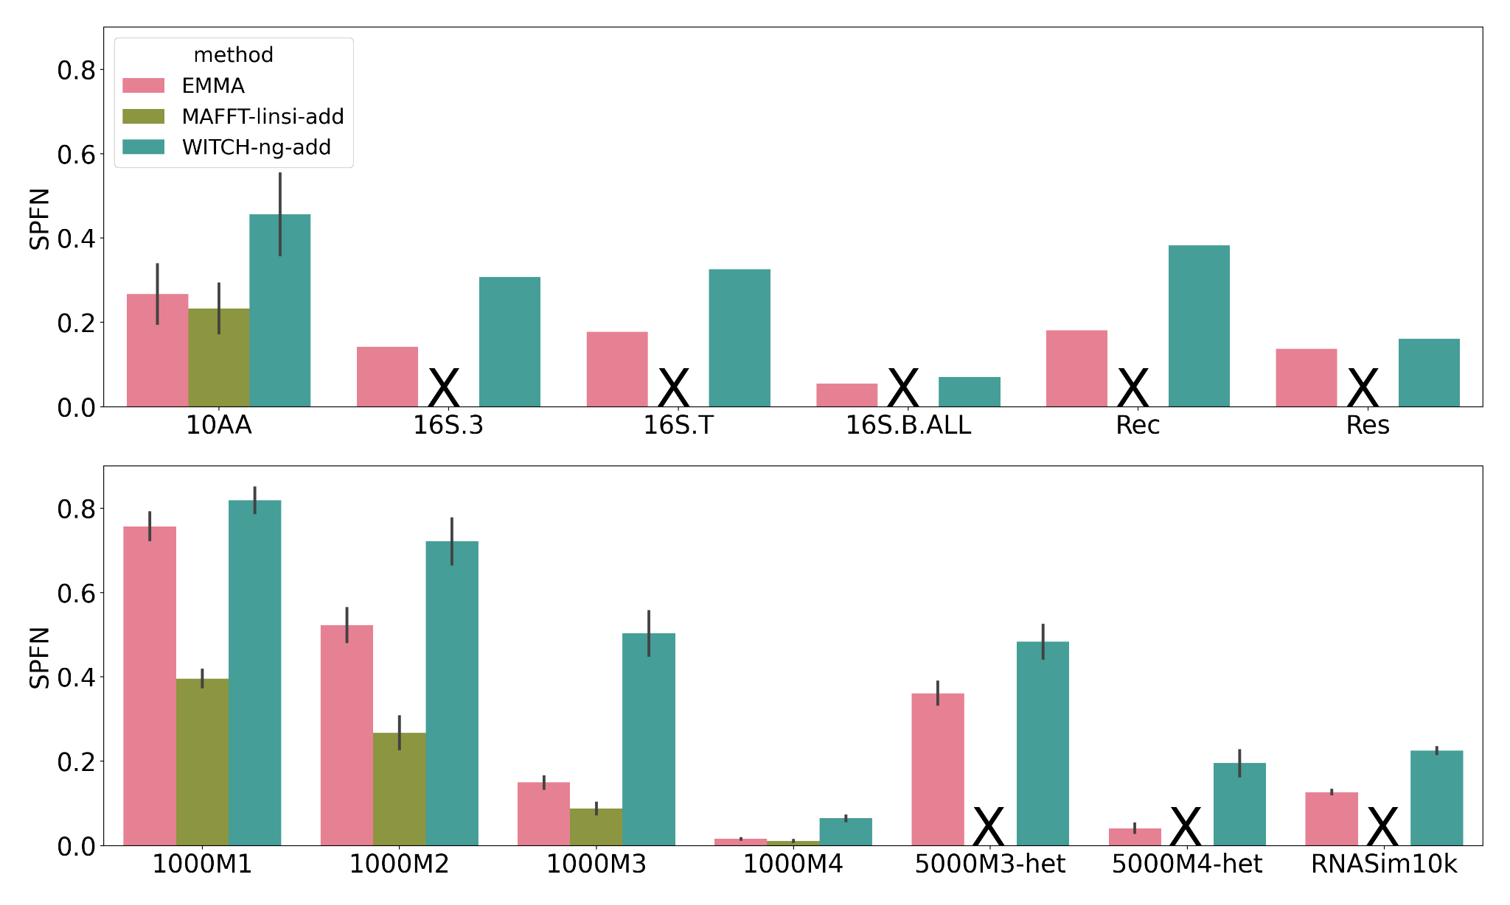
EMMA - experiment results - large clade-based constraint
Large clade-based constraint
Biological data
“X” - failed to run
MAFFT-linsi --add most accurate when it can run. EMMA has similar accuracy
EMMA more accurate than WITCH-ng
320 - 807
6,323
7,350
27,643
96,773
186,802
# sequences

Slide 25
EMMA - experiment results - large clade-based constraint
Large clade-based constraint
Simulated data
“X” - failed to run
MAFFT-linsi --add most accurate when it can run
EMMA and WITCH-ng have high error compared to random constraint
Impact on accuracy for EMMA less noticeable than WITCH-ng on low rates evolution
Higher rates of evolution

Slide 26
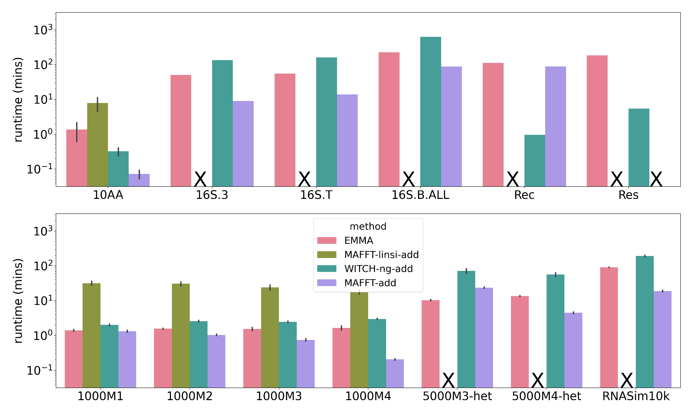
EMMA - experiment results - runtime comparison
Large random constraint
MAFFT --add the fastest, but failed on Res due to out-of-memory issue (128 GB)
EMMA faster than MAFFT-linsi --add and scales to >1000 sequences
EMMA faster than WITCH-ng in some cases
320 - 807
6,323
7,350
27,643
96,773
186,802
# sequences

Slide 27
EMMA vs. MAFFT-linsi --add
Biological data
  Relatively low rates of evolution
  Both have similar accuracy (10AA) on all three constraint scenarios
Simulated data
  Random constraint: EMMA more accurate than MAFFT-linsi --add on high rates of evolution
    MAFFT-linsi degrades in accuracy with high rates of evolution (SATé, PASTA)
    Decomposition → smaller evolutionary diameter for each sub-problem
    Query assignment → ensure each sub-problem has closely related sequences
  Clade-based constraint: MAFFT-linsi --add more accurate
    Decomposition does not help reduce evolutionary diameter for query assignment
    More sparse taxon sampling for each sub-problem

Slide 28

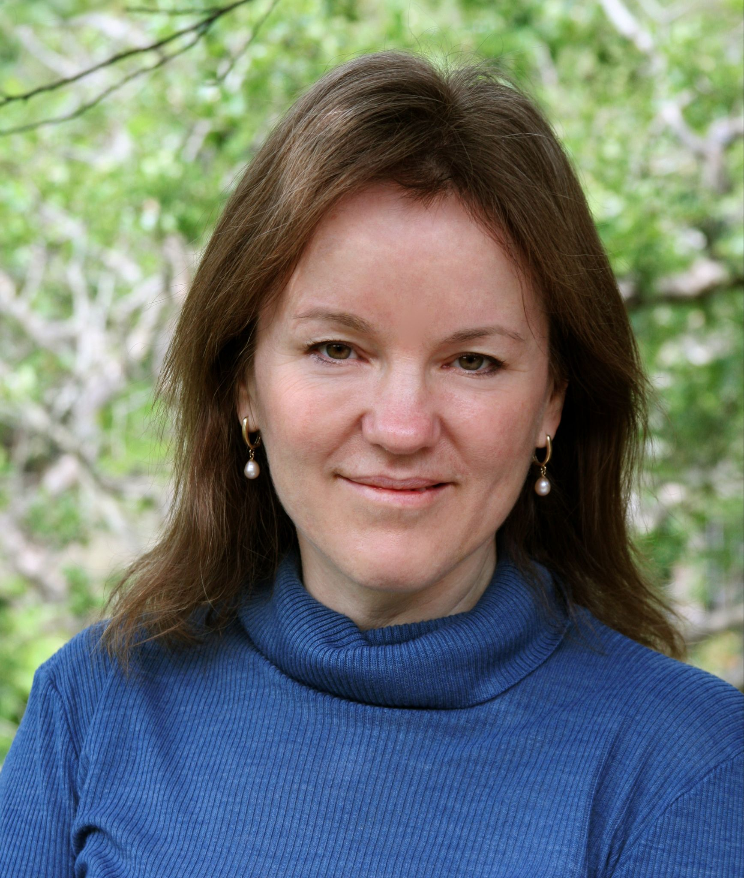



EMMA - observation and discussion
EMMA successfully scales MAFFT-linsi --add to run on much larger datasets, including those up to ~186,000 sequences (Res)
It usually has the best accuracy compared to WITCH-ng and even just MAFFT-linsi --add (when it can run)
Comparing to HMM-based methods, EMMA can find homologies between added sequences
Clade-based constraint leads to bad accuracy (for all methods)
  An extreme case study (constraint not representative of added sequences)
  May need new techniques to achieve good accuracy
Random constraint is more typical, for which EMMA is the most accurate
  Denser taxa sampling generally means higher accuracy (for all methods)
Support: NSF grant - #2006069
Sandia National Laboratories LDRD

Slide 29
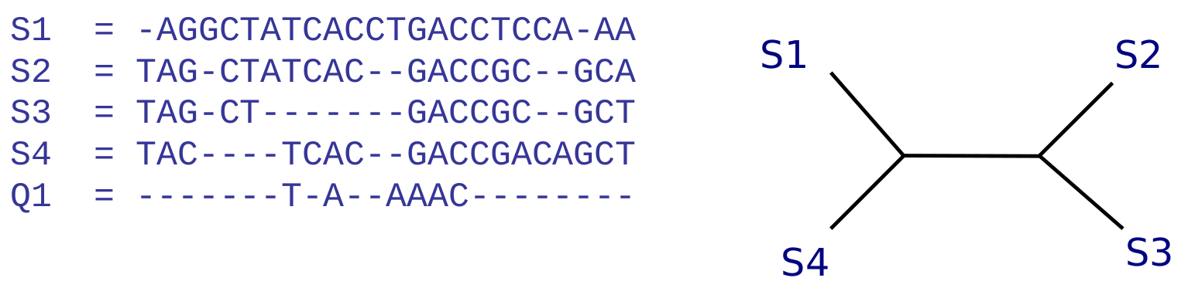
Intro to SCAMPP and BSCAMPP
Phylogenetic placement problem: Given a query sequence and multiple sequence alignment, determine the placement into an existing ‘backbone’ tree.

Slide 30
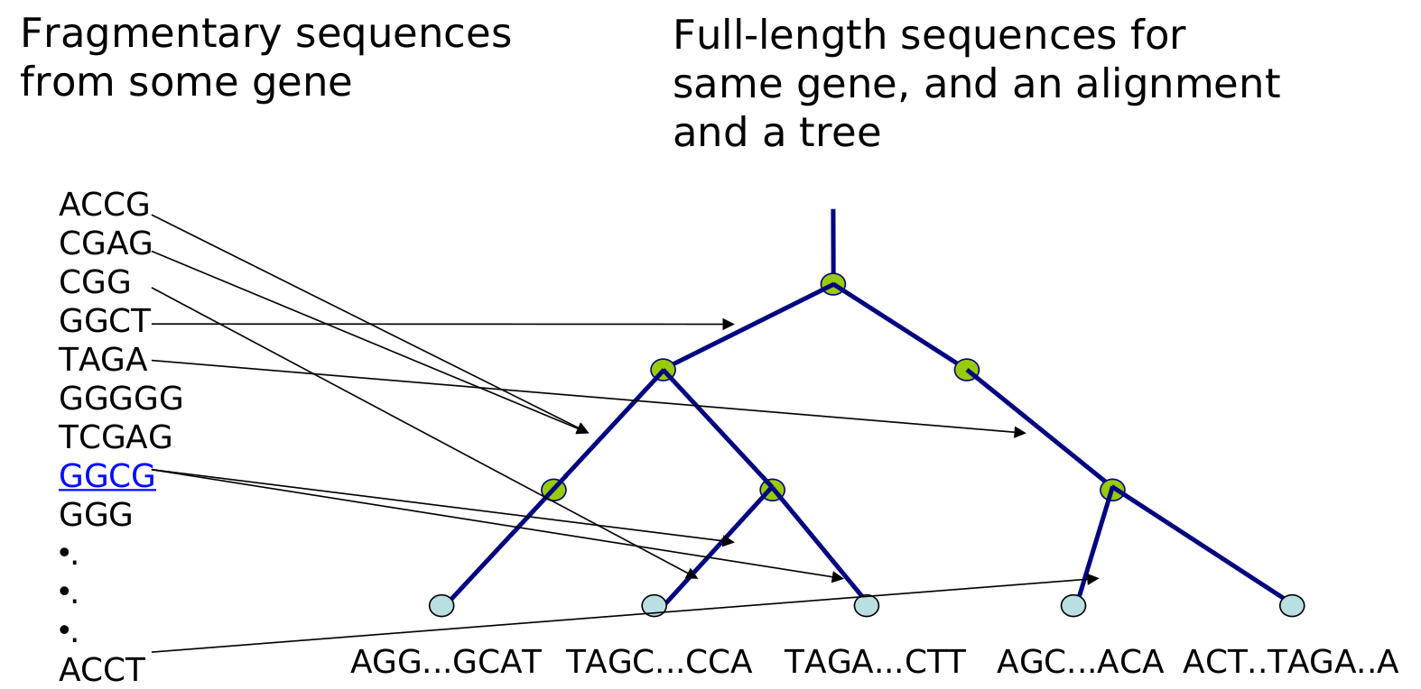
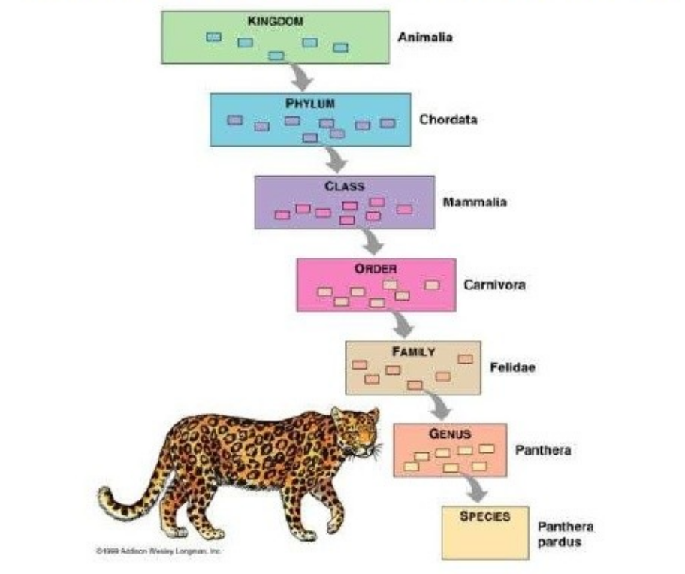
Placement into a taxonomy of full-length sequences
Metagenomics: lots of reads inserted independently

Slide 31
Leading Methods for Phylogenetic Placement
Maximum likelihood methods (expensive to run):
pplacer (Matsen et al., 2010)
EPA-ng (Barbera et al., 2019)
Distance-based methods:
APPLES-2 (Balaban et al., 2021).
Parsimony-based methods:
UShER (Turakhia et al., 2021)
Alignment-free methods:
App-SpaM (Blanke et al., 2021)
RAPPAS (Linard et al., 2019)
pplacer and EPA-ng limited to small backbone trees
EPA-ng scales sublinearly with number of queries
Our goal: Scaling ML phylogenetic placement methods to large trees and many queries

Slide 32
SCAMPP Framework (Wedell et al., TCBB 2022)
Designed to allow existing phylogenetic placement methods use larger backbone trees.
Used with specified phylogenetic placement method (e.g., pplacer)
Input: Backbone tree with branch lengths, alignment and set of aligned query sequences, and a subtree size.
For each query sequence:
Stage 1- Extract placement subtree from backbone tree
Stage 2 - Use pplacer to find edge in placement subtree and location and distal length along placement edge.
Stage 3 - Find edge in backbone tree using branch lengths.

Slide 33
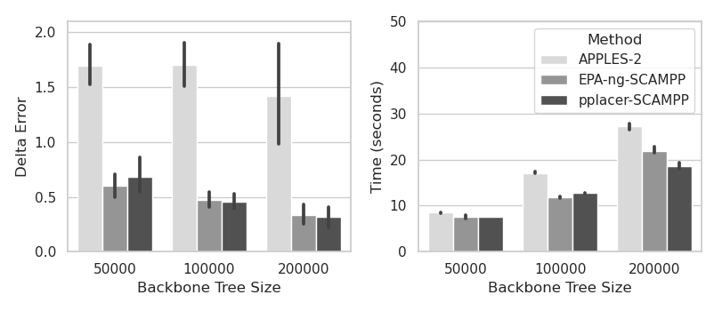
SCAMPP Results
SCAMPP implemented with EPA-ng and pplacer show better accuracy and competitive runtime than APPLES-2 for SINGLE QUERY SEQUENCE PLACEMENT.
Detla Error: increase in topological error produced by adding query.

Slide 34
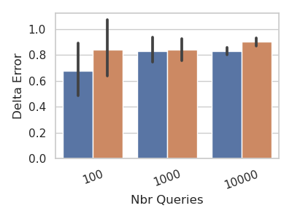
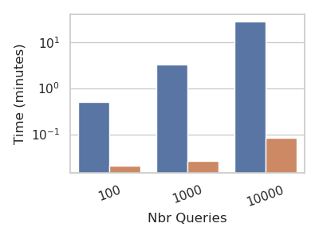
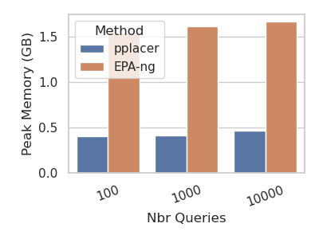
EPA-ng Scales the Number of Queries
EPA-ng’s runtime scales sublinearly with respect to the number of queries.
This motivates BSCAMPP

Slide 35
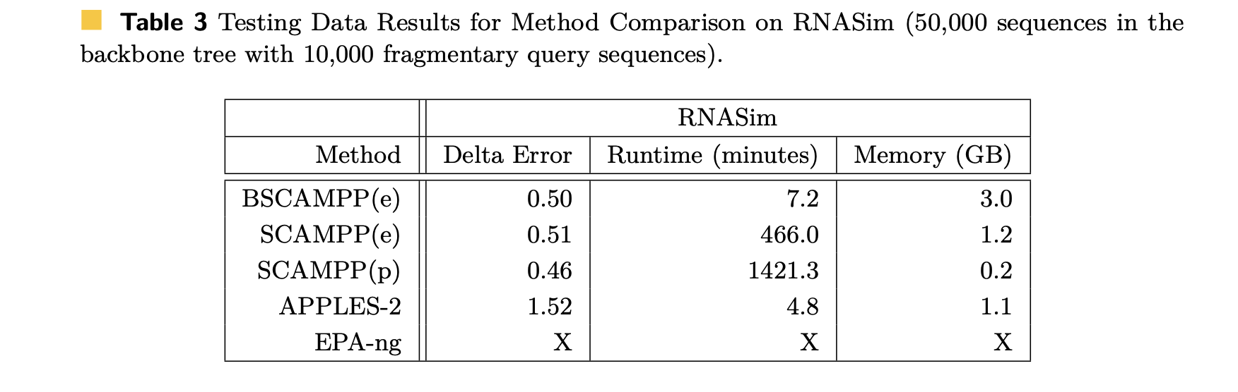
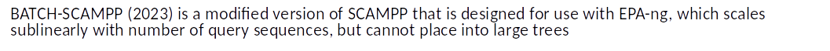
Batch-SCAMPP initial results

Slide 36
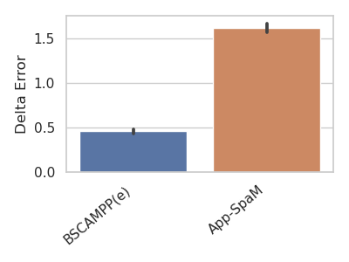
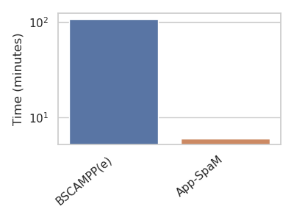
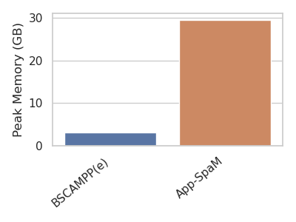
BSCAMPP(e) vs. Alignment Free
We show App-SpaM. RAPPAS failed due to memory.
BSCAMPP uses estimated alignments using UPP.
BSCAMPP runtime is largely estimating alignment.
RNASim 50K (training clade)
Fragmentary queries (~150nt)
50,000 leaf backbone tree
10,000 query sequences

Slide 37
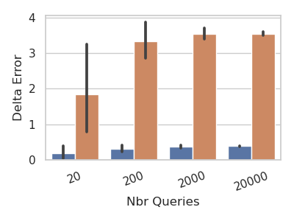
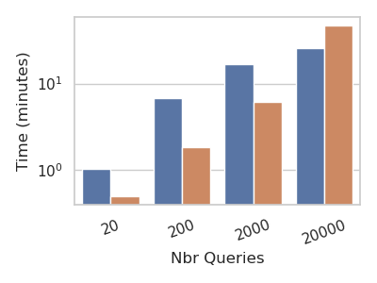
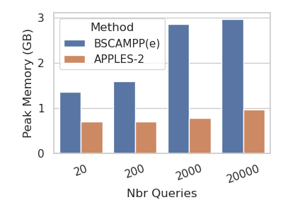
BSCAMPP(e) vs. APPLES-2
APPLES-2 is very fast and has low memory requirement, but has much higher placement error than Batch-SCAMPP(EPA-ng)
BSCAMPP(EPA-ng) runtime is sublinear with number of query sequences
RNASim 180K (testing clade)
Fragmentary queries (~150nt)
180,000 leaf backbone tree
Up to 20,000 query sequences

Slide 38
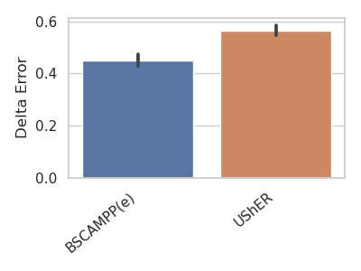
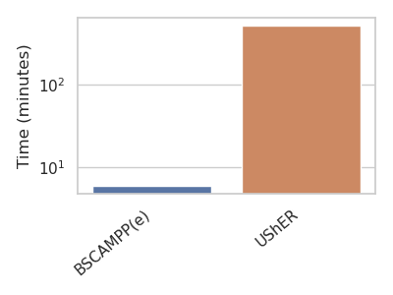
BSCAMPP(e) vs. UShER
RNASim 50K (training clade)
Fragmentary queries (~150nt)
50,000 leaf backbone tree
10,000 query sequences
Using true alignments.
Memory usage less than 4GB for both methods.

Slide 39
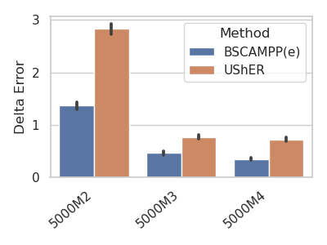
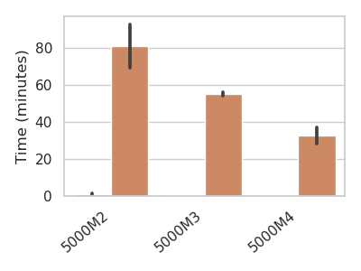
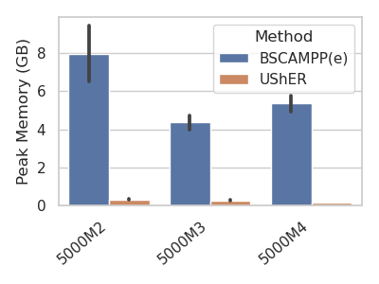
More UShER vs. BSCAMPP(e) Changing rate of evolution
UShER still worse than BSCAMPP with lower rates of evolution
Placing 10,000 fragments onto 4,000 leaf backbone trees
5000M2: high rate
5000M3: medium rate
5000M4: low rate

Slide 40
Summary
New approaches to constructing and updating large-scale alignment and tree estimation, with outstanding accuracy
All software available in open-source form on github
We are looking for collaborations

Slide 41
Summary
BSCAMPP(e) most accurate of all tested methods.
APPLES-2 and App-SpaM can be faster.
BSCAMPP matches accuracy of SCAMPP, but is much faster for placing many queries.
Available on GitHub:
Full paper on BioRxiv:
Acknowledgements: (List funding)

Slide 42
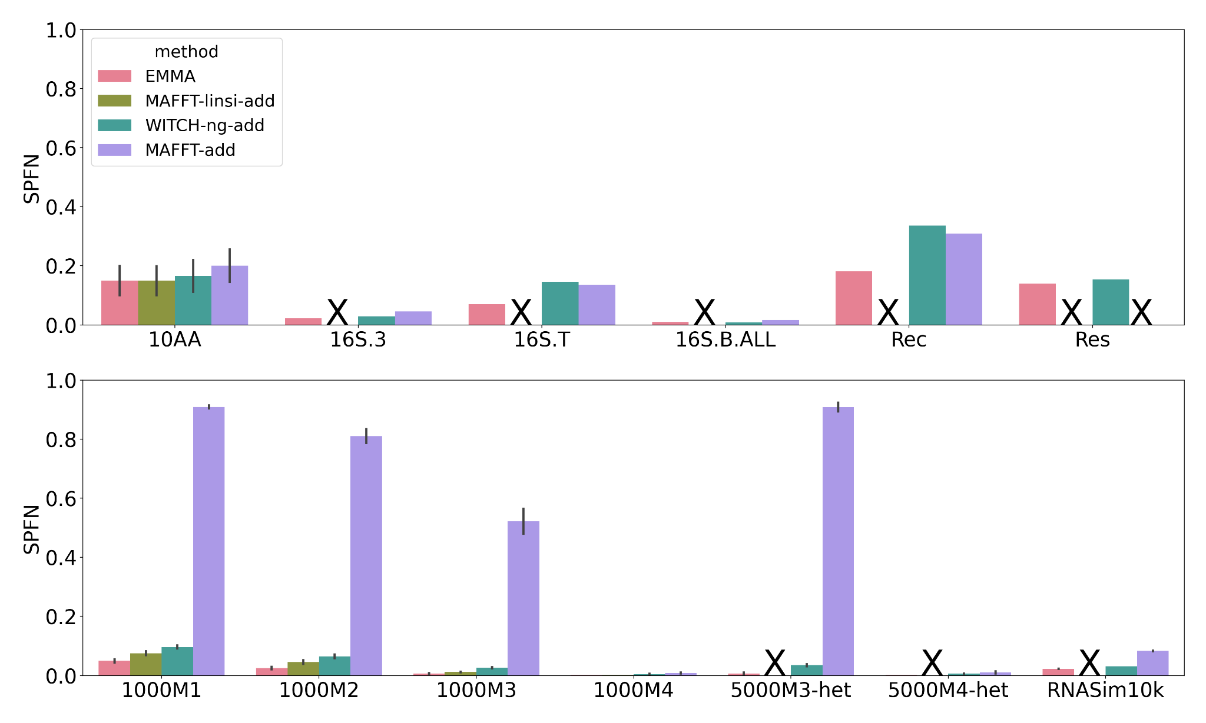
Backup slides - results with MAFFT --add
Large random constraint

