Slide 1
Divide-and-conquer techniques for large-scale evolutionary tree estimation
Tandy Warnow
The University of Illinois
With students: Minhyuk Park and Chengze Shen

Slide 2
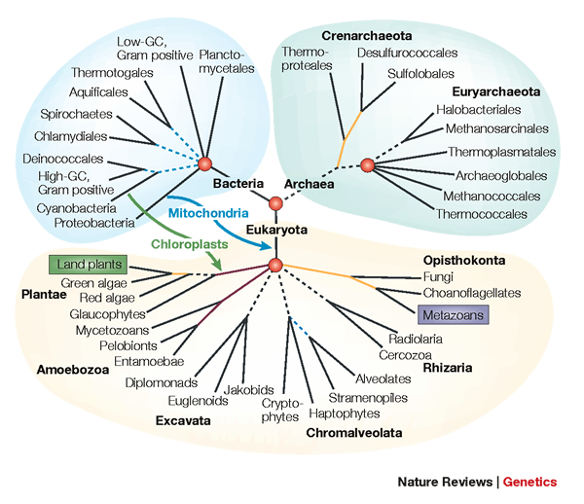
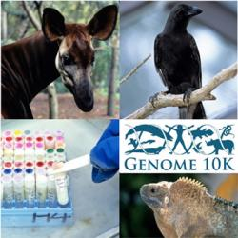
Phylogenomics
Phylogeny + genomics = genome-scale phylogeny estimation
.

Slide 3
Phylogenomic pipeline
Select taxon set and markers
Gather and screen sequence data, possibly identify orthologs
Compute multiple sequence alignments for each locus, and construct gene trees
Compute species tree or network:
  Combine the estimated gene trees, OR
  Estimate a tree from a concatenation of the multiple sequence alignments
Get statistical support on each branch (e.g., bootstrapping)
Estimate dates on the nodes of the phylogeny
Use species tree with branch support and dates to understand biology

Slide 4
Phylogenomic pipeline
Select taxon set and markers
Gather and screen sequence data, possibly identify orthologs
Compute multiple sequence alignments for each locus, and construct gene trees
Compute species tree or network:
  Combine the estimated gene trees, OR
  Estimate a tree from a concatenation of the multiple sequence alignments
Get statistical support on each branch (e.g., bootstrapping)
Estimate dates on the nodes of the phylogeny
Use species tree with branch support and dates to understand biology

Slide 5
Large datasets are difficult
Two dimensions:
  Number of loci
  Number of species (or individuals)
Missing data
Heterogeneity
Many analytical pipelines involve Maximum likelihood and Bayesian estimation

Slide 6
What I hope to convince you of:
Great progress in large-scale phylogeny estimation (both for gene trees and species trees) and large-scale multiple sequence alignment
For all these problems, divide-and-conquer improves runtime, scalability, and sometimes accuracy
Yet there are opportunities to make even bigger advances – including in accuracy – through high-level algorithm design. Massive parallelism will also help runtime/memory and scalability to very large datasets.
Today’s talk:
  High-level by me
  Then Minhyuk will go into detail about gene tree estimation
  Then Chengze will go into detail about multiple sequence alignment

Slide 7
Phylogenomic pipeline
Select taxon set and markers
Gather and screen sequence data, possibly identify orthologs
Compute multiple sequence alignments for each locus, and construct gene trees
Compute species tree or network:
  Combine the estimated gene trees, OR
  Estimate a tree from a concatenation of the multiple sequence alignments
Get statistical support on each branch (e.g., bootstrapping)
Estimate dates on the nodes of the phylogeny
Use species tree with branch support and dates to understand biology

Slide 8
DNA Sequence Evolution (Idealized)
AAGACTT
-3 mil yrs
AAGACTT
-2 mil yrs
AAGGCCT
AAGGCCT
AAGGCCT
AAGGCCT
TGGACTT
TGGACTT
TGGACTT
TGGACTT
-1 mil yrs
AGGGCAT
AGGGCAT
TAGCCCT
TAGCCCT
AGCACTT
AGGGCAT
TAGCCCT
AGCACTT
AGCACTT
AGGGCAT
TAGCCCA
TAGACTT
AGCACAA
AGCGCTT
today
AGGGCAT
TAGCCCA
TAGACTT
AGCACAA
AGCGCTT

Slide 9
Phylogeny Problem
U
V
W
X
Y
AGGGCAT
TAGCCCA
TAGACTT
TGCACAA
TGCGCTT
X
U
Y
V
W

Slide 10
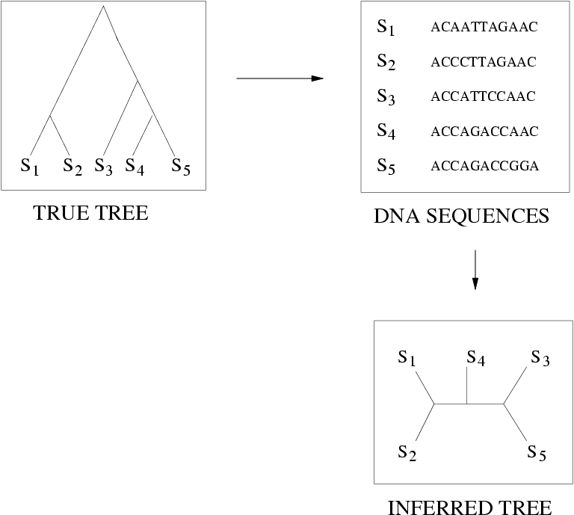
FN
FN: false negative
(missing edge)
FP: false positive
(incorrect edge)
50% error rate
FP

Slide 11
Is method M statistically consistent under model G?
Question answered by mathematical proof
Error
in species tree inferred by method M
Amount of data
generated under model G and then given to method M as input

Slide 12
Markov Models of Sequence Evolution
The different sites are assumed to evolve i.i.d. down the model tree, so it suffices to model a single site
Jukes-Cantor, 1969 (simplest DNA site evolution model):
The state at the root is randomly drawn from {A,C,T,G} (nucleotides)
The model tree T is binary and has substitution probabilities p(e) on each edge e, with 0<p(e)<3/4
If a site (position) changes on an edge, it changes with equal probability to each of the remaining states
The evolutionary process is Markovian.
More complex models (e.g., Generalized Time Reversible) are also considered, often with little change to the theory.

Slide 13
Maximum likelihood tree estimation
Input: multiple sequence alignment and “model” (e.g., GTR, Jukes-Cantor)
Output: Model tree (rooted binary tree with numeric parameters) that maximizes the probability of producing the alignment
Other optimization problems also used, such as maximum parsimony, and various distance-based optimization.
Bayesian methods also used.

Slide 14
Maximum likelihood tree estimation
Theory:
  Statistically consistent under standard models
  Low sample complexity (Roch & Sly, Prob. Theory and Related Fields, 2017): phase transition (logarithmic then polynomial)
  NP-hard
Empirical (based on heuristics) – using RAxML (leading ML heuristic)
  Outstanding accuracy on simulated data
  Challenging on large datasets (best methods can take CPU years or fail to run on large datasets)

Slide 15
Maximum Likelihood Software (heuristics)
RAxML-ng (probably the best?)
IQ-TREE2 (possibly competitive with RAxML-ng)
FastTree 2 (extremely fast, not as accurate)
And others, but none competitive with RAxML-ng
These use hill-climbing and randomness to get out of local optima
None (other than FastTree 2) are designed really for ML on large datasets (many sequences)

Slide 16

Divide-and-Conquer using Disjoint Tree Mergers
Note: use most accurate method on subsets, and treat as absolute constraints
Decompose species set into pairwise disjoint subsets.
Erin Molloy,
Introduced this
approach
Full
species
set
Build a tree on each
subset
Auxiliary
Info
(e.g., distance
matrix)
Tree
on full
species set
Compute tree on entire set of species using “Disjoint Tree Merger” method

Slide 17
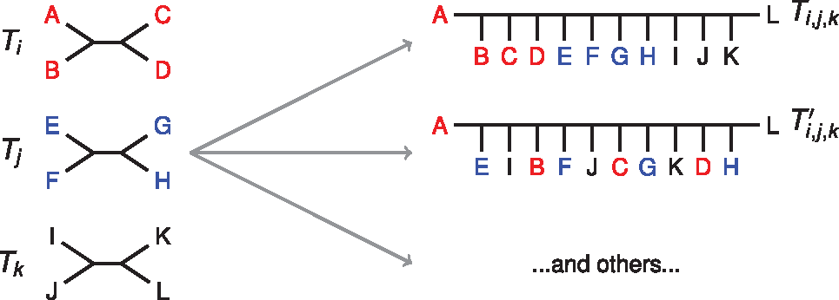

DTMs Merge Subset Trees
Notes:
Subset trees are requirements (constraint trees)
Blending is permitted!
Notes:
Fig. 1. Given a set of trees on pairwise disjoint leaf sets, many possible compatibility supertrees exist. Here we show two compatibility supertrees, labeled Ti,j,k and Ti,j,k′, for T={Ti,Tj,Tk}; others can also be identified. Notably, the trees in T form connected subtrees in Ti,j,k (i.e. Ti,j,k is formed by connecting the trees in T by edges), but this is not the case for Ti,j,k′. We refer to the first type of compatibility supertree as un-blended, and the second type as blended
Unless provided in the caption above, the following copyright applies to the content of this slide: © The Author(s) 2019. Published by Oxford University Press.This is an Open Access article distributed under the terms of the Creative Commons Attribution Non-Commercial License (http://creativecommons.org/licenses/by-nc/4.0/), which permits non-commercial re-use, distribution, and reproduction in any medium, provided the original work is properly cited. For commercial re-use, please contact journals.permissions@oup.com

Slide 18
Divide-and-Conquer using Disjoint Tree Mergers
Note: use most accurate method on subsets, and treat as absolute constraints
Decompose species set into pairwise disjoint subsets.
Erin Molloy,
Introduced this
approach
Full
species
set
Theorem:
If the subtree method is statistically consistent, then many DTM methods are statistically consistent.
Build a tree on each
subset
Auxiliary
Info
(e.g., distance
matrix)
Tree
on full
species set
Compute tree on entire set of species using “Disjoint Tree Merger” method

Slide 19
Disjoint Tree Mergers (DTMs)
NJMerge (Molloy and Warnow, Alg Mol Biol 2019)
TreeMerge (Molloy and Warnow, Bioinf 2019)
Constrained-INC (Zhang, Rao, and Warnow, Alg Mol Biol 2019)
Guide Tree Merger (Smirnov and Warnow, 2020)

Slide 20
Guide Tree Merger
Input:
  set T of trees T_{i} on leafset S_{i} (disjoint sets)
  “guide tree” T on union of S_{i}
Output: Tree T* that induces each T_{i} and minimizes the bipartition distance to T
NP-hard
If we constrain T* to be formed by adding edges between the trees T_{i} (i.e., no blending allowed), then solvable in polynomial time.
Smirnov and Warnow, BMC Genomics 2020

Slide 21
Divide-and-Conquer Gene Tree Estimation
Note: use most accurate method on subsets, and treat as absolute constraints
Decompose species set into pairwise disjoint subsets.
Full
species
set
RAxML, IQ-TREE, etc
Build a tree on each
subset
Auxiliary
Info
(e.g., distance
matrix)
Tree
on full
species set
Compute tree on entire set of species using “Disjoint Tree Merger” method
Guide Tree Merger

Slide 22
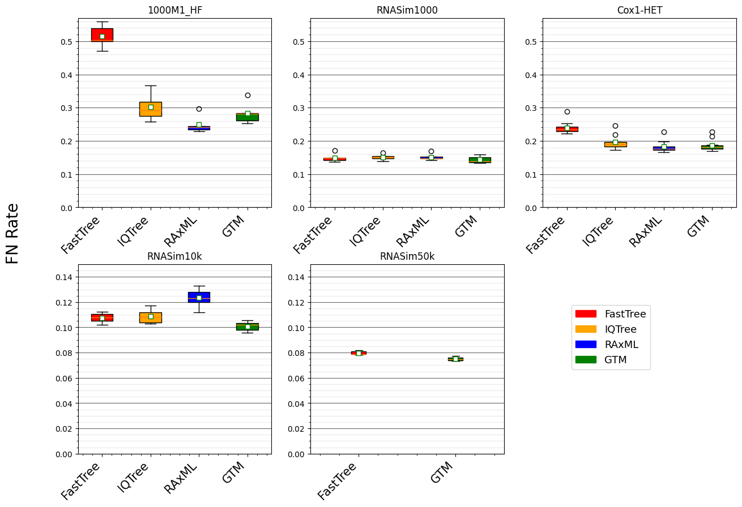


Figure 2 from “Disjoint Tree Mergers for Large-Scale Maximum Likelihood Tree Estimation”, Park et al., Algorithms 2021
GTM pipeline:
starting tree is IQ-Tree or FastTree (smaller datasets),
IQ-tree used to compute subset trees,
Guide Tree = Starting Tree

Slide 23
GTM-pipeline:
Scales to large datasets
Is competitive with RAxML and IQ-TREE for accuracy
Is only slightly slower than starting tree (but more accurate)

Slide 24
Results on simulated datasets with 10K and 50K sequences
Trends
On RNASim10k: GTM most accurate topology
On RNASim50K:
  IQTree failed
  RAxML had nearly 100% error
  GTM most accurate
Each method allowed up to 16 cores, 256GB of RAM, and 7 days of wall-time

Slide 25

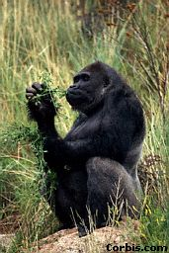


Species Tree Estimation
Orangutan
Gorilla
Chimpanzee
Human
From the Tree of the Life Website,
University of Arizona

Slide 26
Multiple causes for discord, including
Incomplete Lineage Sorting (ILS),
Gene Duplication and Loss (GDL), and
Horizontal Gene Transfer (HGT)

Slide 27
Multiple causes for discord, including
Incomplete Lineage Sorting (ILS),
Gene Duplication and Loss (GDL), and
Horizontal Gene Transfer (HGT)

Slide 28
Is method M statistically consistent under model G?
Question answered by mathematical proof
Error
in species tree inferred by method M
Amount of data
generated under model G and then given to method M as input

Slide 29

Main Approaches for Species Tree Estimation under ILS
gene 1 gene 2 … gene k
Concatenation is not statistically consistent (and is expensive)
ASTRAL is statistically consistent and is much faster
Species
e.g., RAxML
. . .
Concatenation
Analyze
separately
e.g., ASTRAL
. . .
Summary Method
Notes:
point out that supertree methods take overlaping trees and produce a tree, and that the whole process of first generating small trees and then applying a supertree method is often referred to as the “supertree approach”.

Slide 30
Divide-and-Conquer using Disjoint Tree Mergers
Note: use most accurate method on subsets, and treat as absolute constraints
Decompose species set into pairwise disjoint subsets.
Erin Molloy,
Introduced this
approach
Full
species
set
Theorem:
If the subtree method is statistically consistent, then many DTM methods are statistically consistent.
Build a tree on each
subset
Auxiliary
Info
(e.g., distance
matrix)
Tree
on full
species set
Compute tree on entire set of species using “Disjoint Tree Merger” method

Slide 31
Disjoint Tree Mergers for Species Tree Estimation
Note: use most accurate method on subsets, and treat as absolute constraints
Decompose species set into pairwise disjoint subsets.
Erin Molloy,
Introduced this
approach
Full
species
set
Use ASTRAL or Concatenation for subtree construction!
Combine with DTM method.
Build a tree on each
subset
Auxiliary
Info
(e.g., distance
matrix)
Tree
on full
species set
Compute tree on entire set of species using “Disjoint Tree Merger” method

Slide 32
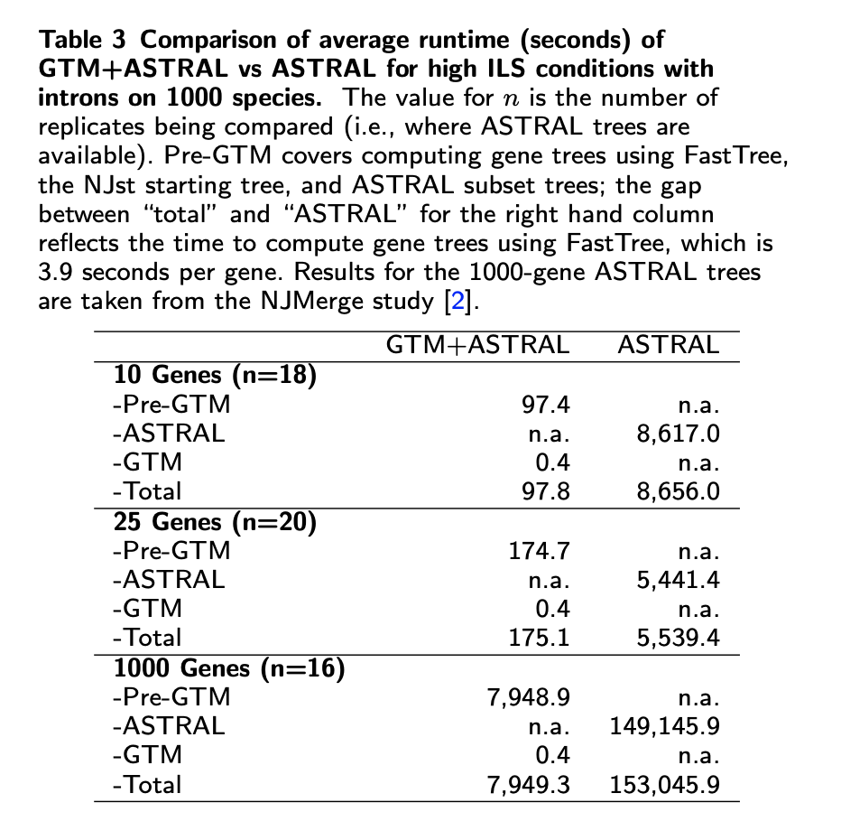
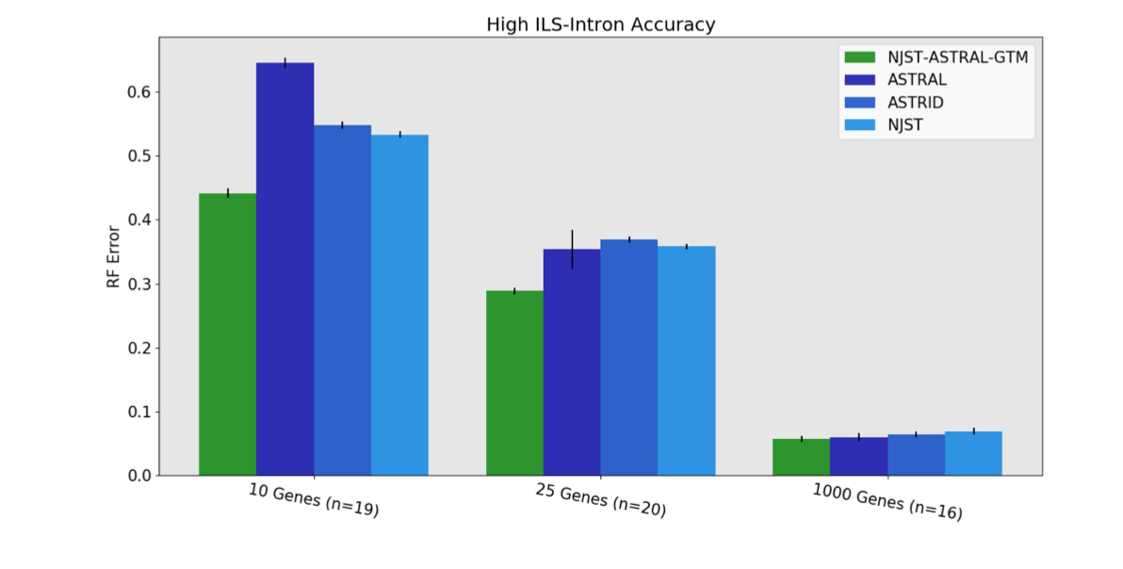
GTM+ASTRAL: faster and more accurate than ASTRAL

Slide 33
Overall summary about tree estimation
Large-scale phylogenetic tree estimation is becoming truly feasible!
  Large numbers of sequences no longer a major impediment
  Heterogeneity across the genome presents challenges, but methods are being developed that address biological heterogeneity
GTM-pipelines improve scalability, reduce runtime, and sometimes improve accuracy
However, we should be able to do better
  Develop new techniques for the division into subsets
  Take advantage of massive parallelism for the middle step (constructing trees on the subsets)
  Improve GTM (allow blending)

Slide 34
Turning over to Minhyuk and Chengze
They will go into greater detail about the methods and results, covering:
  Maximum Likelihood gene tree estimation (Minhyuk)
  Multiple sequence alignment (Chengze)

