Slide 1
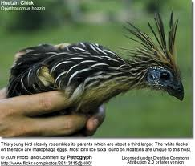
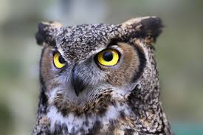
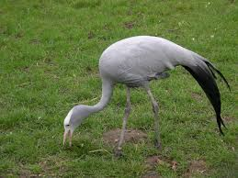




Entering the genomic era of the
Tree of Life
Tandy Warnow
The University of Illinois

Slide 2

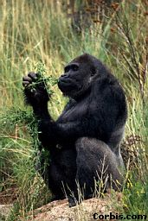


Species Tree
Orangutan
Gorilla
Chimpanzee
Human
From the Tree of the Life Website,
University of Arizona

Slide 3
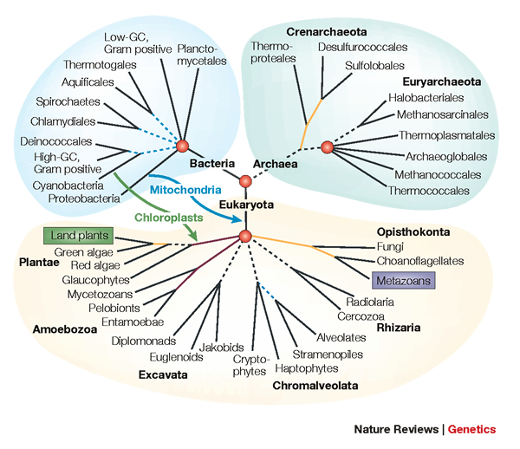
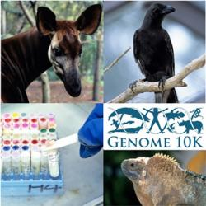
Phylogenomics
Phylogeny + genomics = genome-scale phylogeny estimation
.

Slide 4
Opening remarks: this is an exciting time!
My goal: Phylogenomics for all!
  without a supercomputer or large compute farm!
I predict tremendous advances over the next 3-5 years for species tree estimation in the presence of GDL+ILS+HGT:
  theoretical foundations (what is consistent, new statistical models)
  development of new methods (with strong empirical and theoretical performance)
  advances in scalable methods (thousands of species and tens of thousands of genes)

Slide 5
Phylogeny Estimation
U
V
W
X
Y
AGGGCAT
TAGCCCA
TAGACTT
TGCACAA
TGCGCTT
X
U
Y
V
W

Slide 6
Phylogeny estimation: CS and Statistics
Assume DNA sequences are generated on an unknown model tree, and try to infer the tree from the observed sequences seen at the leaves
NP-hard optimization problems
Large datasets
Years of CPU time for standard methods
This research combines mathematics, statistics, and computer science:
Algorithm design, proofs, implementation, simulations and testing

Slide 7
Identifiability, Consistency, and Sample Complexity
Assume DNA sequences are generated on an unknown model tree, and try to infer the tree from the observed sequences seen at the leaves
Is the model tree identifiable?
Is a given method statistically consistent?
How much data does the method need to be accurate with high probability? (aka “sample complexity”)

Slide 8
Is method M statistically consistent under model G?
Question answered by mathematical proof
Error
in species tree inferred by method M
Amount of data
generated under model G and then given to method M as input

Slide 9
Genome-scale data?
error
Length of the genome

Slide 10
Multiple causes for discord, including
Incomplete Lineage Sorting (ILS),
Gene Duplication and Loss (GDL), and
Horizontal Gene Transfer (HGT)

Slide 11
This talk
Species tree estimation when ILS is the only ”problem”
  Proof of identifiability and statistically consistent methods (and those which aren’t)
  What works in practice – and how to improve estimation on large datasets
Species tree estimation when GDL is present
  Tremendous advances in the last two years
What next?

Slide 12
Multiple causes for discord, including
Incomplete Lineage Sorting (ILS),
Gene Duplication and Loss (GDL), and
Horizontal Gene Transfer (HGT)

Slide 13
MSC+GTR Hierarchical Model
Gene trees evolve within the species tree (under the Multi-Species Coalescent model)
Sequences evolve down the gene trees (under GTR model)

Slide 14








1KP: Thousand Transcriptome Project
G. Ka-Shu Wong
U Alberta
J. Leebens-Mack
U Georgia
N. Wickett
Northwestern
N. Matasci
iPlant
T. Warnow, S. Mirarab, N. Nguyen
UT-Austin/UIUC UT-Austin /UCSD UT-Austin/UCSD
2014 PNAS study: 103 plant transcriptomes, 400-800 single copy “genes”
2019 Nature study: much larger!
Major Challenges:
Multi-copy genes omitted (9500 -> 400)
Massive gene tree heterogeneity consistent with ILS

Slide 15
Major challenge:
Multi-copy genes omitted
Massive gene tree heterogeneity consistent with ILS.

Slide 16
Four major approaches
Concatenation using Maximum likelihood (CA-ML): NP-hard, and not consistent in the presence of ILS
Summary methods (e.g., ASTRAL, ASTRID, MP-EST): consistent, and much faster than CA-ML, but impacted by gene tree estimation error
Site-based methods (e.g., SVDquartets, SVDquest): consistent but not very computationally efficient
Co-estimation methods (StarBEAST and StarBEAST2): consistent, very accurate, but very expensive

Slide 17
Four major approaches
Concatenation using Maximum likelihood (CA-ML): NP-hard, and not consistent in the presence of ILS
Summary methods (e.g., ASTRAL, ASTRID, MP-EST): consistent, and much faster than CA-ML, but impacted by gene tree estimation error
Site-based methods (e.g., SVDquartets, SVDquest): consistent but not very computationally efficient
Co-estimation methods (StarBEAST and StarBEAST2): consistent, very accurate, but very expensive

Slide 18
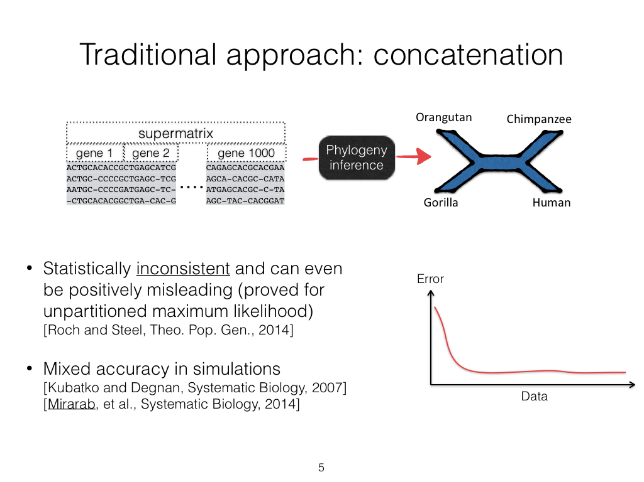

Slide 19
Four major approaches
Concatenation using Maximum likelihood (CA-ML): NP-hard, and not consistent in the presence of ILS
Summary methods (e.g., ASTRAL, ASTRID, MP-EST): consistent, and much faster than CA-ML, but impacted by gene tree estimation error
Site-based methods (e.g., SVDquartets, SVDquest): consistent but not very computationally efficient
Co-estimation methods (StarBEAST and StarBEAST2): consistent, very accurate, but very expensive

Slide 20
Main competing approaches
gene 1 gene 2 … gene k
Species
. . .
Concatenation
Analyze
separately
. . .
Summary Method
Notes:
point out that supertree methods take overlaping trees and produce a tree, and that the whole process of first generating small trees and then applying a supertree method is often referred to as the “supertree approach”.

Slide 21
MSC+GTR Hierarchical Model
Gene trees evolve within the species tree (e.g., under the Multi-Species Coalescent model)
Sequences evolve down the gene trees (e.g., under GTR model, possibly with indels)

Slide 22
Summary Method Protocol
Given gene sequence alignments, compute gene trees
Given gene trees, combine into species tree
Faster than concatenation,
and can be parallelized

Slide 23


Slide 24
Theorem: Under MSC, most probable quartet tree is the species tree

Slide 25
ASTRAL uses dynamic programming to solve a constrained version of this problem, and is provably statistically consistent

Slide 26
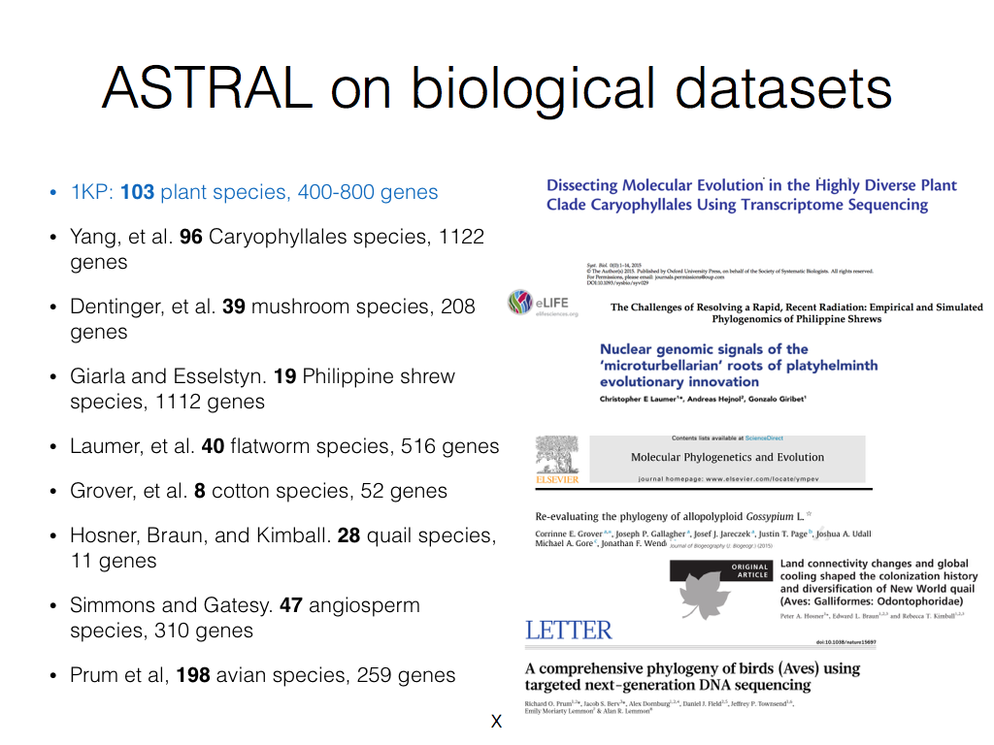

Slide 27
ASTRAL – pros and cons
The good: ASTRAL is
  Very popular statistically consistent method for species tree estimation
  Very fast for many datasets (much faster than concatenation)
The mixed:
  Concatenation can be more accurate under some conditions
The bad:
  ASTRAL can fail to complete on large enough datasets within reasonable time frames (days of computation)

Slide 28

Divide-and-Conquer using Disjoint Tree Mergers
Note: use most accurate method on subsets, and treat as absolute constraints
Decompose species set into pairwise disjoint subsets.
Full
species
set
Build a tree on each
subset
Auxiliary
Info
(e.g., distance
matrix)
Tree
on full
species set
Compute tree on entire set of species using “Disjoint Tree Merger” method

Slide 29
Divide-and-Conquer Species Tree Estimation
Note: use most accurate method on subsets, and treat as absolute constraints
Decompose species set into pairwise disjoint subsets.
Full
species
set
ASTRAL
Build a tree on each
subset
Auxiliary
Info
(e.g., distance
matrix)
Tree
on full
species set
Compute tree on entire set of species using “Disjoint Tree Merger” method
Guide Tree Merger

Slide 30

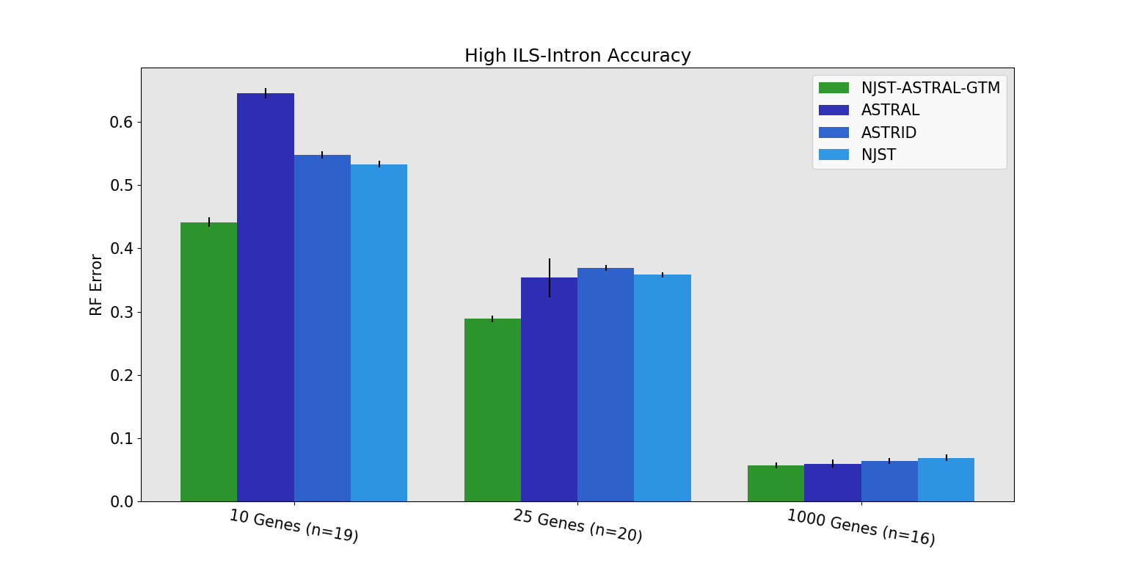
GTM-ASTRAL vs ASTRAL
GTM-pipeline vs ASTRAL (seconds) on 1000 species (after gene trees estimated):
GTM ASTRAL
10 genes: 98 vs 8,656
25 genes: 175 vs 5,539
1000 genes: 7,949 vs 153,046

Slide 31
Summary of DTM pipeline results
Divide-and-conquer pipelines using DTMs maintain statistical consistency and run in polynomial time
Used with ASTRAL or RAxML, DTM pipelines reduce running time and memory usage, and produce species trees of comparable or better accuracy
Runtimes are generally only slightly more expensive than the starting tree
Embarassingly parallel

Slide 32
Impact of gene tree estimation error
Basic questions:
  How do methods perform when there is low signal per gene?
  Can statistical consistency still be guaranteed?

Slide 33
Statistical consistency (two variants)
Type 1: the number of loci and number of sites per gene both increase.
Type 2: the number of loci increases, but the number of sites per gene is bounded by a fixed value
Roch, Nute, and Warnow (Syst Biol 2019)
Summary methods and fully partitioned ML can be positively misleading in the Type 2 setting.
Proof is basically an elaboration on the Felsenstein Zone argument

Slide 34
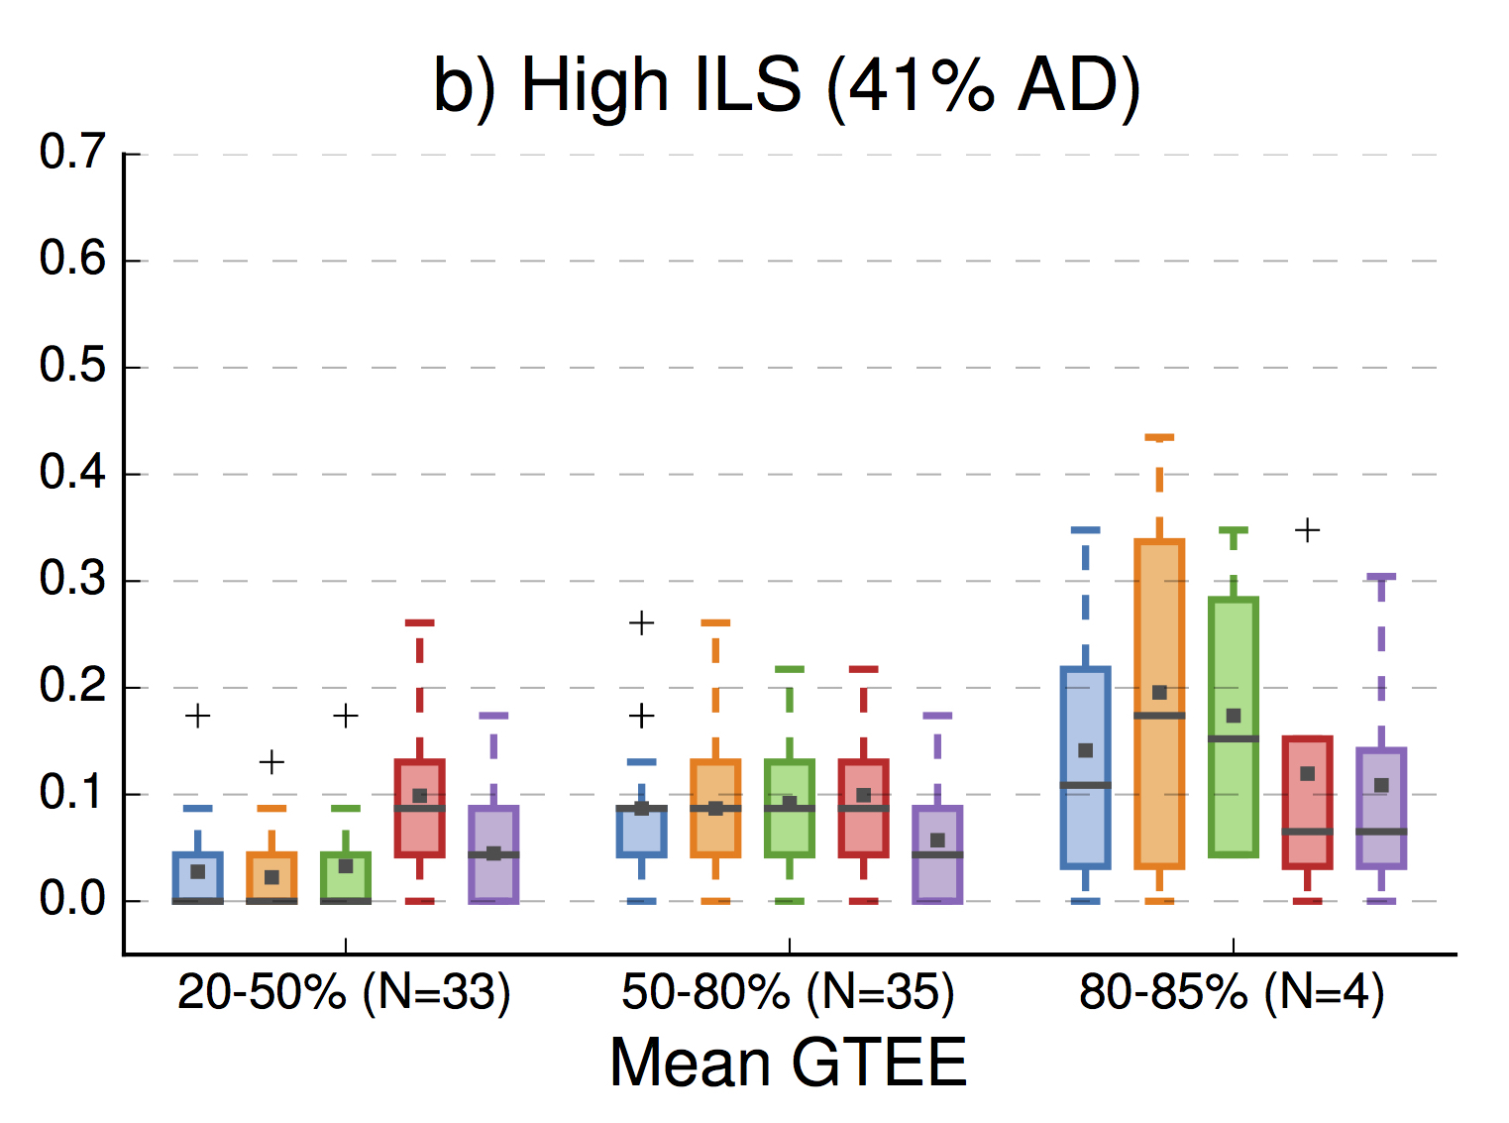

Impact of Gene Tree Estimation Error
(from Molloy and Warnow 2017)
GTEE: gene tree estimation error
CA-ML: concatenation with ML
26 species, 1000 genes, with high ILS (anomaly zone)
Note: Summary methods better than CA-ML for low GTEE, then worse!
Error is fraction
of bipartitions
that are not
recovered
Summary Methods
Site-based Method

Slide 35
ILS-based species tree estimation (Summary)
Last few years have seen a revolution in methods and theory
Several methods have excellent accuracy – but choice of method depends on data
Statistical consistency is complicated
Empirical accuracy (biological and simulated data) also complicated:
Scaling to large datasets an issue

Slide 36
This talk
Species tree estimation when ILS is the only ”problem”
  Proof of identifiability and statistically consistent methods (and those which aren’t)
  What works in practice – and how to improve estimation on large datasets
Species tree estimation when GDL is present
  Tremendous advances in the last two years
What next?

Slide 37
1KP: Thousand Transcriptome Project
G. Ka-Shu Wong
U Alberta
J. Leebens-Mack
U Georgia
N. Wickett
Northwestern
N. Matasci
iPlant
T. Warnow, S. Mirarab, N. Nguyen
UT-Austin/UIUC UT-Austin /UCSD UT-Austin/UCSD
2014 PNAS study: 103 plant transcriptomes, 400-800 single copy “genes”
2019 Nature study: much larger!
Major Challenges:
Multi-copy genes omitted (9500 -> 400)
Massive gene tree heterogeneity consistent with ILS

Slide 38
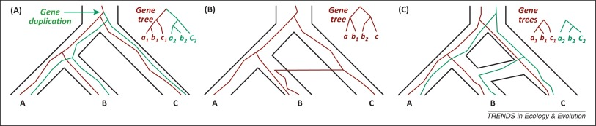
Gene Family Trees
The species tree has one duplication (at the root), which produces a gene family tree that has two copies of the species tree!
Multi-copy trees: MUL-trees
Figure by Luay Nakhleh, TREE 2013

Slide 39
Problem: Given set of MUL-trees, infer the species tree
Note: no orthology detection

Slide 40
Species tree estimation under GDL
Concatenation: requires restriction to single-copy genes (throws out data) OR knowledge of orthology (not reliable)
Summary methods: gene tree parsimony (e.g., DupTree and iGTP) and supertree methods adapted to MUL-trees (e.g., MulRF and FastMulRFS), also guenomo (Bayesian method).
Bayesian co-estimation of gene trees and species trees (e.g., PhylDog)
Note:
Nothing proven to be statistically consistent under GDL… until 2019
Nothing proven to be statistically consistent under GDL… until 2019

Slide 41
Species tree estimation under GDL
Concatenation: requires restriction to single-copy genes (throws out data) OR knowledge of orthology (not reliable)
Summary methods: gene tree parsimony (e.g., DupTree and iGTP) and supertree methods adapted to MUL-trees (e.g., MulRF and FastMulRFS), also guenomo (Bayesian method).
Bayesian co-estimation of gene trees and species trees (e.g., PhylDog)
Note:
Nothing proven to be statistically consistent under GDL… until 2019
Nothing proven to be statistically consistent under GDL… until 2019

Slide 42


Theorem (Legried, Molloy, Warnow, and Roch, 2019): ASTRAL-multi is statistically consistent under GDL and runs in polynomial time.
Theorem (Molloy and Warnow, 2019): FastMulRFS is statistically consistent under a generic duplication-only or loss-only model, and runs in polynomial time.
Note: Both methods use dynamic programming to solve NP-hard discrete optimization problems within constrained search space in polynomial time.
Theorem: Under GDL, most probable quartet tree is the species tree

Slide 43
But…ASTRAL-multi is not as accurate as other methods!
Results on 100-species datasets with moderate GDL, moderately high ILS, and high GTEE

Slide 44
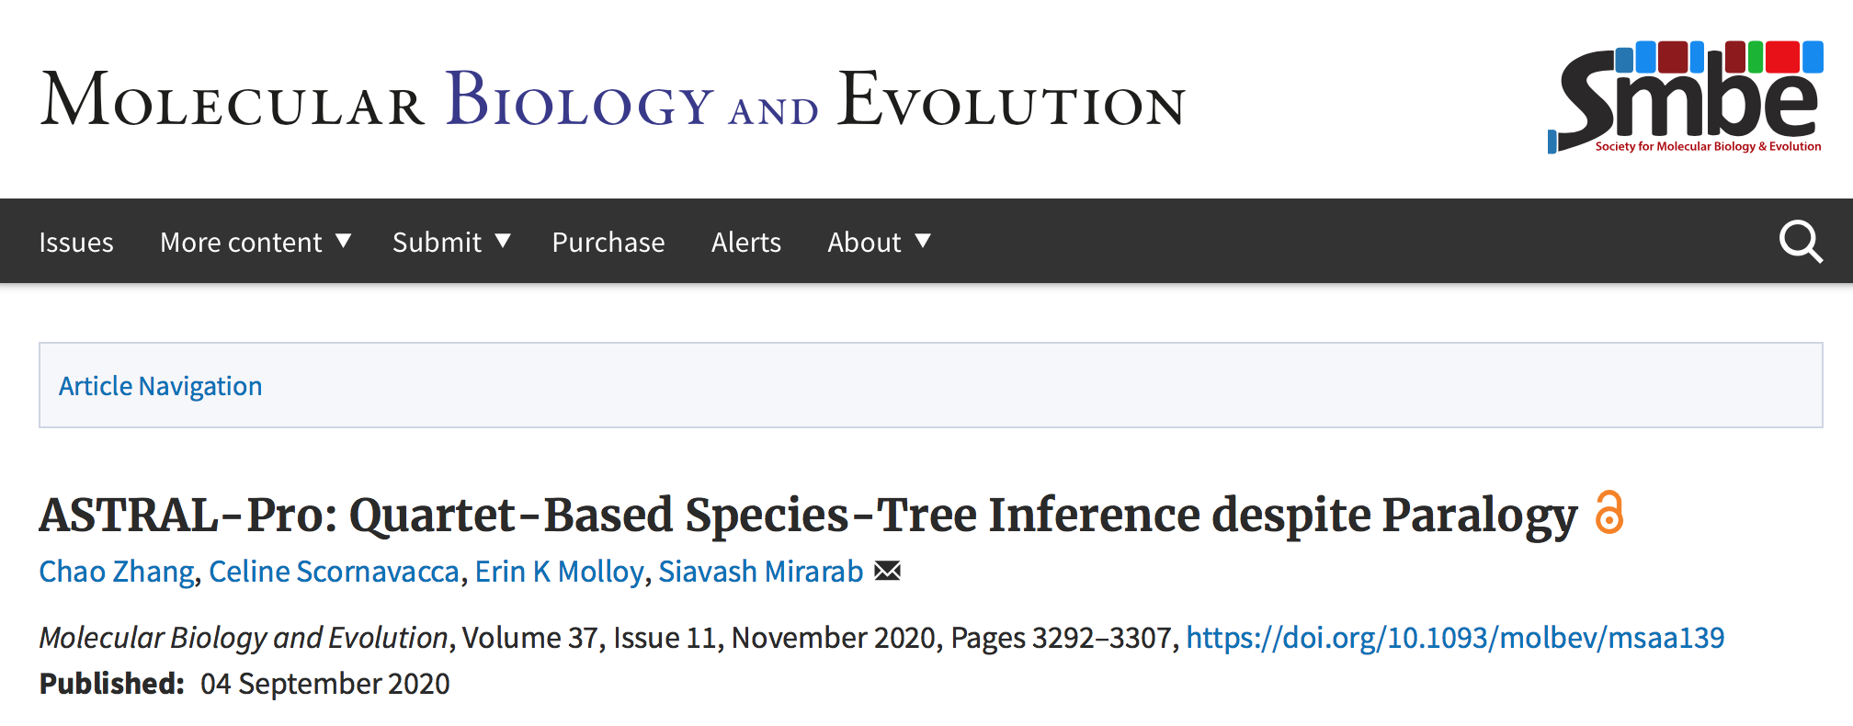

Slide 45
ASTRAL-Pro was designed to specifically address GDL:
Root and “tag” each gene tree (nodes are identified as duplications or speciations)
Modify weighting on quartet trees to reflect speciation

Slide 46
Results on 1000-taxon Species Trees
Accuracy: no important differences on these large datasets.
Speed: ASTRID-multi fastest, but ASTRAl-Pro nearly same. FastMulRFS slowest (max about 7 hours).
1000 species and 1000 gene trees estimated from 100bp alignments (approx. 44% mean gene tree error), AD=20%,
duplication rate of 5.0 × 10−10, and loss/dup = 1.
James Willson, Mrinmoy Ruddur, and Tandy Warnow. AlCoB 2021. Lecture Notes in Computer Science, vol 12715.
Springer, Cham. https://doi.org/10.1007/978-3-030-74432-8_8

Slide 47
Summary for GDL
ASTRAL-Pro and ASTRID-multi
  Very accurate (more accurate than ASTRAL-multi) – both hard to beat!
  Can run on very large datasets (1000 species, 1000 genes)
  Does not require orthology detection
  Guaranteed polynomial time
But
  ASTRAL-Pro can be slow on large datasets with high rates of GDL, and proof of consistency depends on correct “rooting and tagging”
  ASTRID-multi: no proof of consistency under any GDL model
Note:
  Same tricks used for ASTRAL (e.g., GTM and TreeMerge, FASTRAL) can be used on ASTRAL-Pro to improve scalability

Slide 48
This talk
Species tree estimation when ILS is the only ”problem”
  Proof of identifiability and statistically consistent methods (and those which aren’t)
  What works in practice – and how to improve estimation on large datasets
Species tree estimation when GDL is present
  Tremendous advances in the last two years
What next?

Slide 49
What about HGT?
HGT also makes heterogeneous gene trees
Under some assumptions of random HGT operating, it may be possible to define the “underlying” species tree.
Can the underlying species tree be inferred from the gene trees, or via concatenation?
Statistical consistency of quartet-based methods established by:
    Roch & Snir, JCB 2013
    Daskalakis & Roch, arXiv 2015

Slide 50
Accuracy in the presence of HGT + ILS
Theorem (Snir and Roch): Under bounded but random HGT, most probable quartet tree is the species tree
Davidson et al., RECOMB-CG, BMC Genomics 2015

Slide 51
Quartet tree robustness
Recurring theme: the most probable quartet tree is the species tree for:
  ILS (Multi-species coalescent)
  ILS+GDL (DLCOAL)
  Random HGT
Hence, quartet-based species tree estimation (from gene trees) is often statistically consistent, if performed properly.
Interestingly, it is also fairly robust

Slide 52
Scaling to large datasets
Scaling to large datasets an issue – affects accuracy and runtime/memory usage
  Number of species (affects all methods)
  Number of loci (affects *BEAST and ASTRAL)
  Amount of gene tree heterogeneity (affects runtime for ASTRAL)
Techniques
  GTM/TreeMerge for scaling ASTRAL and RAxML to large numbers of species
  FASTRAL (not shown): scales ASTRAL to large numbers of loci
  BBCA (not shown): scales *BEAST to large numbers of loci

Slide 53
Summary
Excellent methods for different conditions!
  ASTRAL-Pro: excellent for GDL+ILS
  SpeciesRax: shows promise for GDL+HGT
  Concatenation good for many conditions
  Disjoint Tree Mergers: Enable scalability to large datasets
Lots of theory needs to be established
  Statistical consistency?
  Sample complexity?
  Robustness (missing data, gene tree estimation error)?

Slide 54
Closing remarks: this is an exciting time!
I predict tremendous advances over the next 3-5 years for species tree estimation in the presence of GDL+ILS+HGT:
  theoretical foundations (what is consistent, new statistical models)
  development of new methods (with strong empirical and theoretical performance)
  Advances in scalable methods (thousands of species and tens of thousands of genes)
My goal:
  Phylogenomics for all! (without a supercomputer or large compute farm!)

Slide 55

Acknowledgments
Papers available at http://tandy.cs.illinois.edu/papers.html
Presentations available at http://tandy.cs.illinois.edu/talks.html
Funding: NSF (CCF 1535977 and also NSF Graduate Fellowship to Erin Molloy)
Supercomputers: Blue Waters and Campus Cluster, both supported by NCSA
Write to me: warnow@Illinois.edu

Slide 56
Selection of papers
Willson et al., ALCOB (2021) (simulation study for GDL)
Morel et al. (2021). bioRxiv DOI: 10.1101/2021.03.29.437460 (SpeciesRax)
Markin & Eulenstein, Bioinformatics (2021). (Consistency of ASTRAL-multi under DLCOAL)
Richards and Kubatko, arXiv (2020) arXiv:2010.06063 (Lily-Q and Lily-T)
Zhang et al., MBE (2020) doi:10.1093/molbev/msaa139 (ASTRAL-Pro)
Hill, Legried, and Roch (2020). arXiv: 2007.06697. (Sample complexity for ASTRAL-multi)
Molloy and Warnow, Bioinf (2020) 36.Supplement_1: i57-i65 (FastMulRFS)
Legried et al., J Comp Biol (2020) doi:10.1089/cmb.2020.0424 (ASTRAL-multi and GDL)

Slide 57
Impact of Gene Tree Estimation Error (GTEE)
Accuracy: No important differences given moderately high GTEE.
FastMuLRFS more impacted by GTEE.
Speed: ASTRID-multi and ASTRAL-Pro tied for high accuracy gene trees; ASTRID-multi faster given moderate to high GTEE.
FastMulRFS slowest (max at 2.5 minutes).
100 species, 1000 gene trees, AD=20%, duplication rate of 5.0 × 10−10 and loss/dup = 1.

Slide 58
Impact of ILS (incomplete lineage sorting)
Accuracy: No important differences for low or moderate ILS.
FastMulRFS poor if high ILS.
Speed: ASTRID-multi fastest, FastMulRFS slowest (max at 4 minutes).
100 species, 1000 gene trees, 100-site alignments, duplication rate of 5.0 × 10−10 and loss/dup = 1.

Slide 59
Theorem (Legried, Molloy, Warnow, and Roch, 2019): ASTRAL-multi is statistically consistent under GDL and runs in polynomial time.
Theorem (Molloy and Warnow, 2019): FastMulRFS is statistically consistent under a generic duplication-only or loss-only model, and runs in polynomial time.
Note: Both methods use dynamic programming to solve NP-hard discrete optimization problems within constrained search space in polynomial time.

Slide 60
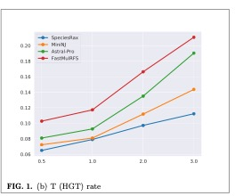
SpeciesRax (Morel…Stamatakis, biorxiv 2021)
SpeciesRax: estimates species tree from gene trees, taking HGT and GDL into account
Simulation study (from bioRxiv) shows good robustness to many model conditions
Results shown here are for 25 species, 100 genes, no ILS, HGT=Dup
DOI: 10.1101/2021.03.29.437460

Slide 61


Simulation study
Methods: ASTRAL-Pro, ASTRID-multi, and FastMulRFS (none proven consistent under GDL, but ASTRAL-Pro and FastMulRFS shown to be more accurate in simulations than ASTRAL-multi)
Simulated datasets (SimPhy and INDELible):
  100 to 1,000 species
  Up to 10,000 gene trees evolved under GDL+ILS
  sequence length varied per gene
James Willson, Mrinmoy Ruddur, and Tandy Warnow. AlCoB 2021. Lecture Notes in Computer Science, vol 12715. Springer, Cham. https://doi.org/10.1007/978-3-030-74432-8_8

Slide 62
Alternatives to ASTRAL
Concatenation Analyses (e.g., using maximum likelihood):
  most commonly used method, not statistically consistent, sometimes more accurate than summary methods
  computationally intensive (e.g., 250 CPU years for the Avian Phylogenomics project with only 48 species) and do not scale to large numbers of species
Co-estimation of gene trees and species trees: too expensive
Other statistically consistent methods: not as accurate as ASTRAL
So we need to make ASTRAL and Concatenation Analyses truly scalable to large datasets!

Slide 63
Impact of number of gene trees
Accuracy: No important differences if given enough genes.
FastMulRFS not so good at few genes.
Time: ASTRID-multi fastest, FastMulRFS slowest (but never more than 2.5 hours)
AD measures
ILS levels (average distance between true gene trees and true species tree)
100 species, 100bp alignments (approx. 43% mean gene tree error), AD=20%, duplication rate of 5.0 × 10−10 and loss/dup = 1.
James Willson, Mrinmoy Ruddur, and Tandy Warnow. AlCoB 2021. Lecture Notes in Computer Science, vol 12715. Springer, Cham. https://doi.org/10.1007/978-3-030-74432-8_8

Slide 64
NJMerge + RAxML vs. RAxML: Better accuracy and faster!

Slide 65
FastMulRFS and MulRF better than ASTRAL-multi!
FastMulRFS is by far the fastest
Data: 100 species, moderate GDL, moderately high ILS,
high gene tree estimation error
Molloy and Warnow, Bioinformatics, Vol. 36, pages i57-i65,

Slide 66
Summary for GDL and ILS
It is not necessary to determine orthology in order to estimate species trees: ASTRAL-Pro, ASTRID-Multi, and FastMulRFS do well.
ASTRAL-Pro and ASTRID-multi display robustness to moderately high gene tree estimation error and and high ILS
Speed is good for all methods, but especially for ASTRID-multi (main expense is computing the gene trees). Even 1000 species and 1000 genes analyzed in under 7 hours for most expensive method.
Statistical consistency established for ASTRAL-multi but not for the other methods, yet empirical performance favors ASTRAL-Pro and ASTRID-multi (so maybe these are also statistically consistent)
Much room for improvement in accuracy through novel method development

