Slide 1

New methods for very-large scale maximum likelihood tree estimation
Tandy Warnow
The University of Illinois
Joint work with: Paul Zaharias and Minhyuk Park

Slide 2
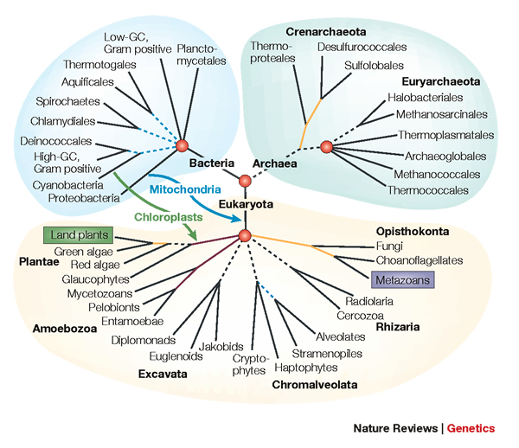
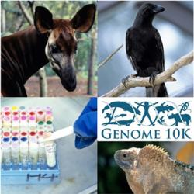
Phylogenomics
Phylogeny + genomics = genome-scale phylogeny estimation
.

Slide 3
Phylogenomic pipeline
Select taxon set and markers
Gather and screen sequence data, possibly identify orthologs
Compute multiple sequence alignments for each locus, and construct gene trees
Compute species tree or network:
  Combine the estimated gene trees, OR
  Estimate a tree from a concatenation of the multiple sequence alignments
Get statistical support on each branch (e.g., bootstrapping)
Estimate dates on the nodes of the phylogeny
Use species tree with branch support and dates to understand biology

Slide 4
Phylogenomic pipeline
Select taxon set and markers
Gather and screen sequence data, possibly identify orthologs
Compute multiple sequence alignments for each locus, and construct gene trees
Compute species tree or network:
  Combine the estimated gene trees, OR
  Estimate a tree from a concatenation of the multiple sequence alignments
Get statistical support on each branch (e.g., bootstrapping)
Estimate dates on the nodes of the phylogeny
Use species tree with branch support and dates to understand biology

Slide 5







1KP: Thousand Transcriptome Project
G. Ka-Shu Wong
U Alberta
J. Leebens-Mack
U Georgia
N. Wickett
Northwestern
N. Matasci
iPlant
T. Warnow, S. Mirarab, N. Nguyen
UT-Austin/UIUC UT-Austin /UCSD UT-Austin/UCSD
2014 PNAS study: 103 plant transcriptomes, 400-800 single copy “genes”
2019 Nature study: much larger!
Major Challenges:
Large alignments (and sequence length heterogeneity)
Multi-copy genes omitted (9500 -> 400)
Massive gene tree heterogeneity consistent with ILS

Slide 6
Major challenges:
Multi-copy genes omitted
Massive gene tree heterogeneity consistent with ILS
Concatenation analysis took 250 CPU years

Slide 7
Large datasets are difficult
Two dimensions:
  Number of loci
  Number of species (or individuals)
Missing data
Heterogeneity
Many analytical pipelines involve Maximum likelihood and Bayesian estimation

Slide 8
What I hope to convince you of:
Great progress in large-scale phylogeny estimation (both for gene trees and species trees)
“Disjoint tree mergers” (DTMs) are generic methods, that can be used with any phylogeny estimation method (for any kind of data), and enable scalability to large datasets.
  The Guide Tree Merger (GTM) is the current leading DTM technique, based on empirical performance.
  GTM improves maximum likelihood gene tree estimation and also species tree estimation.
  However, GTM does NOT allow blending, and so should be able to be improved.
Open problem: Develop a better DTM approach that allows blending.

Slide 9
This talk
Part I: Models of sequence evolution and maximum likelihood
Part II: Divide-and-conquer methods for maximum likelihood tree estimation
Part III: Applications of techniques to species tree estimation, and open problems

Slide 10
Part I
Models of evolution
Maximum likelihood tree estimation

Slide 11
DNA Sequence Evolution (Idealized)
AAGACTT
-3 mil yrs
AAGACTT
-2 mil yrs
AAGGCCT
AAGGCCT
AAGGCCT
AAGGCCT
TGGACTT
TGGACTT
TGGACTT
TGGACTT
-1 mil yrs
AGGGCAT
AGGGCAT
TAGCCCT
TAGCCCT
AGCACTT
AGGGCAT
TAGCCCT
AGCACTT
AGCACTT
AGGGCAT
TAGCCCA
TAGACTT
AGCACAA
AGCGCTT
today
AGGGCAT
TAGCCCA
TAGACTT
AGCACAA
AGCGCTT

Slide 12
Phylogeny Problem
U
V
W
X
Y
AGGGCAT
TAGCCCA
TAGACTT
TGCACAA
TGCGCTT
X
U
Y
V
W

Slide 13
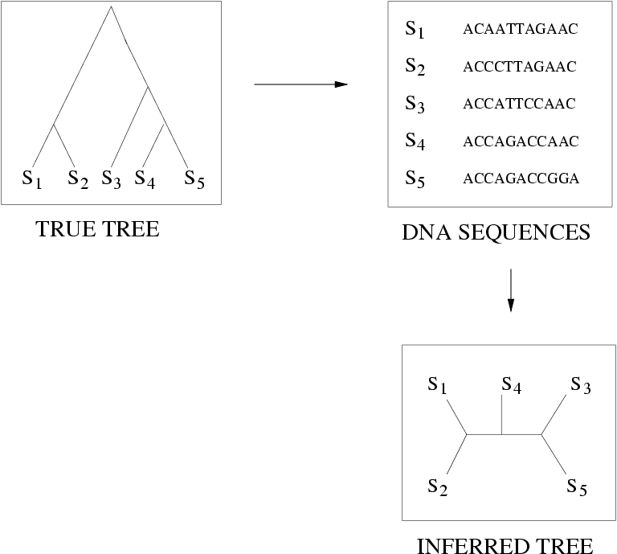
FN
FN: false negative
(missing edge)
FP: false positive
(incorrect edge)
50% error rate
FP

Slide 14
Is method M statistically consistent under model G?
Question answered by mathematical proof
Error
in species tree inferred by method M
Amount of data
generated under model G and then given to method M as input

Slide 15
Markov Models of Sequence Evolution
The different sites are assumed to evolve i.i.d. down the model tree, so it suffices to model a single site
Jukes-Cantor, 1969 (simplest DNA site evolution model):
The state at the root is randomly drawn from {A,C,T,G} (nucleotides)
The model tree T is binary and has substitution probabilities p(e) on each edge e, with 0<p(e)<3/4
If a site (position) changes on an edge, it changes with equal probability to each of the remaining states
The evolutionary process is Markovian.
More complex models (e.g., Generalized Time Reversible) are also considered, often with little change to the theory.

Slide 16
Questions
Is the model tree identifiable?
Which estimation methods are statistically consistent under this model?
What is the sample complexity of the method (i.e., how much data does the method need to estimate the model tree correctly with high probability)?
What are the computational issues?

Slide 17
Answers?
We know a lot about which site evolution models are identifiable, and which methods are statistically consistent.
We know a little bit about the sample complexity for standard methods.
Take home message: need to limit (or not allow) heterogeneity to get model identifiability!

Slide 18
Part III: Large-scale maximum likelihood trees

Slide 19
Maximum likelihood tree estimation
Input: multiple sequence alignment and “model” (e.g., GTR, Jukes-Cantor)
Output: Model tree (rooted binary tree with numeric parameters) that maximizes the probability of producing the alignment
Other optimization problems also used, such as maximum parsimony, and various distance-based optimization.
Bayesian methods also used.

Slide 20
Maximum likelihood tree estimation
Theory:
  Statistically consistent under standard models
  Low sample complexity (Roch & Sly, Prob. Theory and Related Fields, 2017): phase transition (logarithmic then polynomial)
  NP-hard
Empirical (based on heuristics) – using RAxML (leading ML heuristic)
  Outstanding accuracy on simulated data
  Challenging on large datasets (best methods can take CPU years or fail to run on large datasets)

Slide 21
Maximum Likelihood Software (heuristics)
RAxML-ng (probably the best?)
IQ-TREE2 (possibly competitive with RAxML-ng)
FastTree 2 (extremely fast, not as accurate)
And others, but none competitive with RAxML-ng
These use hill-climbing and randomness to get out of local optima
None (other than FastTree 2) are designed really for ML on large datasets (many sequences)

Slide 22

Divide-and-Conquer using Disjoint Tree Mergers
Note: use most accurate method on subsets, and treat as absolute constraints
Decompose species set into pairwise disjoint subsets.
Erin Molloy,
Introduced this
approach
Full
species
set
Build a tree on each
subset
Auxiliary
Info
(e.g., distance
matrix)
Tree
on full
species set
Compute tree on entire set of species using “Disjoint Tree Merger” method

Slide 23
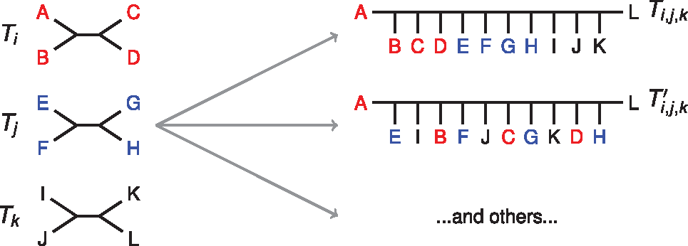

DTMs Merge Subset Trees
Notes:
Subset trees are requirements (constraint trees)
Blending is permitted!
Notes:
Fig. 1. Given a set of trees on pairwise disjoint leaf sets, many possible compatibility supertrees exist. Here we show two compatibility supertrees, labeled Ti,j,k and Ti,j,k′, for T={Ti,Tj,Tk}; others can also be identified. Notably, the trees in T form connected subtrees in Ti,j,k (i.e. Ti,j,k is formed by connecting the trees in T by edges), but this is not the case for Ti,j,k′. We refer to the first type of compatibility supertree as un-blended, and the second type as blended
Unless provided in the caption above, the following copyright applies to the content of this slide: © The Author(s) 2019. Published by Oxford University Press.This is an Open Access article distributed under the terms of the Creative Commons Attribution Non-Commercial License (http://creativecommons.org/licenses/by-nc/4.0/), which permits non-commercial re-use, distribution, and reproduction in any medium, provided the original work is properly cited. For commercial re-use, please contact journals.permissions@oup.com

Slide 24
Divide-and-Conquer using Disjoint Tree Mergers
Note: use most accurate method on subsets, and treat as absolute constraints
Decompose species set into pairwise disjoint subsets.
Erin Molloy,
Introduced this
approach
Full
species
set
Theorem:
If the subtree method is statistically consistent, then many DTM methods are statistically consistent.
Build a tree on each
subset
Auxiliary
Info
(e.g., distance
matrix)
Tree
on full
species set
Compute tree on entire set of species using “Disjoint Tree Merger” method

Slide 25
Disjoint Tree Mergers (DTMs)
NJMerge (Molloy and Warnow, Alg Mol Biol 2019)
TreeMerge (Molloy and Warnow, Bioinf 2019)
Constrained-INC (Zhang, Rao, and Warnow, Alg Mol Biol 2019)
Guide Tree Merger (Smirnov and Warnow, 2020)

Slide 26
Guide Tree Merger
Input:
  set T of trees T_{i} on leafset S_{i} (disjoint sets)
  “guide tree” T on union of S_{i}
Output: Tree T* that induces each T_{i} and minimizes the bipartition distance to T
NP-hard
If we constrain T* to be formed by adding edges between the trees T_{i} (i.e., no blending allowed), then solvable in polynomial time.
Smirnov and Warnow, BMC Genomics 2020

Slide 27
Divide-and-Conquer Gene Tree Estimation
Note: use most accurate method on subsets, and treat as absolute constraints
Decompose species set into pairwise disjoint subsets.
Full
species
set
RAxML, IQ-TREE, etc
Build a tree on each
subset
Auxiliary
Info
(e.g., distance
matrix)
Tree
on full
species set
Compute tree on entire set of species using “Disjoint Tree Merger” method
Guide Tree Merger

Slide 28
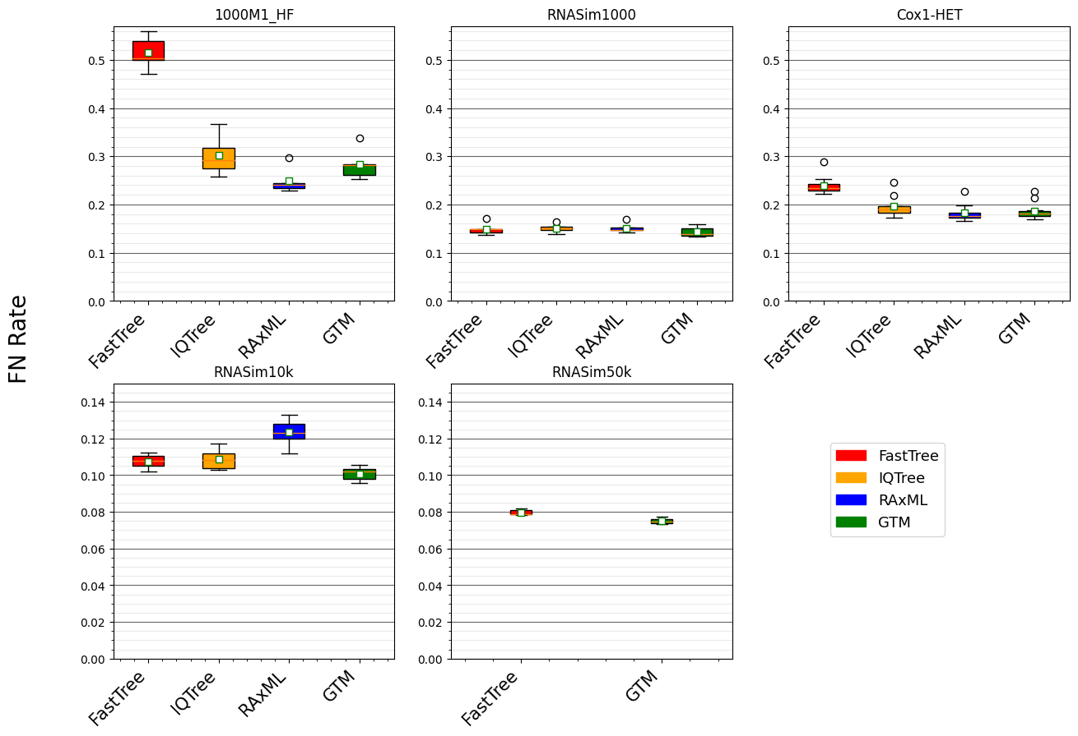


Figure 2 from “Disjoint Tree Mergers for Large-Scale Maximum Likelihood Tree Estimation”, Park et al., Algorithms 2021
GTM pipeline:
starting tree is IQ-Tree or FastTree (smaller datasets),
IQ-tree used to compute subset trees,
Guide Tree = Starting Tree

Slide 29
GTM-pipeline:
Scales to large datasets
Is competitive with RAxML and IQ-TREE for accuracy
Is only slightly slower than starting tree (but more accurate)

Slide 30
Trends
On RNASim10k: GTM most accurate topology
On RNASim50K:
  IQTree failed
  RAxML had nearly 100% error
  GTM most accurate

Slide 31
What about biological data?
We used the same technique but evaluated maximum likelihood scores on an MAGUS+EMMA alignment of the Recombinase dataset (~70,000 protein sequences) from Kelly Williams, restricting the alignment to approximately 1000 sites.
Revised GTM pipeline: construct FastTree tree on full-length sequences, and add remaining sequences in using phylogenetic placement method BATCH-SCAMPP (with EPA-ng) – Eleanor Wedell et al. (2023).
We let RAxML run with different starting trees: its default approach, using FastTree as a starting tree, and using our GTM tree as a starting tree.
We compared these RAxML runs (different starting trees) to each other, using LG+Gamma(4) for the model.
Unpublished analyses performed by Minhyuk Park.

Slide 32
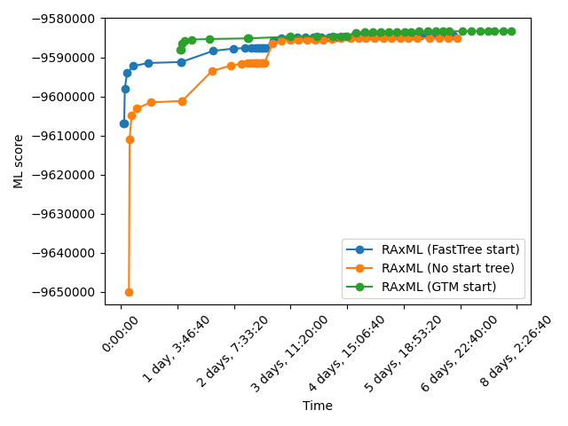
Analysis of Kelly Williams dataset (Minhyuk Park et al., NYP)
Choice of starting tree matters!
RAxML continues to improve its ML score during the entire 8 day period (but most gains are in the first 4 days)
GTM takes a bit more than 24 hours

Slide 33
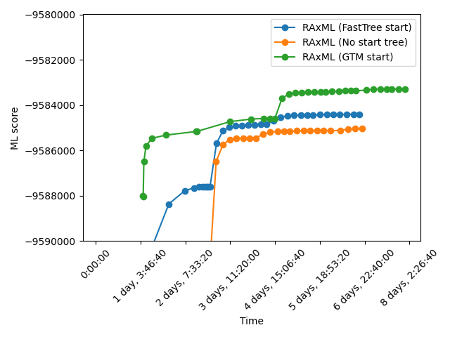
On this dataset,
Default RAxML worst
FastTree is a better starting tree
GTM is much better
Large datasets need long running times and very good starting trees!

Slide 34

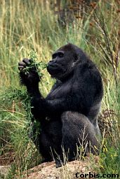


Part III: Species Tree Estimation
Orangutan
Gorilla
Chimpanzee
Human
From the Tree of the Life Website,
University of Arizona

Slide 35
Multiple causes for discord, including
Incomplete Lineage Sorting (ILS),
Gene Duplication and Loss (GDL), and
Horizontal Gene Transfer (HGT)

Slide 36
Multiple causes for discord, including
Incomplete Lineage Sorting (ILS),
Gene Duplication and Loss (GDL), and
Horizontal Gene Transfer (HGT)

Slide 37
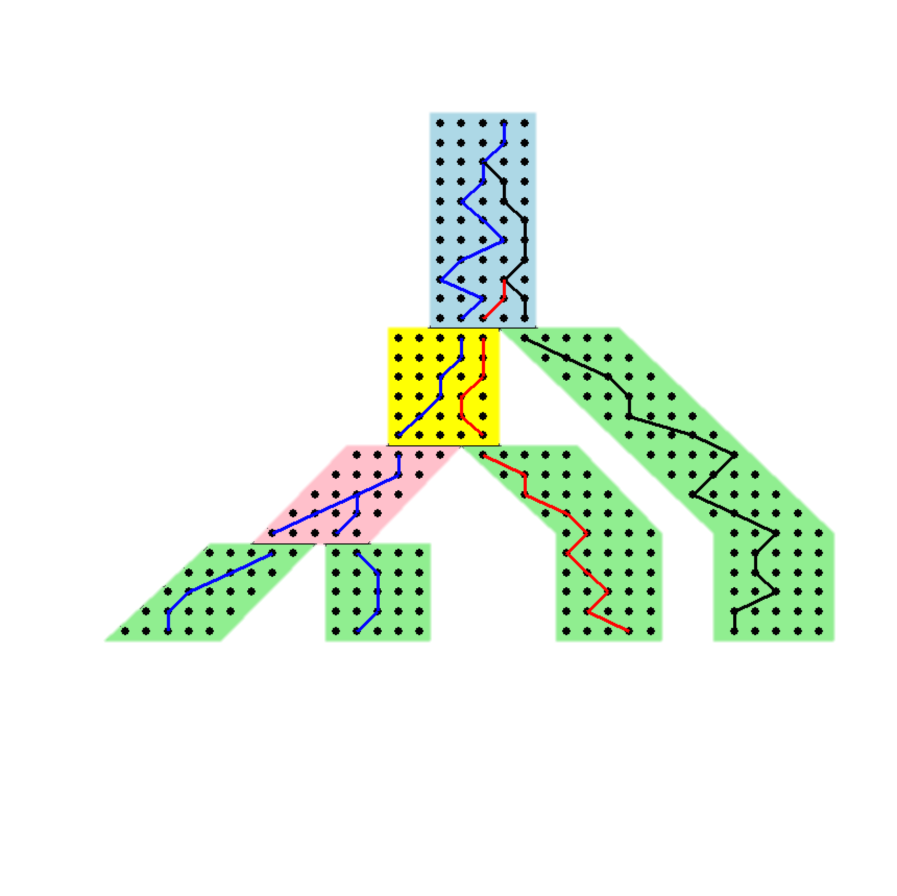
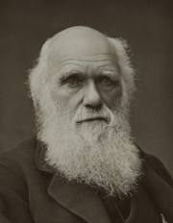



Gene trees inside the species tree (Coalescent Process)
Past
Deep coalescence =
INCOMPLETE
LINEAGE
SORTING (ILS):
gene tree can be different
from the species tree
Present
Courtesy James Degnan
Gorilla and Orangutan are not siblings in the species tree, but they are in the gene tree.

Slide 38
Is method M statistically consistent under model G?
Question answered by mathematical proof
Error
in species tree inferred by method M
Amount of data
generated under model G and then given to method M as input

Slide 39
Genome-scale data?
error
Length of the genome

Slide 40
MSC+GTR Hierarchical Model
Gene trees evolve within the species tree (under the Multi-Species Coalescent model)
Sequences evolve down the gene trees (under GTR model)

Slide 41
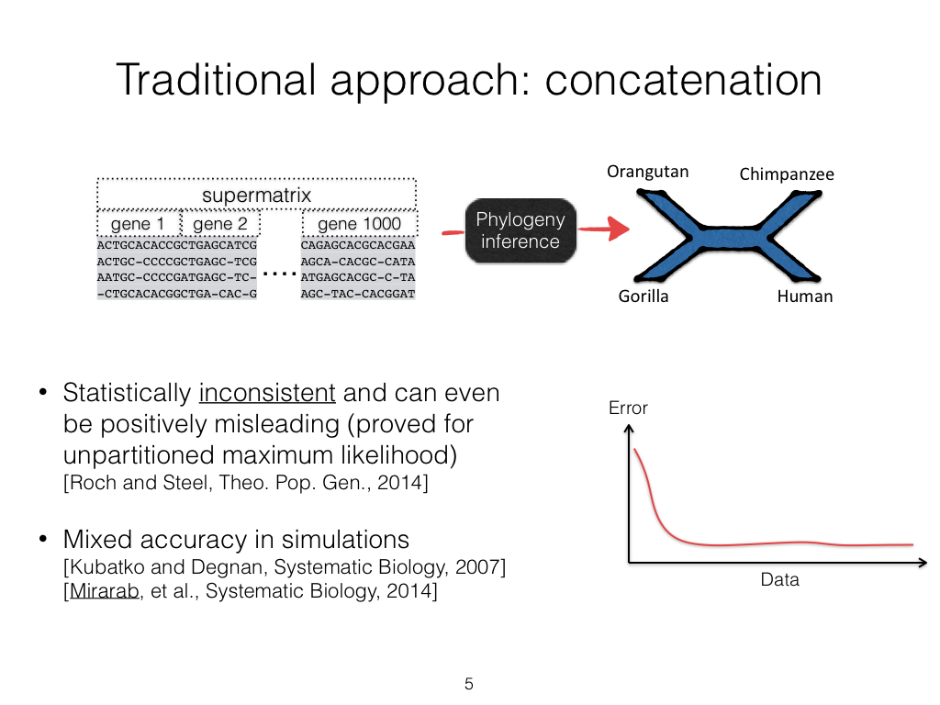

Slide 42

Main Approaches for Species Tree Estimation under ILS
gene 1 gene 2 … gene k
Species
e.g., RAxML
. . .
Concatenation
Analyze
separately
e.g., ASTRAL
. . .
Summary Method
Notes:
point out that supertree methods take overlaping trees and produce a tree, and that the whole process of first generating small trees and then applying a supertree method is often referred to as the “supertree approach”.

Slide 43
Divide-and-Conquer using Disjoint Tree Mergers
Note: use most accurate method on subsets, and treat as absolute constraints
Decompose species set into pairwise disjoint subsets.
Erin Molloy,
Introduced this
approach
Full
species
set
Theorem:
If the subtree method is statistically consistent, then many DTM methods are statistically consistent.
Build a tree on each
subset
Auxiliary
Info
(e.g., distance
matrix)
Tree
on full
species set
Compute tree on entire set of species using “Disjoint Tree Merger” method

Slide 44
Disjoint Tree Mergers for Species Tree Estimation
Note: use most accurate method on subsets, and treat as absolute constraints
Decompose species set into pairwise disjoint subsets.
Erin Molloy,
Introduced this
approach
Full
species
set
Use ASTRAL or Concatenation for subtree construction!
Combine with DTM method.
Build a tree on each
subset
Auxiliary
Info
(e.g., distance
matrix)
Tree
on full
species set
Compute tree on entire set of species using “Disjoint Tree Merger” method

Slide 45
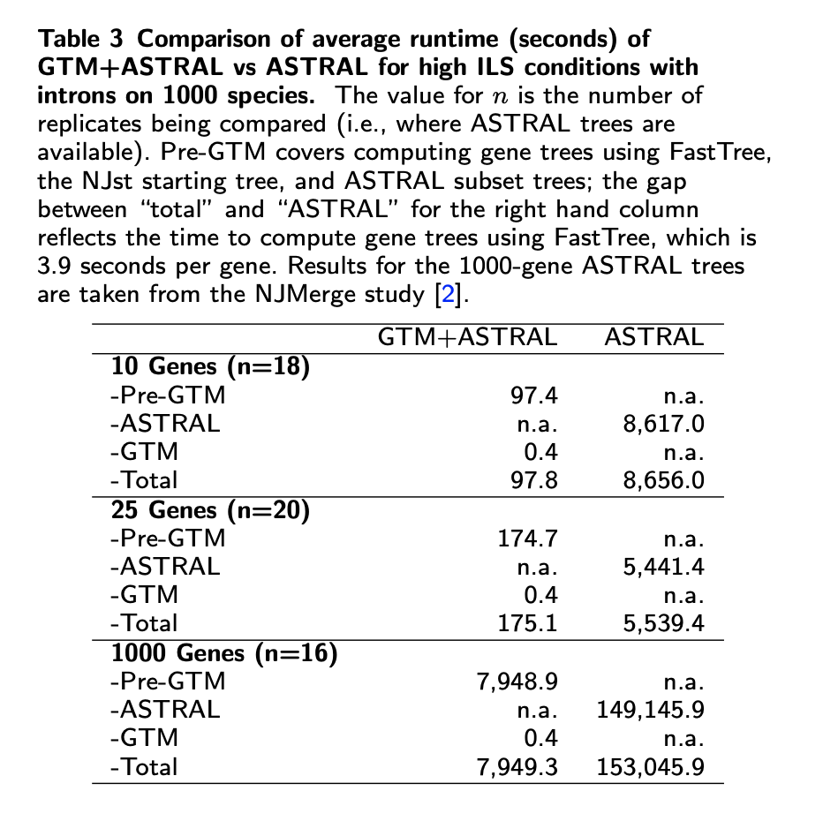
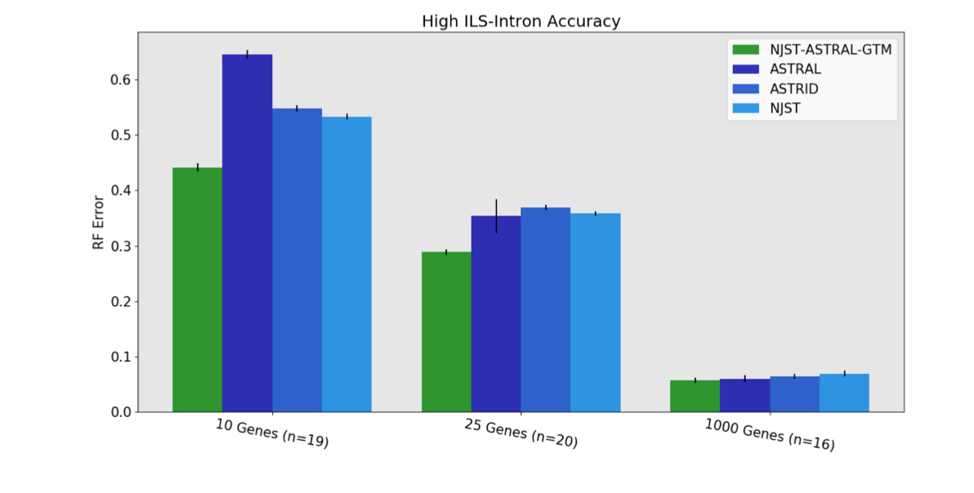
GTM+ASTRAL: faster and more accurate than ASTRAL

Slide 46
Summary and open problem
Great progress in large-scale phylogeny estimation (both for gene trees and species trees)
“Disjoint tree mergers” (DTMs) are generic methods, that can be used with any phylogeny estimation method (for any kind of data).
  DTMs enable scalability to large datasets.
  DTMs improve Maximum Likelihood gene tree estimation as well as ASTRAL (species tree estimation).
  GTM is the current leading DTM technique, based on empirical performance. However, because it does NOT allow blending, it is unlikely GTM is the best that can be done.
Open problem: Develop a better DTM approach that allows blending.

Slide 47
Overall summary
Large-scale phylogenetic tree estimation is becoming truly feasible!
  Large numbers of sequences no longer a major impediment
  Heterogeneity across the genome presents challenges, but methods are being developed that address biological heterogeneity
Not discussed here (and still needs work):
  Phylogenetic networks
  Genome rearrangement phylogeny
  Multiple whole genome alignment

Slide 48

Acknowledgments
Papers available at http://tandy.cs.illinois.edu/papers.html
Presentations available at http://tandy.cs.illinois.edu/talks.html
Software on github, links at http://tandy.cs.illinois.edu/software.html
Funding: NSF (CCF 1535977, ABI-1458652, 2006069, Graduate Fellowship to Erin Molloy), the Grainger Foundation, the Ira and Debra Cohen Fellowship to Vlad Smirnov, and Sandia National Laboratories-Livermore (LDRD)
Supercomputers: Blue Waters and Campus Cluster, both supported by NCSA
Write to me: warnow@Illinois.edu

Slide 49
ASTRAL runs in O(|X|²kn) where there are n species and k genes, and X is the set of allowed bipartitions

Slide 50
Part III: Maximum Likelihood Phylogenetic Placement
Problem: Adding aligned sequences into a tree optimizing likelihood
Applications:
  Updating large trees
  Taxonomic identification of reads in metagenomics and microbiome analysis
  A step in building a large tree (e.g., when some sequences are very short)

Slide 51
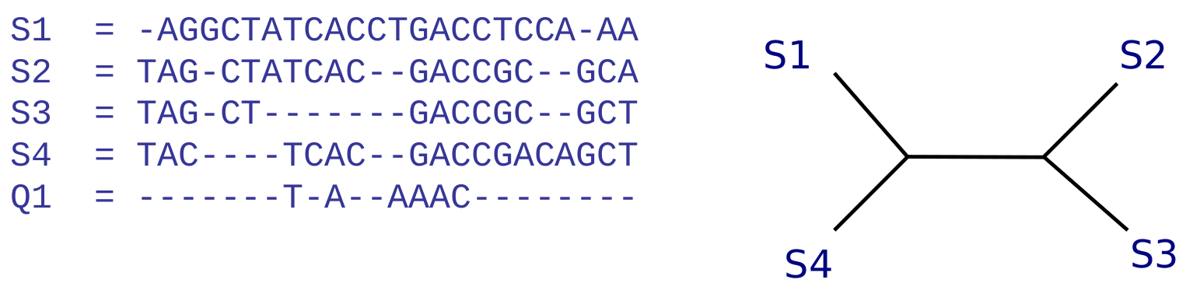
Phylogenetic Placement
Phylogenetic placement problem: Given a query sequence and multiple sequence alignment, determine the placement into an existing reference tree.
Notes:
So what is phylogenetic placement?
Phylogenetic placement methods take as input: a set of aligned reference sequences, and a backbone, or reference tree on those aligned sequences, that has been precomputed, and the phylogenetic placement method seeks to insert one or more aligned query sequences into that precomputed tree. So here this assumes that an alignment has already been computed on both the reference and query sequences.

Slide 52
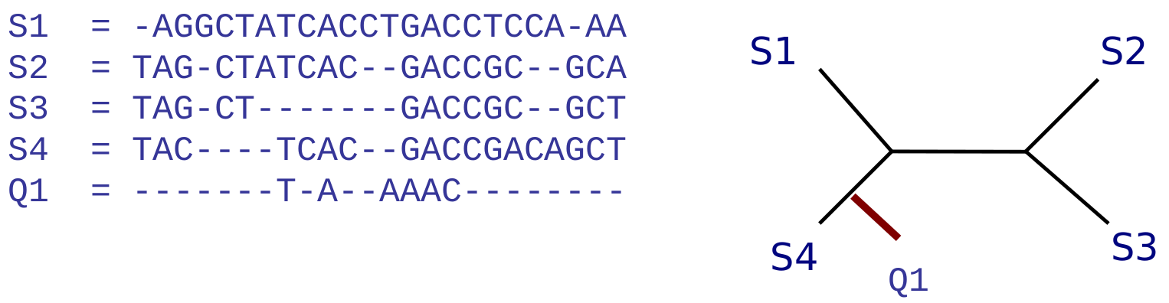
Phylogenetic Placement
Phylogenetic placement problem: Given a query sequence and multiple sequence alignment, determine the placement into an existing reference tree.
Notes:
It returns branches for insertion along with a confidence level and a distal length along which the new node would be placed, as well as a branch length for the new edge.

Slide 53
Maximum likelihood phylogenetic placement
Input:
  Multiple sequence alignment on set S of “backbone sequences”,
  Set Q of query sequences
  Tree T containing sequences in S at the leaves
  “model” (e.g., Jukes-Cantor or GTR)
Output:
  Placement of each query sequence into T to optimize likelihood (in default mode, the query sequences are placed independently)

Slide 54
Existing Methods for Phylogenetic Placement
Maximum likelihood methods (expensive to run):
pplacer (Matsen et al., 2010) is currently the most accurate method, but fails on moderately large trees (e.g., some with 4000 leaves)
EPA-ng (Barbera et al., 2019), designed for speed with large numbers of query sequnces, but can fail on large trees (with 10,000 or more leaves)
Distance-based methods:
APPLES-2 (Balaban et al., 2021), one of the only methods that can place onto large backbone trees (200K sequences)
Parsimony: e.g., UShER, not as well-studied
Alignment-free: not as accurate as pplacer/EPA-ng
Notes:
Existing methods that I will be looking at fall into two categoies

Slide 55
SCAMPP Framework (Wedell et al., TCBB 2022)
Used with selected phylogenetic placement method (e.g., pplacer or EPA-ng)
Input: Backbone tree with branch lengths, alignment and aligned query sequences, and a subtree size.
For each query sequence, independently:
Stage 1- Extract placement subtree of 2000 leaves from backbone tree
Stage 2 - Use PP method to find edge in placement subtree and location and distal length along placement edge.
Stage 3 - Find edge in backbone tree using branch lengths.

Slide 56
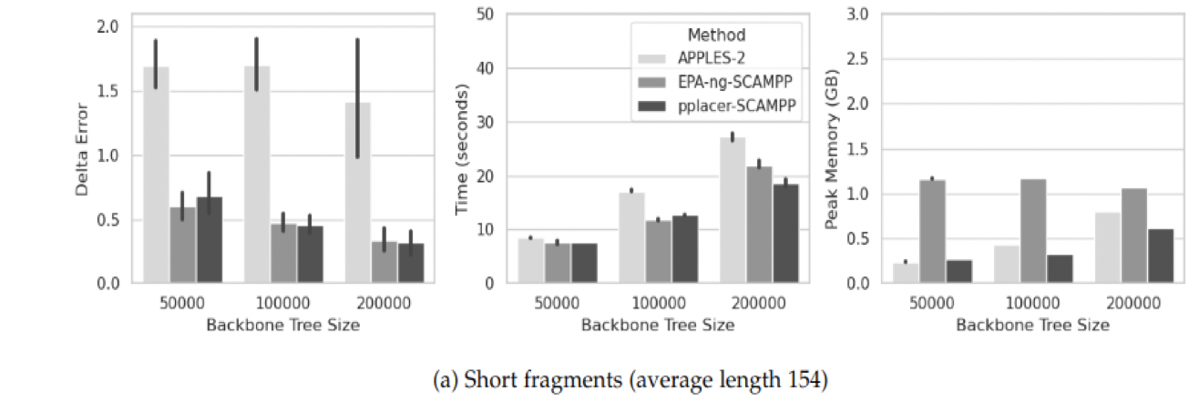
Placing short sequences: SCAMPP accuracy, scalability, and speed
APPLES-2 has high error when placing fragmentary sequences
SCAMPP enables maximum likelihood methods to place into very large trees (200K sequences)
Runtime (per sequence!) and memory usage increases with backbone tree size
Delta-error decreases with the backbone tree size: beneficial impact of increased taxon sampling!

Slide 57
BATCH-SCAMPP (Wedell et al., WABI 2023)
Used with EPA-ng (which has sub-linear runtime in # query sequences)
Input: Backbone tree with branch lengths, alignment and aligned query sequences, and a subtree size.
Modified SCAMPP technique, because we need many query sequences for each selected placement subtree.
So the query sequences vote for subtrees, and then subtrees with many votes get the relevant query sequences.
Afterwards, placement is as in SCAMPP.

Slide 58
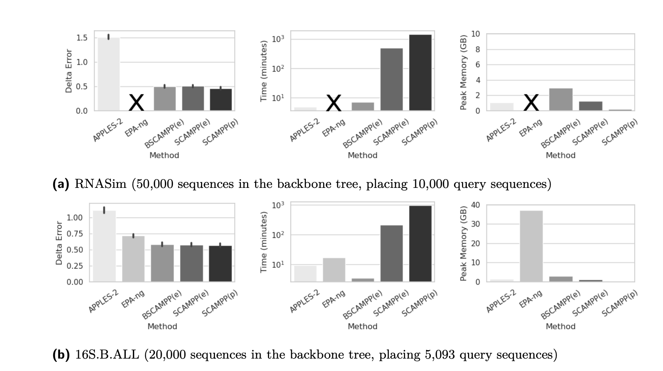
Batch-SCAMPP (WABI 2023) : Placing many short sequences
RNASim: simulated dataset
16S.B.ALL: biological dataset
BATCH-SCAMPP (2023) improves in runtime over SCAMPP.
APPLES-2 is very fast but has much higher placement error than Batch-SCAMPP(EPA-ng)
EPA-ng (and pplacer) fail to run on the large backbone tree

