Slide 1
Resolution Limit
CS 598: Computational Scientometrics
August 31, 2022
Tandy Warnow

Slide 2
Assigned papers
https://www.pnas.org/doi/full/10.1073/pnas.0605965104. Fortunato & Barthélemy, PNAS 2007, “Resolution limit in community detection”
Henceforth, I’ll refer to this as “F&B”

Slide 3
Modularity optimization
Modularity optimization seeks a partition of the vertices into disjoint sets (i.e., clusters) so that the sum of the “modularity” scores of each cluster is maximized
Any cluster/module with positive modularity is considered “actual” (equivalently, real, valid, etc.)
F&B (Fortunato and Barthélemy) proved that optimizing modularity has a resolution limit – modules below a threshold will not be found.
See https://en.wikipedia.org/wiki/Modularity_(networks) for additional references.

Slide 4
Modularity optimization
Partition the graph vertices into m disjoint sets, so as to maximize the sum of the modularity scores per cluster
Assume the clustering has m clusters:
L = total number of edges in network
l_{s} = number of edges in cluster s
d_{s} = total degree of nodes in cluster s (including edges that leave cluster)

Slide 5
F&B discussion
Page 1: “The first term of the summand in Eq. 1 is the fraction of links inside module s; the second term, in contrast, represents the expected fraction of links in that module, if links were located at random in the network (under the only constraint that the degree sequence coincides with the one of the original graph).”

Slide 6
F&B discussion
Page 2: (Paraphrasing) “We conclude that, in a modularity-based framework, a subgraph …is a module if <its modularity score is positive>”

Slide 7
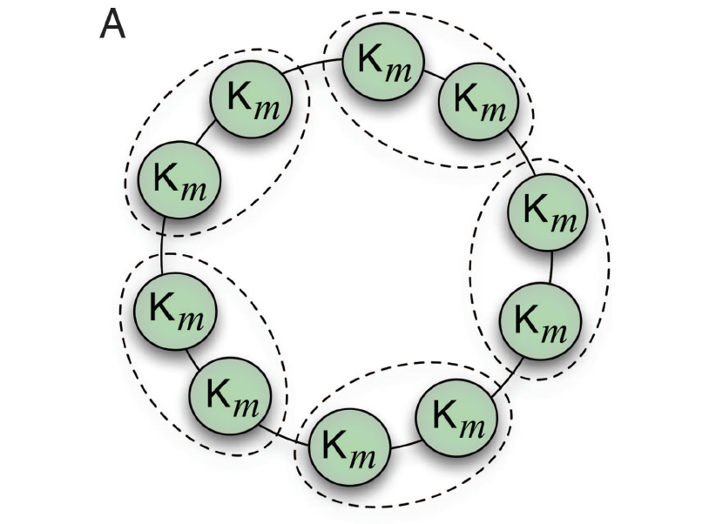
Fortunato & Barthélemy
Basic observation is that Modularity Optimization is subject to a resolution limit (will not find small “actual modules”)
For them, “actual” simply means positive modularity score
Figure 3(A) from Fortunato & Barthélemy

Slide 8
Modularity score
L = total number of edges in network
l_{s} = number of edges in cluster s
d_{s} = total degree of nodes in cluster s (including edges that leave cluster)
Warm-up for calculating modularity scores of single clusters (i.e., calculating modularity(C)).
Assume all networks have at least one edge, so L > 0.
What is the modularity score of a cluster containing a single isolated node in the network?
What is the modularity score of a cluster that has no internal edges?
Assuming that the network has more than one non-trivial component (at least one edge), what is the modularity score of a connected component in the network?
What is the modularity score of the cluster containing the entire network?
Suppose a network N has at least two non-trivial components and then many isolated vertices.
What is the modularity score of the cluster containing all the isolated vertices?
Suppose C is a cluster, and you add some isolated vertices to get C’; what can you say about modularity(C) vs modularity(C’)?

Slide 9
Modularity score
L = total number of edges in network
l_{s} = number of edges in cluster s
d_{s} = total degree of nodes in cluster s (including edges that leave cluster)
Test cases:
Network has two disjoint cliques (K_{n} and K_{m}) that have no edges between them.
For each clique, what is the modularity score?
Network has same two disjoint cliques with an edge between them.
For each clique, what is the modularity score?
Network is just K_{n} (with n>3).
What is the modularity score of a K₃ inside the network?
Network is complete bipartite graph K_{n,m,} and n<m.
What is the modularity score of the LHS? The RHS?
Can you find any cluster with positive modularity?

Slide 10
Modularity score
L = total number of edges in network
l_{s} = number of edges in cluster s
d_{s} = total degree of nodes in cluster s (including edges that leave cluster)
Test cases: For each network and each suggested clustering, calculate the modularity score.
Network has two disjoint cliques (K_{n} and K_{m}), n<m, that have no edges between them.
Clustering: the two cliques
Network has same two disjoint cliques with an edge between them.
Clustering: the two cliques
Network has same two disjoint cliques with all nodes in K_{n} adjacent to the same single node x in K_{m}.
Clustering: the two cliques
What if n>m?

Slide 11
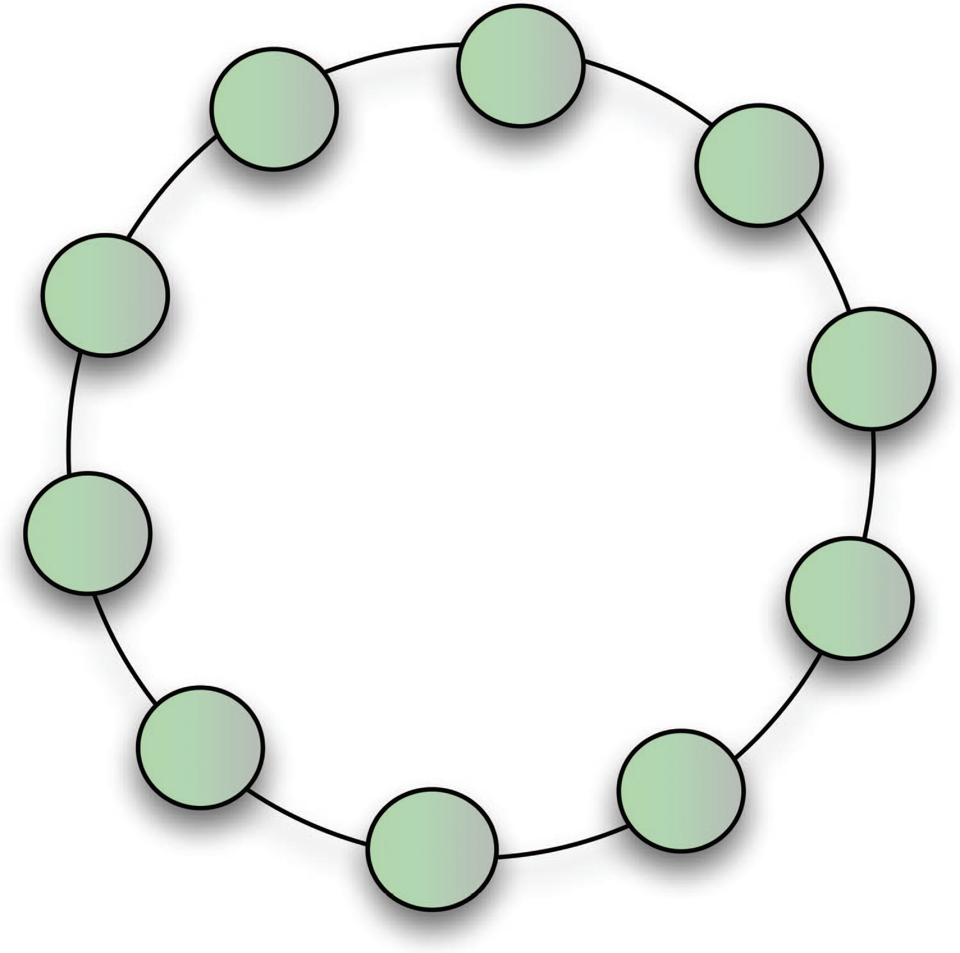
Back to F&B
Assumption (or assertion?): all clusters with positive modularity are ”modules”.
Figure 1 from R&B (on the right) is a ring of cliques, connected by edges.
Each clique has positive modularity.
A natural clustering should return each of these clusters.

Slide 12
Digging down into F&B analysis
They assume that the network N is connected, and is a ring of n>2 clusters, connected by single edges. All clusters are cliques K_{m} with m edges. Note: all these clusters have positive modularity.
They prove Q _{pairs} > Q _{single} when n > m(m-1)+2. This statement is equivalent to saying the clustering that merges adjacent pairs of cliques has modularity that is higher than the obvious (natural) clustering.
Put differently, they prove that clusters that are too small cannot be found in this network for large enough n.
Hence, an infinite set of networks, for which optimizing modularity will not return the natural clustering.

Slide 13
Experiment done by F&B

Slide 14
Closing paragraph in F&B
The fact that quality functions such as modularity can have an intrinsic resolution limit calls for a new theoretical framework that focuses on a local definition of community, rather than on definitions relying on a global null model.
Quality functions are still helpful, but their role should probably be limited to the comparison of partitions with the same number of modules.

Slide 15
Further comments (related to Scientometrics)
In Scientometrics, the main clustering method is the Leiden algorithm, optimized either for modularity or the Constant Potts model
Modularity was favored before the “resolution limit” issue was understood – tends to produce large clusters
Now Constant Potts model is default setting (not subject to resolution limit)

Slide 16
Summary from today
The ”resolution limit” is a theoretical problem (limit to how small a community can be found) but may provide insight into practice
In other words, if your clustering method produces large clusters and doesn’t find smaller clusters, perhaps it is has a resolution limit. Find out.
Consider developing new clustering optimization problems.

Slide 17
Starting 9/7: Distinguished Guest Speakers
Important: Read their papers (see webpage) before coming to the class and be prepared to ask questions.
For example, meet together (or use slack) to discuss their assigned papers.
9/7: Henry Small (Three papers: Shoulders of Giants, Co-citation, and Bayesian conformation)
9/12: Dan Gusfield (click on link for Dan Gusfield to get assigned papers)
9/14: Vincent Traag
9/19: Daniel Hook & Simon Porter
9/21: David Sepkoski
9/28: Kevin Boyack
10/3: Martina Iori
10/5: Srijan Sengupta

Slide 18
Henry Small (speaking Sept 7): papers to read
Co-citation in the scientific literature: A new measure of the relationship between two documents. https://asistdl.onlinelibrary.wiley.com/doi/10.1002/asi.4630240406
ASIS Award of Merit: On the Shoulders of Giants. https://asistdl.onlinelibrary.wiley.com/doi/pdf/10.1002/bult.112
The confirmation of scientific theories using Bayesian causal networks and citation sentiments. https://direct.mit.edu/qss/article/3/2/393/110636/The-confirmation-of-scientific-theories-using

