Slide 1


Computer Science @UIUC
Tandy Warnow, Associate Head for Research
The Grainger College of Engineering
November 2, 2022

Slide 2

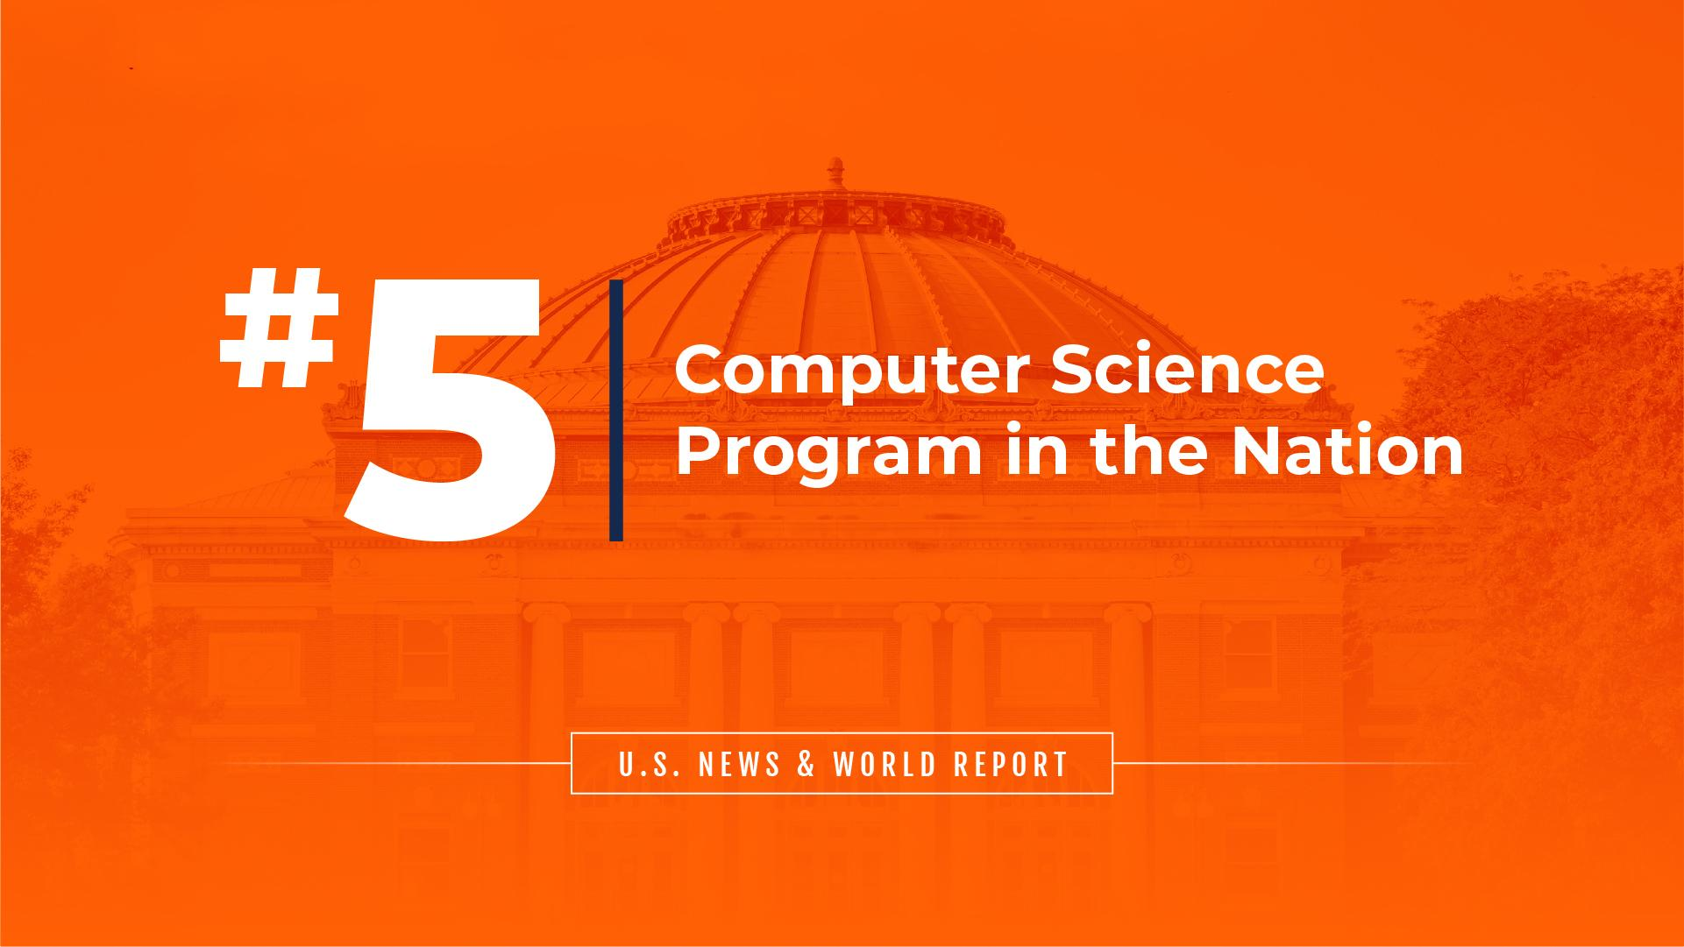
Illinois Computer Science Remains Top-Ranked in the Nation - Grad & Ugrad

Slide 3
National Collaborations

Slide 4
International Collaborations

Slide 5
Engagement with Research Centers
Center for Digital Agriculture
C3.ai Digital Transformation Institute
Genomics and Eco-evolution of Multi-Scale Symbioses
Center for Just Infrastructure
Center for Cognitive Computer Systems Research (C3SR) with IBM
Internet of Battlefield Things (IoBT)
Strategic Research Alliance Center on Computer Security with Intel
Center for Networked Intelligent Components and Environments (C-NICE) with Foxconn Internet Technology

Slide 6
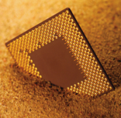


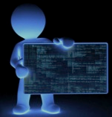
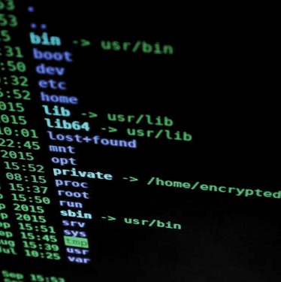


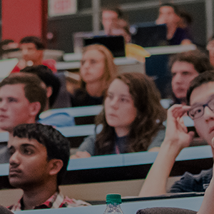




World-Leading Research
Illinois CS is a longstanding pioneer in disciplinary and multidisciplinary research with many legendary contributions that have fundamentally altered both computing and other disciplines
Architecture, Compilers, Parallel Comp
Bioinformatics &
Comp Biology
Data &
Info-Sci
Programming
Languages
Theory & Algorithms
Security & Privacy
Est. 2015
Est. 2019
16
11
12
18
17
19
29
19
9
10
17
AI
Computers & Education
Interactive Computing
Scientific
Computing
Systems &
Networking
Est. 2018
121
121 Core Faculty:
87 Tenure-Track
23 Teaching
11 Research
18 ACM Fellows
20 IEEE Fellows
47 NSF CAREERS
64
64 Affiliate faculty from 9 colleges across campus
#
Core CS faculty doing research in each area
COMPUTER SCIENCE
GRAINGER ENGINEERING
Notes:
I updated this as best I could – Amy is checking the faculty numbers - Michelle
Amy updated.

Slide 7

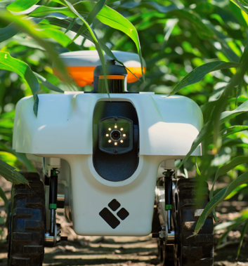
NSF Research AI Institutes: Two at Illinois
CS faculty have major roles in both
AIFARMS - AI Institute for Future Agriculture Resilience, Management, and Sustainability
Molecule Maker Lab – AI Institute for Molecular Discovery, Synthetic Strategy, and Manufacturing

Slide 8
Research Areas
Highlights of AI, DAIS, and S&P
with suggested contacts
In the following slides
Architecture, Compilers, and Parallel Computing
Artificial Intelligence
Bioinformatics and Computational Biology
Computers and Education
Data and Information Systems (DAIS)
Interactive Computing
Programming Languages, Formal Methods, and Software Engineering
Scientific Computing
Security and Privacy (S&P)
Systems and Networking
Theory and Algorithms

Slide 9
Artificial Intelligence (29 faculty)
Lana Lazebnik
Area Chair
UIUC lead on 2 NSF AI Research Institutes
Main Topics:
Theoretical foundations of machine learning (deep learning, reinforcement learning, etc.)
Computer vision
Natural language processing (including text mining)
Machine listening
Robotics
Security and Privacy
Applications: biology, agriculture, chemistry, education
Nancy Amato:
Robotics
Bo Li
Trustworthy ML
Paris Smaragdis:
Machine Listening
David Forsyth:
Computer Vision

Slide 10
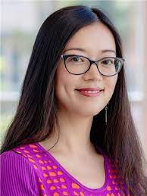
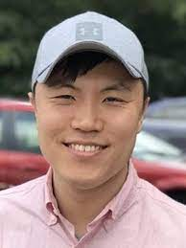
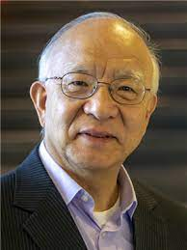
Data and Information Systems (12 faculty)
ChengXiang Zhai
Area Chair
Highlights:
Mining structures from massive unstructured text data
Heterogeneous information networks
Systems for large-scale analytics
Information retrieval
Graph and network algorithms (proximity, connectivity, clustering)
Community detection (especially small, emerging communities) in large networks
Heng Ji
IR, NLP
Yongjoo Park
Systems aspects
Jiawei Han
Data Mining
George Chacko
Community Detection

Slide 11
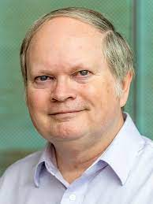
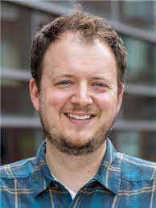
Security & Privacy (17 faculty)
Note: Information Trust Institute (security research related to electric power grid)
Sample Topics:
Defenses against microarchitectural attacks
Detecting intrusions into computer networks
Privacy issues in IoT, medical records
Cryptography, Blockchain
Carl Gunter
Area Chair
Dakshita Khurana
Cryptography
Adam Bates
Network Security
Chris Fletcher,
Hardware Security, Applied Crypto

Slide 12
Computer Science at the University of Illinois
Access
and Inclusion
Educational
Innovation
World-Leading
Research
COMPUTER SCIENCE
GRAINGER ENGINEERING

