Slide 1
Building and Growing Large Phylogenies
Tandy Warnow

Slide 2
Building vs growing
Building: Given unaligned sequences, compute the alignment and the tree.
Growing: Given an alignment and a tree, but also some new sequences

Slide 3
Building a large alignment and tree
Building: Given unaligned sequences, compute the alignment and the tree.
Simultaneously (e.g., BAli-Phy, SATé, PASTA, MAGUS)
First align, then compute the tree
MSA: there are many MSA methods (but only some handle large datasets and sequence length heterogeneity)
Tree estimation: standard ML (RAxML, IQ-TREE, FastTree) and some new approaches
The “building” part of this talk could cover:
Getting large alignments quickly and accurately (e.g., PASTA, UPP/WITCH)
Trying to improve on RAxML (some success)

Slide 4
Growing an alignment and tree
Growing: Given an alignment and a tree, but also new sequences:
Adding sequences into alignments:
MAFFT has techniques (--add)
UPP, WITCH: based on ensembles of Hidden Markov Models
Adding aligned sequences into trees: phylogenetic placement
This “growing” part of this talk will focus on phylogenetic placement methods (pplacer, EPA-ng, APPLES, APPLES-2, and our new method, SCAMPP)

Slide 5
Phylogenetic placement

Slide 6
Phylogenetic Placement
Phylogenetic placement problem: Given a query sequence and multiple sequence alignment, determine the placement into an existing reference tree.
Notes:
So what is phylogenetic placement?
Phylogenetic placement methods take as input: a set of aligned reference sequences, and a backbone, or reference tree on those aligned sequences, that has been precomputed, and the phylogenetic placement method seeks to insert one or more aligned query sequences into that precomputed tree. So here this assumes that an alignment has already been computed on both the reference and query sequences.

Slide 7
Phylogenetic Placement
Phylogenetic placement problem: Given a query sequence and multiple sequence alignment, determine the placement into an existing reference tree.
Notes:
It returns branches for insertion along with a confidence level and a distal length along which the new node would be placed, as well as a branch length for the new edge.

Slide 8
Background
Applications of phylogenetic placement:
Updating a tree with a new sequence, without recomputing the tree
Metagenomics
Taxon Identification
Abundance Profiling
Notes:
So the example that we have seen so far is an instance or the FIRST application shown here, or updating a precomputed tree with a new seuqecne but actually
A lot of these tools for phylogenetic placement were developed with metagenomics in mind.
Typically sequences would be read length and inserted independently.
So say you have many reads of unknown samples, you can use phylogenetic placement toindepenently place each read in your list into a taxonomy in order to perform taxon identification, or abundance profiling, and based on where they appear in the rooted taxonomy, gain information about the species family, genus etc.
This is particularly usefu when analyzing environmental samples, and determining the species of bacteria, virus, etc whatever microbs are present in the sample
Helps with understanding microbial diversity e.g. soil, water, gut..

Slide 9
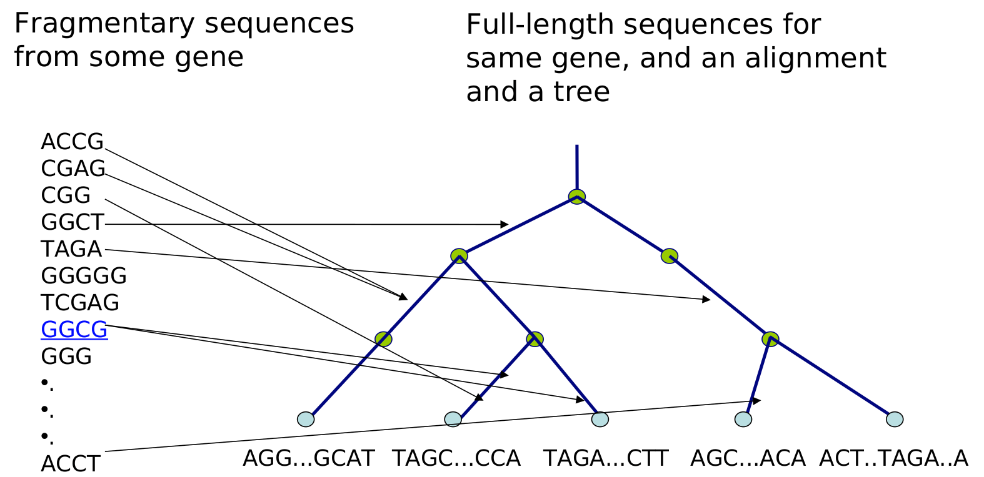
Placement into a taxonomy of full-length sequences
Metagenomics: lots of reads inserted independently
Notes:
So here is an example of phylogenetic placement as used in metagenomic applications
First step before phylogenetic placement would be to align, 2nd is placement with phylogenetic placement,
Reads that appear farther up in the tree will correspond to the different levels of information about the taxonomic information.
So it becomes more clear in this application of placement into a taxonomy, why it might be beneficial to be able to place into larger trees, as the number of identified bacteria and viruses grow

Slide 10
Existing Methods for Phylogenetic Placement
Maximum likelihood methods (expensive to run):
pplacer (Matsen et al., 2010) is currently the most accurate method, but is limited to backbone trees of under 3000 sequences with 64 GB memory.
EPA-ng (Barbera et al., 2019) can place onto trees of up to 10,000 taxa with 64GB memory.
Distance-based methods:
APPLES (Balaban et al., 2019) and APPLES-2 (Balaban et al., 2021). Prior to this study these were the only methods available which can place onto large backbone trees of over 50,000 sequences.
Notes:
Existing methods that I will be looking at fall into two categoies

Slide 11
This talk
SCAMPP: Divide-and-conquer framework to scale phylogenetic placement methods to large datasets (Wedell, Cai, and Warnow, TCBB 2022)
SCAMPP works well with pplacer and EPA-ng
Ongoing work (not yet submitted) is improving this further

Slide 12
SCAMPP Framework
Used with specified phylogenetic placement method (we will show use with pplacer)
Input: Backbone tree with branch lengths, alignment and aligned query sequences, and a subtree size.
Stage 1- Extract placement subtree from backbone tree (pplacer limited to 2000 sequences)
Stage 2 - Use pplacer to find edge in placement subtree and location and distal length along placement edge.
Stage 3 - Find edge in backbone tree using branch lengths.

Slide 13
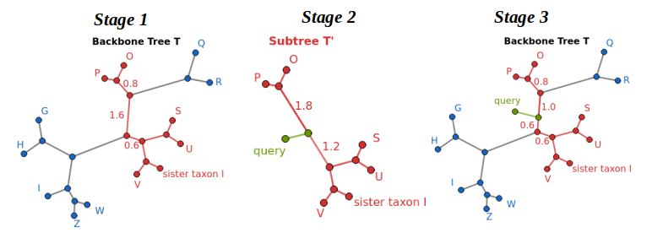
Algorithm Stages
Stage 1 → Extract the subtree T’ containing taxa with smallest total distance to the sister taxon (taxon with smallest Hamming distance to query).
Subtree T’ (in red) with n leaves minimizes the sum of the pairwise distances (based on edge lengths) of sister taxon l to each subtree leaf l_{i} for i in 1...n.
Closest Hamming distance to the query sequence

Slide 14
Algorithm Stages
Stage 1 → Extract the subtree T’ containing taxa with smallest total distance to the sister taxon (taxon with smallest Hamming distance to query).
Stage 2 → Use a phylogenetic placement method on T’ (with branch lengths maintained from the full tree) to obtain query placement within T’.
Query sequence placement (in green) in subtree T’

Slide 15
Algorithm Stages
Stage 1 → Extract the subtree T’ containing taxa with smallest total distance to the sister taxon (taxon with smallest Hamming distance to query).
Stage 2 → Use a phylogenetic placement method on T’ (with branch lengths maintained from the full tree) to obtain query placement within T’.
Stage 3 → Find a path containing the target edge between two leaves in T’ and place the query at the same distance along the corresponding path in full tree T.

Slide 16
Evaluation Procedure
Used a leave-one-out strategy on varying backbone tree sizes.
Datasets of up to 200,000 sequences from APPLES paper (Systematic Biology, largest backbone trees they looked at)
All placement methods were run on the UIUC campus cluster given 64 GB of memory and 4 hours to complete.
Delta Error - Standard measure of error used in other papers, shows the increase in topological error due to phylogenetic placement.

Slide 17
Three experiments
Experiment 1: Pick subtree size for SCAMPP
Experiment 2: Compare SCAMPP-pplacer and SCAMPP-EPA-ng to other methods when placing full-length sequences
Experiment 3: Compare SCAMPP-pplacer and SCAMP-EPA-ng to other methods when placing short and very short sequences

Slide 18
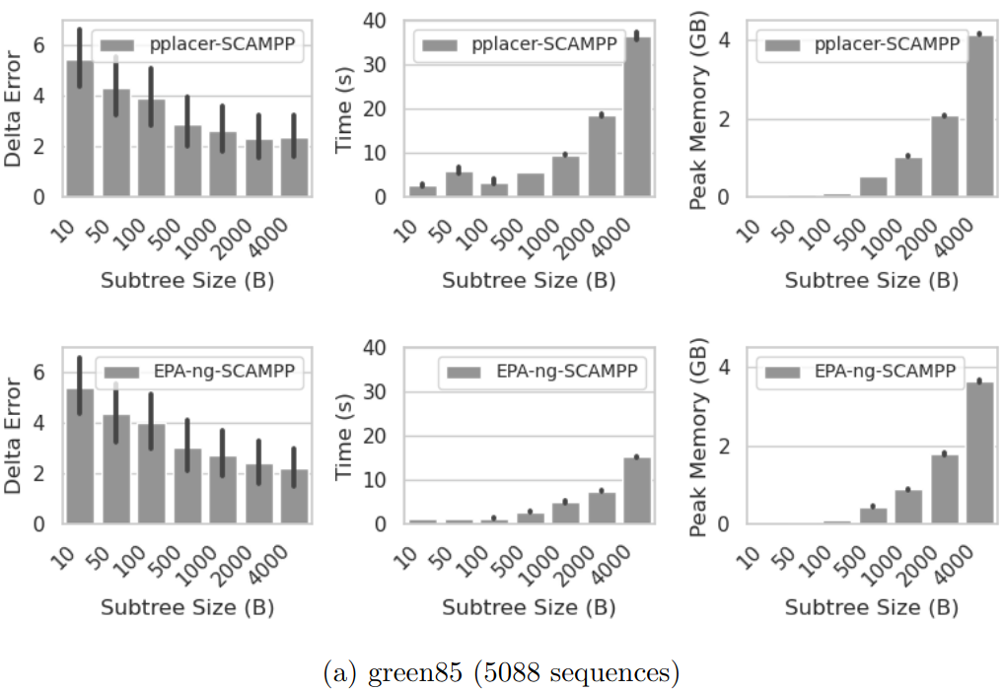
Experiment 1: Choosing a Subtree Size
Tested on a biological datasets from PEWO.
Subtree Size of 2000 for either method shows a reasonable tradeoff between accuracy and runtime/peak memory usage

Slide 19
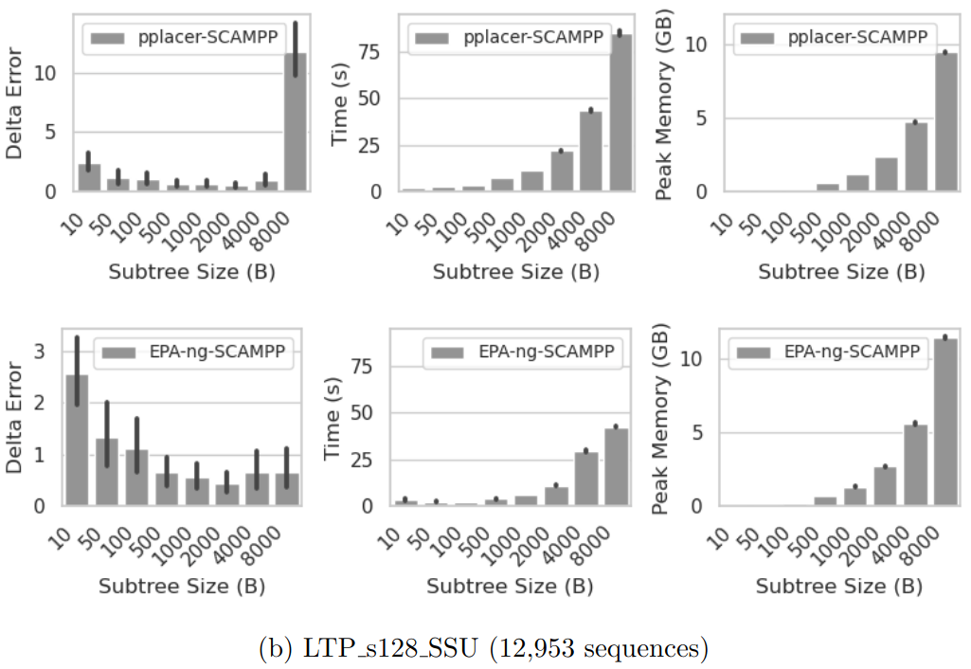
Experiment 1: Choosing a Subtree Size
Tested on another biological dataset from PEWO.
Again – Subtree Size of 2000 for either method shows a reasonable tradeoff between accuracy and runtime/peak memory usage

Slide 20
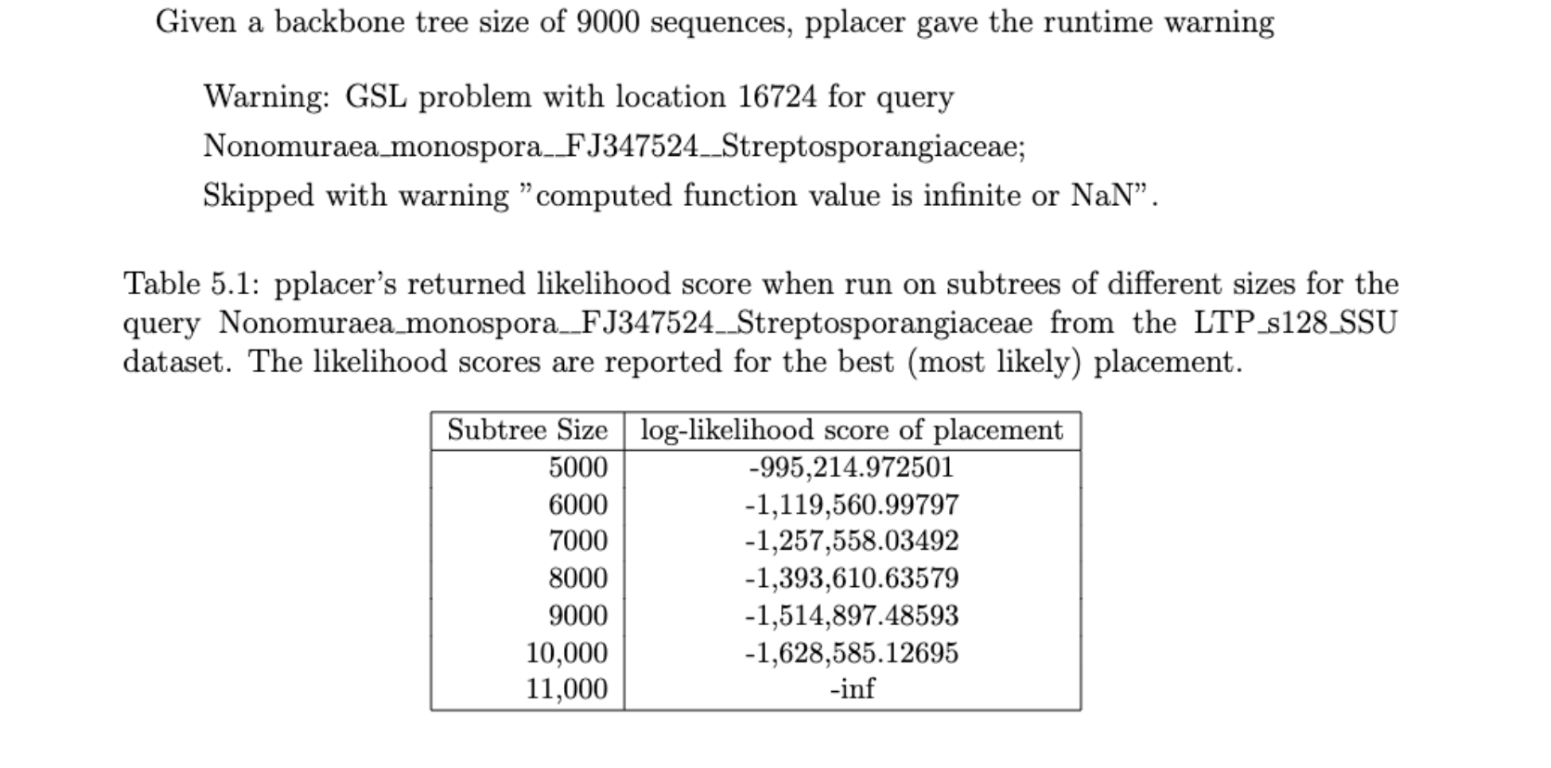
Numerical issues (?) for pplacer

Slide 21
Experiment 1: Subtree Size Choice
This is parameterized and is up to the user, but the defaults are set for our experiments and may be impacting our results:
EPA-ng-SCAMPP - uses a subtree size of 2000
pplacer-SCAMPP - uses a subtree size of 2000

Slide 22
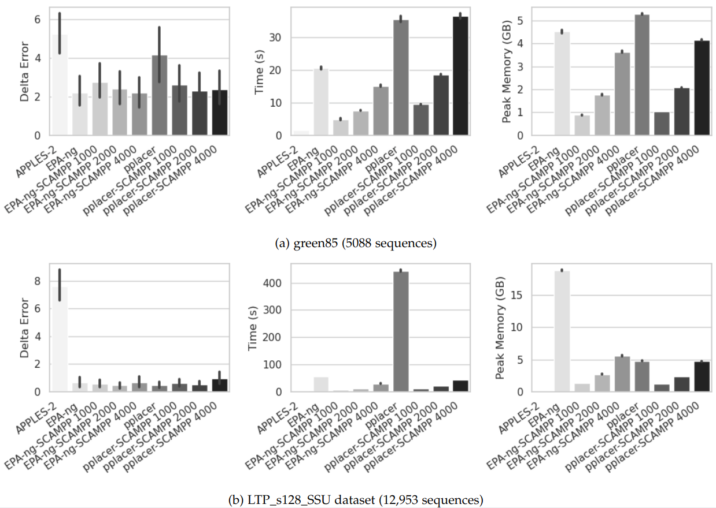
Experiment 2 - Evaluating Against Other Methods
EPA-ng-SCAMPP and pplacer-SCAMPP show lower runtime and memory usage.
EPA-ng-SCAMPP and pplacer-SCAMPP have similar delta error as EPA-ng and pplacer.

Slide 23
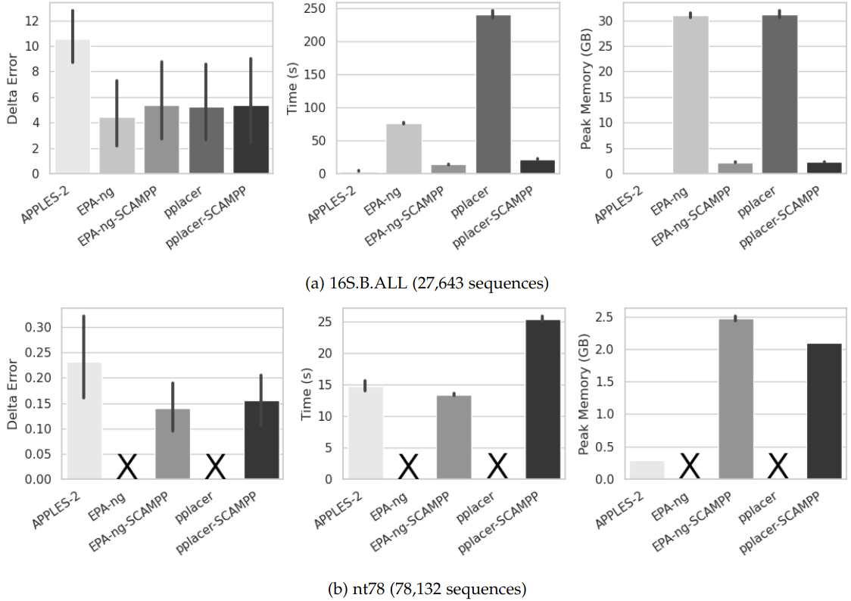
Experiment 2 - Evaluating Against Other Methods
EPA-ng-SCAMPP and pplacer-SCAMPP show lower runtime and memory usage.
EPA-ng-SCAMPP and pplacer-SCAMPP have similar delta error as EPA-ng and pplacer.
On the nt78 simulated dataset neither EPA-ng nor pplacer were able to run.

Slide 24
Experiment 3: Evaluating results on very short sequences (154 nt)

Slide 25
Experiment 3: Results when placing short sequences (385 nt)

Slide 26
Experiment 3: Results when placing full-length sequences (1620 nt)

Slide 27
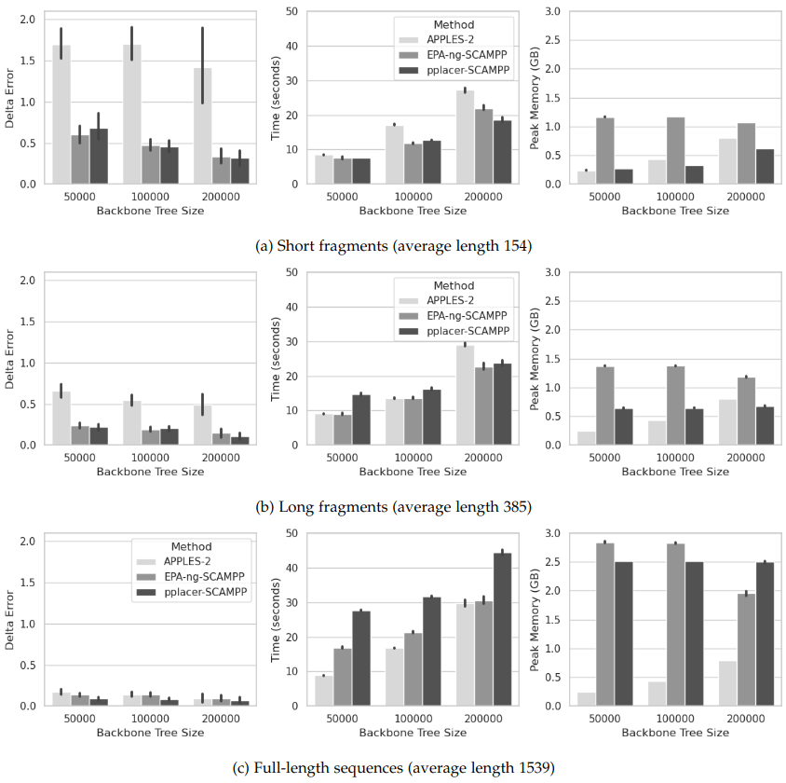
Experiment 3 – Larger Datasets and Fragmentary Sequences
More fragmentary sequences have higher delta error across all methods.
Runtime and memory usage increases with backbone tree size
No advantage of APPLES-2 over pplacer-SCAMPP for placing short sequences into large backbone trees
Delta-error decreases with the backbone tree size: beneficial impact of increased taxon sampling!

Slide 28
Experiment 3 – Larger Datasets and Fragmentary Sequences
More fragmentary sequences have higher delta error across all methods.
Runtime and memory usage increases with backbone tree size
No advantage of APPLES-2 over pplacer-SCAMPP for placing short sequences into large backbone trees
Delta-error decreases with the backbone tree size: beneficial impact of increased taxon sampling!

Slide 29
Experiment 3 – Larger Datasets and Fragmentary Sequences
More fragmentary sequences have higher delta error across all methods.
Runtime and memory usage increases with backbone tree size
No advantage of APPLES-2 over pplacer-SCAMPP for placing short sequences into large backbone trees
Delta-error decreases with the backbone tree size: beneficial impact of increased taxon sampling!

Slide 30
Experiment 3 – Larger Datasets and Fragmentary Sequences
More fragmentary sequences have higher delta error across all methods.
Runtime and memory usage increases with backbone tree size
No advantage of APPLES-2 over pplacer-SCAMPP for placing short sequences into large backbone trees
Delta-error decreases with the backbone tree size: beneficial impact of increased taxon sampling!

Slide 31
Summary
The SCAMPP Framework is a simple, but effective technique for scaling phylogenetic placement to large datasets.
We showed pplacer-SCAMPP and EPA-ng-SCAMPP both scaling to backbone trees of 200,000 sequences.
The most accurate placements were obtained using the largest backbone trees.
Our study shows maximum likelihood based placement gives better accuracy than distance-based placement and can work just as fast.

Slide 32
Practical consequences
Choice of placement method depends on
backbone tree size,
number and length of query sequences,
Relative importance of accuracy vs speed
If accuracy matters more, then try SCAMPP-pplacer
If runtime is important, then APPLES-2 or EPA-ng (if many query sequences), and possibly other methods

Slide 33
Acknowledgements
NSF grants 1458652 and 2006069.
Metin Balaban and Siavash Mirarab for help with APPLES and APPLES-2.
Questions? I can be reached at warnow@Illinois.edu
Notes:
Future work: All of our experiments were leave-one-out procedures, but since metagenomics is particularly focused on

