Slide 1
CS 173 August 28, 2018
Professor Tandy Warnow

Slide 2
Key Objectives
Teach you to do proofs by induction and by contradiction
Teach you to think inductively, and use this approach to design provably correct algorithms
Teach you think think logically
Teach you to communicate clearly without too much notation (e.g., to write good pseudo-code) about algorithms, and why they are correct
Teach you to recognize common graph-theoretic problems and use existing methods to solve real world problems
Teach you to design new algorithms using basic algorithm design techniques (e.g., dynamic programming)
Teach you to analyze running time and communicate this with Big-O notation

Slide 3
Why is this course difficult?
This course is a pre-requisite for CS 225 and CS 374, two classes that are difficult because of the requirement that you know how to *prove* things and write clearly using mathematical ideas and notation.
This course will prepare you well for these classes, so that you’ll be comfortable when you take them.
In addition, this course will help you prepare for being a strong programmer and also for getting into graduate school!
But don’t worry – all of us will help you do well in the course. And although the class is difficult, the grading policy is generous.

Slide 4
Grading
Participation in discussion section: 10 pts
Reading Quizzes: 10 pts
Homework: 20 pts (due Tuesdays at 10PM on Moodle, bottom homework dropped)
Midterms (October 11 and November 13, evenings): 40 pts
Final exam: 20 pts
Please note:
I will grade on a curve so that at least 25% of the class gets an A and at least 60% get B or better.
The last time I taught this course, 33% got A’s, 38% got B’s, so more than 70% got As or Bs, several received A+.
My goal is for everyone to do well. So if everyone deserves an A, then everyone will get an A!
The best way to do well in the class is to not fall behind!

Slide 5
Websites
http://tandy.cs.illinois.edu/cs173-warnow.html - this is the Course Webpage, for nearly everything
Piazza – really just for you
Moodle – for homework and reading quiz assignments and submissions.
Please look at the course webpage the day before class for the PDF/PPT of the upcoming lecture, announcements, and reading assignments.
Always check Moodle for homework and reading quiz assignment due dates.
Don’t use Piazza to get solutions to your homework (nor to post solutions).

Slide 6
Differences between Lectures A and B
Similarities:
We will both use cover much of the same material
We will both have homework submitted through Moodle
Differences:
Different textbooks
I will not cover number theory or state diagrams (B lecture may)
I will cover “trees” differently (as handled by Rosen)
I will give examples from computational biology to illustrate techniques and concepts
The B lecture will have in-class examlets, the A lecture will have two midterms (evenings)
The A lecture will have an honors section

Slide 7
Two-person games
Two players, A and B. A starts.
In the beginning there are two piles of stones, with K and L stones respectively.
During a turn, a player must take at least one stone – the choice is between one stone off of both piles, or one stone off of one of the two piles. The person who takes the last stone wins.
Who wins when
K = 1 and L = 1?
K = 2 and L = 1?
K = 3 and L = 3?
K = 4 and L = 16?
You can probably figure out a pattern here… but see if you can try to *prove* that you are right. (This is something you’ll learn how to do in this class.)
Spoiler: this can be solved using dynamic programming, and the proof of correctness uses induction

Slide 8
Another two-person game
Again two players, A and B. A begins. The starting position has two piles of stones, with K and L stones.
During a turn, the player can take 1 or 2 stones off in total, and these can be from the same pile, or from different piles.
Who wins
K=2 and L=1?
K=2 and L=2?
K=101 and L =47?
Figuring out who has a winning strategy is harder here, but still feasible. You’ll learn how to do this, and prove you are correct, in this class.
Spoiler: this can be solved using dynamic programming and the proof of correctness uses induction.

Slide 9
Something perhaps more realistic
Biologists often try to infer how evolution occurred.

Slide 10
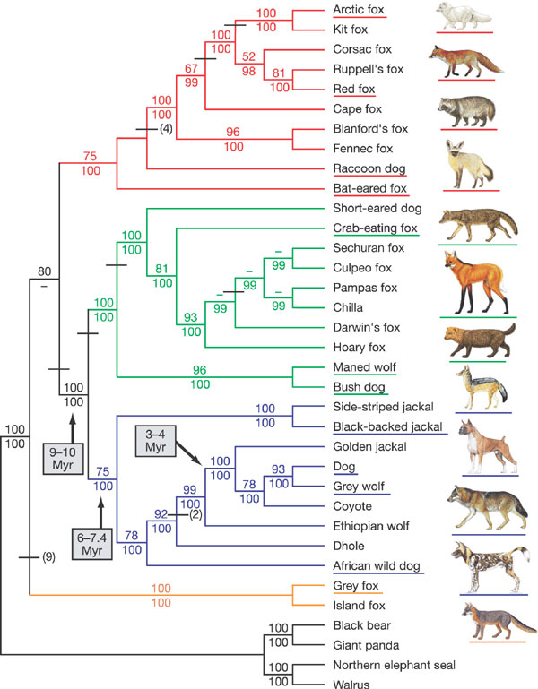
Lindblad-Toh et al., Nature 2005

Slide 11
Input: unaligned sequences
S1 = AGGCTATCACCTGACCTCCA
S2 = TAGCTATCACGACCGC
S3 = TAGCTGACCGC
S4 = TCACGACCGACA

Slide 12
Phase 1: Alignment
S1 = AGGCTATCACCTGACCTCCA
S2 = TAGCTATCACGACCGC
S3 = TAGCTGACCGC
S4 = TCACGACCGACA
S1 = -AGGCTATCACCTGACCTCCA
S2 = TAG-CTATCAC--GACCGC--
S3 = TAG-CT-------GACCGC--
S4 = -------TCAC--GACCGACA

Slide 13
Phase 2: Construct tree
S1 = AGGCTATCACCTGACCTCCA
S2 = TAGCTATCACGACCGC
S3 = TAGCTGACCGC
S4 = TCACGACCGACA
S1 = -AGGCTATCACCTGACCTCCA
S2 = TAG-CTATCAC--GACCGC--
S3 = TAG-CT-------GACCGC--
S4 = -------TCAC--GACCGACA
S1
S2
S4
S3

Slide 14
First Align, then Compute the Tree
S1 = AGGCTATCACCTGACCTCCA
S2 = TAGCTATCACGACCGC
S3 = TAGCTGACCGC
S4 = TCACGACCGACA
S1 = -AGGCTATCACCTGACCTCCA
S2 = TAG-CTATCAC--GACCGC--
S3 = TAG-CT-------GACCGC--
S4 = -------TCAC--GACCGACA
S1
S2
S4
S3

Slide 15
Multiple Sequence Alignment (MSA): another grand challenge¹
S1 = AGGCTATCACCTGACCTCCA
S2 = TAGCTATCACGACCGC
S3 = TAGCTGACCGC
…
Sn = TCACGACCGACA
S1 = -AGGCTATCACCTGACCTCCA
S2 = TAG-CTATCAC--GACCGC--
S3 = TAG-CT-------GACCGC--
…
Sn = -------TCAC--GACCGACA
Novel techniques needed for scalability and accuracy
NP-hard problems and large datasets
Current methods do not provide good accuracy
Few methods can analyze even moderately large datasets
Many important applications besides phylogenetic estimation
¹ Frontiers in Massive Data Analysis, National Academies Press, 2013

Slide 16
How did one DNA sequence evolve into another one?
X = ACATA
Y = TCAGAGG
Suppose every substitution, insertion, and deletion costs 1.
What is the minimum cost transformation?
Solution:
ACATA -> CACATA -> TCACATA -> TCAGATA -> TCAGAGA -> TCAGAGG
So the edit distance is 5 (3 substitutions and 2 insertions)

Slide 17
Pairwise Alignment of DNA Sequences
X = ACATA
Y = TCAGAGG
The minimum cost transformation is
ACATA -> CACATA -> TCACATA -> TCAGATA -> TCAGAGA -> TCAGAGG,
This corresponds to a pairwise alignment:
- - A C A T A
T C A G A G G
Note that the dashes indicate insertions or deletions.

Slide 18
Computing the Pairwise Alignment Between DNA Sequences
How do we find the best pairwise alignment (equivalently, the minimum edit distance) between an arbitrary pair of sequences?
Answer: Dynamic Programming!

Slide 19
How do biologists compute evolutionary trees?

Slide 20
Maximum Parsimony
Input: Set S of n aligned sequences of length k
Output:
A phylogenetic tree T leaf-labeled by sequences in S
additional sequences of length k labeling the internal nodes of T
such that
is minimized, where H(i,j) denotes the Hamming distance between sequences at nodes i and j

Slide 21
Maximum Parsimony
Input: Set S of n aligned sequences of length k
Output:
A phylogenetic tree T leaf-labeled by sequences in S
additional sequences of length k labeling the internal nodes of T
such that
is minimized, where H(i,j) denotes the Hamming distance between sequences at nodes i and j
Note: E(T) is a set, denoting
the edges of a tree.

Slide 22
Maximum parsimony (example)
Input: Four sequences
ACT
ACA
GTT
GTA
Question: which of the three trees has the best MP scores?

Slide 23
Maximum Parsimony
ACT
GTA
ACA
ACT
GTT
ACA
GTT
GTA
ACA
GTA
ACT
GTT

Slide 24
Maximum Parsimony
ACT
GTA
ACA
ACT
2
GTT
GTA
ACA
ACA
1
1
2
GTT
3
2
GTT
ACA
GTA
MP score = 5
MP score = 6
ACA
GTA
ACA
GTA
1
2
1
ACT
GTT
MP score = 4
Optimal MP tree

Slide 25
MP: computational complexity
For four leaves, we can do this by inspection
ACA
GTA
ACA
GTA
1
2
1
ACT
GTT
MP score = 4

Slide 26
But finding the best tree is NP-hard!
Optimal labeling can be computed in polynomial time!
ACA
GTA
ACA
GTA
1
2
1
ACT
GTT
MP score = 4

Slide 27
NP-hardness and Algorithms
Finding the best possible parsimony score of a given tree T (with leaves labelled by DNA sequences) can be computed in polynomial time using an algorithmic technique called “Dynamic Programming”. You will learn how to design dynamic programming algorithms in this course.
But finding the best possible tree for the sequences is NP-hard. You will learn what that means, and how to design methods that address NP-hard problems.

Slide 28
Solving NP-hard problems exactly is … unlikely
#leaves | #trees
4 | 3
5 | 15
6 | 105
7 | 945
8 | 10395
9 | 135135
10 | 2027025
20 | 2.2 x 10²⁰
100 | 4.5 x 10¹⁹⁰
1000 | 2.7 x 10²⁹⁰⁰
Number of (unrooted) binary trees on n leaves is (2n-5)!!
If each tree on 1000 taxa could be analyzed in 0.001 seconds, we would find the best tree in
2890 millennia

Slide 29
Approaches for “solving” MP
Hill-climbing heuristics (which can get stuck in local optima)
Randomized algorithms for getting out of local optima
Approximation algorithms for MP (based upon Steiner Tree approximation algorithms).
Local optimum
Cost
Global optimum
Phylogenetic trees

Slide 30
Logic Problem
Suppose that in the village of LALA, everyone is either a truth teller (and always tells the truth) or a liar (and so always lies).
You meet two LALA villagers -- Henry and Allen.
Henry says “Allen is a truth teller”
Allen says “Only one of us is a truth teller”
Is either a truth teller? If so, who?

Slide 31
Two more problems
Suppose A is a finite set of integers, and satisfies:
Whenever x is an element of A, then 2x is an element of A
What is A?
Suppose B is a set of integers and satisfies:
Whenever x is an element of B, then x+1 is an element of B.
Can B be finite?

Slide 32
Concepts (so far)
Two-person games
Sets
Trees (a special kind of graph)
Running time – and “Big-O” notation
NP-hardness
Dynamic programming
Proofs by induction
Recursive definitions
Computational biology problems
Logic problems

Slide 33
Other
My office hours are Tuesdays, 11 AM-12 PM, in Siebel 3235 (starting today).
If you are interested in doing research with me, please come see me. I have NSF funding for undergraduate research for qualified students.

Slide 34
Upcoming Assignments
Reading Assignments: see course webpage http://tandy.cs.illinois.edu/cs173A-2018-lectures.html
Homework assignments and Reading Quizzes must be submitted on Moodle, and start next week. Check Moodle for the assignments and their deadlines. (Submitting early and then resubmitting is fine – but don’t miss the deadline.)
If you aren’t yet registered for the course but are hoping to get into the course, please add yourself to Moodle – the password will be given in class.

