Slide 1
Advances in Large-scale Multiple Sequence Alignment
Tandy Warnow
Grainger Distinguished Chair in Engineering
The University of Illinois at Urbana-Champaign
http://tandy.cs.illinois.edu
This PPTX is available online at http://tandy.cs.Illinois.edu/warnow-msa-CGSI-2023.pptx

Slide 2
Multiple Sequence Alignment (MSA): a scientific grand challenge¹
S1 = AGGCTATCACCTGACCTCCA
S2 = TAGCTATCACGACCGC
S3 = TAGCTGACCGC
…
Sn = TCACGACCGACA
S1 = -AGGCTATCACCTGACCTCCA
S2 = TAG-CTATCAC--GACCGC--
S3 = TAG-CT-------GACCGC--
…
Sn = -------TCAC--GACCGACA
Novel techniques needed for scalability and accuracy
NP-hard problems and large datasets
Current methods do not provide good accuracy
Few methods can analyze even moderately large datasets
Many important applications besides phylogenetic estimation
¹ Frontiers in Massive Data Analysis, National Academies Press, 2013

Slide 3
What are MSAs used for?
Inferring evolutionary histories
Predicting biomolecular (RNA, protein) structure
Genome annotation and assembly
And others

Slide 4
Phylogenomic pipeline
Select taxon set and markers
Gather and screen sequence data, possibly identify orthologs
Compute multiple sequence alignments for each locus, and construct gene trees
Compute species tree or network:
  Combine the estimated gene trees, OR
  Estimate a tree from a concatenation of the multiple sequence alignments
Get statistical support on each branch (e.g., bootstrapping)
Estimate dates on the nodes of the phylogeny
Use species tree with branch support and dates to understand biology

Slide 5
Phylogenomic pipeline
Select taxon set and markers
Gather and screen sequence data, possibly identify orthologs
Compute multiple sequence alignments for each locus, and construct gene trees
Compute species tree or network:
  Combine the estimated gene trees, OR
  Estimate a tree from a concatenation of the multiple sequence alignments
Get statistical support on each branch (e.g., bootstrapping)
Estimate dates on the nodes of the phylogeny
Use species tree with branch support and dates to understand biology

Slide 6

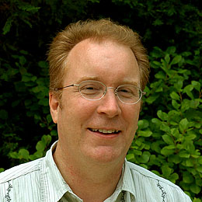
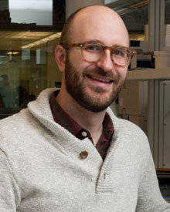




1kp: Thousand Transcriptome Project
G. Ka-Shu Wong
U Alberta
J. Leebens-Mack
U Georgia
N. Wickett
Northwestern
N. Matasci
iPlant
T. Warnow, S. Mirarab, N. Nguyen
UIUC UT-Austin UT-Austin
Plus many many other people…
Plant Tree of Life based on transcriptomes of ~1200 species
More than 13,000 gene families (most not single copy)
Gene Tree Incongruence
Challenge:
Alignment of datasets with > 100,000 sequences
with many very short sequences

Slide 7
Outline
Part I: Basic concepts and techniques
  Computing pairwise alignments
  Computing multiple sequence alignments
Part II: Techniques for Large-scale MSA
  Divide-and-conquer MSA
  “Two-phase” (compute backbone, then add remaining sequences)
Part III: Adding to alignments
Part IV: Discussion and Future Work

Slide 8
Part I: Basic Concepts
Homology
Indels (insertions and deletions)
True pairwise alignment
Edit transformation
Global vs local alignment
Transitivity

Slide 9
Indels (insertions and deletions)
Deletion
Mutation
…ACGGTGCAGTTACCA…
…ACCAGTCACCA…
Homology: two letters (nucleotides or amino-acids) that are
related by descent from a common ancestor
Notes:
9

Slide 10
Deletion
Substitution
…ACGGTGCAGTTACCA…
Insertion
…ACGGTGCAGTTACC-A…
…AC----CAGTCACCTA…
…ACCAGTCACCTA…
The true pairwise alignment
  Reflects historical substitution, insertion, and deletion events
  Letters (nucleotides or amino acids) in the same column are supposed to be homologs
Notes:
10
Homology = nucleotides lined up since they come from a common ancestor.
Indel = dash.

Slide 11
Deletion
Substitution
…ACGGTGCAGTTACCA…
Insertion
…ACGGTGCAGTTACC-A…
…AC----CAGTCACCTA…
…-C----CAGT------…
…ACCAGTCACCTA…
Then two deletions
(one at front, long one at end)
CCAGT
The true multiple alignment
  Reflects historical substitution, insertion, and deletion events
  Defined using transitive closure of pairwise alignments defined on the edges of the true tree
Notes:
11
Homology = nucleotides lined up since they come from a common ancestor.
Indel = dash.

Slide 12
Pairwise alignment
Global alignment: finding the lowest-cost edit transformation, solved using Needleman-Wunsch (dynamic programming)
Polynomial time!
Allows for variations in cost function and similarity scores, still polynomial time

Slide 13
Examples
For each pair of sequences, what is the best global pairwise alignment?
Suppose that indels and substitutions each have cost 1.
S1 = ACTAG
S2 = GCTAG
S3 = ACTAG
S4 = TTACTAGGA
S5 = TTAAGAGAACTATGGACCTA
S6 = GAGAAGGTAGGTTTAAGTAAGCCATTA

Slide 14
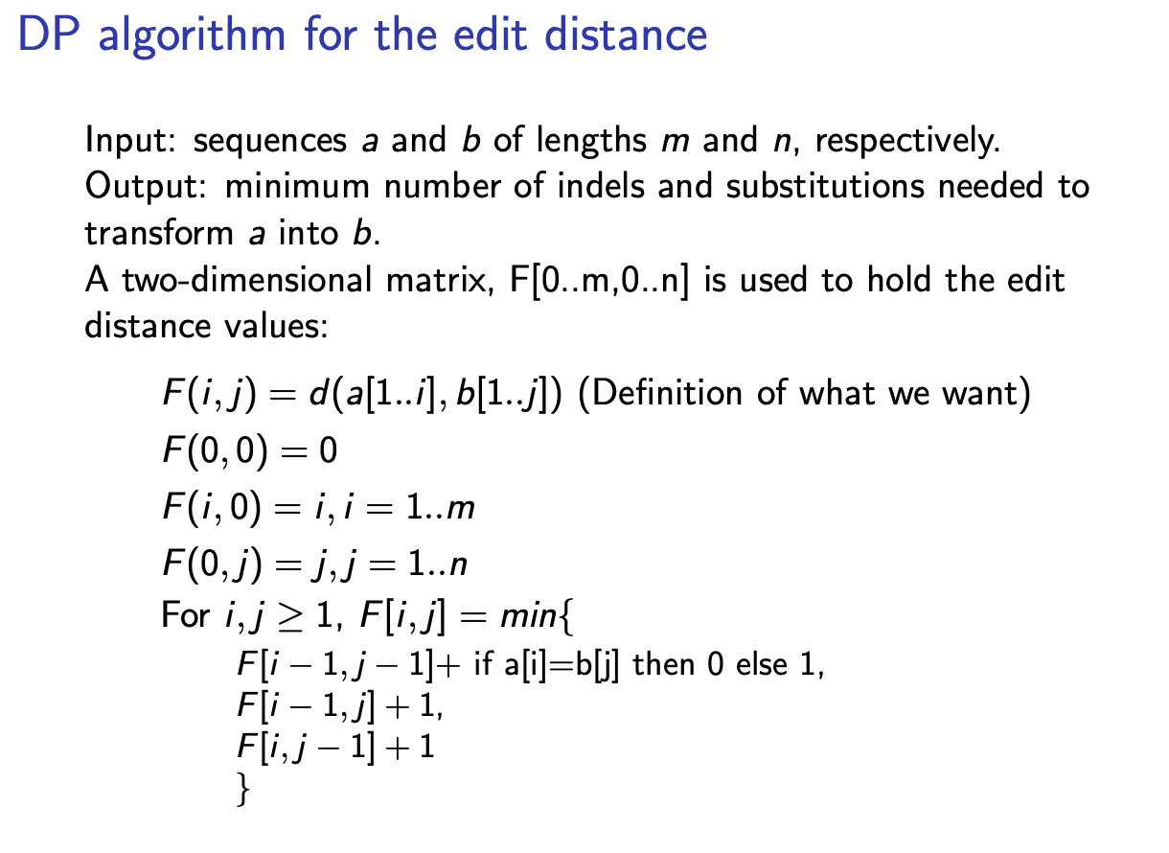

Slide 15
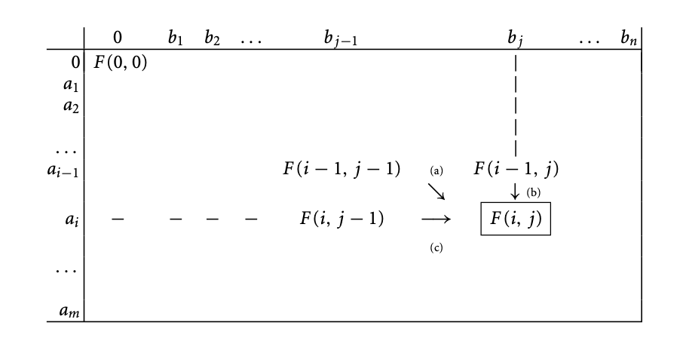
Needleman-Wunsch
From Huson et al., (2010)

Slide 16
Pairwise alignment
Global alignment: finding the lowest-cost edit transformation, solved using Needleman-Wunsch (dynamic programming)
Local alignment: finding the two substrings of highest similarity, solved using Smith-Waterman (also dynamic programming)
Polynomial time!
Both allow for variations in cost function and similarity scores, still polynomial time

Slide 17
Multiple Sequence Alignment
Optimization problems extend pairwise alignment
  Minimizing sum-of-pairs costs
  Minimizing tree length
  Likelihood-based approaches (e.g., Bayesian estimation)
Optimization problems are NP-hard
Bayesian estimation is even less scalable

Slide 18
Standard approaches?
Standard methods use a variety of techniques, such as extending pairwise alignments with:
  Star alignment
  Progressive alignment
  Ensemble methods, including “Consistency”
  Supervised learning

Slide 19
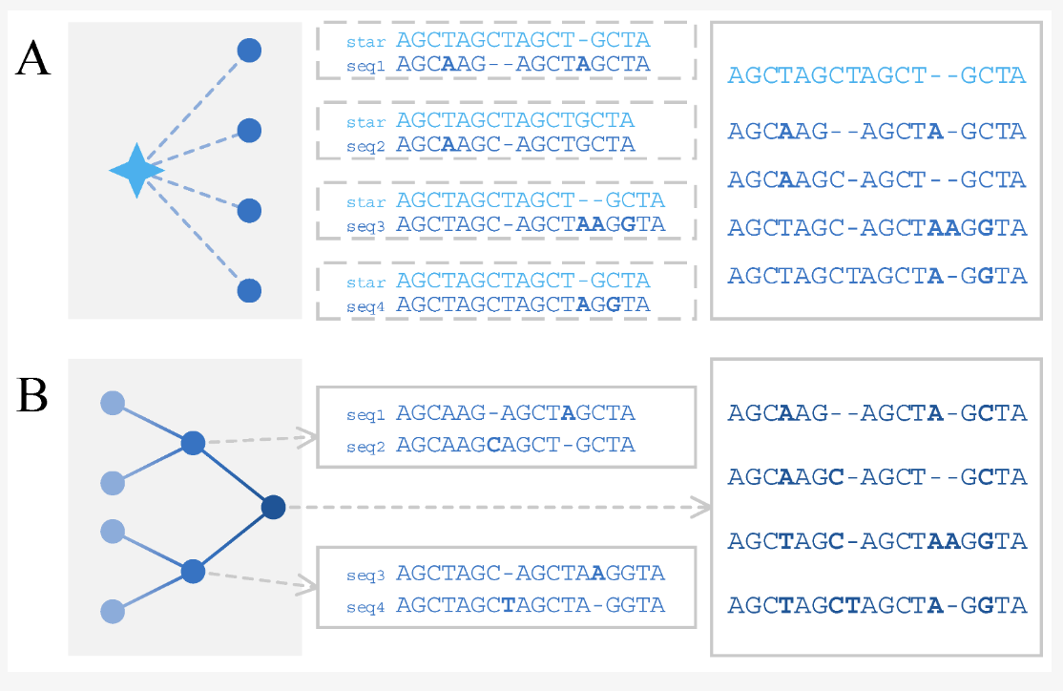
Star (aka “Center-Star”) Alignment
Star alignment: the “center” sequence is an input sequences, and all sequences are aligned to the center.
This approach works well when all the input sequences are very similar to each other
Chao, J.; Tang, F.; Xu, L. Developments in Algorithms for Sequence Alignment: A Review.
Biomolecules 2022, 12, 546. https://doi.org/10.3390/biom12040546

Slide 20
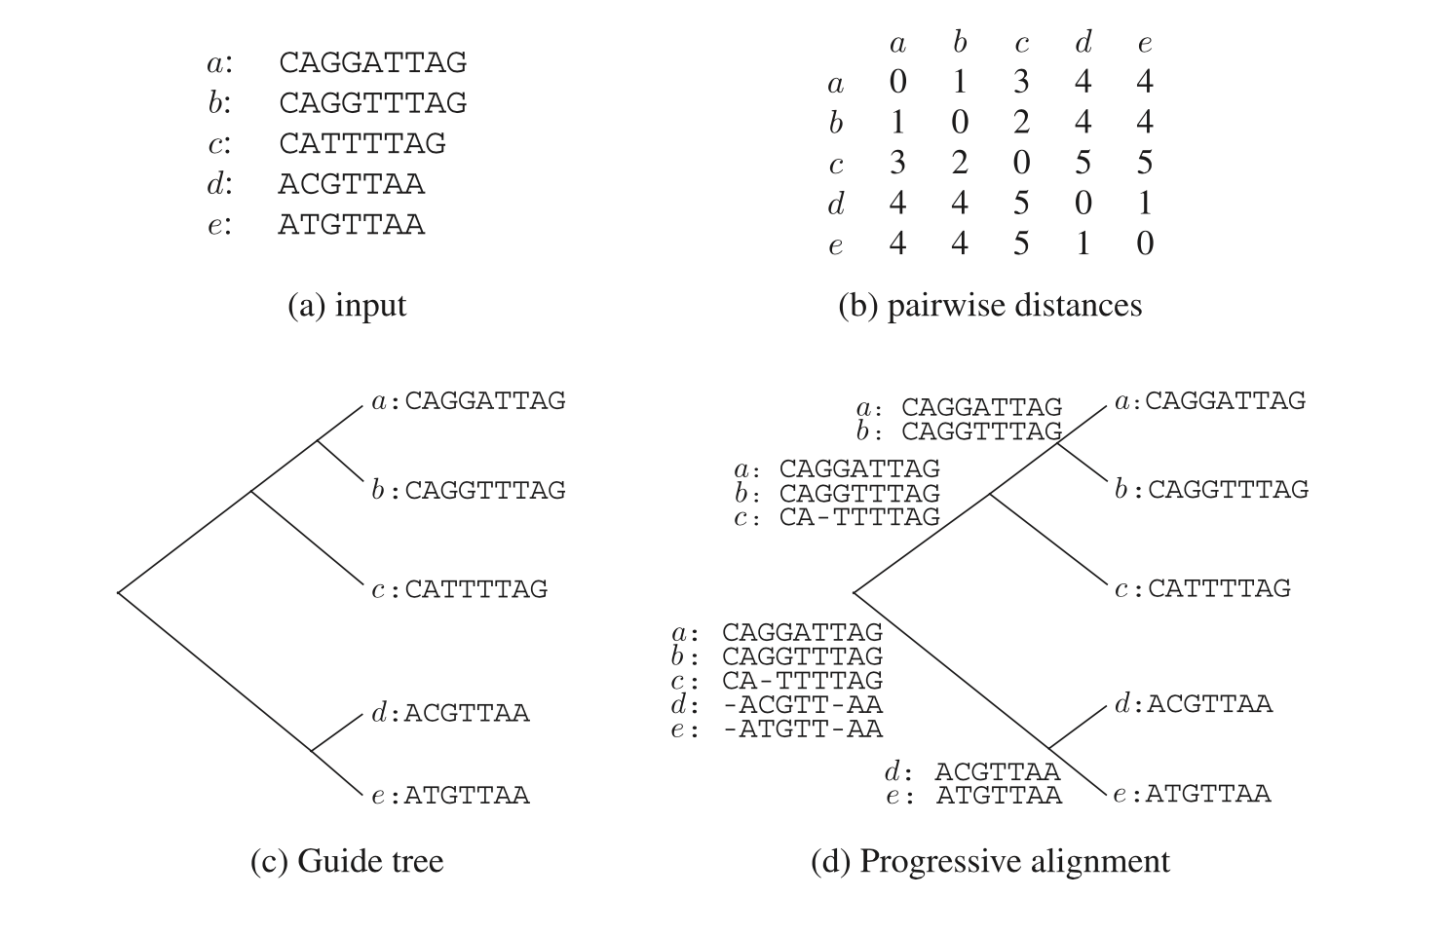
Progressive alignment
Figure 2.9 from Huson et al. (2010)

Slide 21
Simulation Studies
S1 = AGGCTATCACCTGACCTCCA
S2 = TAGCTATCACGACCGC
S3 = TAGCTGACCGC
S4 = TCACGACCGACA
Unaligned Sequences
S1 = -AGGCTATCACCTGACCTCCA
S2 = TAG-CTATCAC--GACCGC--
S3 = TAG-CT-------GACCGC--
S4 = -------TCAC--GACCGACA
S1 = -AGGCTATCACCTGACCTCCA
S2 = TAG-CTATCAC--GACCGC--
S3 = TAG-C--T-----GACCGC--
S4 = T---C-A-CGACCGA----CA
S1
S2
S1
S4
Compare
S4
S3
S2
S3
True tree and alignment
Estimated tree and alignment

Slide 22
MSA+Tree estimation
Alignment methods
Clustal
POY (and POY*)
Probcons (and Probtree)
Probalign
MAFFT
Muscle
Di-align
T-Coffee
Prank (PNAS 2005, Science 2008)
Opal (ISMB and Bioinf. 2007)
FSA (PLoS Comp. Bio. 2009)
Infernal (Bioinf. 2009)
Etc.
Phylogeny methods
Bayesian MCMC
Maximum parsimony
Maximum likelihood
Neighbor joining
FastME
UPGMA
Quartet puzzling
Etc.
RAxML: heuristic for large-scale ML optimization
Notes:
22

Slide 23
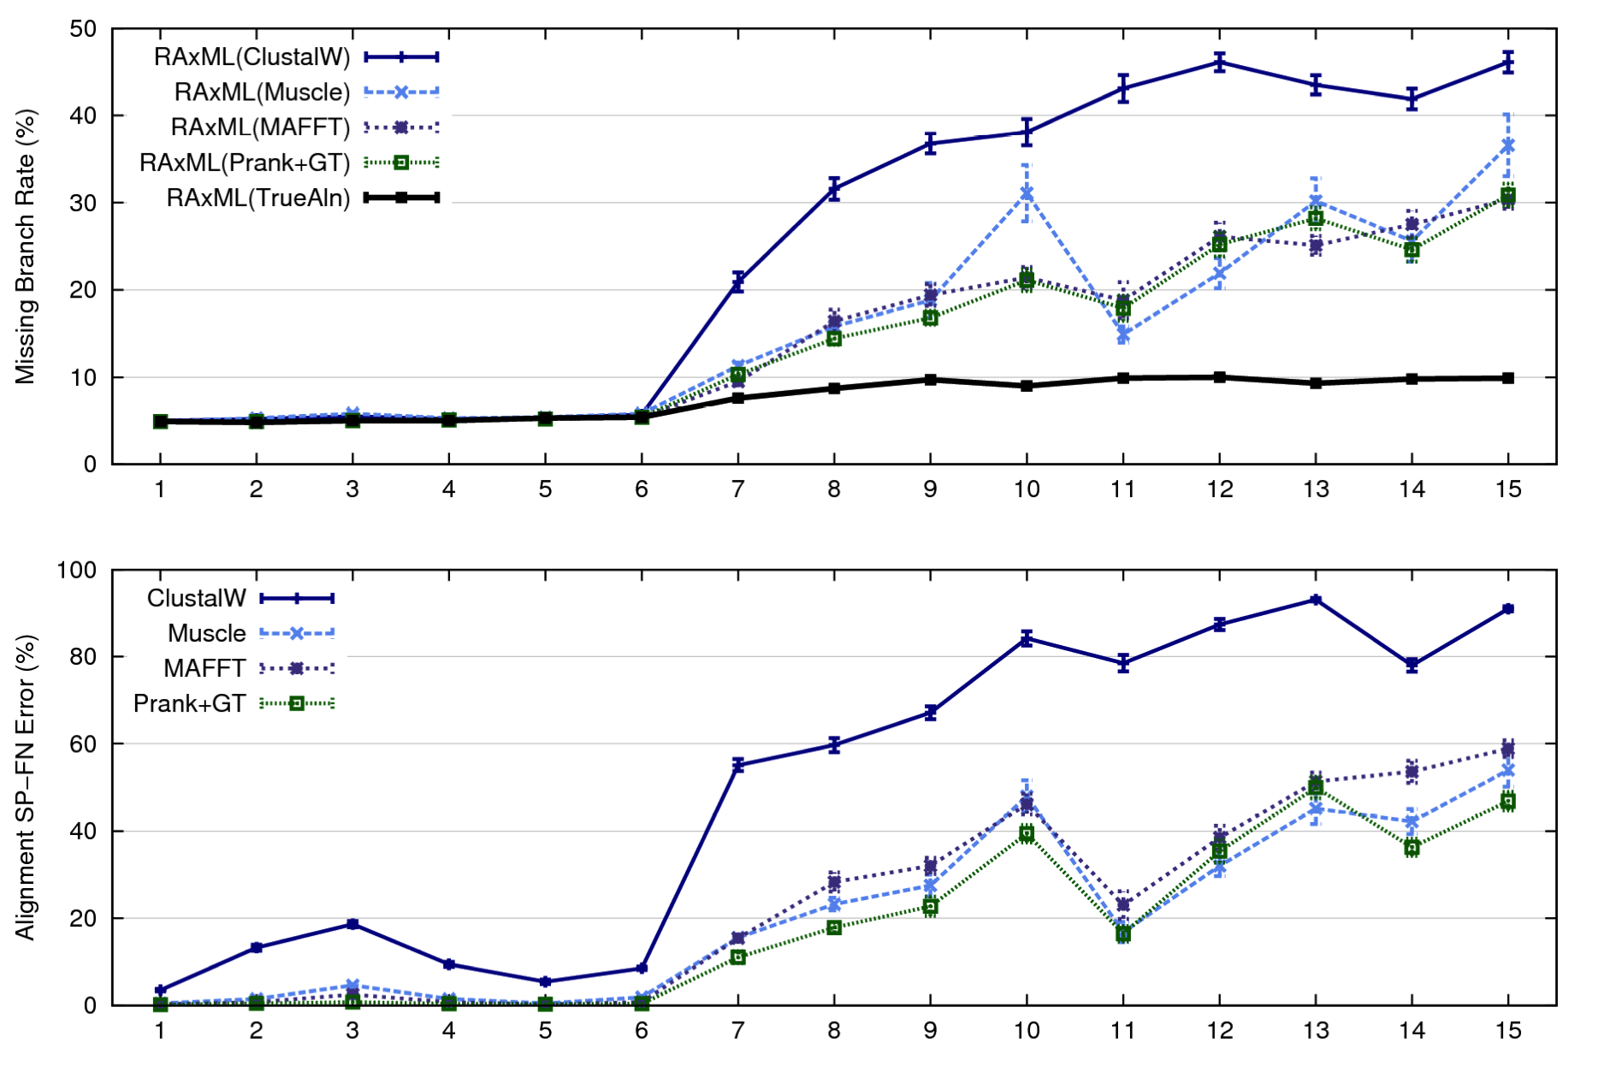
1000-taxon models, ordered by difficulty (Liu et al., 2009)
Notes:
23
1. 2 classes of MC: easy, moderate-to-difficult
2. true alignment
3. 2 classes: ClustalW, everything else
Alignment error, measured this way, isn't a perfect predictor of tree error, measured this way.

Slide 24
What makes for an “easy” MSA?
MSA is easy when the input is a small set of very similar sequences
  All nearly the same length
  Very few substitutions
  Very few “indels”
But large datasets are difficult, even when they are otherwise relatively “easy”

Slide 25
What makes MSA difficult?
Large numbers of sequences
High evolutionary rates
Sequence length heterogeneity (e.g., fragments)
Very long sequences (e.g., genome-scale)
Rearrangement events

Slide 26
What makes MSA difficult?
Large numbers of sequences
High evolutionary rates
Sequence length heterogeneity (e.g., fragments)
Very long sequences (e.g., genome-scale)
Rearrangement events

Slide 27
Part II: Techniques for Large-Scale MSA

Slide 28
Large-scale MSA
Challenges
High evolutionary rates
Sequence length heterogeneity (e.g., fragments)
Very long sequences

Slide 29
Three obvious challenges
  Addressing very large datasets
  Addressing high evolutionary rates
  Addressing sequence length heterogeneity

Slide 30
Techniques for de novo MSA
Divide-and-conquer
  Divide dataset (sequences) into disjoint subsets, align subsets, merge subset alignments
“Two-phase” (mainly for datasets with sequence length heterogeneity)
  Construct “backbone alignment” for the full-length sequences
  Add remaining sequences into the backbone alignment

Slide 31
Techniques for de novo MSA
Divide-and-conquer
  Divide dataset (sequences) into disjoint subsets, align subsets, merge subset alignments
“Two-phase” (mainly for datasets with sequence length heterogeneity)
  Construct “backbone alignment” for the full-length sequences
  Add remaining sequences into the backbone alignment

Slide 32
Divide-and-conquer
Divide-and-conquer “meta-methods” for large numbers of sequences and high evolutionary rates:
  SATé, PASTA, and MAGUS

Slide 33
Re-aligning on a tree
A
C
Decompose dataset
A
B
C
D
B
D
Align subsets
A
B
C
D
Estimate ML tree on merged alignment
ABCD
Merge
sub-alignments
Notes:
Comment on subset size

Slide 34
Standard Methods
Many excellent methods for the relatively easy inputs
Statistical alignment (e.g., BAli-Phy)
Few of these methods can provide good accuracy on challenging datasets

Slide 35
SATé, PASTA, and MAGUS Algorithms
Obtain initial alignment and estimated ML tree
Tree
Use tree to compute new alignment
Estimate ML tree on new alignment
Alignment
Repeat until termination condition, and
return the alignment/tree pair with the best ML score

Slide 36
1000-taxon models, ordered by difficulty (Liu et al., 2009)
Notes:
36
1. 2 classes of MC: easy, moderate-to-difficult
2. true alignment
3. 2 classes: ClustalW, everything else
Alignment error, measured this way, isn't a perfect predictor of tree error, measured this way.

Slide 37
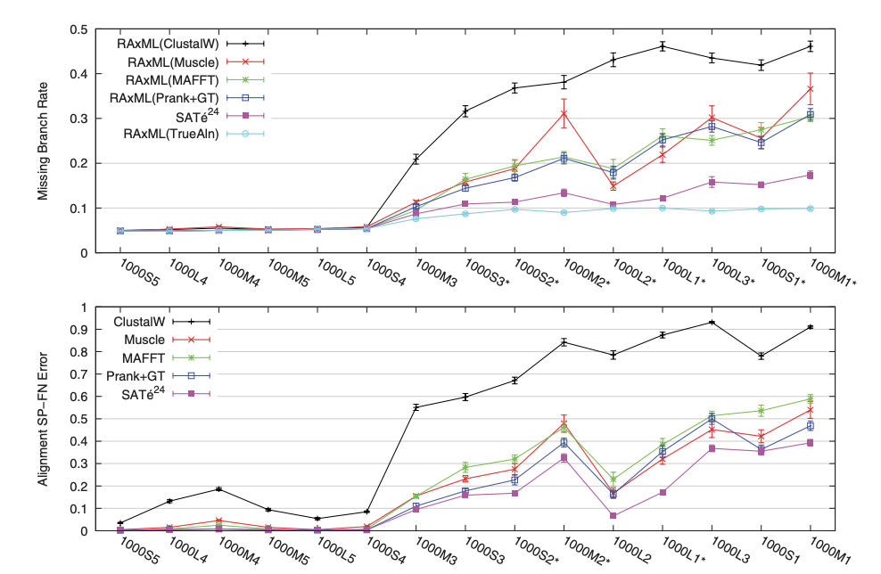

Slide 38
Improvement over time
SATé-1 (Science 2009): up to about 8,000
SATé-2 (Syst Biol 2012): up to 50,000
PASTA (J Comp Biol 2014): up to 1,000,000
MAGUS (Bioinformatics 2021): more accurate than PASTA (and one iteration suffices) – up to 1,000,000
Each method improved on the previous with respect to MSA and Tree accuracy, speed, and scalability to large datasets

Slide 39
SATé-II vs PASTA vs MAGUS
Decomposition: the same technique (delete centroid edges)
Subset alignments: the same (all computed MAFFT-linsi alignments)
Merging:
  SATé-II uses a guide tree to merge the subset alignments up the tree
  PASTA aligns all “adjacent pairs” of alignments, and then finishes with transitivity
  MAGUS aligns all subset alignments *at once* (using a complex pipeline involving Markov Clustering)

Slide 41
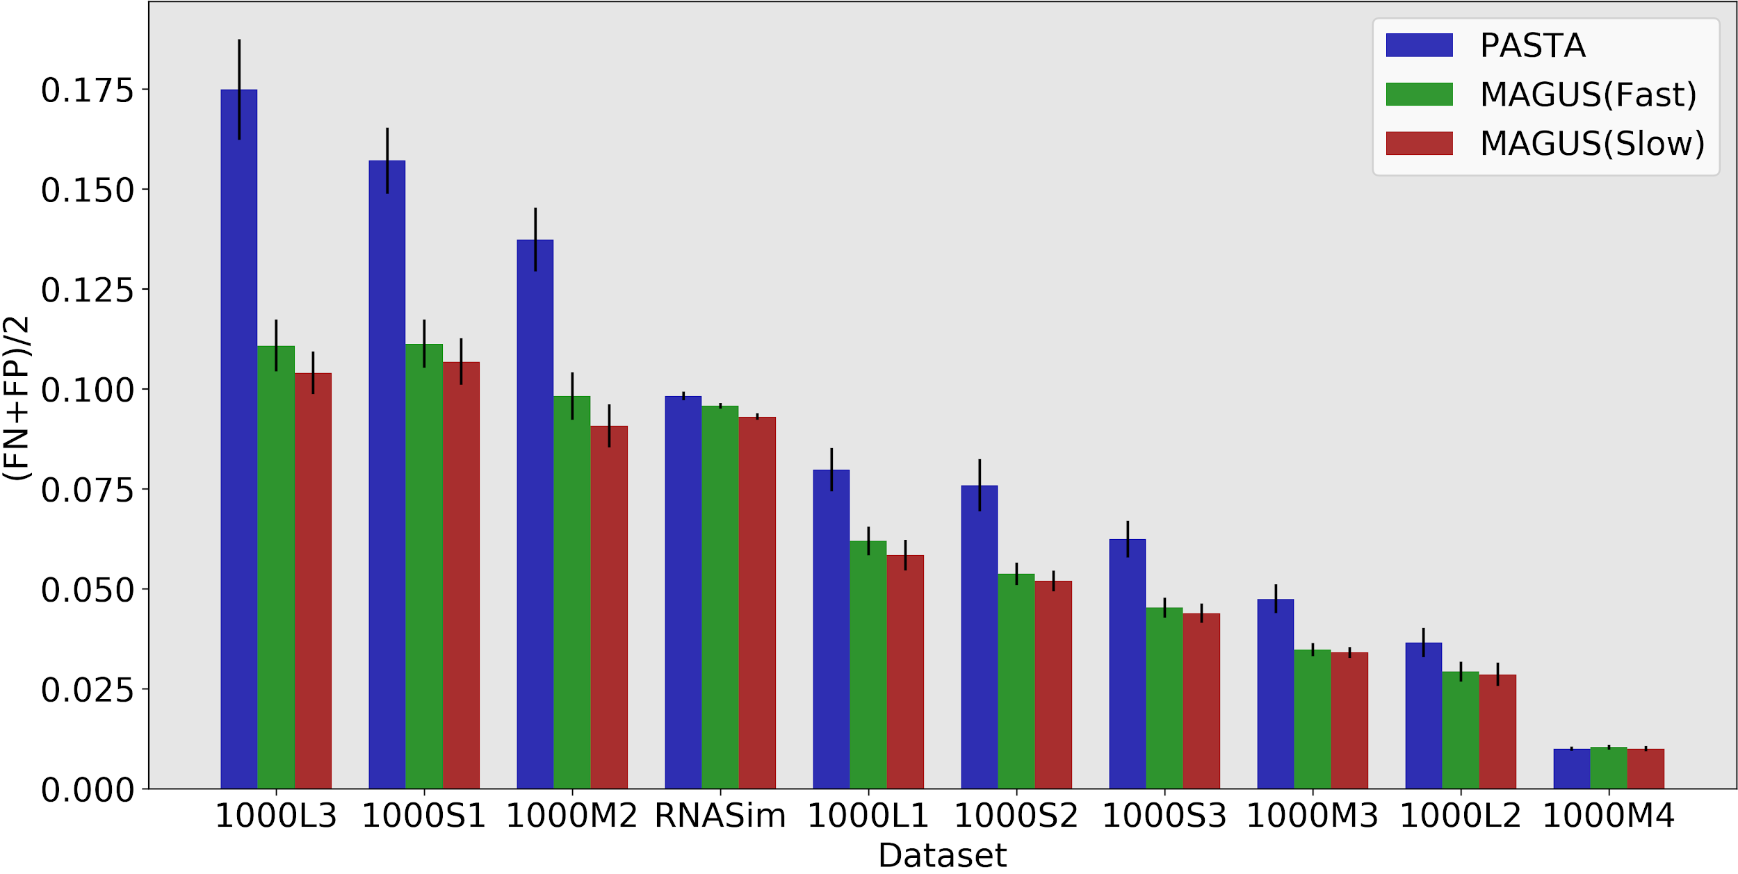
MAGUS: More Accurate Alignments than PASTA
MAGUS
Department of Computer Science
GRAINGER ENGINEERING

Slide 42
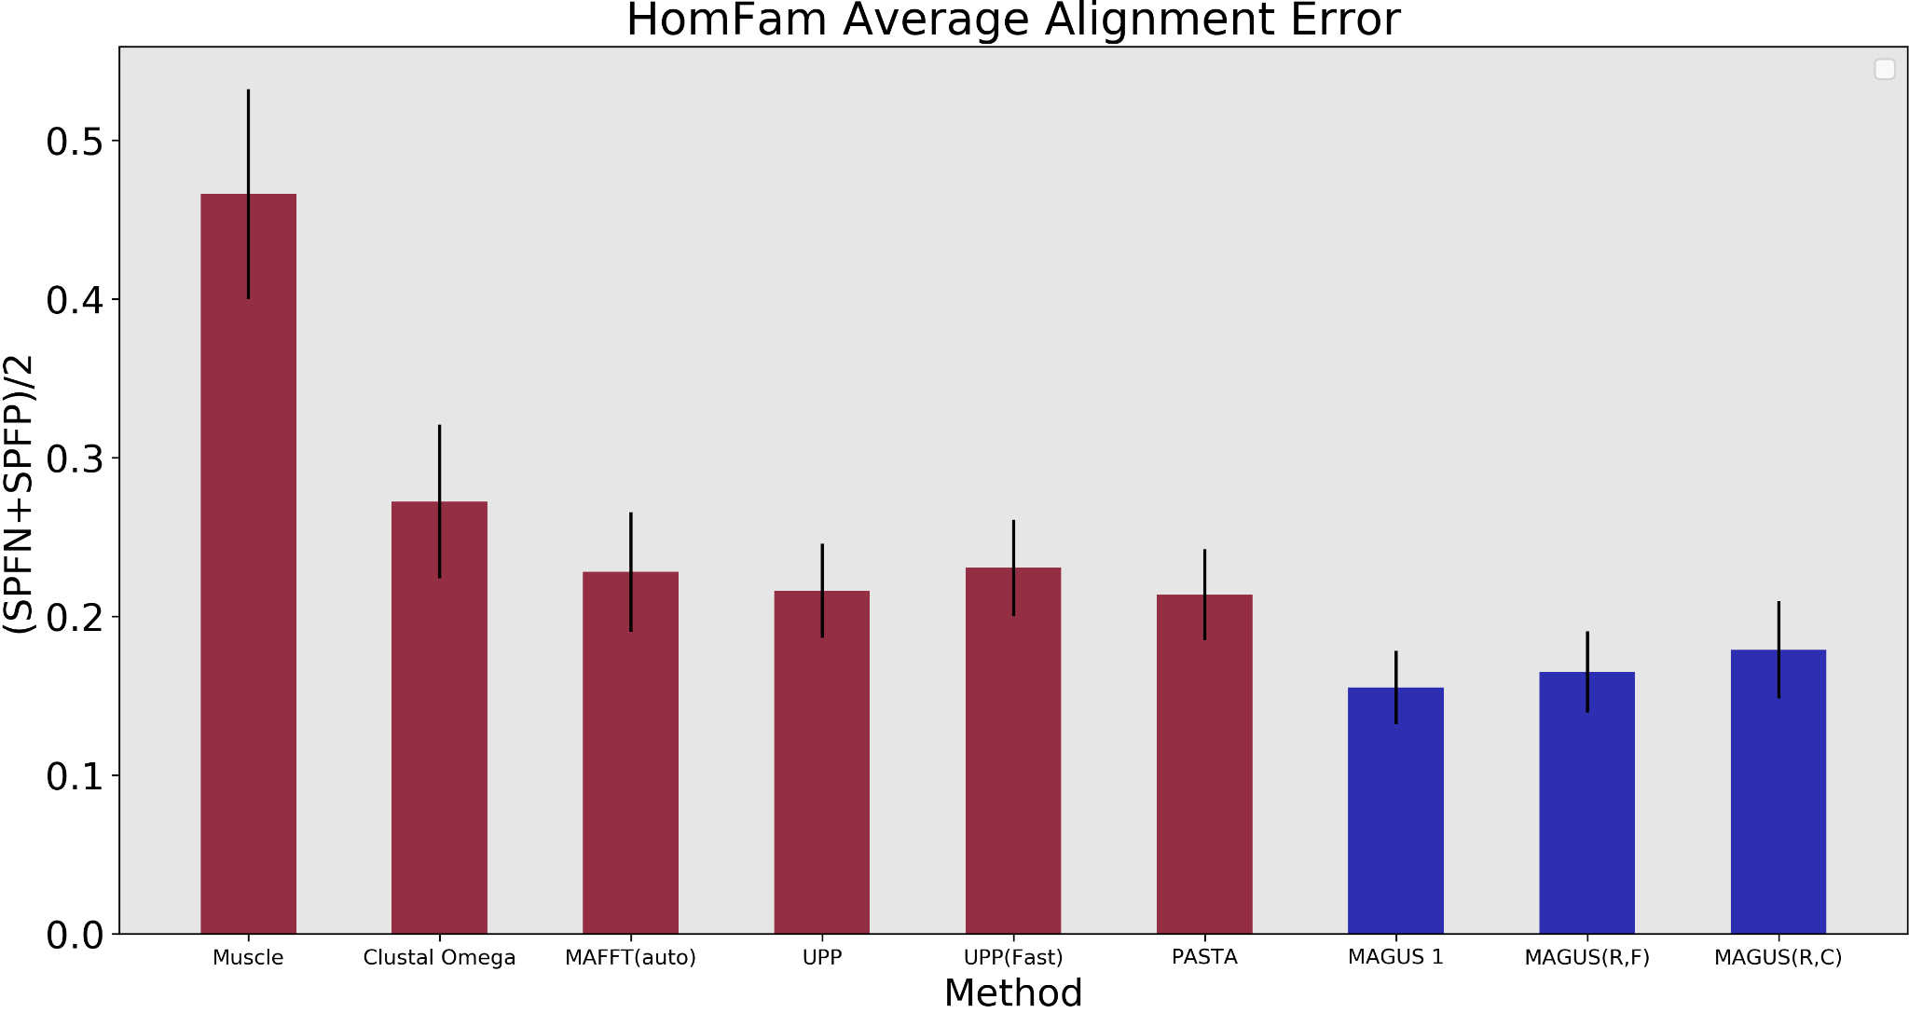
MAGUS: excellent on protein benchmarks too
Recursive MAGUS
GRAINGER ENGINEERING

Slide 43
Summary for Divide-and-Conquer
Can be used with any base MSA method (we showed results with MAFFT-linsi, but improvements also found for other methods, including BAli-Phy)
Iteration can help
Merging alignments “all at once” promising; related to John Kececioglu’s “Maximum Weight Trace” problem

Slide 44
Sequence Length Heterogeneity
The next challenge is sequence length heterogeneity (especially fragmentary sequences)

Slide 45
1kp: Thousand Transcriptome Project
G. Ka-Shu Wong
U Alberta
J. Leebens-Mack
U Georgia
N. Wickett
Northwestern
N. Matasci
iPlant
T. Warnow, S. Mirarab, N. Nguyen
UIUC UT-Austin UT-Austin
Plus many many other people…
Plant Tree of Life based on transcriptomes of ~1200 species
More than 13,000 gene families (most not single copy)
Gene Tree Incongruence
Challenge:
Alignment of datasets with > 100,000 sequences
with many very short sequences

Slide 46
1KP dataset: more than
100,000 p450 amino-acid
sequences, many fragmentary
All standard multiple
sequence alignment
methods we tested
performed poorly on
datasets with fragments.

Slide 47
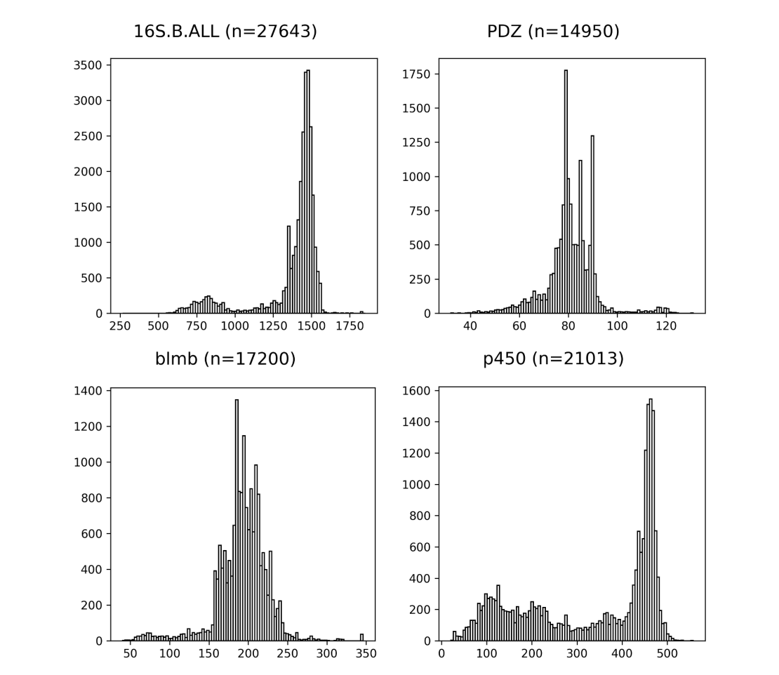
Sequence length heterogeneity

Slide 48
Solution: Two-phase approach
Phase 1: Select a collection of “full-length” sequences, and compute a “backbone” alignment on them.
Phase 2: Add the remaining sequences into the backbone alignment.
Note: Each stage matters!
Depends on which sequences are in the backbone, and how the backbone alignment is computed (but can use expensive methods)
Depends on how the remaining sequences are added to the backbone (can use “local alignment” techniques)

Slide 49
UPP
UPP = “Ultra-large multiple sequence alignment using Phylogeny-aware Profiles”
Nguyen, Mirarab, and Warnow. Genome Biology, 2014.
Purpose: highly accurate large-scale multiple sequence alignments, even in the presence of fragmentary sequences.

Slide 50
UPP
UPP = “Ultra-large multiple sequence alignment using Phylogeny-aware Profiles”
Nguyen, Mirarab, and Warnow. Genome Biology, 2015
Purpose: highly accurate large-scale multiple sequence alignments, even in the presence of fragmentary sequences.
Uses an ensemble of HMMs

Slide 51
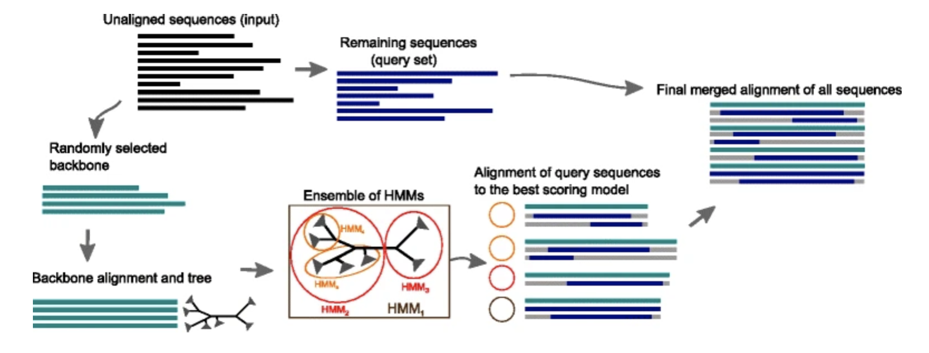
UPP (Nguyen et al. 2015)
The Ensemble of Hidden Markov Models is a “model” for the backbone alignment.
The HMMs are built on subset alignments, may not be clades in the backbone tree.

Slide 52
MAGUS: excellent on protein benchmarks too
Recursive MAGUS
GRAINGER ENGINEERING

Slide 53
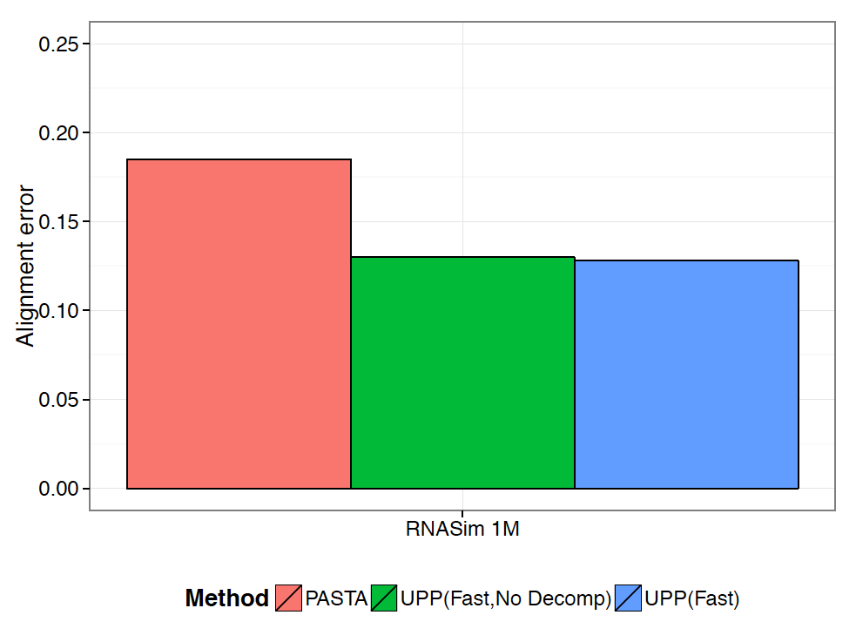
RNASim Million Sequences: alignment error
Notes:
We show alignment error using average of SP-FN and SP-FP.
UPP variants have better alignment scores than PASTA.
(Not shown: Total Column Scores – PASTA more accurate than UPP)
No other methods tested could complete on these data
PASTA under-aligns: its alignment is 43 times wider than true alignment (~900 Gb of disk space). UPP alignments were closer in length to true alignment (0.93 to 1.38 wider).

Slide 54
UPP vs. PASTA: impact of fragmentation
Under high rates of evolution,
PASTA is badly impacted
by fragmentary sequences (the
same is true for other methods).
Under low rates of evolution,
PASTA can still be highly accurate
(data not shown).
UPP continues to have good
accuracy even on datasets
with many fragments under
all rates of evolution.
Performance on fragmentary datasets of the 1000M2 model condition

Slide 55
Other two-phase methods
These methods start the same as UPP (extract backbone alignment, build ensemble of HMMs on backbone), but then do things differently to add the query sequences to the backbone
WITCH (Chengze Shen et al, J. Comp Biol 2022.) and WITCH-ng (Baqiao Liu and T. Warnow, Bioinformatics Advances 2022.): weights the HMMs, computes extended alignment for each HMM, merges the extended alignments using “consensus alignment” technique
HMMerge (Minhyuk Park and T. Warnow, Bioinformatics Advances.): weights the HMMs, combines them into new Hidden Markov Model (not profile HMM), and uses that new HMM to add query sequences
All are more accurate than UPP

Slide 56
Part III: Adding to MSAs
Problem:
Input: MSA A and set Q of additional (unaligned) sequences
Output: add the sequences in Q to A (without changing A)
Applications:
Two-phase methods (like UPP, WITCH, etc)
Taxon identification (e.g., in metagenomics)
Updating existing alignment

Slide 57
Methods for updating MSAs
HMM-based methods: UPP-add, WITCH-add, WITCH-ng-add, HMMerge-add
MAFFT-add (and its most accurate setting, MAFFT-linsi-add)
EMMA (Chengze Shen et al., WABI 2023):
  Extends the ideas in UPP-add, but follows by running MAFFT-linsi-add. (New version under development)

Slide 58
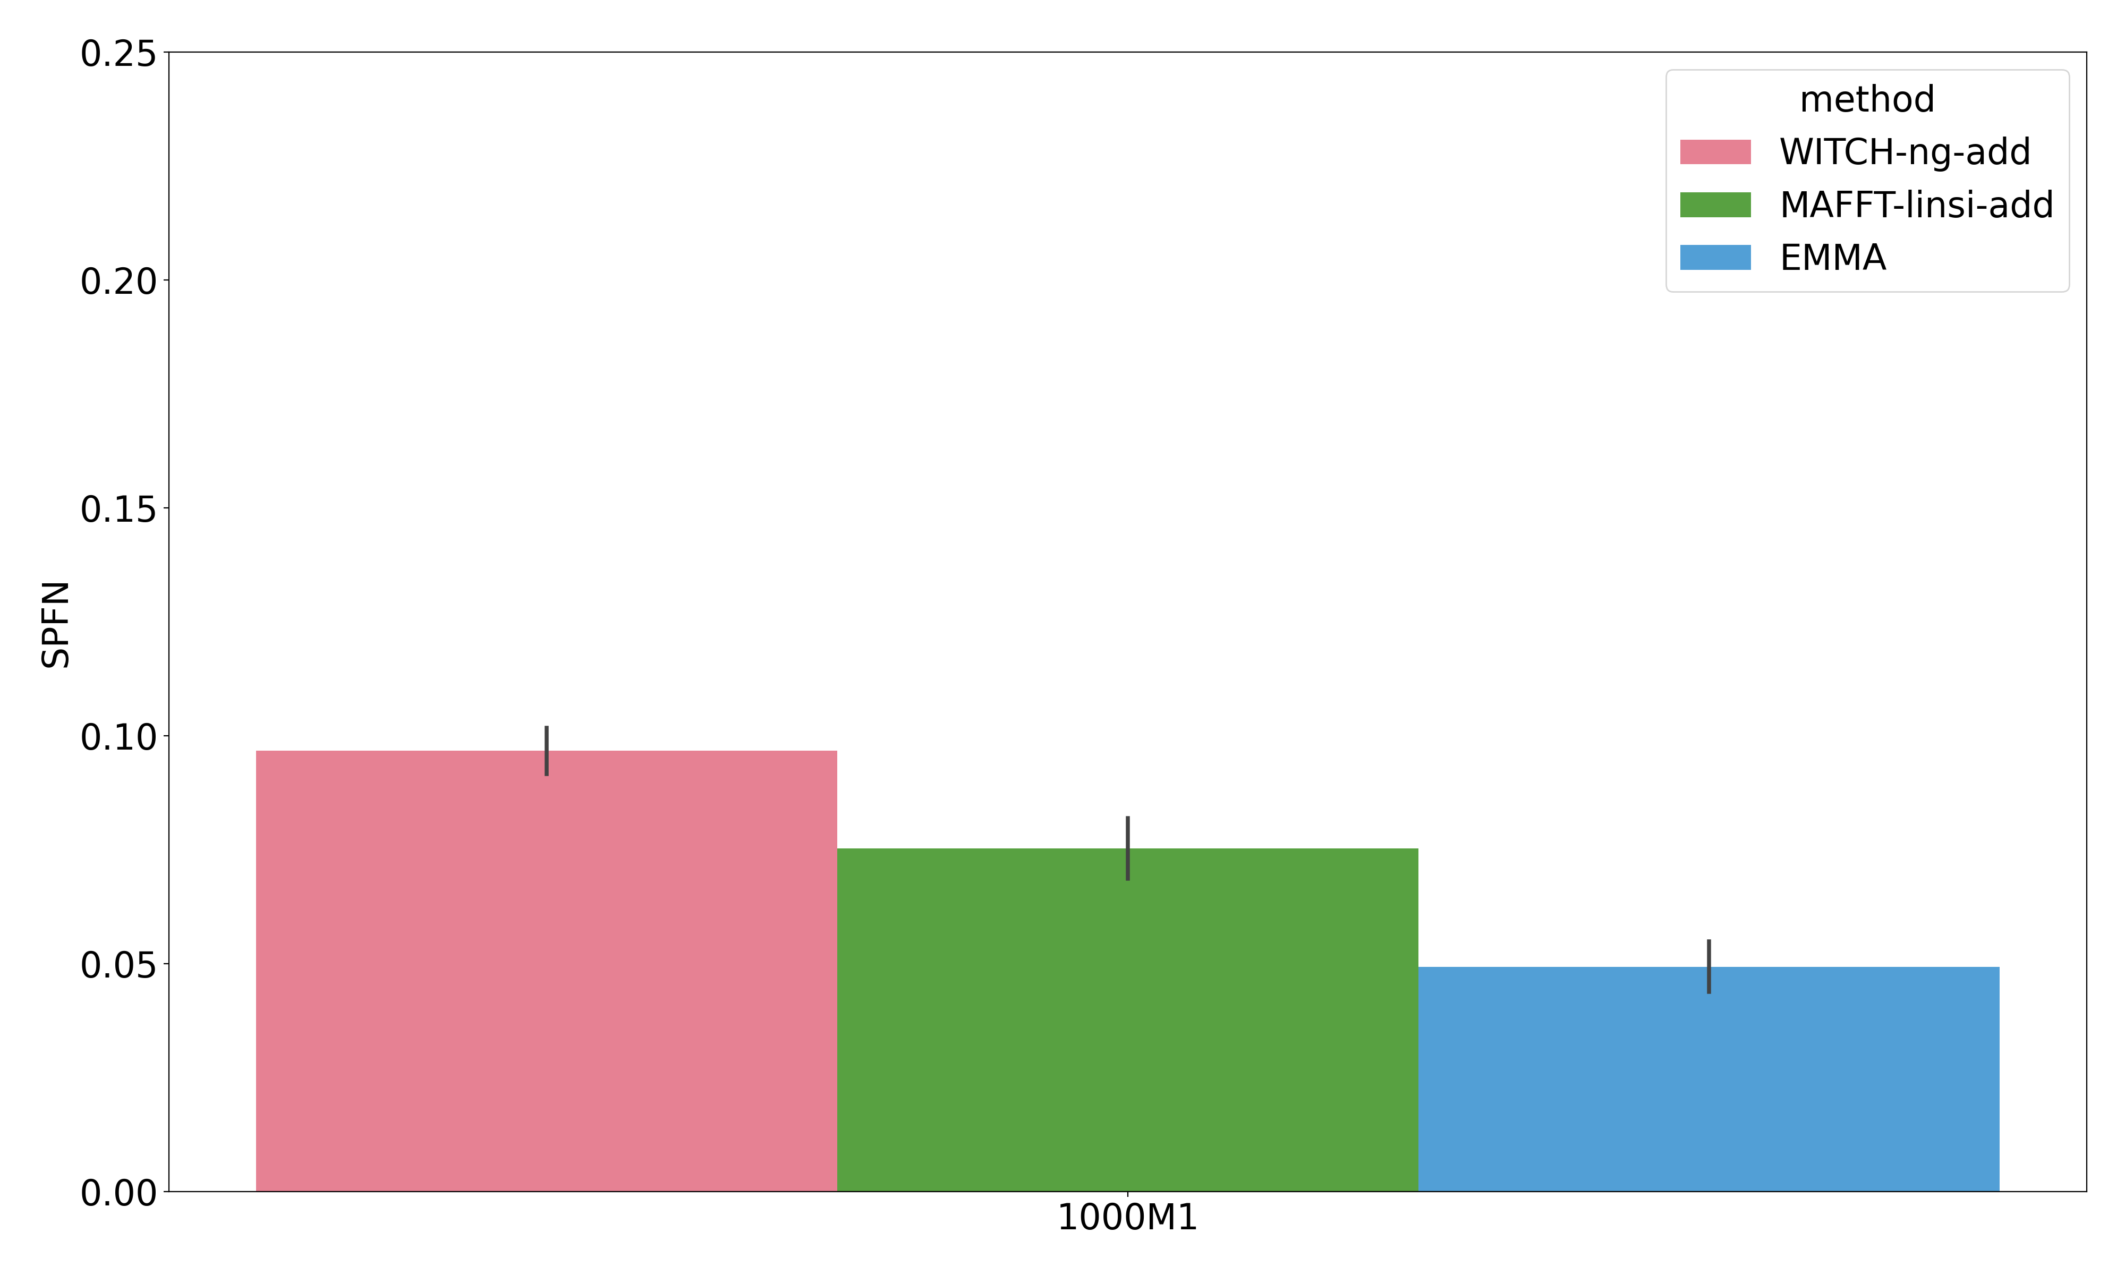
Comparison of EMMA-add, WITCH-ng-add, and MAFFT-linsi-add:
The benefit of not using HMMs to align query sequences
SPFN of different methods (fraction of missing true pairwise homologies)
Dataset: 1000M1 with a high rate of evolution; all sequences are full-length
Backbone: 250 randomly selected sequences from full set.

Slide 59
Part IV: Discussion

Slide 60
Progress in MSA has been made
MSA is challenging, but algorithmic techniques can improve accuracy and scalability:
  Dataset size can be addressed using good divide-and-conquer approaches.
  Heterogeneity in sequence length can be addressed using “local alignment” approaches, such as profile HMMs, with ensembles of profile HMMs providing improved accuracy.

Slide 61
Algorithmic challenges
How can we assess alignment uncertainty and use it in downstream analyses?
Can we use a set of MSAs to advantage, instead of a single MSA? For example, can we develop effective and efficient “ensemble” methods?
What are the best ways to merge disjoint alignments?
How can we efficiently perform statistical alignment?

Slide 62
Summary
Multiple sequence alignment (MSA) has large downstream consequences in bioinformatics analyses.
MSA is far from solved – esp. (but not only) on large datasets with high rates of evolution, sequence length heterogeneity, and streaming data.
New techniques show promise
Not discussed: multiple whole genome alignment, MSA with rearrangements, statistical alignment

Slide 63


Acknowledgments
PASTA and UPP: Siavash Mirarab and Nam-phuong Nguyen
MAGUS: Vlad Smirnov
WITCH: Chengze Shen and Minhyuk Park
EMMA: Chengze Shen and Baqiao Liu
NSF grants: 1458652 and 2006069
Grainger Foundation (at UIUC)
TACC, Blue Waters, and UIUC campus cluster
PASTA, UPP, SEPP, and TIPP are available on github at https://github.com/smirarab/
PASTA+BAli-Phy at http://github.com/MGNute/pasta
MAGUS: at https://github.com/vlasmirnov/MAGUS
WITCH: at https://github.com/c5shen/WITCH
WITCH-ng at https://github.com/RuneBlaze/WITCH-NG.
EMMA at https://github.com/c5shen/EMMA
Papers available at http://tandy.cs.illinois.edu/papers.html

Slide 64
MSAs: different purposes
Many different purposes:
  Inferring evolutionary histories
  Predicting biomolecular (RNA, protein) structure
  Genome annotation and assembly
Should we evaluate MSA via the impact on these applications?
Do we need different MSA methods for these different applications? (What is the impact of false positive or false negative homologies in each case?)

Slide 65
MSA Evaluation: Benchmarks
Simulations are reliable but perhaps not realistic
Biological datasets are realistic, but…all sorts of things can go wrong. In particular, “homologies” are also, to some extent, estimated rather than gold standard.
Important to make progress on this (see issues raised in Nute et al., Systematic Biology)

Slide 66
Multiple Sequence Alignment (MSA): a scientific grand challenge¹
S1 = AGGCTATCACCTGACCTCCA
S2 = TAGCTATCACGACCGC
S3 = TAGCTGACCGC
…
Sn = TCACGACCGACA
S1 = -AGGCTATCACCTGACCTCCA
S2 = TAG-CTATCAC--GACCGC--
S3 = TAG-CT-------GACCGC--
…
Sn = -------TCAC--GACCGACA
Novel techniques needed for scalability and accuracy
NP-hard problems and large datasets
Current methods do not provide good accuracy
Few methods can analyze even moderately large datasets
Many important applications besides phylogenetic estimation
¹ Frontiers in Massive Data Analysis, National Academies Press, 2013

Slide 67

Acknowledgments
PASTA and UPP: Siavash Mirarab and Nam-phuong Nguyen
Evaluating BAli-Phy: Mike Nute
MAGUS: Vlad Smirnov
WITCH: Chengze Shen and Minhyuk Park
eMAFFT-add: Chengze Shen and Baqiao Liu
NSF grants: 1458652 and 2006069
Grainger Foundation (at UIUC)
TACC, Blue Waters, and UIUC campus cluster
PASTA, UPP, SEPP, and TIPP are available on github at https://github.com/smirarab/
PASTA+BAli-Phy at http://github.com/MGNute/pasta
MAGUS: at https://github.com/vlasmirnov/MAGUS
WITCH and eMAFFT-add: at https://github.com/c5shen/WITCH
Papers available at http://tandy.cs.illinois.edu/papers.html

Slide 68
Summary (so far)
Large number of sequences and high rates of evolution:
  Divide-and-conquer enables datasets with 1,000,000 sequences to be aligned with high accuracy
  Can use your preferred “base method”
Datasets with fragmentary sequences:
  Two-phase methods work well
  Depends on backbone alignment
  Depends on how sequences are added into the backbone (e.g., UPP-add, MAFFT—add)

Slide 69
Part IV: Statistical Alignment
Since MSA and tree estimation are both about evolution (recognition of homologies due to evolution), can we co-estimate them together, using a statistical model of evolution?
BAli-Phy (Redelings and Suchard) is the main method for this problem.

Slide 70
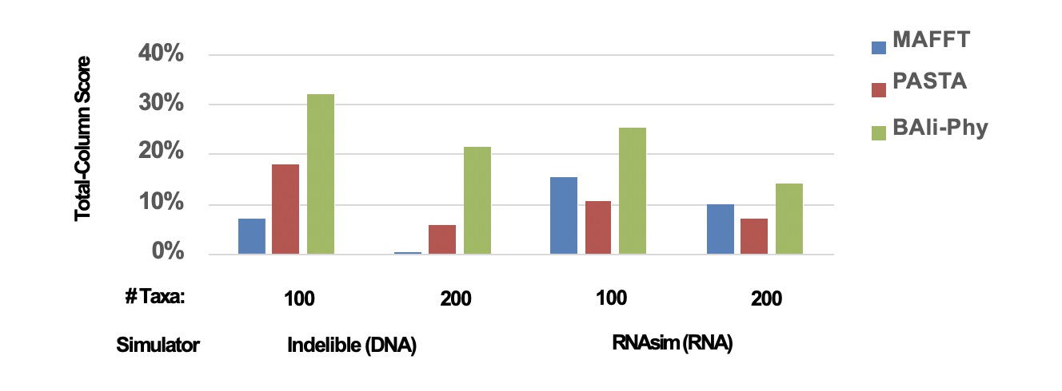
BAli-Phy: better than PASTA!

Slide 71
But: BAli-Phy is limited to small datasets
From www.bali-phy.org/README.html, 5.2.1. Too many taxa?
“BAli-Phy is quite CPU intensive, and so we recommend using 50 or fewer taxa in order to limit the time required to accumulate enough MCMC samples. (Despite this recommendation, data sets with more than 100 taxa have occasionally been known to converge.) We recommend initially pruning as many taxa as possible from your data set, then adding some back if the MCMC is not too slow.”

Slide 72
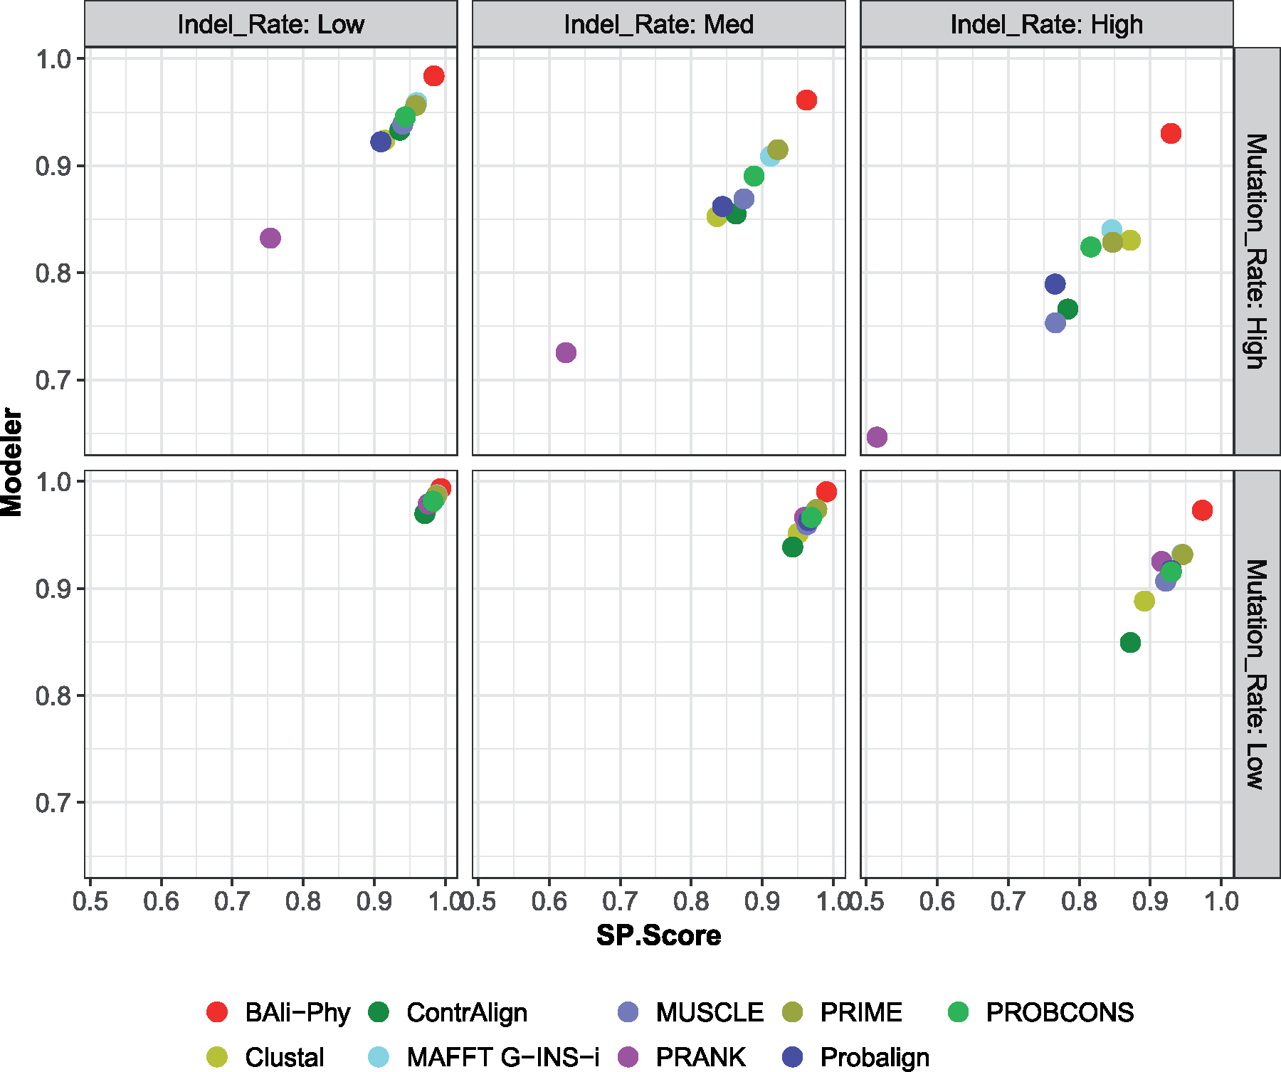

BAli-Phy is best on small simulated protein datasets!
BAli-Phy is best!
Notes:
Figure 6. Modeler score (i.e., precision) versus SP-Score (i.e., recall) for MSA methods on simulated amino acid data sets with 27 sequences for 6 different model conditions that vary by the substitution rate and indel rate; averages over 20 replicates are shown. See Supplementary Excel File available on Dryad for actual numeric values.
Unless provided in the caption above, the following copyright applies to the content of this slide: © The Author(s) 2018. Published by Oxford University Press, on behalf of the Society of Systematic Biologists.This is an Open Access article distributed under the terms of the Creative Commons Attribution License (http://creativecommons.org/licenses/by-nc/4.0/), which permits unrestricted re-use, distribution, and reproduction in any medium, provided the original work is properly cited. For commercial re-use, please contactjournals.permissions@oup.com

Slide 73
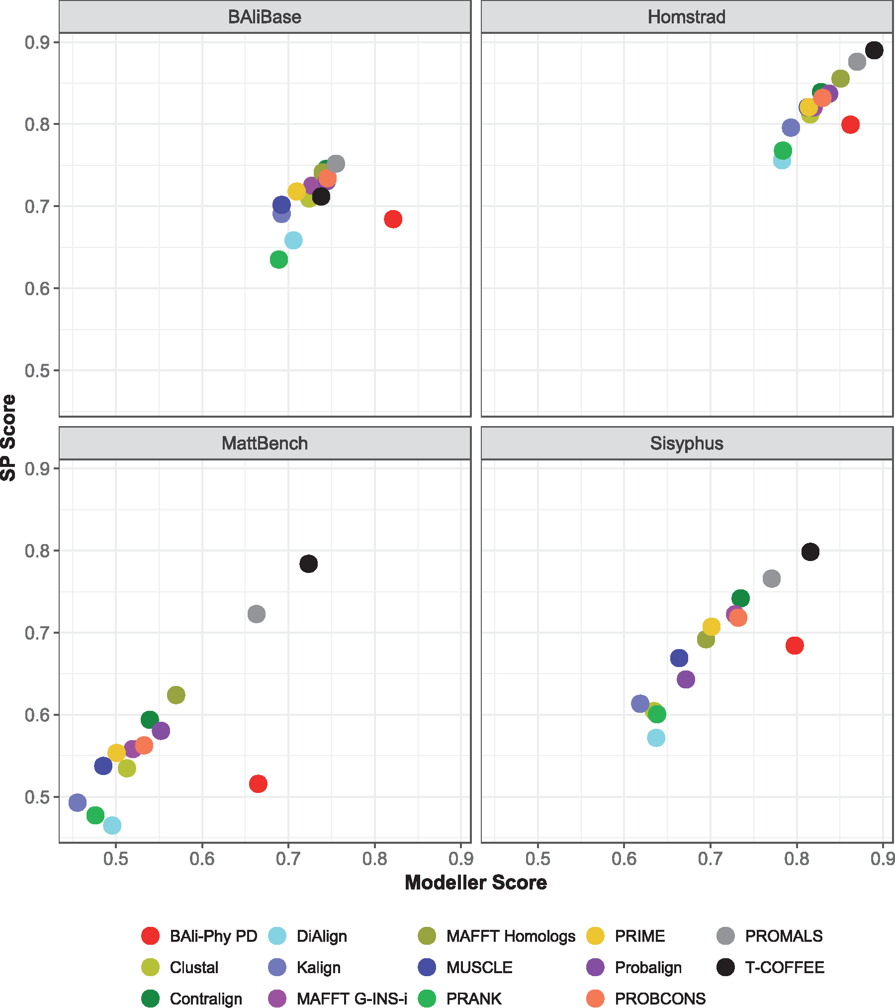
BAli-Phy not so great on on 1192 small biological protein datasets
T-Coffee and PROMALS
are best!
BAli-Phy good for
Modeler score, but not
so good for SP-Score
(e.g., MAFFT better)
Notes:
Figure 2. Average Modeler Score (i.e., precision) versus SP-Score (i.e., recall) of all alignment methods on the individual biological benchmarks. Results shown are for 1192 data sets from the four benchmark collections (658 from BAliBase, 231 from Homstrad, 202 from Mattbench, and 101 from Sisyphus) See Supplementary Table S2 and Excel File available on Dryad for actual numeric values.
Unless provided in the caption above, the following copyright applies to the content of this slide: © The Author(s) 2018. Published by Oxford University Press, on behalf of the Society of Systematic Biologists.This is an Open Access article distributed under the terms of the Creative Commons Attribution License (http://creativecommons.org/licenses/by-nc/4.0/), which permits unrestricted re-use, distribution, and reproduction in any medium, provided the original work is properly cited. For commercial re-use, please contactjournals.permissions@oup.com

Slide 74
Observations
Simulated data: Bali-Phy is the best!
Protein benchmarks: BAli-Phy in middle
  Good for Modeler score (so low false positives)
  Not good for SP-score (so high false negatives)
BAli-Phy under-aligns on biological datasets, but not on simulated datasets

Slide 75
What is going on?
Most likely not an issue of failure of the MCMC analyses to converge (48 hours, 32 processors, < 30 sequences).
Possible explanations:
Model misspecification (i.e., BAli-Phy model not appropriate)
Structural alignments and evolutionary alignments different
The structural alignments are not correct
All these explanations are likely true, but the relative contributions are unknown.

Slide 76
Part IV: Discussion and Recommendations
Summary of progress and recommendations
Future research questions

Slide 77
Recommendations
For datasets with at most 1000 sequences and low sequence length heterogeneity:
  MAFFT (especially –l-insi or –g-insi)
  Promals, Contralign, and other methods for proteins
  I don’t know what to say about BAli-Phy
For large datasets w/o sequence length heterogeneity: MAGUS
For very fast analysis of large protein datasets: FAMSA
For datasets with sequence length heterogeneity
  UPP, WITCH (-ng), EMMA (recent improvement of UPP)
For genome-scale datasets: much harder question (another talk)

Slide 78
Other questions
Large datasets can produce extremely large alignments. How should we handle this?
Can we predict impact of alignment error on the downstream analysis?
What are the differences in desirable properties for alignments for different downstream purposes (e.g., protein structure prediction vs. tree estimation)?

Slide 79
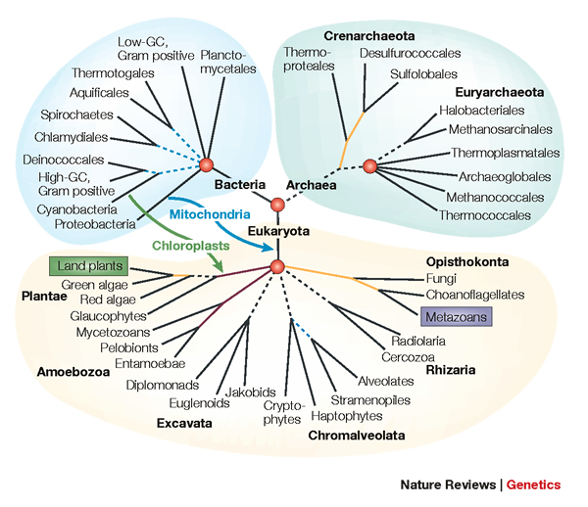
The Tree of Life: Multiple Challenges
Scientific challenges:
Ultra-large multiple-sequence alignment
Gene tree estimation
Metagenomic classification
Alignment-free phylogeny estimation
Supertree estimation
Estimating species trees from many gene trees
Genome rearrangement phylogeny
Reticulate evolution
Visualization of large trees and alignments
Data mining techniques to explore multiple optima
Theoretical guarantees under Markov models of evolution
Techniques: applied probability theory, graph theory, supercomputing, and heuristics
Testing: simulations and real data

Slide 80
List of papers
Smirnov, V. & Warnow, T. (2020). MAGUS: Multiple Sequence Alignment using Graph Clustering. Bioinformatics, Volume 37, Issue 12, 15 June 2021, Pages 1666-1672,
Shen, C., Park, M. & Warnow, T. (2022). WITCH: Improved Multiple Sequence Alignment through Weighted Consensus HMM alignment. J. Computational Biology, Vol. 29, issue 8, pages:782-801
Nute, MG, Saleh, E., & Warnow, T. (2019). Evaluating statistical multiple sequence alignment in comparison to other alignment methods on protein data sets. Systematic Biology, Volume 68, Issue 3, May 2019, Pages 396-411
Gupta, M., Zaharias, P., & Warnow, T. (2021). Accurate large-scale phylogeny-aware alignment using BAli-Phy. Bioinformatics, 37(24), 4677-4683.
Warnow, T. (2021). Revisiting Evaluation of Multiple Sequence Alignment Methods. In: Katoh K. (eds) Multiple Sequence Alignment. Methods in Molecular Biology, vol 2231.

