Slide 1
Multiple Sequence Alignment with PASTA
Michael Nute
Austin, TX
June 17, 2016

Slide 2
Agenda
Quick recap of PASTA Algorithm
Run the GUI
Explore GUI options and what they do in terms of PASTA
Run a test alignment
Explore PASTA outputs and diagnostics
Run a different test alignment
Compare the PASTA fill-in-the-blank defaults for the two test alignments

Slide 3
PASTA: Installation
We hope everybody has been able to install PASTA based on instructions from our email. If not:
See detailed installation instructions at:
https://github.com/smirarab/pasta
Three Options:
MAC
DMG file available at the link above
Linux
Detailed instructions available at the link above
Requires JAVA, wxPython,
Virtual Machine (Recommended: VirtualBox)
Virtual appliance available at link above
This is the only option for Windows users

Slide 4
SATé and PASTA Algorithms
Obtain initial alignment and estimated ML tree
Tree
Estimate ML tree on new alignment
Use tree to compute new alignment
Alignment
Repeat until termination condition, and
return the alignment/tree pair with the best ML score

Slide 5
PASTA Algorithm
Input: unaligned sequences
1) Get initial alignment
2) Estimate tree on current alignment
3) Break into subsets according to tree
6) Use transitivity to merge subset pairs into a full alignment, scrap the old tree
(repeat)
4) Use external aligner to align subsets
5) Use external profile aligner to merge subset alignments
?

Slide 6
PASTA GUI

Slide 7
PASTA Algorithm
PASTA GUI
Initial Alignment
3
Get a Tree
1
2
3
This applies to the Tree Estimator in particular
Transitivity merge
?
Decompose
2
Align subsets
This is the alignment tool used to align the subsets (several options).
Tool for merging two subset alignments. (OPAL or MUSCLE)
Tool to estimate a maximum likelihood tree (FastTree or RAxML)
Merge subset alignments pairwise
1

Slide 8
PASTA Algorithm
Initial Alignment
6
Get a Tree
This should be checked if the sequence file (4) should be treated as aligned. If not checked, PASTA will generate a fast progressive alignment to start.
5
4
Transitivity merge
The basic input to the problem: FASTA file with sequences in need of alignment
4
?
Decompose
<-- not implemented yet
Data type (DNA, RNA or Protein)
5
6
The user can provide a starting tree that will cause the algorithm to skip the initial alignment step.
Align subsets
Merge subset alignments pairwise

Slide 9
PASTA Algorithm
Initial Alignment
Get a Tree
Transitivity merge
Basic administrative settings:
Job Name – all output files will start with this name.
Output Dir – folder where output files will go.
CPUs – number of processors
Max. Memory (MB) – only applies to Java when OPAL is called.
?
Decompose
Align subsets
Merge subset alignments pairwise

Slide 10
PASTA Algorithm
Decomposition Steps:
Start by choosing a branch according to the Decomposition option (Centroid or Longest Branch).
For each of the two subsets created, if the number of taxa is greater than Max. Subproblem, then repeat on that subset.
Initial Alignment
Get a Tree
Stopping criteria for the decomposition. Can be either a fixed size or a percentage of the total taxa.
Transitivity merge
?
7
Decompose
7
8
How to decide where to bisect the tree, (either Centroid Edge or the Longest Branch).
8
Align subsets
Merge subset alignments pairwise

Slide 11
PASTA Algorithm
Initial Alignment
Get a Tree
Transitivity merge
?
Decompose
When to Stop Running?
(see below)
Which iteration to return? (Final or Highest Likelihood)
Align subsets
Should final tree be RAxML?
Merge subset alignments pairwise
Two-Phase search is simply 1) run an alignment, 2) get a tree from it. This is completely different than PASTA and if this is checked, PASTA (formally) will not be run.

Slide 12
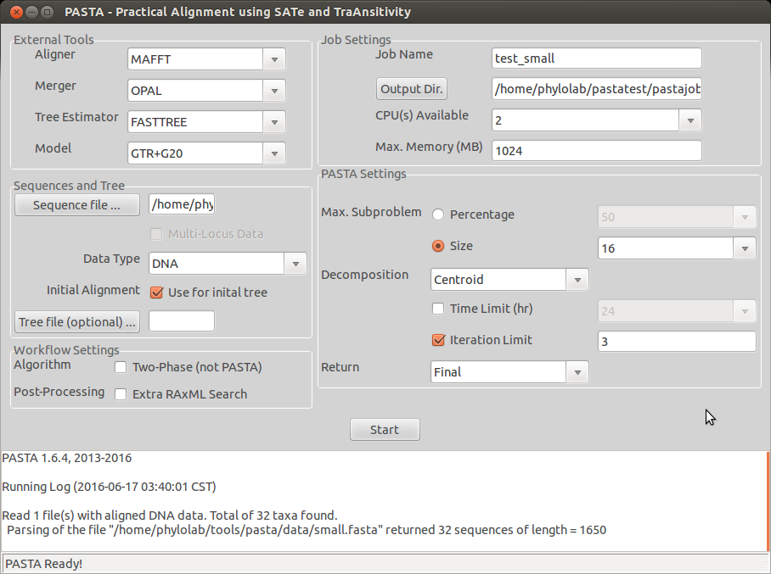
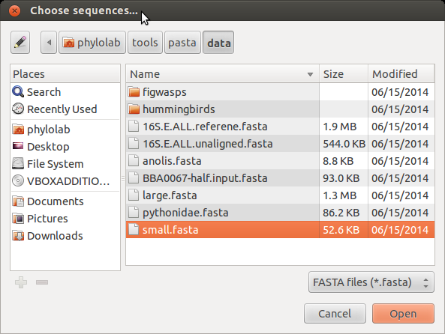
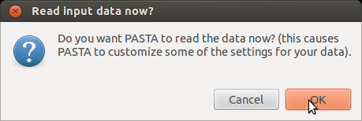
Example 1: small.fasta
Step 1: Read in the data. Located at <pasta-folder>/data/small.fasta
This is the PASTA install folder on the Virtual Machine
Reads in the DATA and sets Type, prints some stats:

Slide 13
Example 1: small.fasta
Importing the data caused the GUI to automatically set several settings based on the size, data type, etc…
It noticed that the data type was DNA
It also noticed that this fasta file contains aligned sequences.

Slide 14
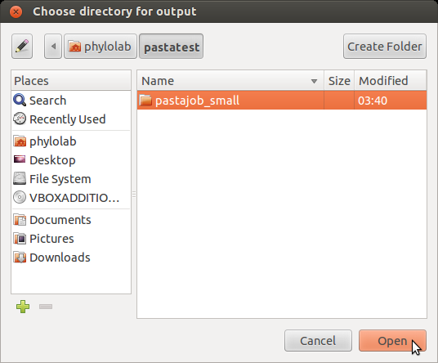
Example 1: small.fasta
Step 2: name the job & set the output folder:
Recommended: Use the create folder dialog to create a specific folder for these outputs.

Slide 15
Example 1: small.fasta
Step 3: Say “GO”

Slide 16
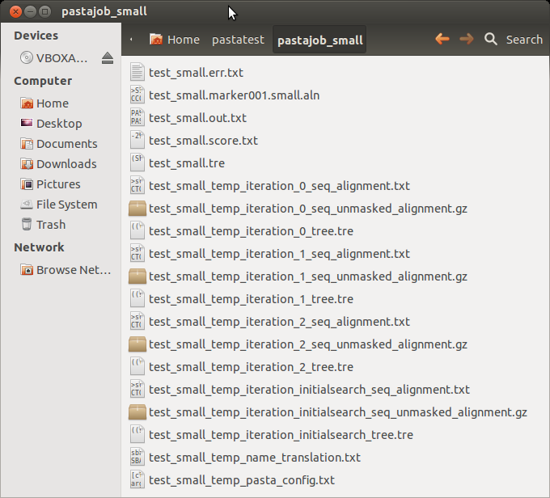
Example 1: Examining the Output Folder
= Important File
Final Alignment: always in this name format:
<jobname>.marker001.<original-fasta-name>.aln
Job Output (Errors): contains PASTA console output when errors are reported. If this file is zero bytes, that is a good thing.
Job Output: contains PASTA console output. Always good to examine this file after a run.
Final Tree
Intermediate alignments and trees after the initial search and after each iteration. Useful mainly for diagnostics and debugging
Config File: This saves all the settings for this particular job. The same exact job can be re-run from the command line by running “python run_pasta.py” with the path to this file as the ONLY argument

Slide 17
Example 2: BBA0067 (time permitting)
(protein data)

Slide 18
Final Tips & Best Practices
After running an alignment, it is always a good idea to look at the console outputs generated to verify that PASTA did what it was expected to do. If the error file is non-zero size, read that too.
The PASTA default settings are appropriate and well-chosen for most applications. Unless you have a good reason to use something else, this is a good starting point.
PASTA scales with the number of cores available, so giving it as many processors as possible is a good idea.
There are more settings available than what is in the GUI. Check the config file output for any pasta job to see the full list. Also can type “python run_pasta.py –h” from the pasta folder to see a thorough help menu
Approximate running time benchmarks (length=1500 base pairs):
100 Sequences: <10 minutes on a laptop
1000 Sequences: About 1-3 hours on a 16-core server
10000 Sequences: About 8-15 hours on a 16-core server
(Should scale about linearly after this, but will depend on settings…)

Slide 19
Resources
PASTA User Group:
https://groups.google.com/forum/#!forum/pasta-users
Link to these slides:
http://publish.illinois.edu/michaelnute/useful-files/
Github Repository (which has more documentation, including full install instructions):
http://github.com/smirarab/pasta
My Email: nute2@Illinois.edu

