Slide 1
Scaling BAli-Phy to Large Datasets
June 16, 2016
Michael Nute

Slide 2
BAli-Phy: Brief Summary
What is BAli-Phy? (Redelings & Suchard, 2005)
Software from 2005 that takes as input unaligned sequences and co-estimates the alignment and the phylogeny in a way that accounts for indels.
Output can be a multiple sequence alignment, a phylogeny, or both, and can give estimate of uncertainty in each one.
Why is it interesting?
The statistical model is unique and detailed, so given enough time it might find a better optimum than other methods.
Experimental evidence has shown that it gives more accurate multiple sequence alignments than more common methods (Liu, et al, 2012).
¹Redelings, B. D., & Suchard, M. a. (2005). Joint Bayesian estimation of alignment and phylogeny. Systematic Biology, 54(3), 401–418.
²Liu, K., Raghavan, S., Nelesen, S., Linder, C. R., & Warnow, T. (2009). Rapid and accurate large-scale coestimation of sequence alignments and phylogenetic trees. Science (New York, N.Y.), 324(5934), 1561–4.

Slide 3
BAli-Phy: Brief Summary
What is the disadvantage?
Software cannot handle more than ≈200 taxa due to suspected numerical instability.
Computation is very slow: most publications using it have run for several weeks.
(Gaya, et al., 2011) 68 sequences ran in 3 weeks
Largest data set we have found is 117-sequences (McKenzie, et al., 2014)

Slide 4
BAli-Phy: Quick Look at Results (1 of 2)
Alignment Error*
False Negative %
(1 – SP-Score)
False Positive %
(1 – Modeler Score)
# Taxa:
100
200
100
200
Simulator:
Indelible (DNA)
RNAsim (RNA)
*Averages over 10 replicates

Slide 5
BAli-Phy: Quick Look at Results (2 of 2)
Alignment Accuracy*
Total-Column Score
# Taxa:
100
200
100
200
Simulator:
Indelible (DNA)
RNAsim (RNA)
Total-Column Score: Percentage of columns from the reference alignment that are fully reproduced by the estimated alignment.
*Averages over 10 replicates

Slide 6
SATé and PASTA Algorithms
Obtain initial alignment and estimated ML tree
Tree
Estimate ML tree on new alignment
Use tree to compute new alignment
Alignment
Repeat until termination condition, and
return the alignment/tree pair with the best ML score

Slide 7
PASTA Algorithm
Input: unaligned sequences
1) Get initial alignment
2) Estimate tree on current alignment
3) Break into subsets according to tree
6) Use transitivity to merge subset pairs into a full alignment, scrap the old tree
(repeat)
4) Use external aligner to align subsets
5) Use external profile aligner to merge subset alignments
?

Slide 8
Divide and Conquer with BAli-Phy
QUESTION: Since we saw that BAli-Phy gives better alignments on small numbers of taxa, could we get better alignment on large data sets if we used BAli-Phy on subsets?
ANSWER: Yes, but it takes a lot of computing resources.
To get the most out of PASTA+BAli-Phy, start with the tree from the LAST iteration of default PASTA

Slide 9
Methods to Compare
PASTA:
Iterations 1-3: MAFFT (Subset Size 200)
(all default settings)
PASTA+BAli-Phy
Iterations 1-3: MAFFT (Subset Size 200)
Iteration 4: BAli-Phy (Subset Size 100)
PASTA+MAFFT
Iterations 1-3: MAFFT (Subset Size 200)
Iteration 4: MAFFT (Subset Size 100)
MAFFT L-INS-i
Default MAFFT (v7.273) using the mafft-linsi command
All default settings…
Takes advantage of faster MAFFT on early iterations where subsets are more diverse.
Helpful to identify whether any gain is from extra iteration or because BAli-Phy was used.
Useful comparison to benchmark difficulty of alignment. MAFFT is popular and L-INS-i is the most accurate version.

Slide 10
Error Reduction (1000 Sequences)
False Negative %
(i.e. 1 - SP-Score)
(Smaller is better)
False Positive %
(i.e. 1 – Modeler Score)

Slide 11
Accuracy Gain (1000 Sequences)
Total Column Score

Slide 12
Tree Error Relative to ML(Reference Alignment)
Delta-RF (RAxML)

Slide 13
Accuracy Gain (1000 Sequences, Detail)

Slide 14
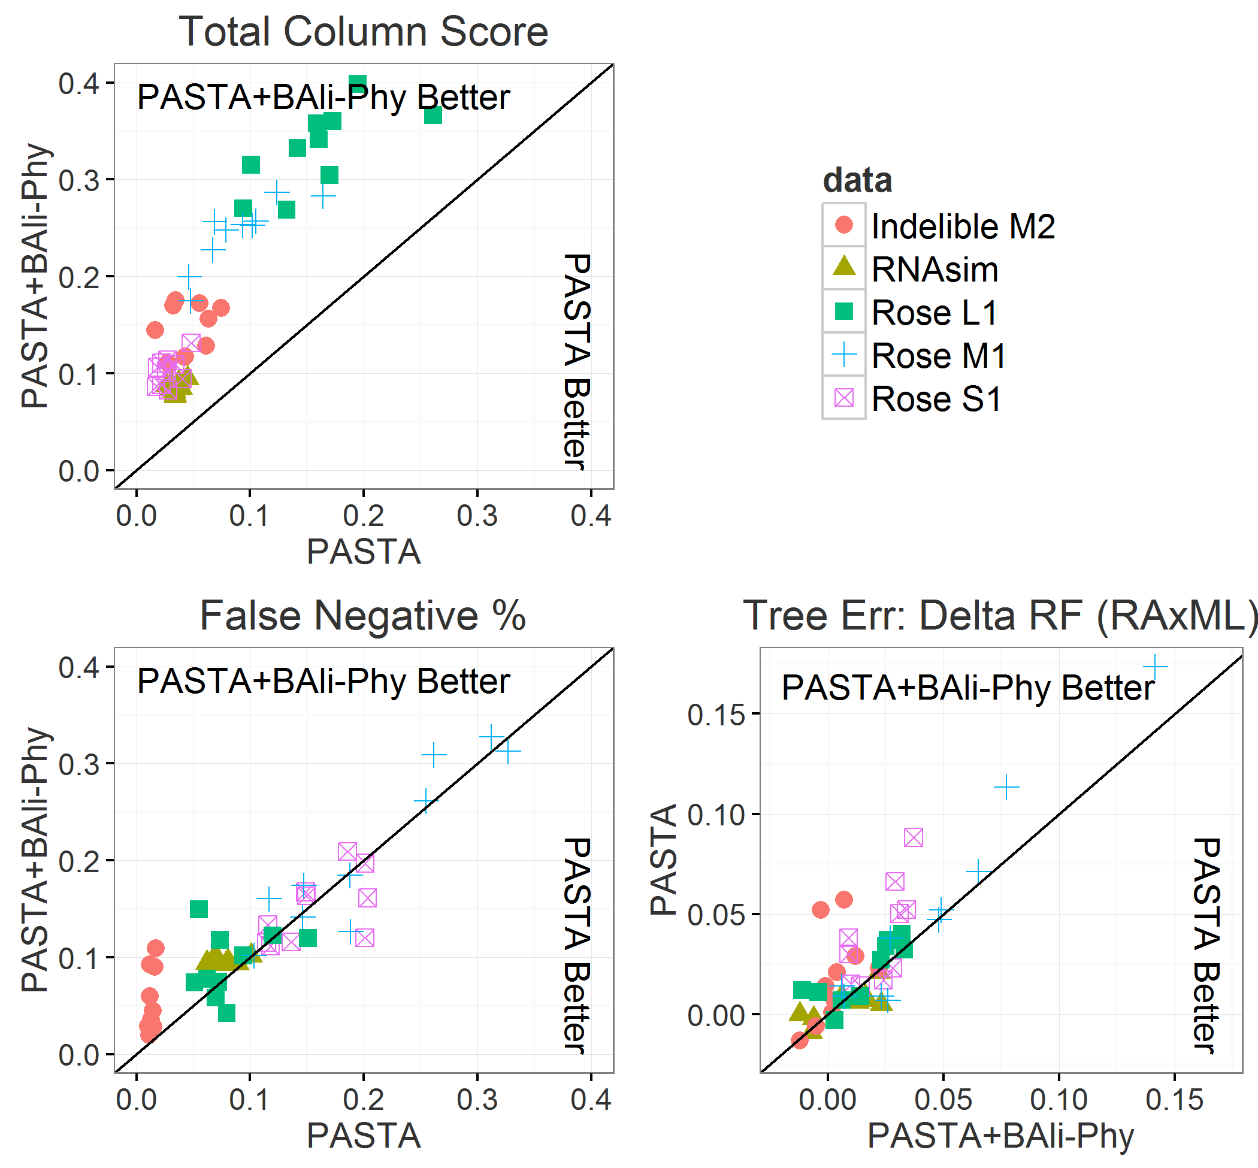
Accuracy Gain (1000 Sequences, Detail)

Slide 15
Scaling to 10,000 Sequences
We can use UPP (Nguyen, et al, 2015) to extend an alignment to larger numbers of sequences:
Take a random “backbone” subset (i.e. 1,000 sequences from previous slides)
Align the backbone
Align all remaining sequences to the backbone via HMMs

Slide 16
Scaling to 10,000 Sequences
Accuracy of full alignment tends to track the accuracy of the backbone:

Slide 17
Scaling to 10,000 Sequences

Slide 18
Hypothetical Running Time Comparison
Data: 1000 Taxa
Goal: Run PASTA (1 iteration, maximum subset size 100)
Resource: 1 Server, 32 Cores
Question: How long does each subset-alignment method take?
Answer:
With 1,000 taxa and subsets no larger than 100, we’ll have approximately 15 subsets (between 10-16).
MAFFT:
Takes 1 core approx. 10-20 minutes to do 1 subset. Can do all subsets in parallel.
Total: 10-20 minutes
BAli-Phy:
Takes 24 hours for all 32 cores to do 1 subset. Can’t run in parallel since we only have 32 cores.
Total: 15 Days
These calculations are hypothetical but representative.
If we have multiple servers, we can run BAli-Phy in parallel in less time…
Still, if we want to run BAli-Phy it makes the most sense to several iterations with MAFFT first.

Slide 19
Summary
BAli-Phy provides more accurate alignments than MAFFT on small data, which can translate to more accurate alignments on up to 1,000 taxa by boosting with PASTA.
Although the running time is longer, this allows BAli-Phy to be scaled in a parallel way, so we can align 1,000 sequences in the time it takes to align 100.
Alignment accuracy translates to improved tree accuracy on this data.
Alignments can be further extended to 10,000 sequences using UPP
Code at: http://github.com/mgnute/pasta

Slide 20
Acknowledgements
Special Thanks
This is a joint work with my advisor, Prof. Tandy Warnow. Special thanks to Nam Nguyen for early collaboration on this project and for teaching me the codebase for PASTA and UPP, and to Erin Molloy for several helpful discussions and suggestions over the course of this research.
NSF
This work was funded by NSF grant III:AF:1513629
Blue Waters
This research is part of the Blue Waters sustained-petascale computing project, which is supported by the National Science Foundation (awards OCI-0725070 and ACI-1238993) and the state of Illinois. Blue Waters is a joint effort of the University of Illinois at Urbana-Champaign and its National Center for Supercomputing Applications.

Slide 21
References
[1.] Redelings, B. D., & Suchard, M. (2005). Joint Bayesian estimation of alignment and phylogeny. Systematic Biology, 54(3), 401–418.
[2.] Liu, K., Raghavan, S., Nelesen, S., Linder, C. R., & Warnow, T. (2009). Rapid and accurate large-scale coestimation of sequence alignments and phylogenetic trees. Science (New York, N.Y.), 324(5934), 1561–4.
[3.] Katoh, K., Misawa, K., Kuma, K., & Miyata, T. (2002). MAFFT: a novel method for rapid multiple sequence alignment based on fast Fourier transform. Nucleic Acids Research, 30(14), 3059–3066.
[4.] Mirarab, S., Nguyen, N., Guo, S., Wang, L.-S., Kim, J., & Warnow, T. (2015). PASTA: Ultra-Large Multiple Sequence Alignment for Nucleotide and Amino-Acid Sequences. Journal of Computational Biology, 22(5), 377–386.
[5.] McKenzie, S. K., Oxley, P. R., & Kronauer, D. J. C. (2014). Comparative genomics and transcriptomics in ants provide new insights into the evolution and function of odorant binding and chemosensory proteins. BMC Genomics, 15(1), 718.
[6.] Liu, K., Warnow, T. J., Holder, M. T., Nelesen, S. M., Yu, J., Stamatakis, A. P., & Linder, C. R. (2012). SATe-II: Very Fast and Accurate Simultaneous Estimation of Multiple Sequence Alignments and Phylogenetic Trees. Systematic Biology, 61(1), 90–106.
[7.] Nguyen, N. D., Mirarab, S., Kumar, K., & Warnow, T. (2015). Ultra-large alignments using phylogeny-aware profiles. Genome Biology, 16(1), 124.

