Slide 1
Community Detection and “Well-Connectedness”
Tandy Warnow
Department of Computer Science

Slide 3
What are communities (in graphs)?
Communities should be:
Individuals are connected within the community
More connected internally than externally
Within a graph, the individuals are vertices (nodes) and edges reflect connections.
How do we find these communities? (What algorithms?)
What graphical properties should these communities have?

Slide 4
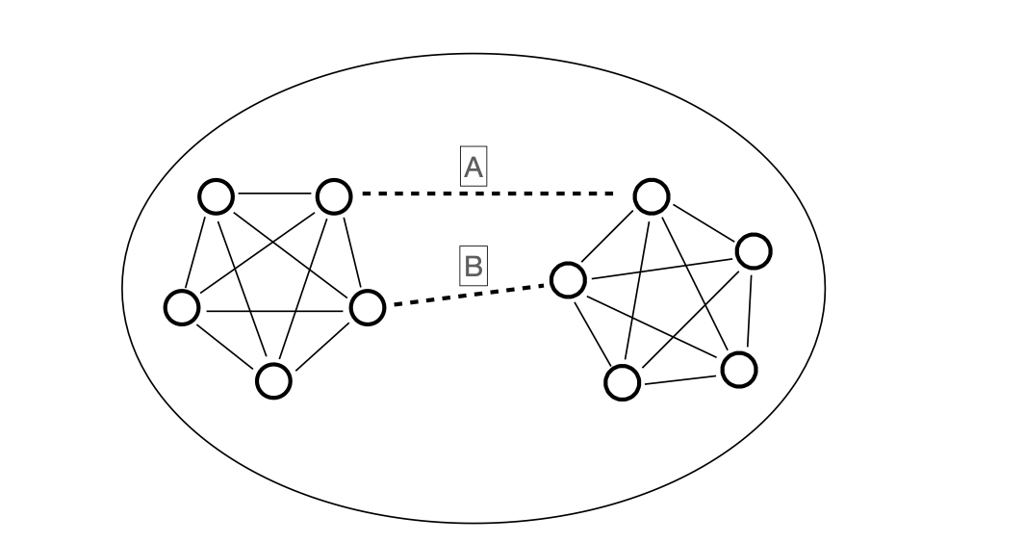
Is this cluster well-connected?
An “edge cut” is a set of edges whose removal disconnects the graph.
{A,B} is an edge cut.
Do you think this is a well-connected cluster?
Suppose only one of the edges A and B is present.
Is this cluster (with ten nodes) well-connected?

Slide 5
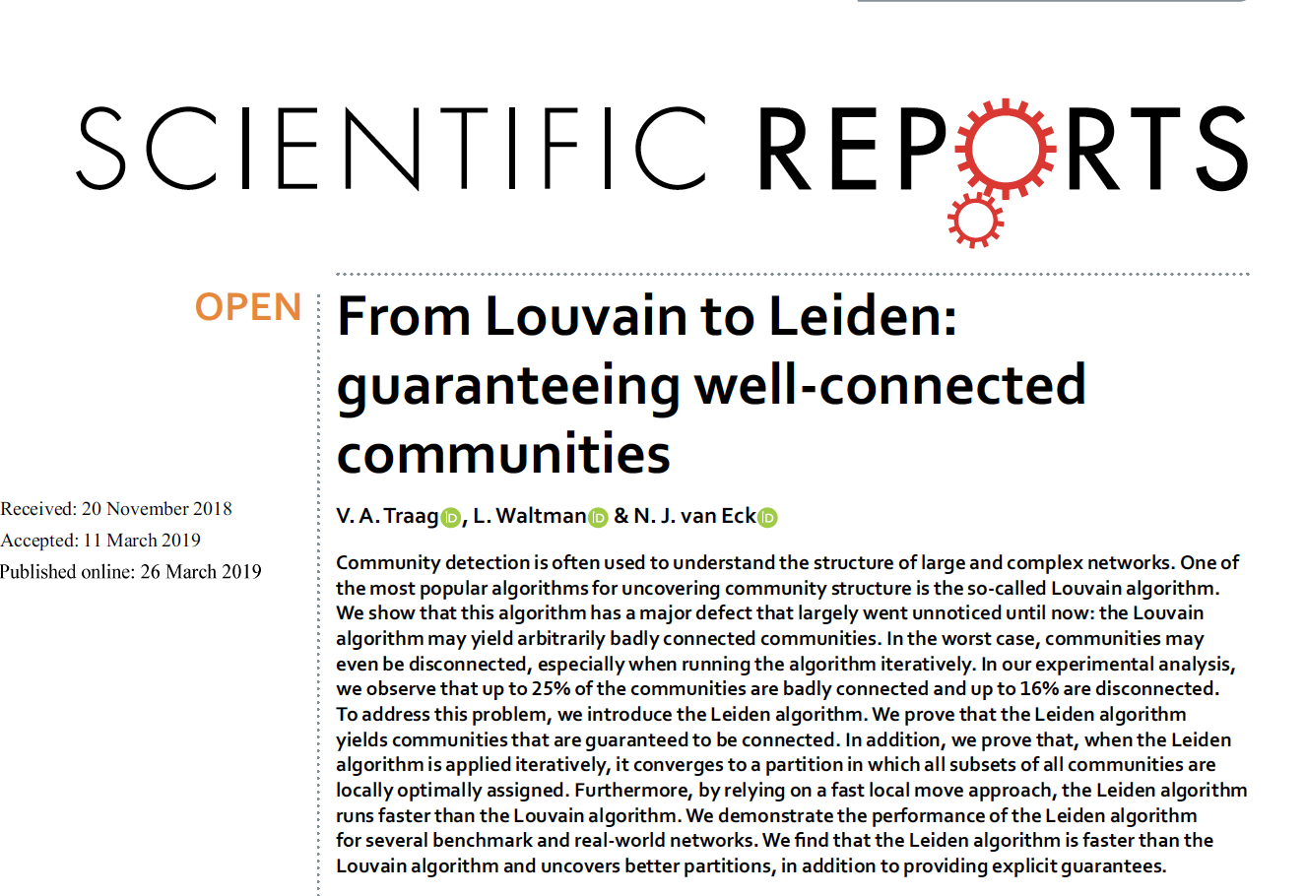

Slide 6
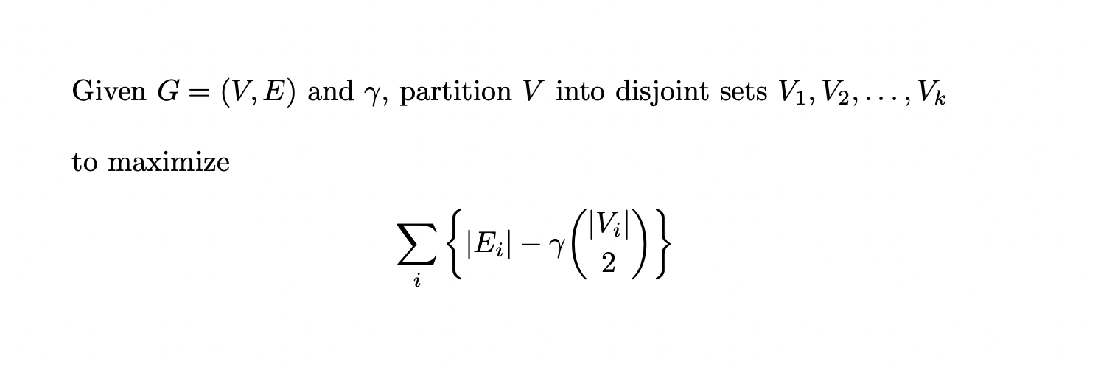
Leiden and CPM-optimization
Theorem (from Traag et al.): For any cluster C in an optimal CPM clustering, every edge-cut E₀ splitting C into sets A and B satisfies

Slide 7
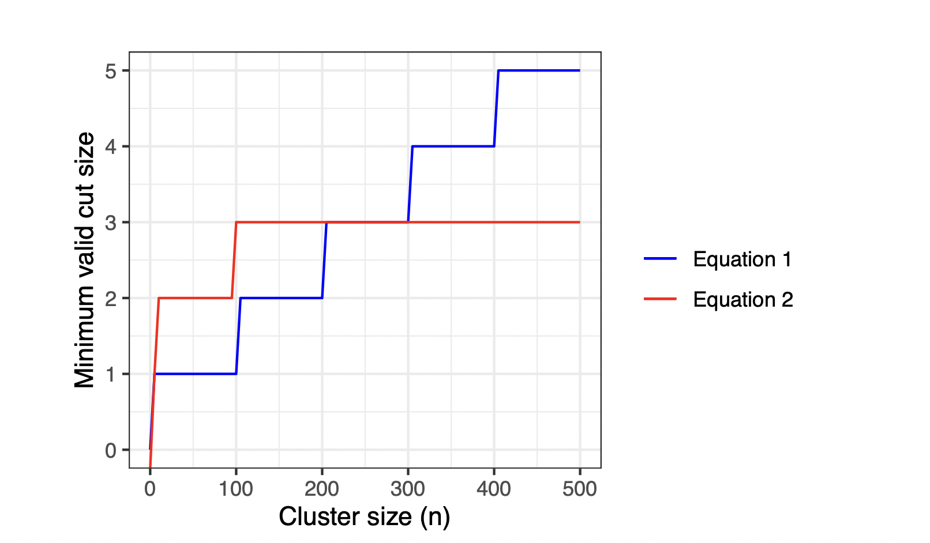
Comparing two lower bounds on minimum edge cut size
Equation 1: the guarantee for CPM-optimal clusters, from Traag et al.
Equation 2: We require only that the edge cut exceed log10(n)

Slide 8
Datasets

Slide 9
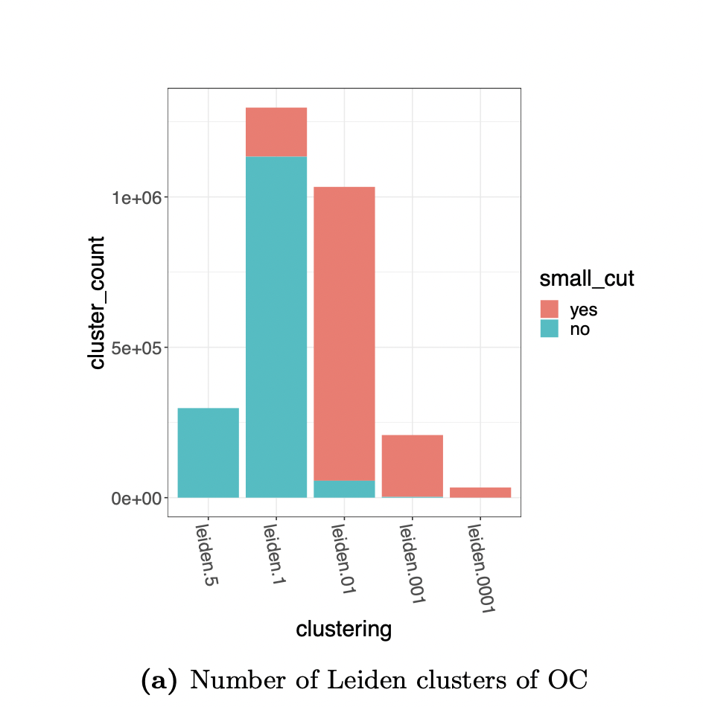
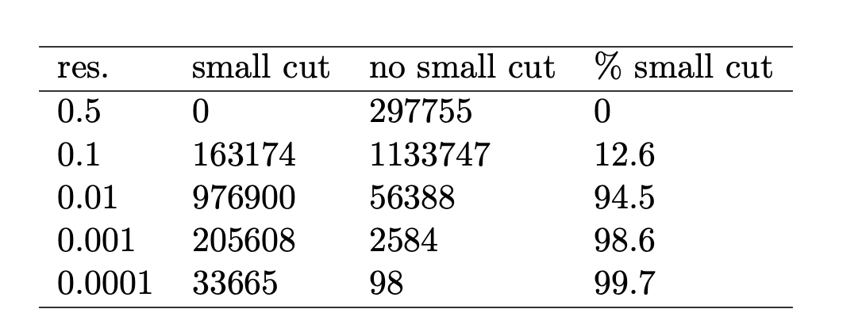
CPM-based clustering of Open Citations Network
Note: Except for large resolution values,
Leiden clusters are not well-connected!

Slide 10
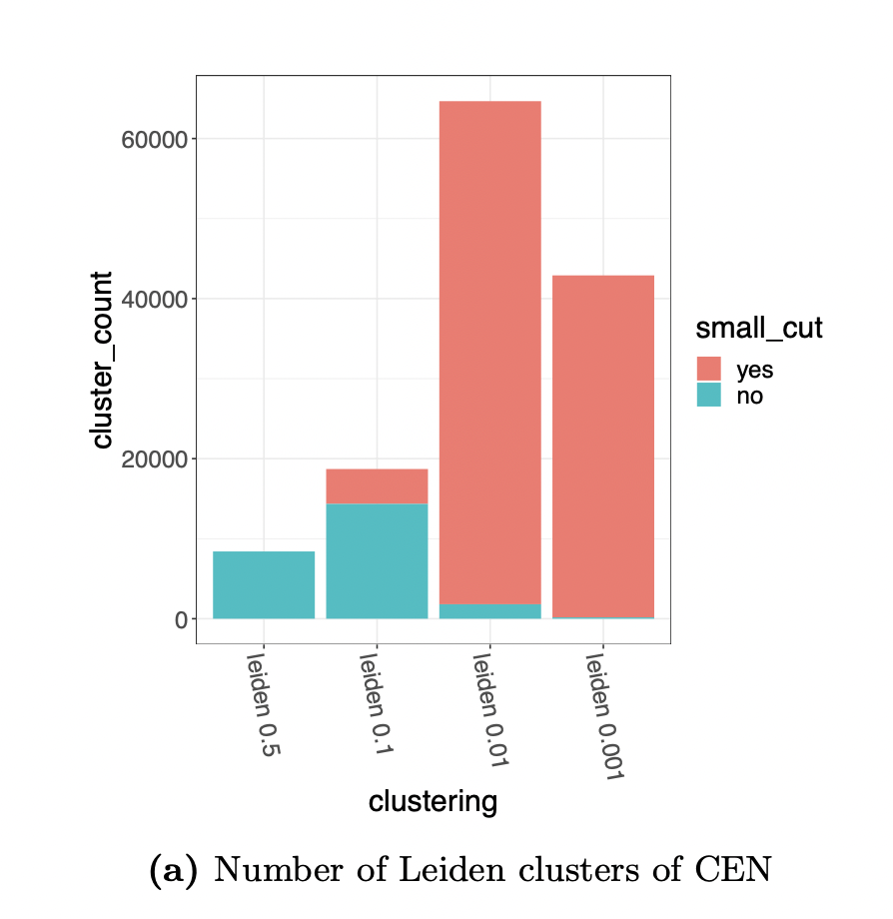
CPM-based clustering of Curated Exosome Network
Note: Except for large resolution values,
Leiden clusters are not well-connected!

Slide 11
The Connectivity Modifier pipeline

Slide 12
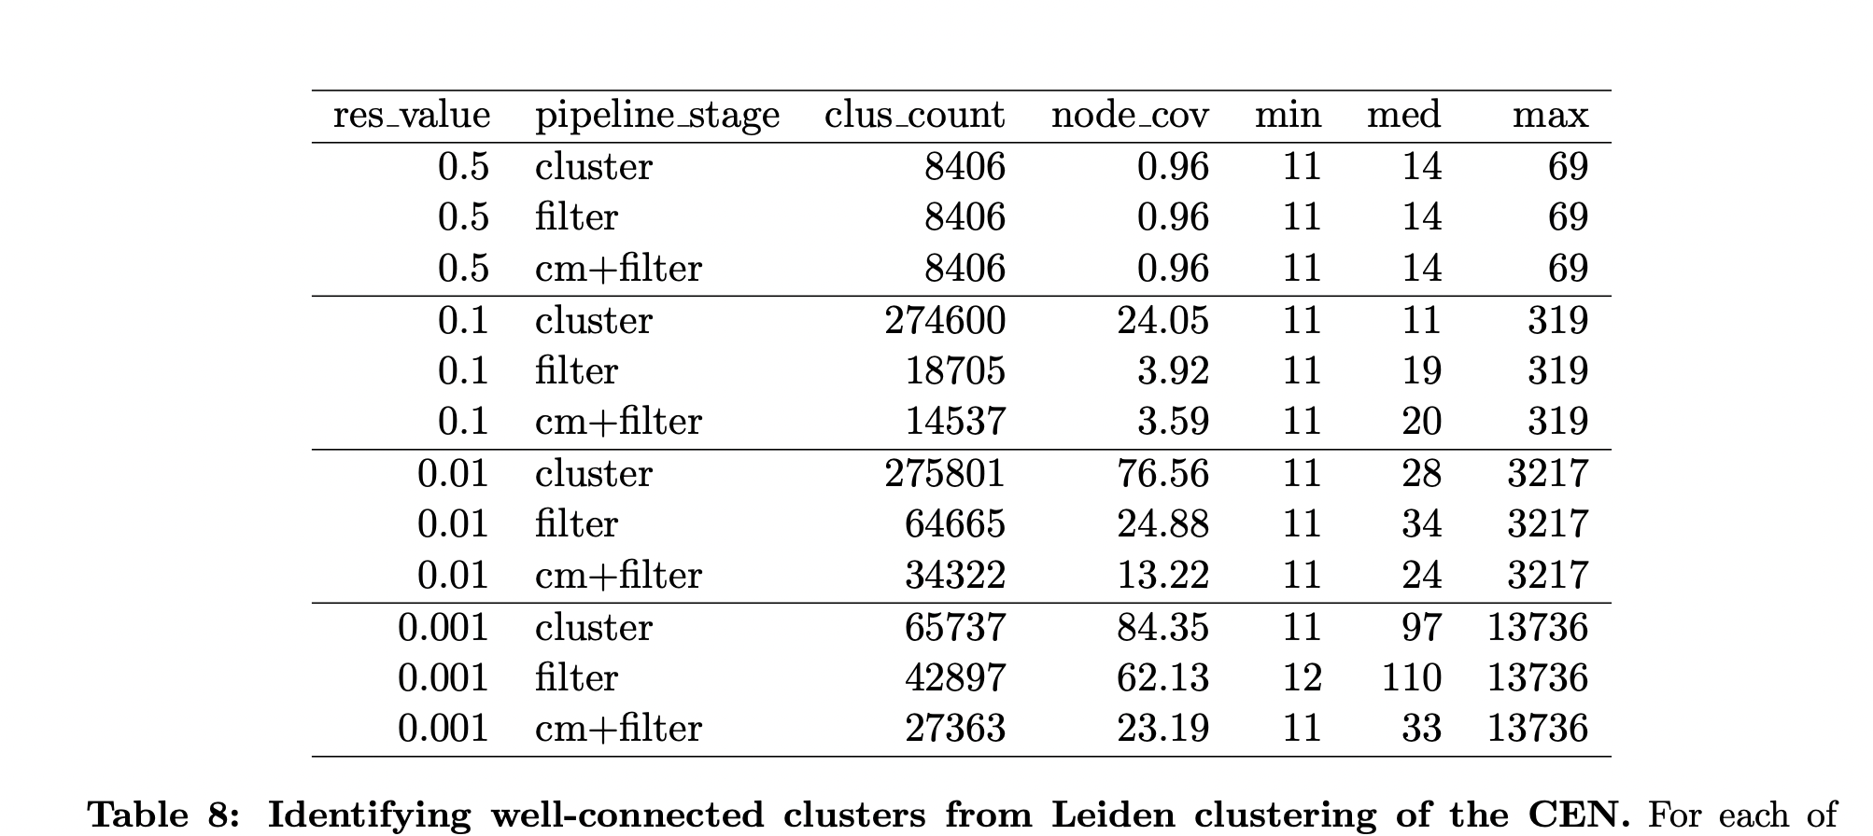
Connectivity Modifier produces large drops in node coverage!

Slide 13
Summary so far…
Leiden on real world networks:
Many Leiden clusters have small edge cuts
Connectivity Modifier reduces node coverage (sometimes dramatically)
Maybe in real-world networks…
Not all vertices belong to communities?
Leiden clusters don’t display good community structure?
What does this mean for research that has used Leiden clustering?

Slide 14
What about synthetic networks?
LFR: very popular software for generating networks, with the goal of resembling real-world networks
Technique:
Give LFR some parameter values (from a real-world network) and it will produce a synthetic network that is supposed to resemble the real-world network, with “true” community structure
Every node is in a community
LFR synthetic networks are used to evaluate community detection methods!

Slide 15
LFR vs real-world networks

Slide 16
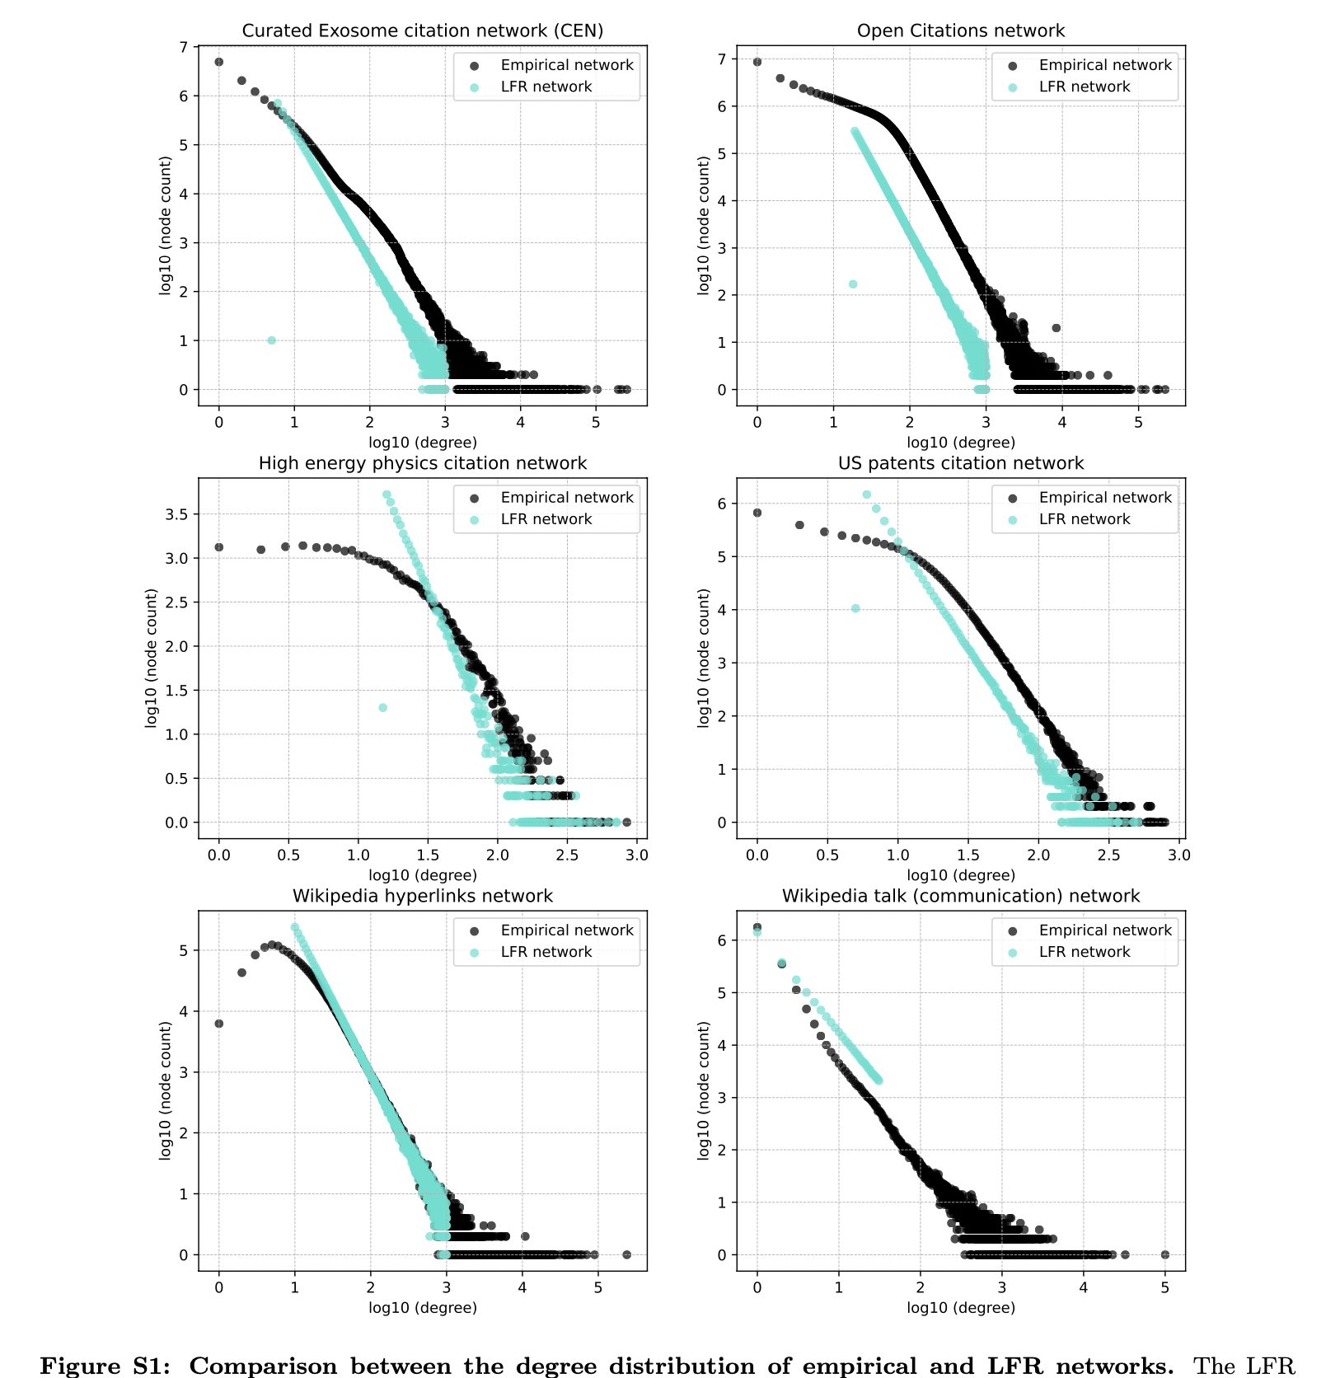
Is LFR able to reproduce real-world networks?

Slide 17
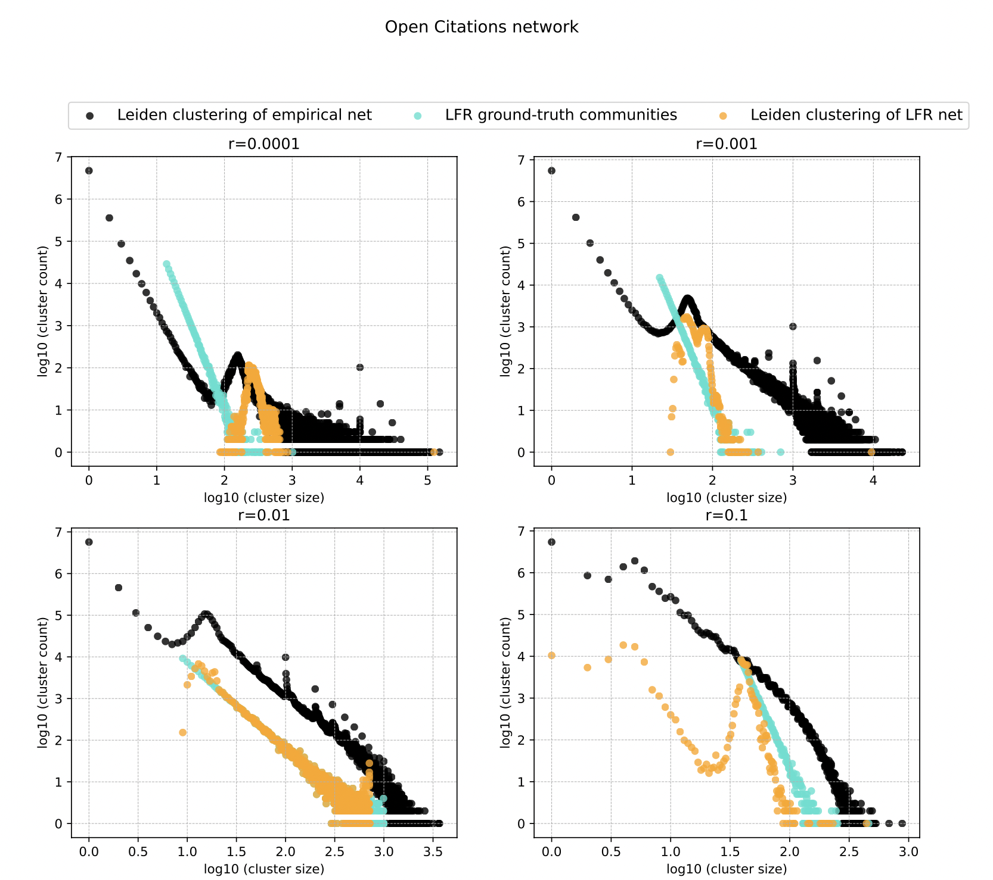
Is LFR able to reproduce real-world networks?

Slide 18
Summary of Part II (LFR vs real-world)
LFR networks behave very differently from real-world networks
Different degree distribution
Different response to Connectivity Modifier
Different response to Leiden clustering
Basic assumptions of LFR networks
Every node is in some cluster
Degree distribution and cluster sizes follow some nice distribution (power-law)
Something is wrong, but exactly what it is, we do not yet know

Slide 19
Overall summary
Community detection is important, but Leiden and other major approach(es) may not produce valid communities
Opinions may differ about what constitutes a valid community, but… well-connectivity is probably a basic one (but what is a good definition for well-connected)?
Synthetic network generation may fail to reproduce important features of real-world networks
Lots of questions without answers, lots of work to be done

Slide 20
Take-home messages
It’s important to look carefully, and not just believe titles, claims, etc
Mathematics doesn’t lie, BUT interpreting math is non-trivial
Data can be highly revealing
Even the authors may not understand what they have done

Slide 21
Acknowledgments
This work was supported by the Insper-Illinois program, an Oracle Research Award, and the University of Illinois Urbana-Champaign
Insper faculty: Fabió Ayres
UIUC students: Minhyuk Park, Yasamin Tabatabaee, Baqiao Liu, Vikram Ramavarapu, and Vidya Pailodi
UIUC faculty: George Chacko and Tandy Warnow

