Slide 1
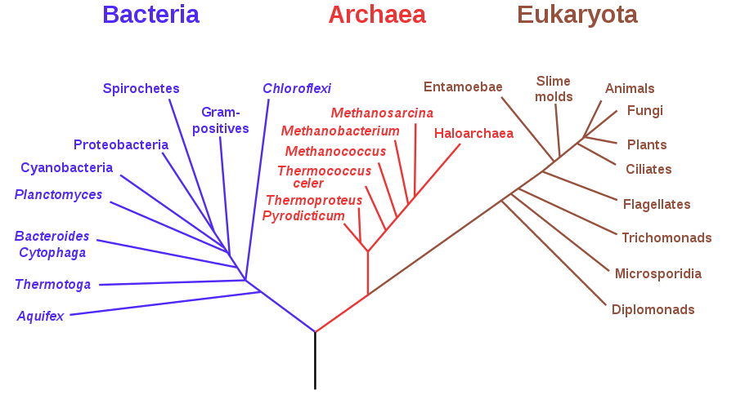
﻿EPA-ng: Massively Parallel Evolutionary Placement of Genetic Sequences
Presented by Grant Greenberg and Vishal Rana
Notes:
Phylogenetic tree of life built using ribosomal RNA sequences, after Karl Woese. Image credit: Modified from Eric Gaba, Wikimedia Commons.0

Slide 2
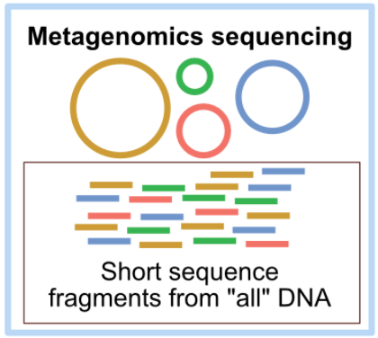
Background: Metagenomics
Metagenomic samples yield millions of reads
Phylogenetic placement used to identify species
﻿BLAST-based approach have limitations:
Misleading assignments if references are not closely related to queries
Notes:
Look up LWR (pplacer)
https://www.google.com/url?sa=i&url=https%3A%2F%2Fastrobiomike.github.io%2Fmisc%2Famplicon_and_metagen&psig=AOvVaw2Z0nF4-0tQ56i0lToQ6ACY&ust=1603941083889000&source=images&cd=vfe&ved=0CA0QjhxqFwoTCIiLkqeo1uwCFQAAAAAdAAAAABAI

Slide 3
Placement Procedure - Algorithm
Input:
Reference MSA
Phylogenetic reference tree (RT)
Query sequences (QS) aligned to reference MSA
Output:
Likelihood weight ratio (LWR) for each QS at each edge in RT
Notes:
Look up LWR (pplacer)

Slide 4
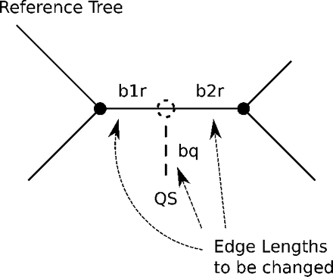
Heuristics – Preplacement and Masking
Preplacement: QS placed at mid-point of edge
Edges filtered based on preplacement likelihoods
Accumulated LWR threshold
RAxML default: Top x% of placements kept
“Baseball” heuristic from pplacer
Masking: Removing uninformative loci from MSA
Notes:
Baseball heuristic, accumulated threshold
Masking especially useful for short reads where MSA has long gaps
Accumulated threshold: Top x branches will a threshold for aggregate likelihood is reached. ???

Slide 5
Datasets
Dataset | # Taxa | # Sites | # QSs | Type
Neotrop Mahe et al. (2017) | 512 | 4,686 | 1M | 16S
BV Srinivasan et al. (2012): | 797 | 2,763 | 15,000 | 16S
Tara Oceans Sunagawa et al. (2015): | 3748 | 3,374 | 10,000 | 16S

Slide 6
Results: Verification of Implementation
Kantorovich–Rubinstein (PKR) metric:
Work required to transform one placement distribution into another by moving the LWR mass along the branches of the RT

Slide 7
Sequential Runtimes
Compare to EPA-RAxML & pplacer on 50,000 sequences
~30-fold performance improvement over pplacer
Alignment takes ~500 min using PaPaRa
3 minutes for EPA-ng
QS alignment major bottleneck

Slide 8
Parallelization
MPI to split overall work between nodes
Each QS can be placed independently
OpenMP to parallelize within the node
Overlapping I/O and computations
Fully parallelized write operations

Slide 9
Parallel Performance
Parallel efficiency:
$E\left(N\right)= {S(N)}/N$
$S\left(N\right)= {T_{1}}/{T_{N}}$
N: # cores
S: parallel speedup
$T_{N}:$ execution time
$T_{1}:$fastest sequential execution time
PE decreases with increasing # cores
Overhead becomes the dominant

Slide 10
Single Node Performance

Slide 11
Thank you! Questions?

