Slide 1
Phylogenetic Networks of Languages
Tandy Warnow
Department of Computer Science

Slide 2



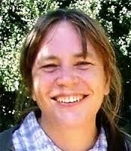

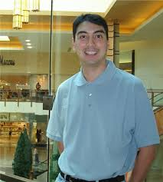
The Computational Historical Linguistics Project
Collaboration with Don Ringe began
in 1994; 17 papers since then, and two
NSF grants.
Dataset generation by Ringe and Ann Taylor
(then a postdoc with Ringe, now Senior Lecturer
at York University).
Method development with Luay Nakhleh (then
my student, now Dean of Engineering at
Rice University), Steve Evans (Prof. Statistics,
Berkeley). Simulation study with Francois
Barbançon (then my postdoc).
New work with Marc Canby (PhD student of Julia Hockenmaier at UIUC).
Ongoing work in IE with Ringe.
http://tandy.cs.illinois.edu/histling.html

Slide 3
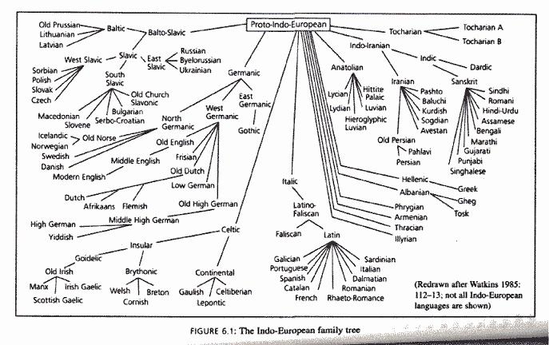
Indo-European languages
From linguistica.tribe.net

Slide 4
Controversies for IE history
Subgrouping: Other than the 10 major subgroups, what is likely to be true? In particular, what about
  Italo-Celtic
  Greco-Armenian
  Anatolian + Tocharian
  Satem Core (Indo-Iranian and Balto-Slavic)
  Location of Germanic
What is the homeland of the Indo-Europeans?

Slide 5
Estimating the date and homeland of the proto-Indo-Europeans
Step 1: Estimate the phylogeny
Step 2: Reconstruct words for proto-Indo-European (and for intermediate proto-languages)
Step 3: Use archaeological evidence to constrain dates and geographic locations of the proto-languages

Slide 6
Possible Indo-European tree
(Ringe, Warnow and Taylor 2000)

Slide 7
Another possible Indo-European tree (Gray & Atkinson, 2004)
Italic Gmc. Celtic Baltic Slavic Alb. Indic Iranian Armenian Greek Toch. Anatolian

Slide 8
“Perfect Phylogenetic Network”
(all characters compatible)
L. Nakhleh, D. Ringe, and T. Warnow, LANGUAGE, 2005

Slide 9
Preview
Indo-European Phylogeny (tree or network) is highly debated, but relevant to research in archaeology, anthropology, and early origins of humans
Phylogenetic networks are needed for modeling evolution, both in linguistics and in biology.
Methods for biological network estimation are mainly likelihood-based and very computationally intensive.
Discrete methods, such as the ones described, could advance discovery.
BUT – very little theory so far establishing identifiability of phylogenetic networks, and statistically consistent methods are (so far) limited (and do not have any performance guarantees on finite data, especially if not generated by the model)
New methods and new theory are both needed.

Slide 10
Historical Linguistic Data
A character is a function that maps a set of languages, L, to a set of states.
Three kinds of characters:
  Phonological (sound changes)
  Lexical (cognate classes, based on meanings from a wordlist)
  Morphological (especially inflectional)

Slide 11
Homoplasy-free evolution
When a character changes state, it changes to a new state not in the tree; i.e., there is no homoplasy (character reversal or parallel evolution)
First inferred for weird innovations in phonological characters and morphological characters in the 19th century, and used to establish all the major subgroups within IE
0
0
1
0
0
0
0
1
1

Slide 12
Our methods/models
1995: Ringe & Warnow “Almost Perfect Phylogeny (APP)”: most characters evolve without homoplasy under a no-common-mechanism assumption (various publications since 1995)
2005: Ringe, Warnow, & Nakhleh “Perfect Phylogenetic Network (PPN)”: extends APP model to allow for borrowing, but assumes homoplasy-free evolution for all characters (Language, 2005)
2006: Warnow, Evans, Ringe & Nakhleh “Extended Markov model”: parameterizes PPN and allows for homoplasy provided that homoplastic states can be identified from the data (Cambridge University Press)

Slide 13
Our methods/models
1995: Ringe & Warnow “Almost Perfect Phylogeny (APP)”: most characters evolve without homoplasy under a no-common-mechanism assumption (various publications since 1995)
2005: Ringe, Warnow, & Nakhleh “Perfect Phylogenetic Network (PPN)”: extends APP model to allow for borrowing, but assumes homoplasy-free evolution for all characters (Language, 2005)
2006: Warnow, Evans, Ringe & Nakhleh “Extended Markov model”: parameterizes PPN and allows for homoplasy provided that homoplastic states can be identified from the data (Cambridge University Press)

Slide 14
WERN 2006 theorem and conjecture
In WERN 2006, we proved that the phylogenetic tree was identifiable from the probability distribution on character states.
We also conjectured that the phylogenetic network might be identifiable under some conditions (e.g., if there was only one borrowing edge).
However, we did not provide any proof, and we did not make any progress on this.

Slide 15
This talk
Introduction to Phylogenetic Networks, including Gambette et al., 2012 algorithm for reconstructing level-1 networks from quartet trees
Models of evolution for linguistic characters (published)
Identifiability of the Linguistic “Genetic” Tree (published)
Identifiability of the Linguistic Phylogenetic Network Topology (unpublished)
Open problems for phylogenetic network estimation

Slide 16
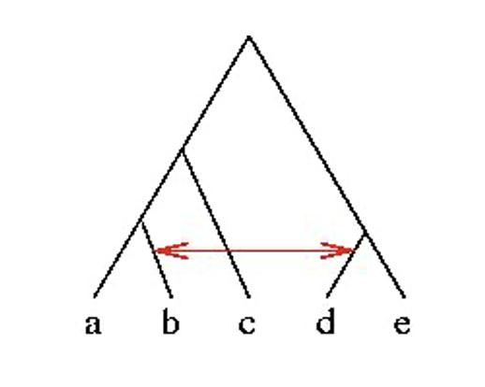
Tree-based network
The network is rooted.
There is an underlying tree, on top of which there are extra edges.
This network has only one extra edge.
For linguistics, think of the red edge as indicating borrowing between two language communities.

Slide 17
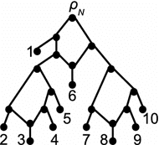
Hybridization networks
Note: the network is rooted – imagine directing edges away from the root.
Every node (other than the root)
has indegree that is either 1 or 2.
A node with indegree 2 is a hybridization node.
Note the cycles!
In this network, the cycles are node-disjoint.
From: Gambette,doi: 0.1007/s00285-016-1068-3

Slide 18
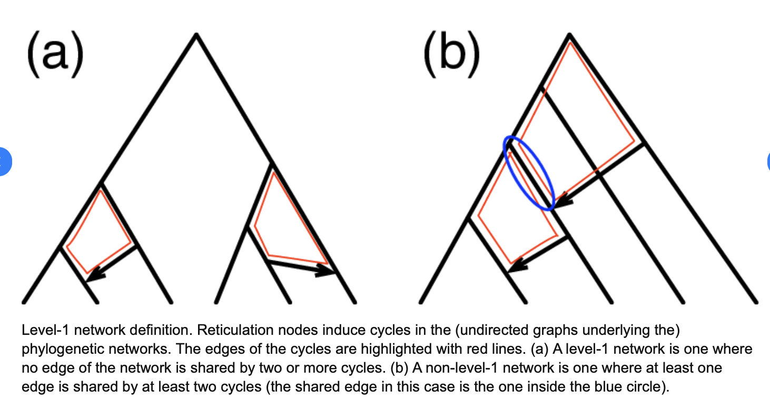
Level-1 networks (and others)
From: Elworth, RA Leo, et al. arXiv arXiv:1808.08662.

Slide 19
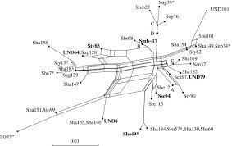
Different kinds of networks
Explicit networks
Implicit networks
From Mol. Biol. Evol. 21(2):255–265. 2004
DOI: 10.1093/molbev/msh018

Slide 20
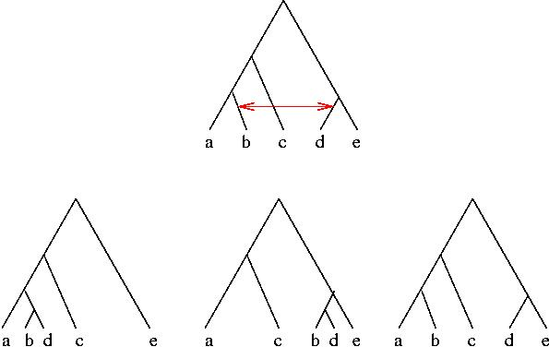
Phylogenetic Networks and the Trees they contain

Slide 21
Q(N): the set of quartet trees in network N
Note, there can be more than
one tree on a given set of
4 leaves!
bd|ae, ab|ce
ac|be

Slide 22
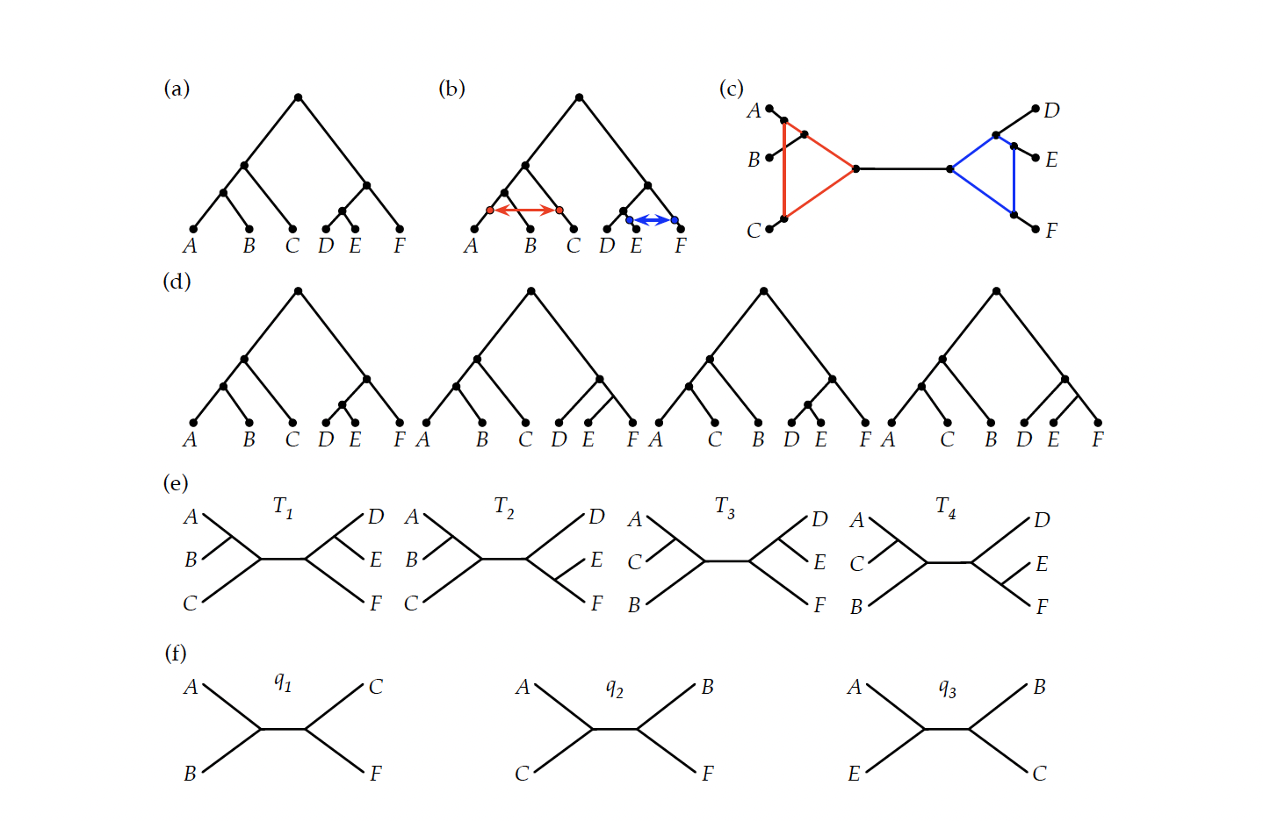
Figure 1 from Warnow et al., 2023.
Examine quartet trees (bottom row): which ones are displayed in the trees in the network?

Slide 23
Constructing Trees from Quartet Trees
Quartet trees: the induced homeomorphic subtree on four leaves.
Q(T): the set of all quartet trees of a tree T.
Theorem: Q(T) uniquely determines T (and T is reconstructable in polynomial time).
In WERN 2006, we used this theorem to establish that if languages evolve down a binary tree T under the WERN 2006 model, then we can estimate T in polynomial time, and in a statistically consistent manner.

Slide 24
Constructing phylogenetic networks
Basic techniques:
From the trees they contain (rooted or unrooted)
From clades (rooted subtrees) or (rooted) triplet trees
From characters that evolve down the network
From (unrooted) quartet trees

Slide 25
Constructing Networks from Quartet Trees
Quartet trees: the induced homeomorphic subtree on four leaves.
Q(N): the set of all quartet trees of a network N.
If N is a tree, then Q(N) uniquely determines N (and reconstructable in polynomial time).
Which networks can we construct from sets of quartet trees?

Slide 26
Problems
Problem 1: Given Q(N), can we reconstruct unrooted topology of N?
Problem 2: Given a proper subset of Q(N), can we reconstruct unrooted topology of N?
Problem 3: Can a set Q of quartet trees, can we find a phylogenetic network N such that Q(N) and Q are close?
Answers require constraining the network topology.

Slide 27
Gambette et al., 2012
Problem 1: Given Q(N), can we reconstruct unrooted topology of N?
Answers:
  if N is a level-1 or level-2 phylogenetic network, then YES (and in polynomial time).
  Otherwise, NP-hard to determine
Gambette et al., 2012 “Quartets and unrooted phylogenetic networks”, J. Bioinformatics and Computational Biology. They give an O(n⁴) algorithm to construct a level-1 network from Q(N), as well as other results.

Slide 28
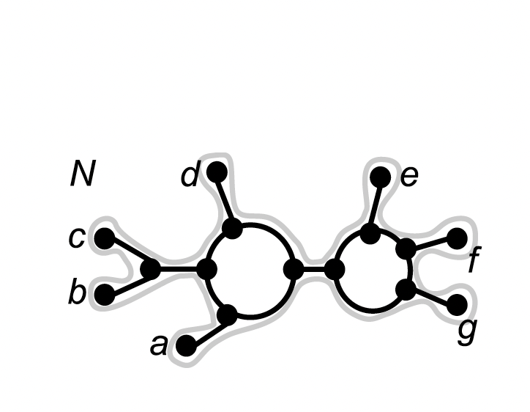
Constructing level-1 network from Q(N) in O(n⁴) time.
Step 1: Let Q* be the set of quartet trees ab|cd such that Q(N) does not contain ac|bd or ad|bc.
Step 2: Construct a maximally resolved tree T* such that Q(T) contains all quartet trees in Q* . (Note: T* may not be binary.)
Step 3: Replace high degree nodes by cycles, to produce Q(N).
N
C
b
d
e
f
T*
a
g
Step 1: Q* contains exactly those quartets for the splits defined by the cut edges.
Step 2: T* is tree formed by collapsing the cycles to single nodes.

Slide 29
Problem 2
Problem 2: Given a proper subset Q of Q(N), can we reconstruct N?
Answer: If Q is dense (at least one tree for every four leaves) and N is level-1, then solvable in polynomial time. Otherwise, not only NP-hard, but there can be exponentially many networks compatible with the set Q.
O(n⁶) algorithm in
Keijsper and RA Pendavingh. Reconstructing a phylogenetic level-1 network from quartets. Bulletin of Mathematical Biology, 76(10):2517–2541, 2014.

Slide 30
Problem 3
Problem 3: Can a set Q of quartet trees, can we find a phylogenetic network N such that Q(N) and Q are close?
Answers (only for case of trees):
NP-hard
PTAS (for case of trees) if Q is dense (has a tree on every four leaves)
See Jiang et al. SICOMP 2001

Slide 31
How can we construct phylogenetic networks?
From the trees they contain?
  How do we obtain these trees?
From characters that evolve down the network?
  What can we assume about the character evolution?

Slide 32
How can we construct phylogenetic networks in biology?
From the trees they contain?
  Gene trees (across the genome)
From characters that evolve down the network?
  In some cases, might be able to infer from SNPs (homoplasy-free binary characters, with known ancestral state)

Slide 33
Reconstructing networks in biology
Much harder than reconstructing trees!
  Even for a fixed number of leaves, there are many more networks than trees (i.e., you can keep adding edges)… how to choose when to stop?
  Little known about statistical identifiability, even for “simple” phylogenetic networks
  Even if you constrain the network model, it’s computationally intensive
  Generally limited to maybe 10 or so species

Slide 34
How can we construct phylogenetic networks for languages?
From the trees they contain?
  How do we obtain these trees?
From characters that evolve down the network?
  What can we assume about the character evolution?

Slide 35
This talk
Introduction to Phylogenetic Networks
Models of evolution for linguistic characters (published)
Identifiability of the Linguistic “Genetic” Tree (published)
Identifiability of the Linguistic Phylogenetic Network Topology (unpublished)
Discussion and Future work

Slide 36
Historical Linguistic Data
A character is a function that maps a set of languages, L, to a set of states.
Three kinds of characters:
  Phonological (sound changes)
  Lexical (cognate classes, based on meanings from a wordlist)
  Morphological (especially inflectional)

Slide 37
Homoplasy-free evolution
When a character changes state, it changes to a new state not in the tree; i.e., there is no homoplasy (character reversal or parallel evolution)
First inferred for weird innovations in phonological characters and morphological characters in the 19th century, and used to establish all the major subgroups within IE
0
0
1
0
0
0
0
1
1

Slide 38
Sound changes
Many sound changes are natural, and should not be used for phylogenetic reconstruction.
Others are bizarre, or are composed of a sequence of simple sound changes. These are useful for subgrouping purposes. Example: Grimm’s Law.
  Proto-Indo-European voiceless stops change into voiceless fricatives.
  Proto-Indo-European voiced stops become voiceless stops.
  Proto-Indo-European voiced aspirated stops become voiced fricatives.

Slide 40
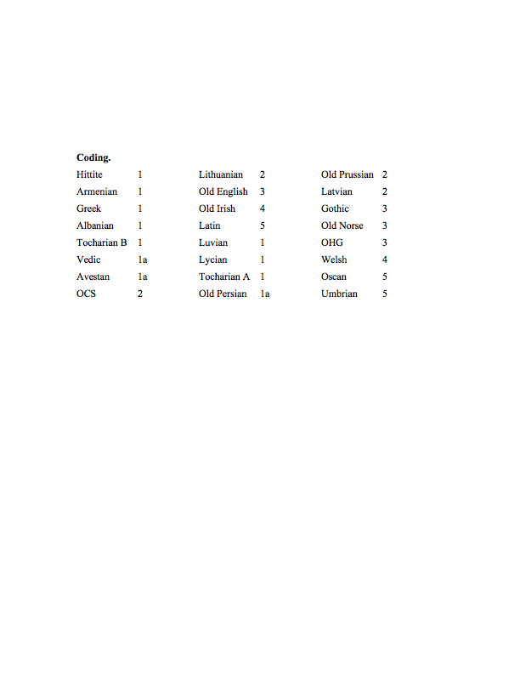
Semantic slot for hand – coded
(Partitioned into cognate classes)

Slide 42
Lexical characters can also evolve without homoplasy
For every cognate class, the nodes of the tree in that class should form a connected subset - as long as there is no undetected borrowing nor parallel semantic shift.
1
1
1
0
0
0
1
1
2
Notes:
Ask Don about the statement of undetected borrowing and parallel semantic shift.

Slide 43
Our (RWT) Data
Ringe & Taylor (2002)
  259 lexical
  13 morphological
  22 phonological
These data have cognate judgments estimated by Ringe and Taylor, and vetted by other Indo-Europeanists. (Alternate encodings were tested, and mostly did not change the reconstruction.)
Polymorphic characters, and characters known to evolve in parallel, were removed.

Slide 44
Differences between different characters
Lexical: most easily borrowed (most borrowings detectable), and homoplasy relatively frequent (we estimate about 25-30% overall for our wordlist, but a much smaller percentage for basic vocabulary).
Phonological: can still be borrowed but much less likely than lexical. Complex phonological characters are infrequently (if ever) homoplastic, although simple phonological characters very often homoplastic.
Morphological: least easily borrowed, least likely to be homoplastic.

Slide 45
Our methods/models
1995: Ringe & Warnow “Almost Perfect Phylogeny”: most characters evolve without homoplasy under a no-common-mechanism assumption (various publications since 1995)
2005: Ringe, Warnow, & Nakhleh “Perfect Phylogenetic Network”: extends APP model to allow for borrowing, but assumes homoplasy-free evolution for all characters (Language, 2005)
2006: Warnow, Evans, Ringe & Nakhleh “Extended Markov model”: parameterizes PPN and allows for homoplasy provided that homoplastic states can be identified from the data (Cambridge University Press)

Slide 46
Modelling issues
What are the units?
Polymorphism
Homoplasy
Non-treelike evolution
Non-i.i.d. evolution and violations of the rates-across-sites assumption (heterotachy)
Deviation from the lexical clock (is dating even really possible?)
Note:
The 2006 WERN (Warnow, Evans, Ringe, and Nakhleh) model has homoplasy and reticulation, characters evolve independently but not identically, but polymorphism is not allowed.

Slide 47
First analysis: Almost Perfect Phylogeny
The original dataset contained 375 characters (336 lexical, 17 morphological, and 22 phonological).
We screened the dataset to eliminate characters likely to evolve homoplastically or by borrowing.
On this reduced dataset (259 lexical, 13 morphological, 22 phonological), we attempted to maximize the number of compatible characters while requiring that certain of the morphological and phonological characters be compatible. (Computational problem NP-hard.)

Slide 48
Indo-European Tree
(95% of the characters compatible)

Slide 49
Second attempt:
Perfect Phylogenetic Network (PPN)
We explain the remaining incompatible characters by inferring previously undetected “borrowing”.
Perfect Phylogenetic Network: We require all characters evolve down some tree contained inside the network (and without homoplasy!)
We attempted to find a PPN with the smallest number of contact edges, borrowing events, and with maximal feasibility with respect to the historical record. (Computational problems NP-hard).
Our analysis produced one solution with only three contact edges that optimized each of the criteria. Two of the contact edges are well-supported.

Slide 50
Perfect Phylogenetic Networks
Problem formulation
Input: set of languages described by characters
Output: Network on which all characters evolve without homoplasy, but can be borrowed
Nakhleh, Ringe, and Warnow, 2005. Language.

Slide 51
“Perfect Phylogenetic Network”
(all characters compatible)
L. Nakhleh, D. Ringe, and T. Warnow, LANGUAGE, 2005

Slide 52
Comments
This network is very “tree-like” (only three contact edges needed to explain the data.
Two of the three contact edges are strongly supported by the data (many characters are borrowed).
If the third contact edge is removed, then the evolution of the remaining (two) incompatible characters needs to be explained.
  Probably this is parallel semantic shift.

Slide 53
WERN 2006 model
Warnow, Evans, Ringe & Nakhleh (WERN) “Extended Markov model”: parameterizes PPN and allows for homoplasy provided that homoplastic states can be identified from the data (Cambridge University Press)
Basic idea:
  Characters can evolve with homoplasy, but we know the homoplastic states
  Characters evolve independently but not identically – can have a “no-common-mechanism model”
The paper proves that if there is no borrowing (and so the evolution is down a tree), then the topology of the tree is identifiable (relatively easy proof from getting quartet trees)

Slide 54
WERN 2006 conjecture
In WERN 2006, we conjectured that the phylogenetic network might be identifiable under some conditions (e.g., if there was only one borrowing edge).
However, we did not provide any proof, and we did not make any progress on this.

Slide 55
Work in 2022-2023
Work with Marc Canby (submitted): modeling polymorphism (e.g., two words for same meaning) – new analysis of Indo-European, plus simulation study.
Work with Steve Evans and Luay Nakhleh: proving that a level-1 phylogenetic network is identifiable (and providing polynomial time methods to construct the network) under the Warnow, Evans, Ringe, and Nakhleh model (with mild constraints). This will appear as a book chapter.

Slide 56
Our methods/models
Warnow, Evans, Ringe & Nakhleh “Extended Markov model”: parameterizes PPN and allows for homoplasy provided that homoplastic states can be identified from the data (Cambridge University Press, 2006)

Slide 57
WERN 2023 model
WERN 2006: Warnow, Evans, Ringe & Nakhleh (WERN) “Extended Markov model”: parameterizes PPN and allows for homoplasy provided that homoplastic states can be identified from the data (Cambridge University Press)
WERN 2006 Basic idea:
  Characters can evolve with homoplasy, but we know the homoplastic states
  Characters evolve independently but not identically – can have a “no-common-mechanism model”
WERN 2023:
  Add the constraint that the probability of homoplastic state at the root is less than 1

Slide 58
Warnow et al., 2023
Warnow, Evans, and Nakhleh 2023 (to appear) proves that:
  The unrooted phylogenetic network topology is identifiable under the WERN 2023 model, as long as the unrooted network is level-1 (with a mild assumption on root state not being always homoplastic)
  The rooted topology is also identifiable if the probability of homoplasy-free binary characters is strictly positive

Slide 59
Reminder: Phylogenetic Networks and the Trees they contain

Slide 60
Q(N): The set of all quartet trees of a network N

Slide 61
Figure 1 from Warnow et al., 2023. Examine quartet trees (bottom row): which ones are displayed in the trees in the network? (Which ones are in Q(N)?)

Slide 62
Quartet Tree Calculator (QTC)
Collect quartet trees (uv|wx) satisfying:
  Any character c with non-homoplastic states 1 and 2, where c(u)=c(v)=1 and c(w)=c(x)=2 defines a quartet
  Note that such a quartet tree uv|wx is in Q(N)
Theorem 1: As the number of characters goes to infinity, with probability converging to 1, QTC produces Q(N)

Slide 63
Constructing a network from Q(N)
Problem: Given Q(N), can we construct the unrooted topology of N?
Answer: If N is a level-1 network, then the unrooted topology for N can be constructed from Q(N) in polynomial time.
Algorithms to do this are in Gambette et al. (2012) and Keijsper and Pendavingh (2014). These are not simple methods.

Slide 64
QBTE (Quartet-Based Topology Estimator)
Given the characters (evolving down a network under the the WERN 2023 model)
Apply QTC to obtain quartet tree set Q
Apply Gambette et al. (or some other method) to construct the unrooted topology
Theorem 2: If N is level-1 and characters evolve down N under the WERN 2023 model, then QBTE is statistically consistent for estimating the unrooted topology of N.

Slide 65
Limitations to QBTE
Note that the algorithm we described has two steps:
  Apply QBTE to obtain set Q (an estimate of Q(N))
  Apply Gambette et al. (or some other method) to construct the unrooted network
The algorithm is statistically consistent under the WERN 2006 model if N is a level-1 network, BUT:
  It doesn’t root the network
  No guarantees if Q is not equal to Q(N)

Slide 66
Rooting the network
If QBTE succeeds in constructing a level-1 network, we would like to root it. How do we do this?
If there are homoplasy-free binary characters (with ancestral state known), we can at least partially identify the location of the root. But given enough of them, we can uniquely identify the location! (This is “Root-Network”). It’s not that simple a method .

Slide 67
What if Q is not Q(N)?
QTC produces a set Q of quartet trees, but on “real” data (which are finite and may not be generated by the WERN model), it’s easily the case that Q is not Q(N).
When Q is not Q(N), or a dense subset, the algorithms to construct networks fail to return anything. That is not satisfactory.
What can we do then?

Slide 68
Summary – Part I
We presented the WERN 2023 model of character evolution for languages, and established identifiability of a level-1 phylogenetic network under this model.
We also proved that QBTE (quartet-based tree estimation) is statistically consistent for estimating unrooted level-1 phylogenetic networks. (And following with “RootNetwork” is statistically consistent for estimating the rooted network.)
But these methods are unsatisfying, since they produce zilch when the conditions do not suffice for exact accuracy.

Slide 69
Theoretical questions
Under what types of network models can the underlying tree be inferred in a statistically consistent manner?
What can be said about network models with random borrowing?
Determine approximability of optimization problems (e.g., given Q, find level-1 network N such that Q(N) is close to Q)
  Recall PTAS from Tao Jiang (SICOMP) when Q is dense and N is required to be a tree

Slide 70
Summary – Part 2
All of this is relevant to biological phylogenetic networks as well.
  Under some conditions (SNP data), homoplasy-free binary characters are expected to be realistic assumptions.
  Constructing unrooted level-1 networks is then feasible from quartet trees and/or clades, and rooting the network is also feasible from clades.
  But…level-1 networks are themselves idealized.

Slide 71
Practical Research Projects
Design methods and test them for:
  Estimating a phylogenetic network from Q, even when Q is not Q(N).
  Estimating the underlying “genetic tree” from Q, when Q is not Q(N).
  Adding contact edges to a rooted tree, under the WERN 2023 model.

Slide 72
Summary
Phylogenetic networks are needed for modeling evolution, both in linguistics and in biology.
Methods for biological network estimation are mainly likelihood-based and very computationally intensive.
Discrete methods, such as the ones described, could advance discovery
BUT – very little theory so far establishing identifiability of phylogenetic networks, and statistically consistent methods are (so far) limited (and do not have any performance guarantees on finite data, especially if not generated by the model)
New methods and new theory are both needed.

Slide 73
Modelling issues for Linguistics
What are the units?
Polymorphism
Homoplasy
Non-treelike evolution
Non-i.i.d. evolution and violations of the rates-across-sites assumption (heterotachy)
Deviation from the lexical clock (is dating even really possible?)
Note:
The 2006 WERN (Warnow, Evans, Ringe, and Nakhleh) model has homoplasy and reticulation, does not require i.i.d. evolution across characters, but forbids polymorphism. The 2023 WERN model is very slightly different from the 2006 model.
The 2023 model by Marc Canby addresses polymorphism.

