Slide 1
PPoSS Talk, Nov 2, 2023
Tandy Warnow
University of Illinois at Urbana-Champaign

Slide 2




Phylogeny (evolutionary tree)
Orangutan
Gorilla
Chimpanzee
Human
From the Tree of the Life Website,
University of Arizona

Slide 3
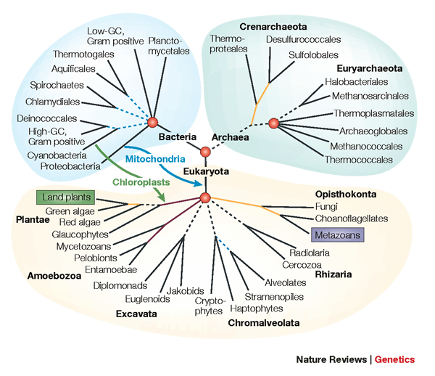
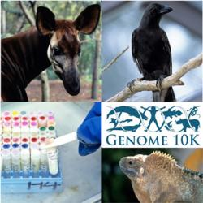
Phylogenomics
Phylogeny + genomics = genome-scale phylogeny estimation
.

Slide 4
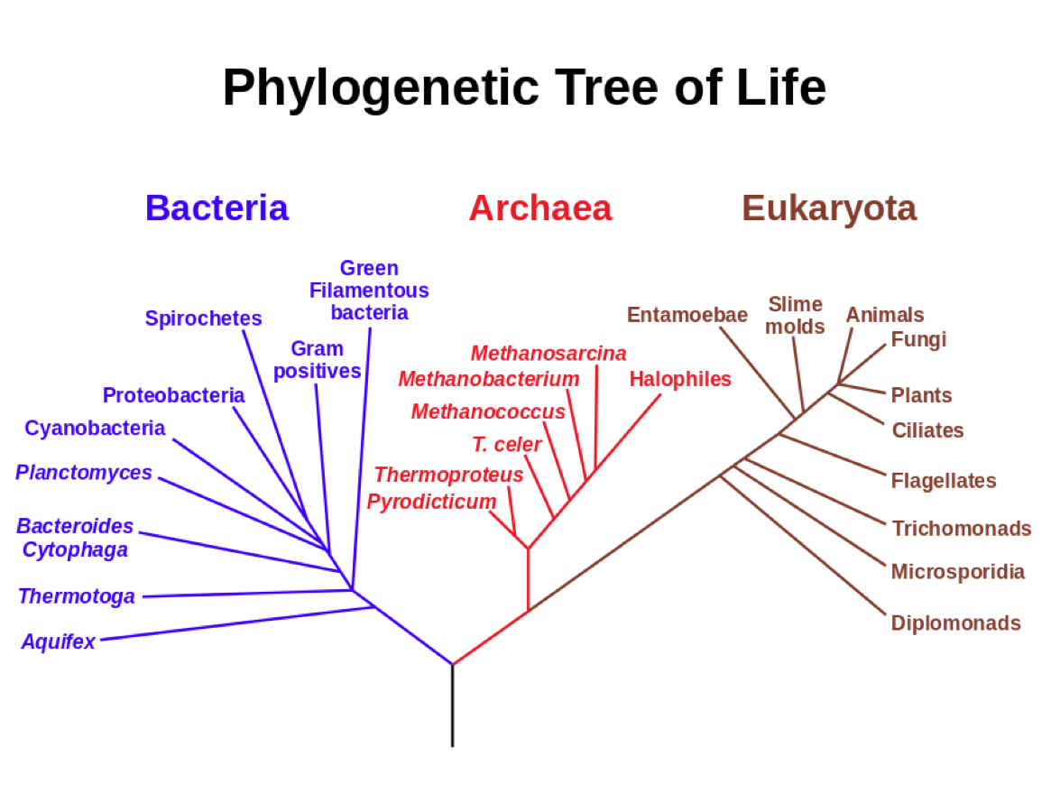
Estimating the Tree of Life
Basic Biology:
How did life evolve?
Applications of phylogenies to:
protein structure and function
population genetics
human migrations
metagenomics
Figure from
https://en.wikipedia.org/wiki/Common_descent

Slide 5
Estimating the Tree of Life
Large datasets!
Millions of species
thousands of genes
NP-hard optimization problems
Exact solutions infeasible
Approximation algorithms
Heuristics
Multiple optima
High Performance Computing:
necessary
but not sufficient
Figure from
https://en.wikipedia.org/wiki/Common_descent

Slide 6
Goal of this PPoSS project (wrt Phylogeny)
Phylogeny estimation can be seen as a statistical estimation problem.
We want fast and accurate methods that are scalable to large datasets (thousands to hundreds of thousands of species, and genome-scale data).
We also want these methods to have statistical guarantees (provably statistically consistent).
The basic technique we will use is divide-and-conquer: using the best methods on subsets.

Slide 7
“Boosters”, or “Meta-Methods”
Meta-methods use divide-and-conquer and iteration (or other techniques) to “boost” the performance of base methods (phylogeny reconstruction, alignment estimation, etc)
Meta-method
Base method M
M*

Slide 8
Today’s Fast Intro to Phylogenetics Research
Models of evolution, identifiability, statistical consistency
Trees, additive matrices, and chordal graphs
Divide-and-conquer phylogeny estimation: overlapping vs disjoint subsets
Genome-scale phylogeny:
  Incomplete lineage sorting and species tree estimation under the Multi-Species Coalescent model (MSC)
  ASTRAL: non-parametric accurate and statistically consistent species tree estimation under the MSC
  TreeMerge/GTM: scaling species tree methods to large datasets

Slide 9
Phyogenomic Pipeline
Assemble and annotate genomes (e.g., determine orthologs)
Compute multiple sequence alignments of individual loci
Construct gene trees
Construct species tree
Perform post-tree analyses (e.g., estimate dates, infer selection, etc.)

Slide 10
Phyogenomic Pipeline
Assemble and annotate genomes (e.g., determine orthologs)
Compute multiple sequence alignments of individual loci
Construct gene trees
Construct species tree
Perform post-tree analyses (e.g., estimate dates, infer selection, etc.)

Slide 11
DNA Sequence Evolution (Idealized)
AAGACTT
-3 mil yrs
AAGACTT
-2 mil yrs
AAGGCCT
AAGGCCT
AAGGCCT
AAGGCCT
TGGACTT
TGGACTT
TGGACTT
TGGACTT
-1 mil yrs
AGGGCAT
AGGGCAT
TAGCCCT
TAGCCCT
AGCACTT
AGGGCAT
TAGCCCT
AGCACTT
AGCACTT
AGGGCAT
TAGCCCA
TAGACTT
AGCACAA
AGCGCTT
today
AGGGCAT
TAGCCCA
TAGACTT
AGCACAA
AGCGCTT

Slide 12
Phylogeny Problem
U
V
W
X
Y
AGGGCAT
TAGCCCA
TAGACTT
TGCACAA
TGCGCTT
X
U
Y
V
W

Slide 13
Markov Models of Sequence Evolution
The different sites are assumed to evolve i.i.d. down the model tree
Simplest site evolution model (Jukes-Cantor, 1969):
The model tree T is binary and has substitution probabilities p(e) on each edge e, with 0<p(e)<3/4.
The state at the root is randomly drawn from {A,C,T,G} (nucleotides)
If a site (position) changes on an edge, it changes with equal probability to each of the remaining states.
The evolutionary process is Markovian.
More complex models (such as the Generalized Time Reversible model) are also considered, often with little change to the theory.

Slide 14
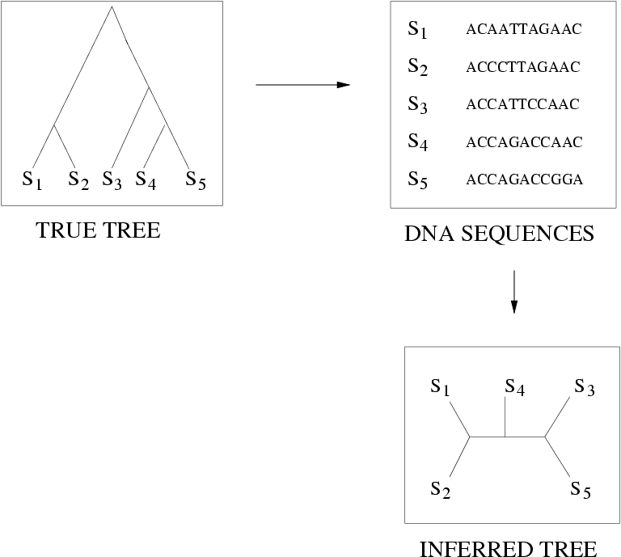
FN
FN: false negative
(missing edge)
FP: false positive
(incorrect edge)
50% error rate
FP

Slide 15
Is method M statistically consistent under model G?
Question answered by mathematical proof
Error
in species tree inferred by method M
Amount of data
generated under model G and then given to method M as input

Slide 16
Questions
Is the model tree identifiable?
Which estimation methods are statistically consistent under this model?
How much data does the method need to estimate the model tree correctly (with high probability)?
What are the computational issues?

Slide 17
Answers for Gene Tree Evolution?
We know a lot about which site evolution models are identifiable, and which methods are statistically consistent.
  Maximum Likelihood statistically consistent, but NP-hard (good heuristics)
  Distance-based methods also statistically consistent and typically polynomial time, but generally less accurate than maximum likelihood
We know a little bit about the sample complexity (i.e. sequence length requirements) for standard methods.
  Maximum likelihood has optimal sample complexity, standard distance-based methods do not
Take home message: maximum likelihood preferred, even though hard to find good solutions

Slide 18
Genome-scale data?
error
Data

Slide 19
Phylogenomics
Phylogeny + genomics = genome-scale phylogeny estimation
.

Slide 20
Incomplete Lineage Sorting (ILS) is a dominant cause of
gene tree heterogeneity

Slide 21
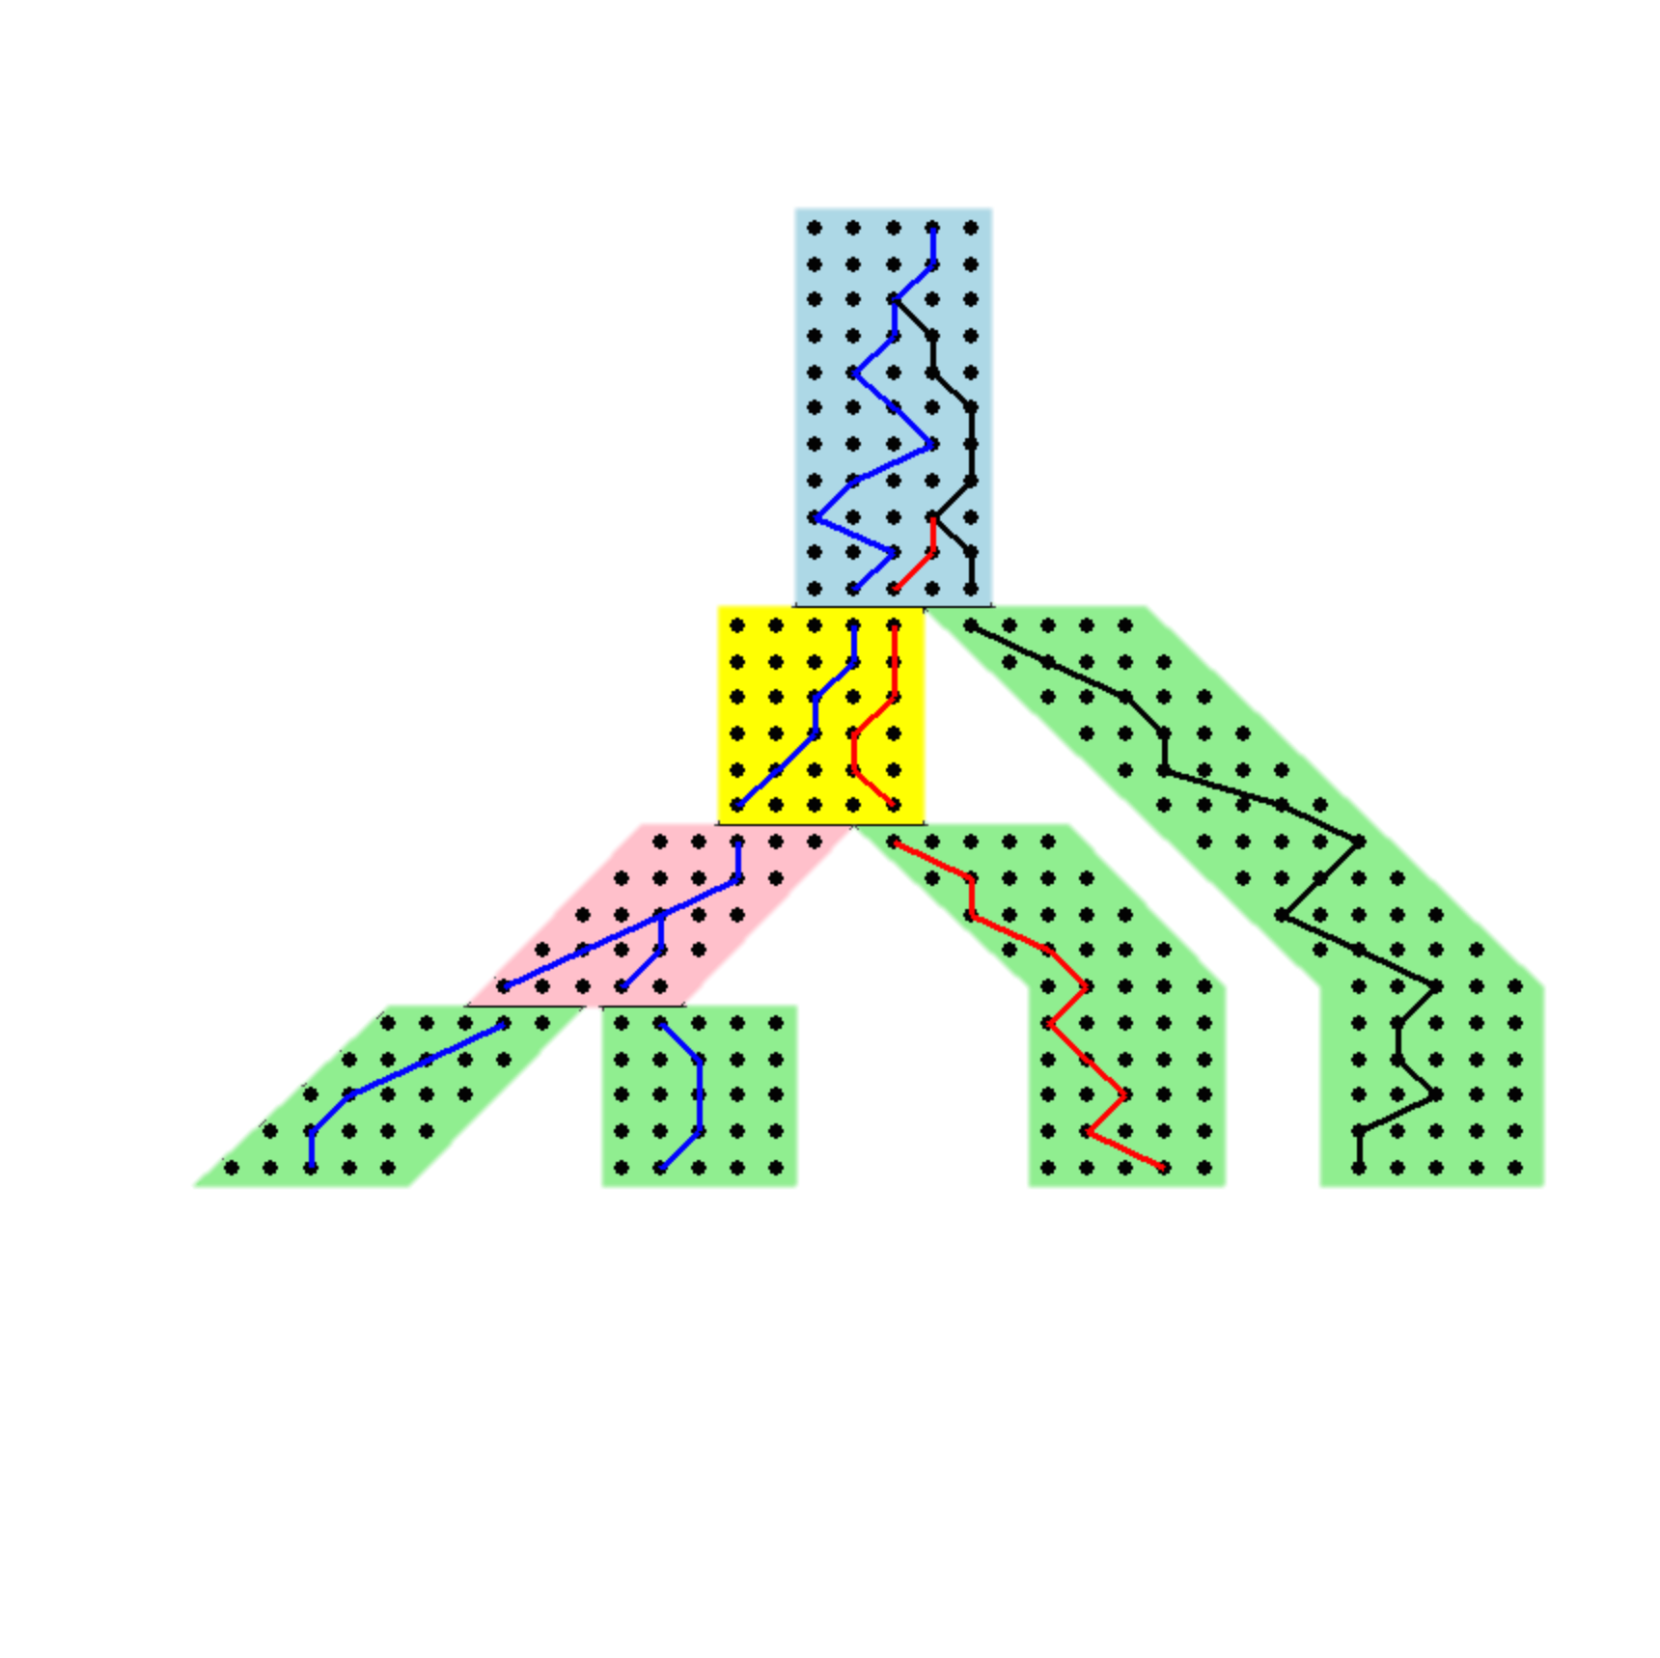
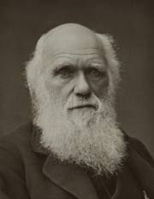



Gene Trees inside the Species Tree (Multi-Species Coalescent)
Past
Present
Courtesy James Degnan
Gorilla and Orangutan are not siblings in the species tree, but they are in the gene tree.

Slide 22
Gene Trees inside the Species Tree (Multi-Species Coalescent)
Past
Deep coalescence =
INCOMPLETE
LINEAGE
SORTING (ILS):
gene tree can be different
from the species tree
Present
Courtesy James Degnan
Gorilla and Orangutan are not siblings in the species tree, but they are in the gene tree.

Slide 23







1KP: Thousand Transcriptome Project
G. Ka-Shu Wong
U Alberta
J. Leebens-Mack
U Georgia
N. Wickett
Northwestern
N. Matasci
iPlant
T. Warnow, S. Mirarab, N. Nguyen
UT-Austin UT-Austin UT-Austin
103 plant transcriptomes, 400-800 single copy “genes”
Next phase will be much bigger
Wickett, Mirarab et al., PNAS 2014
Major Challenge:
Massive gene tree heterogeneity consistent with ILS

Slide 24
Major challenge:
Massive gene tree heterogeneity consistent with ILS.

Slide 25
Hierarchical Model: MSC+GTR
Multi-locus data, generated by a hierarchical model
  Species tree generates gene trees under Multi-Species Coalescent (MSC)
  Gene trees generate sequences under the Generalized Time Reversible (GTR) model
How can we estimate the species tree from the sequence data?

Slide 29
Suppose we can estimate all the
gene trees correctly.
Can we estimate the species trees from lots of true gene trees?

Slide 30
How to estimate a 4-leaf species tree
Theorem (Allman et al.): Under the multi-species coalescent model, for any four taxa A, B, C, and D, the most probable unrooted gene tree on {A,B,C,D} is identical to the unrooted species tree induced on {A,B,C,D}.
Notes:
point out that supertree methods take overlaping trees and produce a tree, and that the whole process of first generating small trees and then applying a supertree method is often referred to as the “supertree approach”.

Slide 31
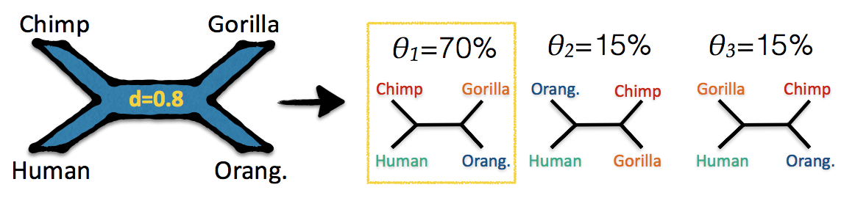
How to estimate a 4-leaf species tree
Theorem (Allman et al.): Under the multi-species coalescent model, for any four taxa A, B, C, and D, the most probable unrooted gene tree on {A,B,C,D} is identical to the unrooted species tree induced on {A,B,C,D}.
Notes:
point out that supertree methods take overlaping trees and produce a tree, and that the whole process of first generating small trees and then applying a supertree method is often referred to as the “supertree approach”.

Slide 32
Species tree estimation from unrooted gene trees
Corollary: Under the multi-species coalescent model, the species tree is identifiable from the gene tree distribution
Proof: For every four species, select most frequently observed tree as the species tree. Then combine quartet trees!
Notes:
point out that supertree methods take overlaping trees and produce a tree, and that the whole process of first generating small trees and then applying a supertree method is often referred to as the “supertree approach”.

Slide 33
Species tree estimation from unrooted gene trees
Corollary: Under the multi-species coalescent model, the species tree is identifiable from the gene tree distribution
Proof: For every four species, select most frequently observed tree as the species tree. Then combine quartet trees!
Notes:
point out that supertree methods take overlaping trees and produce a tree, and that the whole process of first generating small trees and then applying a supertree method is often referred to as the “supertree approach”.

Slide 34


Slide 35
ASTRAL
Statistically consistent under the MSC, and runs in polynomial time
Solves constrained version of the NP-hard Maximum Quartet Support problem using dynamic programming
  Input: Gene trees and set X of allowed bipartitions
  Output: Species tree T that maximizes the quartet support criterion, subject to drawing its bipartitions from the set X

Slide 37
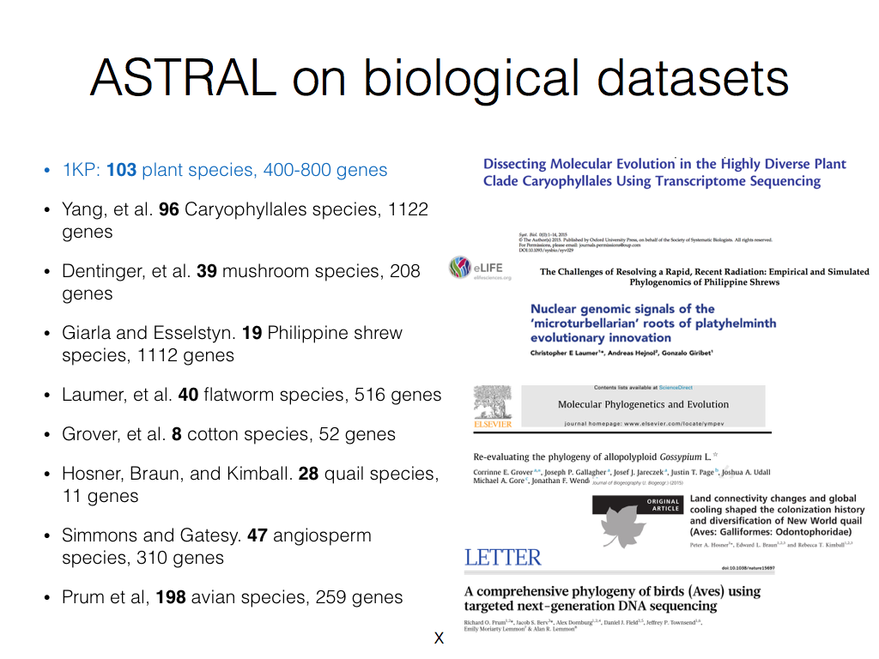

Slide 38
ASTRAL – great, but…
The good: ASTRAL is
  increasingly used in practice
  statistically consistent given true gene trees
  sometimes more accurate than concatenation, but impacted by gene tree estimation error
  very fast for many datasets (faster than concatenation)
The bad: ASTRAL can fail to complete on large enough datasets within reasonable time frames (days of computation)

Slide 39
The alternatives are worse
Concatenation Analyses (e.g., using RAxML):
  most commonly used method, not statistically consistent, sometimes more accurate than summary methods
  computationally intensive (e.g., 250 CPU years for the Avian Phylogenomics project with only 48 species) and do not scale to large numbers of species
Co-estimation of gene trees and species trees: too expensive
Other statistically consistent methods: not as accurate as ASTRAL

Slide 40
Goal of this PPoSS project (wrt Phylogeny)
Phylogeny estimation can be seen as a statistical estimation problem.
We want fast and accurate methods that are scalable to large datasets (thousands to hundreds of thousands of species, and genome-scale data).
We also want these methods to have statistical guarantees (provably statistically consistent).
The basic technique we will use is divide-and-conquer: using the best methods on subsets.

Slide 41
Divide-and-conquer using Chordal Graphs
A matrix is additive if it equals path lengths in an edge-weighted tree
Distances calculated in phylogenetics (from sequence data) converge to additive matrices, as the sequence length increases
If we threshold an additive matrix, we obtain a chordal graph: one that has no simple cycles of size four or larger
Chordal graphs have lovely properties
  Can list all maximal cliques in polynomial time
  Minimum vertex separators are maximal cliques
  Can obtain decompositions into overlapping subsets, and employ in divide-and-conquer strategies

Slide 42
Divide-and-conquer using Chordal Graphs
Chordal graphs have lovely properties
  Can list all maximal cliques in polynomial time
  Minimum vertex separators are maximal cliques
  Can obtain decompositions into overlapping subsets, and employ in divide-and-conquer strategies
If we do this, we need methods that combine overlapping subset trees, i.e., “supertree” methods
These approaches have not been as scalable as needed.

Slide 43

Divide-and-Conquer using Disjoint Tree Mergers
Note: use most accurate method on subsets, and treat as absolute constraints
Decompose species set into pairwise disjoint subsets.
Full
species
set
Build a tree on each
subset
Auxiliary
Info
(e.g., distance
matrix)
Tree
on full
species set
Compute tree on entire set of species using “Disjoint Tree Merger” method

Slide 44
Divide-and-Conquer using Disjoint Tree Mergers
Note: use most accurate method on subsets, and treat as absolute constraints
Decompose species set into pairwise disjoint subsets.
Full
species
set
ASTRAL
Build a tree on each
subset
Auxiliary
Info
(e.g., distance
matrix)
Tree
on full
species set
Compute tree on entire set of species using “Disjoint Tree Merger” method
TreeMerge or GTM

Slide 45
Divide-and-Conquer using Disjoint Tree Mergers
Note: use most accurate method on subsets, and treat as absolute constraints
Decompose species set into pairwise disjoint subsets.
Full
species
set
Theorem: TreeMerge+ASTRAL and GTM+ASTRAL are both
statistically consistent and polynomial time
ASTRAL
Build a tree on each
subset
Auxiliary
Info
(e.g., distance
matrix)
Tree
on full
species set
Compute tree on entire set of species using “Disjoint Tree Merger” method
TreeMerge or GTM

Slide 46
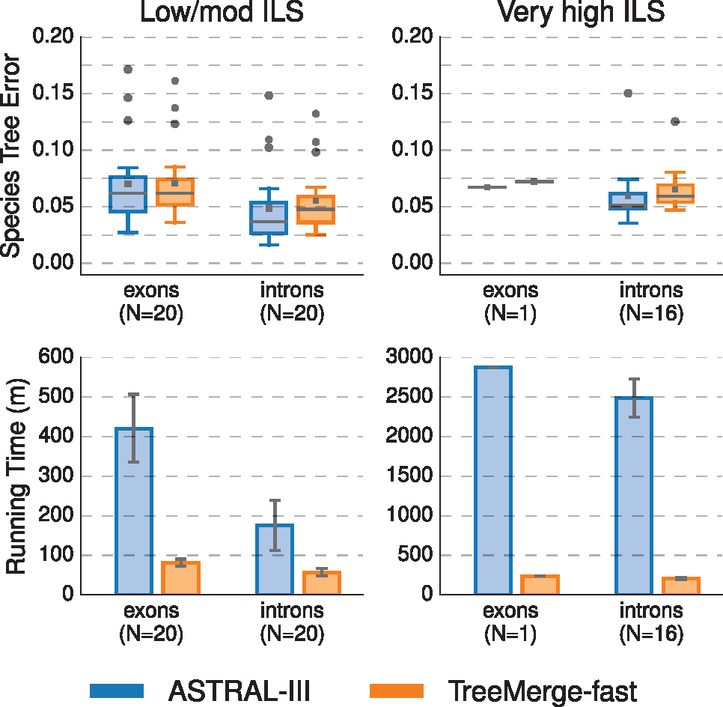

Impact of using TreeMerge with ASTRAL-III on 1000 species and 1000 genes
Theorem: TreeMerge+ASTRAL
is statistically consistent and polynomial time
Empirical: TreeMerge maintains accuracy, reduces running time, and improves scalability
Notes:
Fig. 3. Impact of using TreeMerge-fast with ASTRAL-III. The top row shows species tree estimation error for datasets with 1000 taxa and 1000 genes; gray bars represent medians, gray squares represent means, gray circles represent outliers, box plots extend from the first to the third quartiles, and whiskers extend to plus/minus 1.5 times the interquartile distance (unless greater/less than the maximum/minimum value). The bottom row shows running time (in minutes); bars represent means and error bars represent standard deviations across replicate datasets. The running time of TreeMerge-fast is the time to estimate the distance matrix, to estimate each subset tree using ASTRAL-III, and to combine the subset trees using TreeMerge-fast (Equation 1). The number N of replicates on which ASTRAL-III completed is shown on the x-axis; note that averages are taken across the replicates on which ASTRAL-III completed. When ASTRAL-III did not complete, it was due to running longer than the 48-h maximum wall-clock time
Unless provided in the caption above, the following copyright applies to the content of this slide: © The Author(s) 2019. Published by Oxford University Press.This is an Open Access article distributed under the terms of the Creative Commons Attribution Non-Commercial License (http://creativecommons.org/licenses/by-nc/4.0/), which permits non-commercial re-use, distribution, and reproduction in any medium, provided the original work is properly cited. For commercial re-use, please contact journals.permissions@oup.com

Slide 47

Guide Tree Merger
Smirnov and Warnow, RECOMB-Comparative Genomics
Guide Tree Merger (GTM): Another Disjoint Tree Merger method… unlike TreeMerge, it does not allow blending
Github site: https://github.com/vlasmirnov/GTM
Algorithmic strategy:
divide species set into disjoint subsets,
compute species trees on the subsets using selected species tree method, and
connect subset trees by adding edges (no blending!), so as to minimize distance to the given guide tree (polynomial time!)

Slide 48
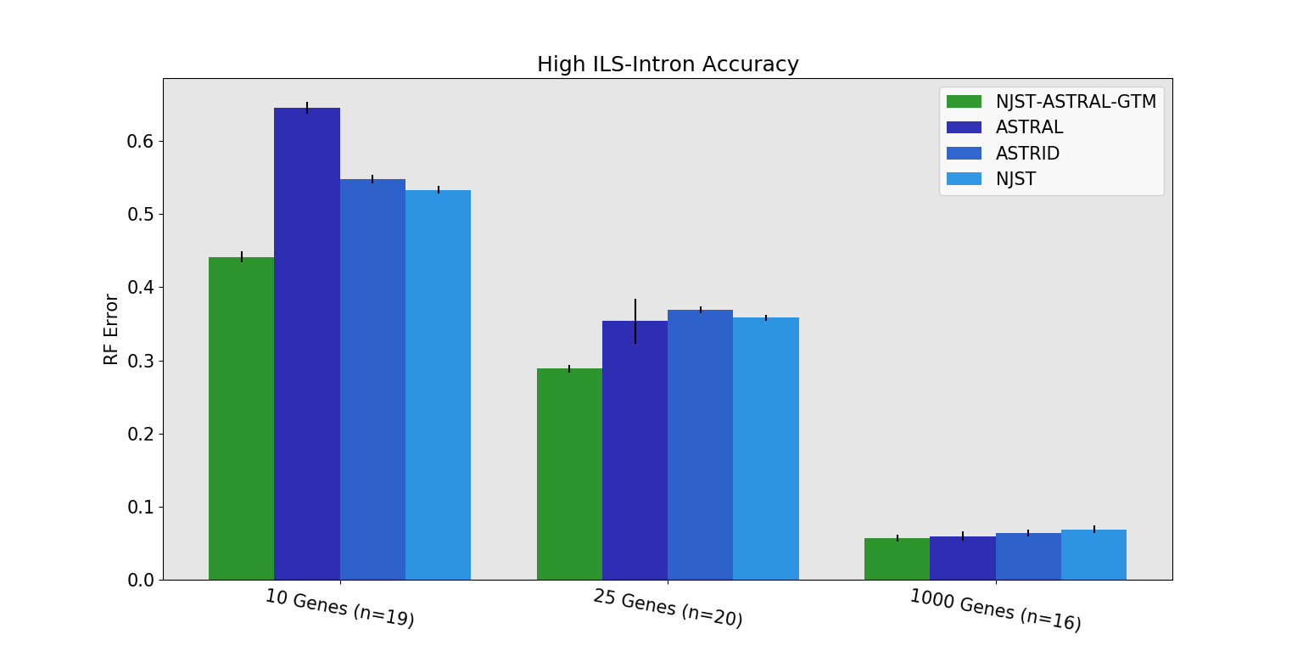
ASTRAL+GTM: better than ASTRAL!

Slide 49
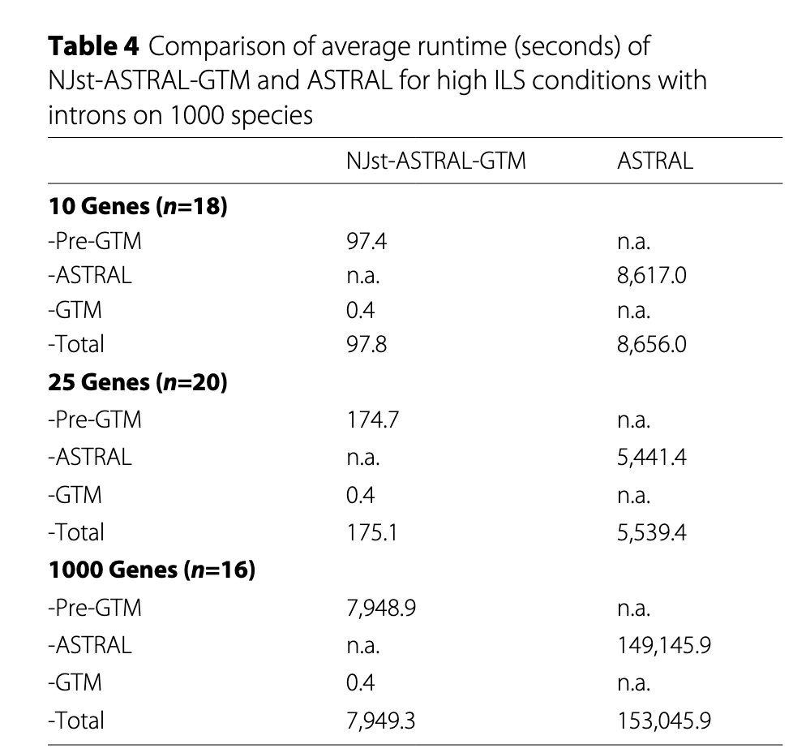

Slide 50
Main competing approaches
gene 1 gene 2 . . . gene k
Species
. . .
Concatenation
Analyze
separately
. . .
Summary Method
Notes:
point out that supertree methods take overlaping trees and produce a tree, and that the whole process of first generating small trees and then applying a supertree method is often referred to as the “supertree approach”.

Slide 51
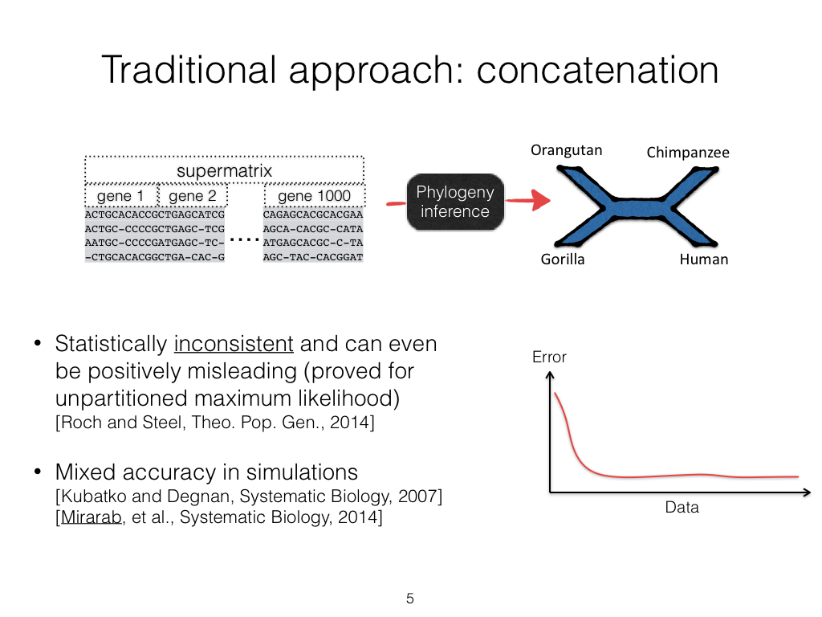

Slide 52
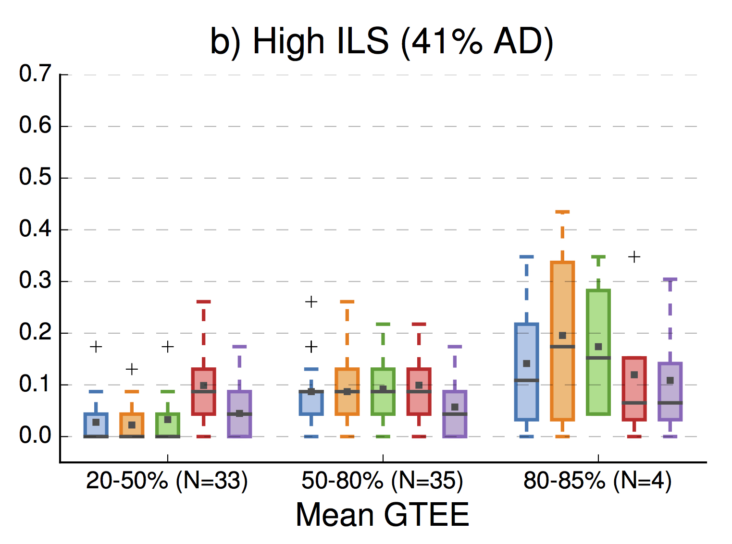

Impact of Gene Tree Estimation Error
(from Molloy and Warnow 2017)
Note:
Summary
methods
better than
CA-ML
for low
GTEE,
then worse!
Error is fraction
of bipartitions
that are not
recovered
Summary Methods
Site-based Method

Slide 53
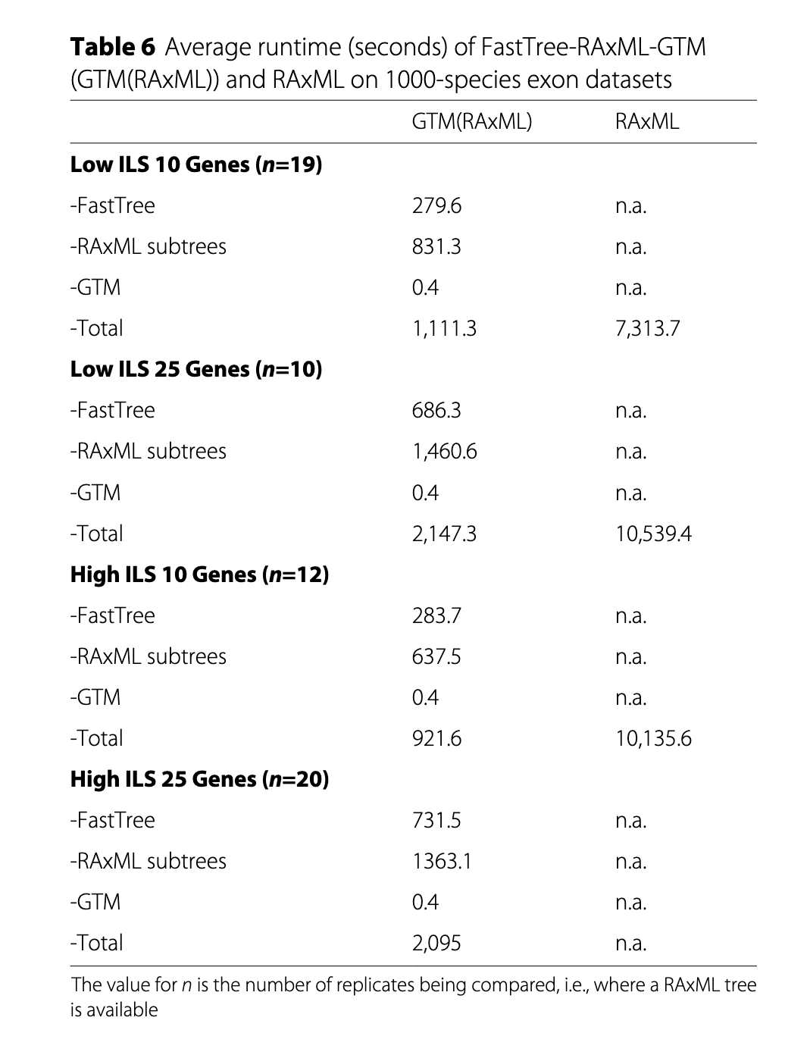
The GTM pipeline used with RAxML
on subsets matches accuracy with
RAxML, but is much faster

Slide 54
Summary about phylogenetic tree estimation
The best tree estimation methods are computationally intensive, and tree-space grows exponentially.
The Divide-and-Conquer pipelines we are developing (especially GTM) maintain statistical consistency, maintain or improve accuracy and are much faster.
In addition, they naturally enable parallel implementations.

Slide 55
What about Community Detection?
I also work on community detection in large networks, largely in the context of Scientometrics
Our recent paper (Park et al., Complex Networks 2023) addresses failure of standard community detection methods (aka clustering methods) to produce well-connected clusters.
See https://tandy.cs.illinois.edu/bibliometrics.html for papers

Slide 56
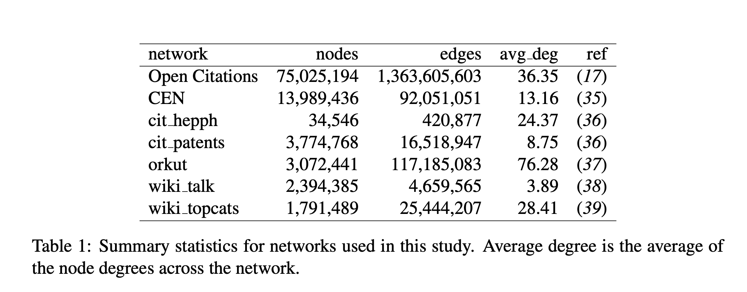
Networks we studied

Slide 57
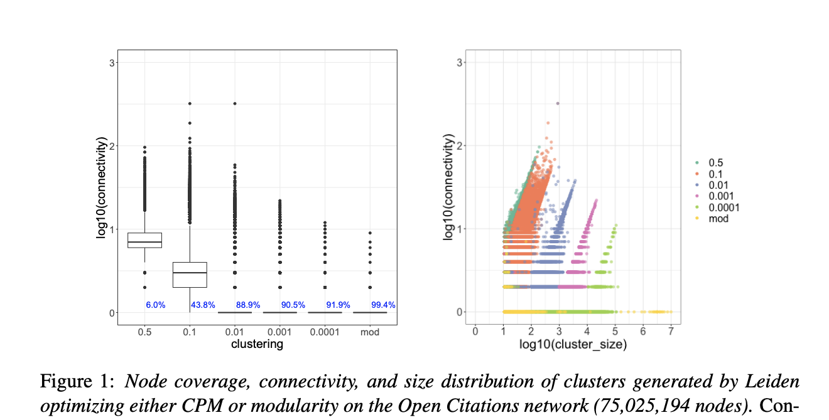
Many small edge cuts in Leiden clusters on real-world networks
Leiden optimizing the
Constant Potts Model (CPM)
or modularity (mod)
Results using other clustering
methods are similar

Slide 58
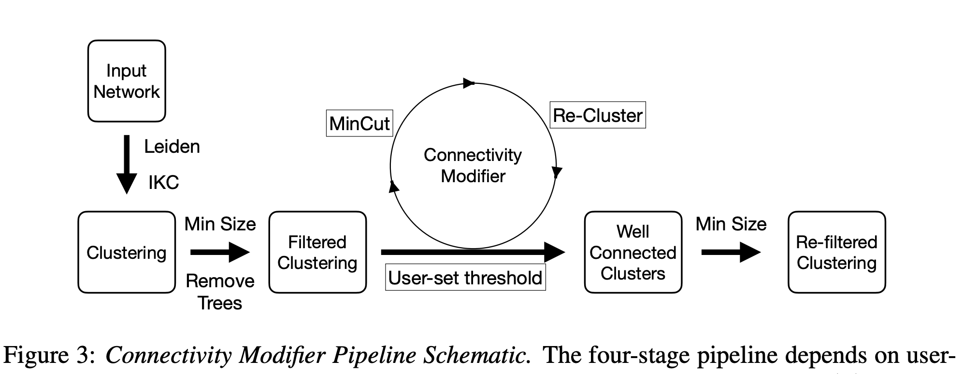
The Connectivity Modifier (CM) Pipeline
Defaults used in our study:
all clusters have min cuts above log₁₀ n, where n is cluster size, and have size at least 11

Slide 59
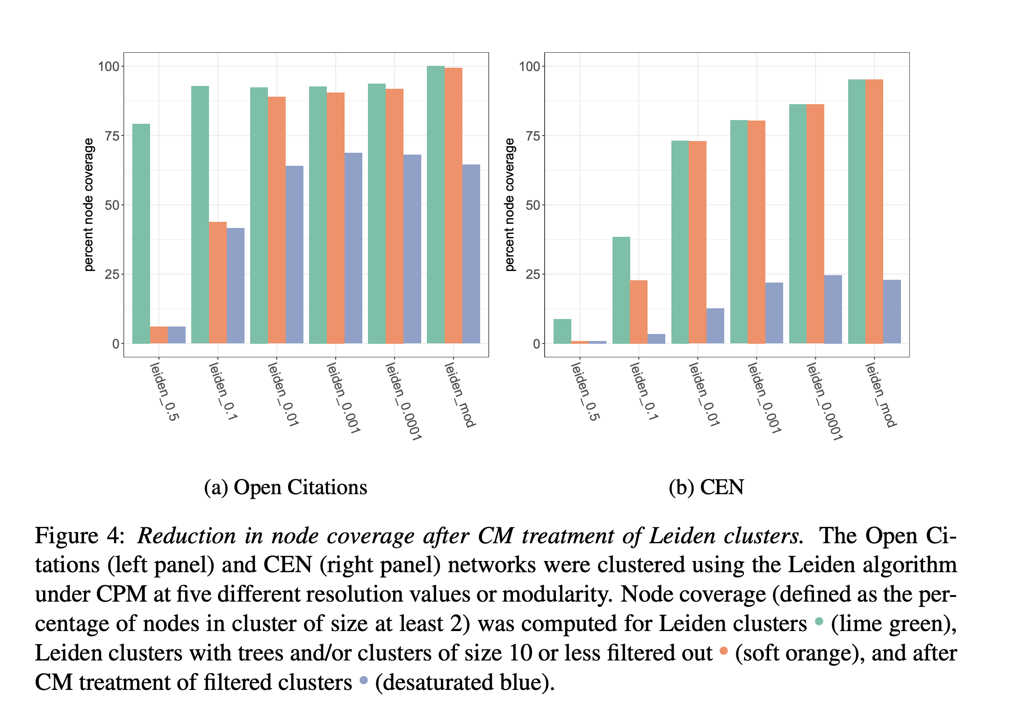
Impact of the Connectivity Modifier
CPM clustering is impacted by the resolution parameter: small values give high node coverage, but many of these clusters are poorly connected (even trees).
Modularity-optimization is similar to CPM with a small resolution parameter.
Using CM reduces node coverage

Slide 60
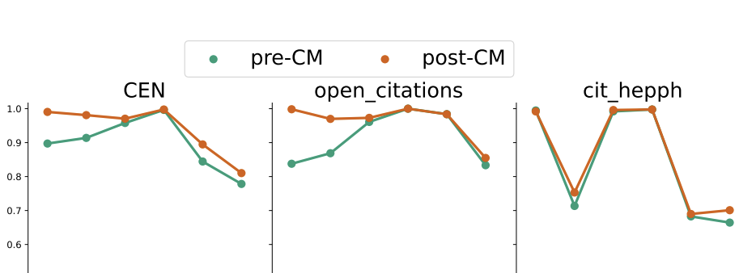

The CM pipeline improves accuracy
Results for NMI accuracy on LFR networks. Results for other criteria are similar.

Slide 61
Summary
The tendency for standard clustering methods to have poorly connected clusters (or else have low node coverage) is striking.
CM ensures that all returned clusters are well-connected, according to the user specified bound
CM improves accuracy on LFR networks
But after CM, there is a drop in node coverage that can be large.
How do we explain the drop in node coverage?
  Perhaps not the case that the entire network is covered by communities?

