Slide 1

Scalable divide-and-conquer strategies for phylogeny estimation
Tandy Warnow
The University of Illinois

Slide 2

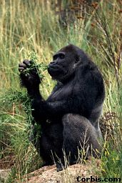


Phylogeny (evolutionary tree)
Orangutan
Gorilla
Chimpanzee
Human
From the Tree of the Life Website,
University of Arizona

Slide 3
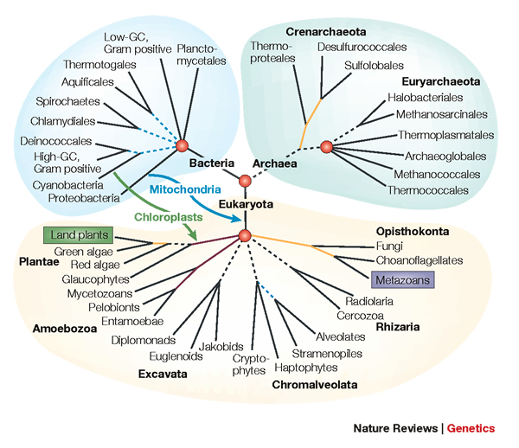
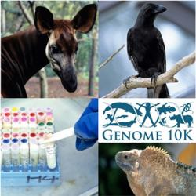
Phylogenomics
Phylogeny + genomics = genome-scale phylogeny estimation
.

Slide 4
Challenges: Large-scale phylogeny estimation
Runtime and memory usage can be large
  Desirable statistical estimation problems are NP-hard
  Traditional concatenation approaches take hundreds of CPU years (even for small numbers of species) for genome-scale data
  Even single genes can take weeks or months of CPU time
Heterogeneity and model complexity frequent in biological data create model misspecification
Limited “ground truth” for supervised learning
Errors in estimated phylogenies produce errors in downstream analyses

Slide 5
Data Analytics, HPC, and AI in Phylogeny Estimation
Data Analytics: Comparisons of trends on simulated and biological data are revealing (limitations of simulation models, modeling evolutionary processes, understanding methods)
HPC: Everything is computationally intensive (CPU years) and HPC is frequently relied upon
AI: varies in terms of type
  Deep Learning: increasingly explored, so far not successful
  Other machine learning (e.g., reinforcement learning): potentially promising
  Model-based statistical estimation: very common
  Incorporation of domain knowledge beneficial

Slide 6
DNA Sequence Evolution (Idealized)
AAGACTT
-3 mil yrs
AAGACTT
-2 mil yrs
AAGGCCT
AAGGCCT
AAGGCCT
AAGGCCT
TGGACTT
TGGACTT
TGGACTT
TGGACTT
-1 mil yrs
AGGGCAT
AGGGCAT
TAGCCCT
TAGCCCT
AGCACTT
AGGGCAT
TAGCCCT
AGCACTT
AGCACTT
AGGGCAT
TAGCCCA
TAGACTT
AGCACAA
AGCGCTT
today
AGGGCAT
TAGCCCA
TAGACTT
AGCACAA
AGCGCTT

Slide 7
Phylogeny Problem
U
V
W
X
Y
AGGGCAT
TAGCCCA
TAGACTT
TGCACAA
TGCGCTT
X
U
Y
V
W

Slide 8
Markov Models of Sequence Evolution (Gene Tree)
The different sites are assumed to evolve i.i.d. down the model tree, so it suffices to model a single site
Jukes-Cantor, 1969 (simplest DNA site evolution model):
The state at the root is randomly drawn from {A,C,T,G} (nucleotides)
The model tree T is binary and has substitution probabilities p(e) on each edge e, with 0<p(e)<3/4
If a site (position) changes on an edge, it changes with equal probability to each of the remaining states
The evolutionary process is Markovian.
More complex models are also considered, often with little change to the theory.

Slide 9
Phylogeny estimation as a statistical problem
Assume DNA sequences are generated on an unknown model tree, and try to infer the tree from the observed sequences seen at the leaves
Many methods:
  Maximum likelihood: Find the model tree that maximizes the probability of generating the observed sequences
  Bayesian estimation
  Distance-based methods (e.g., neighbor joining)
  Maximum parsimony
NP-hard optimization problems, heuristics

Slide 10
This talk
Fast introduction to statistical phylogenetic estimation
Disjoint Tree Mergers (DTMs)
DTM pipelines used for species tree estimation
DTM pipelines used for gene tree estimation
Discussion

Slide 11
Questions
Theory questions:
Is the model tree identifiable?
Is the estimation method statistically consistent under this model?
What is the sample complexity for the method?
How robust is the method to model misspecification?
Empirical questions:
What is the accuracy of the method on finite data (evaluated using simulations)?
What are the computational requirements for the method?

Slide 12
Is method M statistically consistent under model G?
Question answered by mathematical proof
Error
in species tree inferred by method M
Amount of data
generated under model G and then given to method M as input

Slide 13
Answers?
We know a lot about which site evolution models are identifiable, and which methods are statistically consistent.
We know a little bit about the sample complexity for standard methods.

Slide 14
Maximum likelihood for gene tree estimation
Theory:
  Statistically consistent
  Low sample complexity (Roch & Sly, Prob. Theory and Related Fields, 2017): phase transition (logarithmic then polynomial)
  NP-hard
Empirical (based on heuristics)
  Outstanding accuracy on simulated data
  Challenging on large datasets (best methods can take CPU years or fail to run on large datasets)

Slide 15
Maximum likelihood for gene tree estimation
ML is a dominant method for phylogeny estimation
Leading heuristics: RAxML and IQ-TREE
FastTree 2 used for very large datasets (but isn’t as accurate as RAxML or IQ-TREE)
Parallelism focused on scaling with the length of the input alignment

Slide 16
DNNs useful for phylogeny estimation?
Sequence evolution models are simplistic (to enable statistical identifiability and consistency)
Biological data is more complex, and includes heterotachy (changes across the sites and across the tree)?
Two papers introduced DNNs for quartet tree estimation to try to improve phylogeny estimation under complex models
  Suvorov et al., Systematic Biology 2020
  Zou et al., Molecular Biology and Evolution, 2020
Zaharias et al. (RECOMB 2021) compared DNNs to standard methods based on simple models

Slide 17
ML is more accurate than DNNs and other methods
Figure from
Zaharias et al., RECOMB 2021
20-sequence datasets generated under complex AA models (lots of heterotachy)
Same models used to train DNNs (from Zou et al., MBE 2020)
IQ-TREE used for maximum likelihood estimation

Slide 18
Phylogenomics
Phylogeny + genomics = genome-scale phylogeny estimation
.

Slide 19
Genome-scale data?
error
Length of the genome

Slide 20
Multiple causes for discord, including
Incomplete Lineage Sorting (ILS),
Gene Duplication and Loss (GDL), and
Horizontal Gene Transfer (HGT)

Slide 21
Multiple causes for discord, including
Incomplete Lineage Sorting (ILS),
Gene Duplication and Loss (GDL), and
Horizontal Gene Transfer (HGT)

Slide 22
Major challenge:
Maximum likelihood tree on concatenated alignments: 250 CPU years
Massive gene tree heterogeneity consistent with ILS.

Slide 23
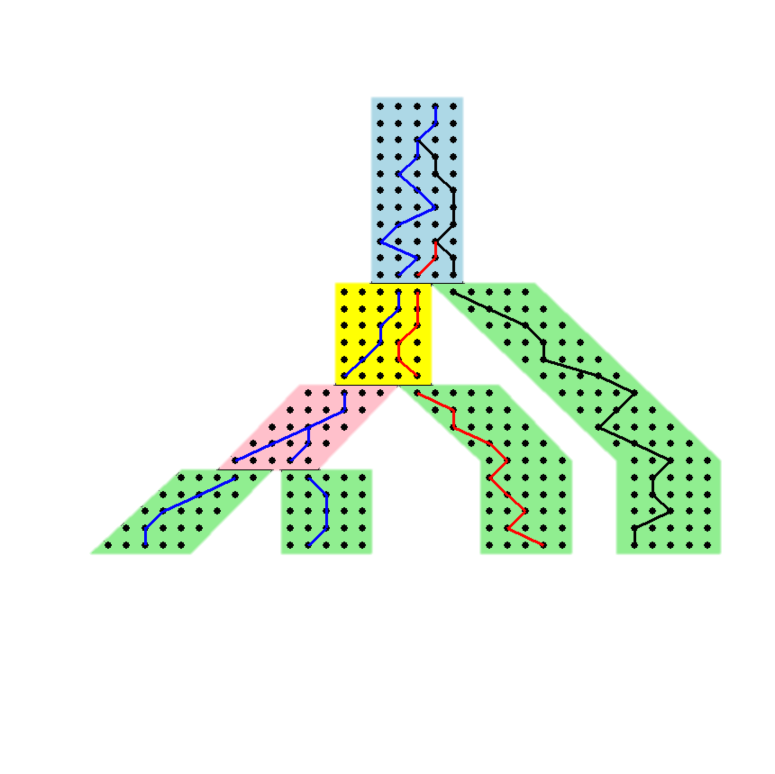




Gene trees inside the species tree (Coalescent Process)
Past
Deep coalescence =
INCOMPLETE
LINEAGE
SORTING (ILS):
gene tree can be different
from the species tree
Present
Courtesy James Degnan
Gorilla and Orangutan are not siblings in the species tree, but they are in the gene tree.

Slide 26







1KP: Thousand Transcriptome Project
G. Ka-Shu Wong
U Alberta
J. Leebens-Mack
U Georgia
N. Wickett
Northwestern
N. Matasci
iPlant
T. Warnow, S. Mirarab, N. Nguyen
UT-Austin UT-Austin UT-Austin
103 plant transcriptomes, 400-800 single copy “genes”
Next phase will be much bigger
Wickett, Mirarab et al., PNAS 2014
Major Challenge:
Massive gene tree heterogeneity consistent with ILS

Slide 27

ASTRAL uses dynamic programming to solve a constrained version of this problem, and is provably statistically consistent

Slide 28
ASTRAL – pros and cons
The good: ASTRAL is
  Very popular statistically consistent method for species tree estimation
  Very fast for many datasets (much faster than concatenation)
The mixed:
  Concatenation can be more accurate under some conditions
The bad:
  ASTRAL can fail to complete on large enough datasets within reasonable time frames (days of computation)

Slide 29
Alternatives to ASTRAL
Concatenation Analyses (e.g., using maximum likelihood):
  most commonly used method, not statistically consistent, sometimes more accurate than summary methods
  computationally intensive (e.g., 250 CPU years for the Avian Phylogenomics project with only 48 species) and do not scale to large numbers of species
Co-estimation of gene trees and species trees: too expensive
Other statistically consistent methods: not as accurate as ASTRAL
So we need to make ASTRAL and Concatenation Analyses truly scalable to large datasets!

Slide 30
Alternatives to ASTRAL
Concatenation Analyses (e.g., using maximum likelihood):
  most commonly used method, not statistically consistent, sometimes more accurate than summary methods
  computationally intensive (e.g., 250 CPU years for the Avian Phylogenomics project with only 48 species) and do not scale to large numbers of species
Co-estimation of gene trees and species trees: too expensive
Other statistically consistent methods: not as accurate as ASTRAL
So we need to make ASTRAL and Concatenation Analyses truly scalable to large datasets!

Slide 31

Divide-and-Conquer using Disjoint Tree Mergers
Note: use most accurate method on subsets, and treat as absolute constraints
Decompose species set into pairwise disjoint subsets.
Erin Molloy,
Introduced this
approach
Full
species
set
Build a tree on each
subset
Auxiliary
Info
(e.g., distance
matrix)
Tree
on full
species set
Compute tree on entire set of species using “Disjoint Tree Merger” method

Slide 32
DTM Methods
NJMerge (Molloy & Warnow, Algorithms for Molecular Biology 2019)
TreeMerge (Molloy & Warnow, Bioinformatics 2019)
Constrained INC (Zhang, Rao, & Warnow, Algorithms for Molecular Biology 2019; also Le et al., TCBB 2020)
Guide Tree Merger (Smirnov & Warnow, 2020, BMC Genomics 2020)

Slide 33
DTM Methods
NJMerge (Molloy & Warnow, Algorithms for Molecular Biology 2019)
TreeMerge (Molloy & Warnow, Bioinformatics 2019)
Constrained INC (Zhang, Rao, & Warnow, Algorithms for Molecular Biology 2019; also Le et al., TCBB 2020)
Guide Tree Merger (Smirnov & Warnow, 2020, BMC Genomics 2020)
All papers available at https:// tandy.cs.Illinois.edu/papers.html

Slide 34
Divide-and-Conquer using Disjoint Tree Mergers
Theorem: DTM pipelines maintain statistical consistency for phylogeny estimation (assuming subset trees computed using statistically consistent methods)
Decompose species set into pairwise disjoint subsets.
Full
species
set
Build a tree on each
subset
Auxiliary
Info
(e.g., distance
matrix)
Tree
on full
species set
Compute tree on entire set of species using “Disjoint Tree Merger” method

Slide 35
Divide-and-Conquer Species Tree Estimation
Note: use most accurate method on subsets, and treat as absolute constraints
Decompose species set into pairwise disjoint subsets.
Full
species
set
ASTRAL
Build a tree on each
subset
Auxiliary
Info
(e.g., distance
matrix)
Tree
on full
species set
Compute tree on entire set of species using “Disjoint Tree Merger” method
Guide Tree Merger

Slide 36

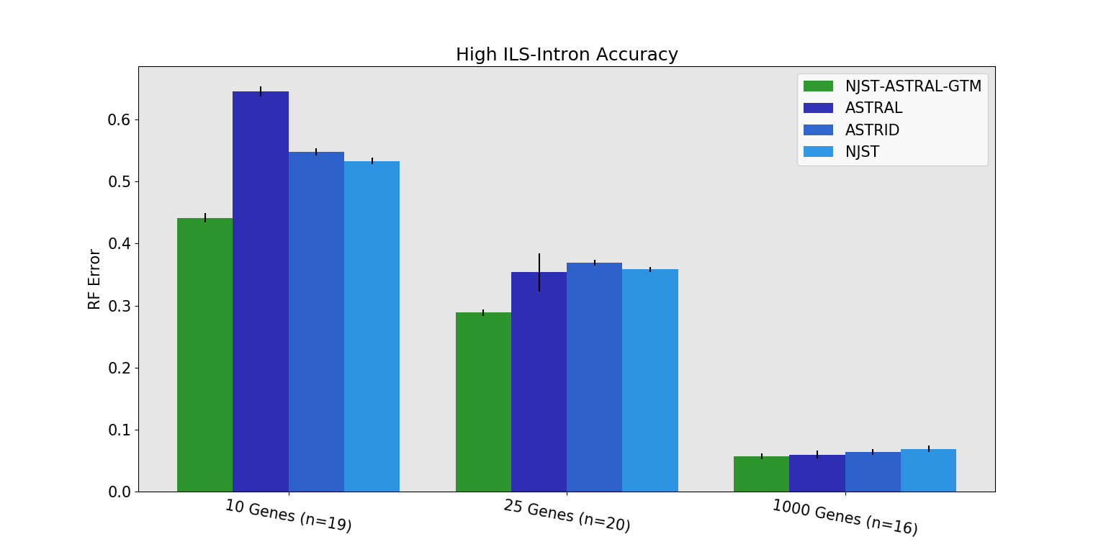
GTM-ASTRAL vs ASTRAL
GTM-pipeline vs ASTRAL (seconds) on 1000 species (after gene trees estimated):
GTM ASTRAL
10 genes: 98 vs 8,656
25 genes: 175 vs 5,539
1000 genes: 7,949 vs 153,046

Slide 37
Divide-and-Conquer Species Tree Estimation
Note: use most accurate method on subsets, and treat as absolute constraints
Decompose species set into pairwise disjoint subsets.
Full
species
set
RAxML
Build a tree on each
subset
Auxiliary
Info
(e.g., distance
matrix)
Tree
on full
species set
Compute tree on entire set of species using “Disjoint Tree Merger” method
NJMerge

Slide 38
NJMerge + RAxML vs. RAxML: Better accuracy and faster!

Slide 39
DTMs for species tree estimation: summary
Species tree estimation: used with ASTRAL or RAxML,
  DTM pipelines reduce running time and memory usage on large multi-locus datasets, and produce species trees of comparable or improved accuracy
  Runtimes are generally only slightly more expensive than the starting tree
  Embarassingly parallel

Slide 40
Maximum likelihood for gene tree estimation
Dominant method for phylogeny estimation
Leading heuristics: RAxML and IQ-TREE
FastTree 2 used for very large datasets (but isn’t as accurate as RAxML or IQ-TREE)

Slide 41
Maximum likelihood for gene tree estimation
Theory:
  Statistically consistent
  Low sample complexity (Roch & Sly, Prob. Theory and Related Fields, 2017): phase transition (logarithmic then polynomial)
  NP-hard (and challenging in practice)
Empirical (based on heuristics)
  Outstanding accuracy on simulated data
  Challenging on large datasets (best methods can take CPU years or fail to run on large datasets)
  Parallelism focused on scaling with the length of the input alignment

Slide 42
Divide-and-Conquer Gene Tree Estimation
Note: use most accurate method on subsets, and treat as absolute constraints
Decompose species set into pairwise disjoint subsets.
Full
species
set
RAxML, IQ-TREE, etc
Build a tree on each
subset
Auxiliary
Info
(e.g., distance
matrix)
Tree
on full
species set
Compute tree on entire set of species using “Disjoint Tree Merger” method
Guide Tree Merger

Slide 43


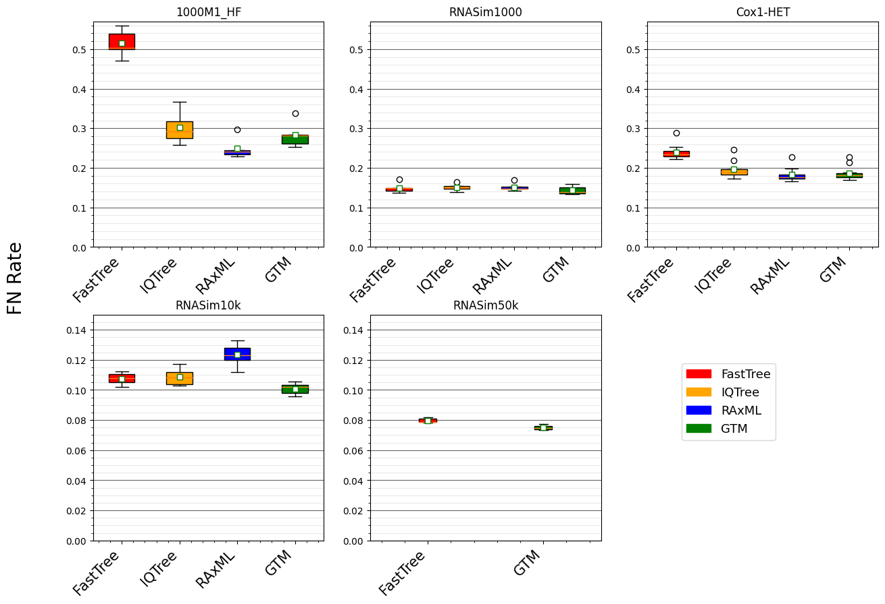
Figure 2 from
“Disjoint Tree Mergers for
Large-Scale Maximum Likelihood
Tree Estimation”
Minhyuk Park, Paul Zaharias, and
Tandy Warnow, Algorithms 2021
GTM pipeline:
starting tree is IQ-Tree or FastTree (smaller datasets),
IQ-tree used to compute subset trees, and
then combined using GTM
Datasets range from 1000 to 50,000 sequences
Results not shown (RAxML and IQ-TREE on RNASim50K) are due to failure to return a tree (IQ-TREE) or returning tree with 100% RF error (RAxML)

Slide 44
Figure 2 from “Disjoint Tree Mergers for Large-Scale Maximum Likelihood Tree Estimation”, Park et al., Algorithms 2021
GTM pipeline:
starting tree is IQ-Tree or FastTree (smaller datasets),
IQ-tree used to compute subset trees, and
then combined using GTM

Slide 45
GTM-pipeline:
Scales to large datasets
Is competitive with RAxML and IQ-TREE for accuracy
Is only slightly slower than starting tree (but more accurate)

Slide 46
GTM-pipeline:
Scales to large datasets
Is competitive with RAxML and IQ-TREE for accuracy
Is only slightly slower than starting tree (but more accurate)

Slide 47
Divide-and-conquer pipeline using GTM improves maximum likelihood gene tree estimation!
IQ-TREE fails on some datasets
RAxML has high error on some datasets
GTM pipeline always completes and is competitive with the best other methods that complete on the data set

Slide 48
Divide-and-Conquer using Disjoint Tree Mergers
Theorem: DTM pipelines maintain statistical consistency for phylogeny estimation (assuming subset trees computed using statistically consistent methods)
Decompose species set into pairwise disjoint subsets.
Full
species
set
Build a tree on each
subset
Auxiliary
Info
(e.g., distance
matrix)
Tree
on full
species set
Compute tree on entire set of species using “Disjoint Tree Merger” method

Slide 49
Summary of DTM pipeline results
Divide-and-conquer pipelines using DTMs maintain statistical consistency and run in polynomial time
For both gene trees and species trees, DTM pipelines reduce running time and memory usage, produce trees with comparable or better accuracy, and can complete on larger datasets
Runtimes are generally only slightly more expensive than the starting tree
Embarrassingly parallel

Slide 50
Data Analytics, HPC, and AI in Phylogeny Estimation
Data Analytics: Comparisons of trends on simulated and biological data are revealing (limitations of simulation models, modeling evolutionary processes, understanding methods)
HPC: Everything is computationally intensive (CPU years) and HPC is frequently relied upon – but is not enough!
AI: varies in terms of type
  Deep Learning: increasingly explored, so far not successful
  Other machine learning (e.g., reinforcement learning): potentially promising
  Model-based statistical estimation: very common
  Incorporation of domain knowledge beneficial

Slide 51
Phylogenetic Inference
“Big Data”:
Heterogeneous
Large
Noisy
Error-ridden
Streaming
Model-misspecification
Approaches:
NP-hard optimization problems and large datasets
Statistical estimation under stochastic models of evolution
Probabilistic analysis of algorithms
Graph-theoretic divide-and-conquer
Chordal graph theory
Combinatorial optimization

Slide 52

Acknowledgments
Papers available at http://tandy.cs.illinois.edu/papers.html
Presentations available at http://tandy.cs.illinois.edu/talks.html
Software on github, links at http://tandy.cs.illinois.edu/software.html
Funding: NSF (CCF 1535977, ABI-1458652, and Graduate Fellowship to Erin Molloy), the Grainger Foundation, and the Ira and Debra Cohen Fellowship to Vlad Smirnov
Supercomputers: Blue Waters and Campus Cluster, both supported by NCSA
Write to me: warnow@Illinois.edu

