Slide 1
Species Tree estimation under Gene Duplication and Loss (GDL)
Tandy Warnow
University of Illinois at Urbana-Champaign
http://tandy.cs.Illinois.edu

Slide 2

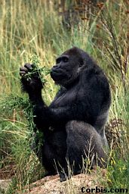


Species Tree
Orangutan
Gorilla
Chimpanzee
Human
From the Tree of the Life Website,
University of Arizona

Slide 3
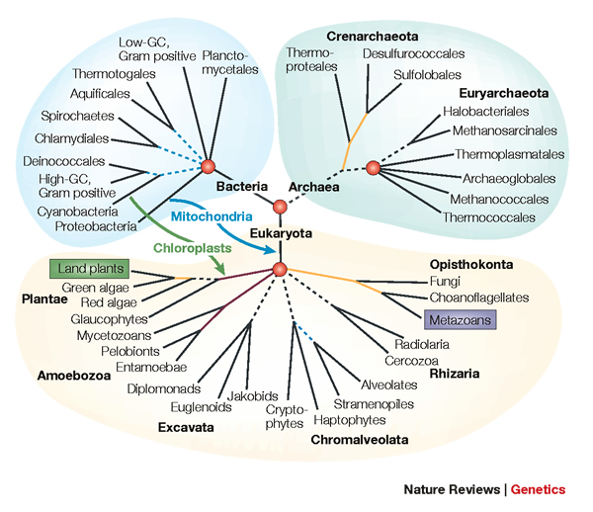
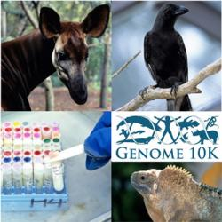
Phylogenomics
Phylogeny + genomics = genome-scale phylogeny estimation
.

Slide 4
Phylogeny Estimation
U
V
W
X
Y
AGGGCAT
TAGCCCA
TAGACTT
TGCACAA
TGCGCTT
X
U
Y
V
W

Slide 5
Is method M statistically consistent under model G?
Question answered by mathematical proof
Error
in species tree inferred by method M
Amount of data
generated under model G and then given to method M as input

Slide 6
Genome-scale data?
error
Length of the genome

Slide 7
Multiple causes for discord, including
Incomplete Lineage Sorting (ILS),
Gene Duplication and Loss (GDL), and
Horizontal Gene Transfer (HGT)

Slide 8








1KP: Thousand Transcriptome Project
G. Ka-Shu Wong
U Alberta
J. Leebens-Mack
U Georgia
N. Wickett
Northwestern
N. Matasci
iPlant
T. Warnow, S. Mirarab, N. Nguyen
UT-Austin/UIUC UT-Austin /UCSD UT-Austin/UCSD
2014 PNAS study: 103 plant transcriptomes, 400-800 single copy “genes”
2019 Nature study: much larger!
Major Challenges:
Multi-copy genes omitted (9500 -> 400)
Massive gene tree heterogeneity consistent with ILS

Slide 9
1KP: Thousand Transcriptome Project
G. Ka-Shu Wong
U Alberta
J. Leebens-Mack
U Georgia
N. Wickett
Northwestern
N. Matasci
iPlant
T. Warnow, S. Mirarab, N. Nguyen
UT-Austin/UIUC UT-Austin /UCSD UT-Austin/UCSD
2014 PNAS study: 103 plant transcriptomes, 400-800 single copy “genes”
2019 Nature study: much larger!
Gene duplication and loss
Major Challenges:
Multi-copy genes omitted (9500 -> 400)
Massive gene tree heterogeneity consistent with ILS

Slide 10
1KP: Thousand Transcriptome Project
G. Ka-Shu Wong
U Alberta
J. Leebens-Mack
U Georgia
N. Wickett
Northwestern
N. Matasci
iPlant
T. Warnow, S. Mirarab, N. Nguyen
UT-Austin/UIUC UT-Austin /UCSD UT-Austin/UCSD
2014 PNAS study: 103 plant transcriptomes, 400-800 single copy “genes”
2019 Nature study: much larger!
Gene duplication and loss
Major Challenges:
Multi-copy genes omitted (9500 -> 400)
Massive gene tree heterogeneity consistent with ILS
Incomplete Lineage Sorting

Slide 11
Today’s talk
Brief introduction to species tree estimation addressing incomplete lineage sorting (ASTRAL and ASTRID)
Breakthrough in GDL-based species tree estimation:
  ASTRAL-multi (statistically consistent)
  ASTRAL-Pro (excellent accuracy)
  ASTRID-multi (excellent accuracy, very fast)
  FastMulRFS (excellent accuracy, not as robust as ASTRAL-Pro or ASTRID-multi)

Slide 12
Multiple causes for discord, including
Incomplete Lineage Sorting (ILS),
Gene Duplication and Loss (GDL), and
Horizontal Gene Transfer (HGT)

Slide 13
MSC+GTR Hierarchical Model
MSC+GTR:
Gene trees evolve within the species tree under the Multi-Species Coalescent (MSC) model
Sequences evolve down the gene trees under the GTR model
Variants can be considered (such as adding indels to the GTR model)

Slide 14
Species Tree Estimation under MSC+GTR
Concatenation using Maximum likelihood: NP-hard, and not consistent in the presence of ILS
Summary methods (e.g., ASTRAL, ASTRID, MP-EST): consistent, and much faster than CA-ML, but impacted by gene tree estimation error
Site-based methods (e.g., SVDquartets, SVDquest): consistent but not very computationally efficient
Co-estimation methods (*BEAST and StarBEAST2): consistent, very accurate, but very expensive

Slide 15
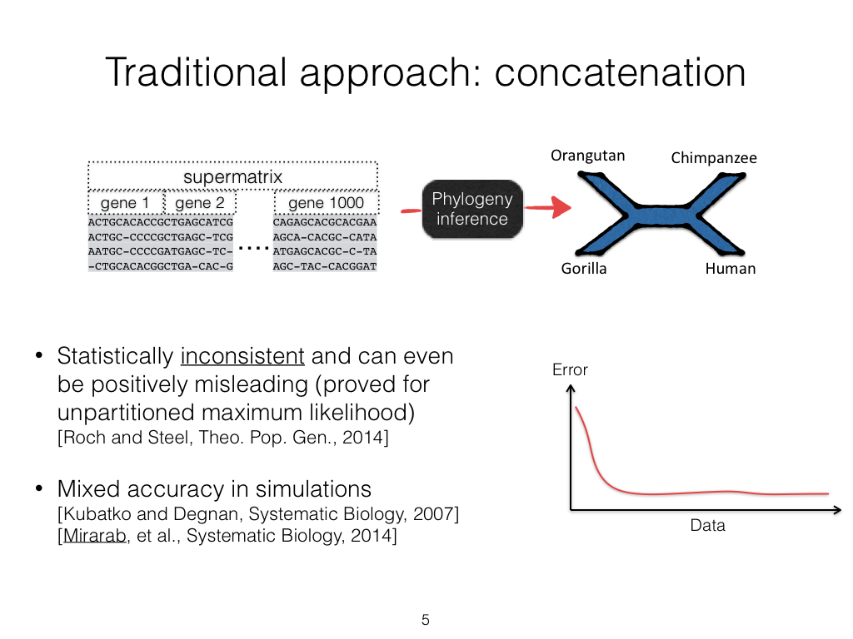

Slide 16
MSC+ GTR Hierarchical Model
Gene trees evolve within the species tree (e.g., under the Multi-Species Coalescent model)
Sequences evolve down the gene trees (e.g., under GTR model, possibly with indels)

Slide 17
Summary Method Protocol
Given gene sequence alignments, compute gene trees
Given gene trees, combine into species tree
Faster than concatenation,
and can be parallelized

Slide 18


Slide 19

ASTRID
ASTRID: Accurate species trees using internode distances, Vachaspati and Warnow, RECOMB-CG 2015 and BMC Genomics 2015
Algorithmic design: Computes a matrix of average leaf-to-leaf distances, and then computes a tree using FastME (more accurate than neighbor Joining and faster, too).
Related to NJst (Liu and Yu, 2010), which computes the same matrix but then computes the tree using neighbor joining (NJ).
Statistically consistent under the MSC
Competitive with ASTRAL for accuracy, but faster on large datasets
O(kn² + n³) time where there are k gene trees and n species

Slide 20
Species Tree Estimation under MSC+GTR
Concatenation using Maximum likelihood: NP-hard, and not consistent in the presence of ILS
Summary methods (e.g., ASTRAL, ASTRID, MP-EST): consistent, and much faster than CA-ML, but impacted by gene tree estimation error
Site-based methods (e.g., SVDquartets, SVDquest): consistent but not very computationally efficient
Co-estimation methods (*BEAST and StarBEAST2): consistent, very accurate, but very expensive

Slide 21
Multiple causes for discord, including
Incomplete Lineage Sorting (ILS),
Gene Duplication and Loss (GDL), and
Horizontal Gene Transfer (HGT)

Slide 22
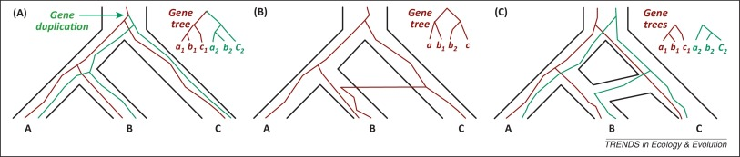
Gene Family Trees
The species tree has one duplication (at the root), which produces a gene family tree that has two copies of the species tree!
Multi-copy trees: MUL-trees
Figure by Luay Nakhleh, TREE 2013

Slide 23
Different gene family trees
Some gene family trees are single copy (and may not agree with the species tree, due to gene loss)

Slide 24
Species tree estimation under GDL
Concatenation: requires restriction to single-copy genes (throws out data) OR knowledge of orthology (not reliable)
Summary methods (combine gene family trees): gene tree parsimony (e.g., DupTree and iGTP) and supertree methods adapted to MUL-trees (e.g., MulRF), also guenomo (Bayesian method)
Bayesian co-estimation of gene trees and species trees (e.g., PhylDog) – too expensive
Nothing proven to be statistically consistent under GDL… until 2019

Slide 25
1KP: Thousand Transcriptome Project
G. Ka-Shu Wong
U Alberta
J. Leebens-Mack
U Georgia
N. Wickett
Northwestern
N. Matasci
iPlant
T. Warnow, S. Mirarab, N. Nguyen
UT-Austin/UIUC UT-Austin /UCSD UT-Austin/UCSD
2014 PNAS study: 103 plant transcriptomes, 400-800 single copy “genes”
2019 Nature study: much larger!
Gene duplication and loss
Major Challenges:
Multi-copy genes omitted (9500 -> 400)
Massive gene tree heterogeneity consistent with ILS

Slide 26
Problem: Given set of gene family trees, infer the species tree
Notes:
No orthology detection needed
Can use all the input gene family trees

Slide 27



Theorem (Legried, Molloy, Warnow, and Roch, 2019, J Comp Biol 2020): ASTRAL-multi is statistically consistent under GDL and runs in polynomial time.
Theorem (Molloy and Warnow, 2019): FastMulRFS is statistically consistent under a generic duplication-only or loss-only model, and runs in polynomial time.
Note: Both methods use dynamic programming to solve NP-hard discrete optimization problems within constrained search space in polynomial time.

Slide 28
Theorem (Legried, Molloy, Warnow, and Roch, 2019, J Comp Biol 2020): ASTRAL-multi is statistically consistent under GDL and runs in polynomial time.
Theorem (Molloy and Warnow, 2019, Bioinf 2020): FastMulRFS is statistically consistent under a generic duplication-only or loss-only model, and runs in polynomial time.
Note: Both methods use dynamic programming to solve NP-hard discrete optimization problems within constrained search space in polynomial time.

Slide 29
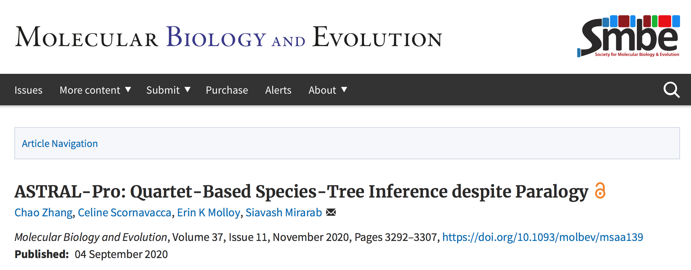

Slide 30
ASTRAL-Pro was designed to specifically address GDL:
Root and “tag” each gene tree (nodes are identified as duplications or speciations)
Modify weighting on quartet trees to reflect speciation

Slide 31


Simulation study (unpublished)
Methods: ASTRAL-Pro, ASTRID-multi, and FastMulRFS (none proven consistent under GDL, but ASTRAL-Pro and FastMulRFS shown to be more accurate in simulations than ASTRAL-multi)
All analyses performed on single nodes, with 16 threads (and at least 64 Gb RAM).
Criteria: species tree error (Robinson-Foulds error rate) and running time (after gene tree estimation complete)
Simulated datasets (SimPhy and INDELible):
  100 to 1,000 species
  Up to 10,000 gene trees evolved under GDL+ILS
  sequence length varied per gene
Authors: James Willson, Mrinmoy Ruddur, and Tandy Warnow

Slide 32
Impact of number of gene trees
Accuracy: No important differences if given enough genes.
FastMulRFS not so good at few genes.
Time: ASTRID-multi fastest, FastMulRFS slowest (but never more than 2.5 hours)
AD measures
ILS levels (average distance between true gene trees and true species tree)
100 species, 100bp alignments (approx. 43% mean gene tree error), AD=20%, duplication rate of 5.0 × 10−10 and loss/dup = 1.

Slide 33
Impact of ILS (incomplete lineage sorting)
Accuracy: No important differences for low or moderate ILS.
FastMulRFS poor if high ILS.
Speed: ASTRID-multi fastest, FastMulRFS slowest (max at 4 minutes).
100 species, 1000 gene trees, 100-site alignments, duplication rate of 5.0 × 10−10 and loss/dup = 1.

Slide 34
Results on 1000-taxon Species Trees
Accuracy: no important differences on these large datasets.
Speed: ASTRID-multi fastest, but ASTRAl-Pro nearly same. FastMulRFS slowest (max about 7 hours).
1000 species and 1000 gene trees estimated from 100bp alignments (approx. 44% mean gene tree error), AD=20%,
duplication rate of 5.0 × 10−10, and loss/dup = 1.

Slide 35
Conclusions
It is not necessary to determine orthology in order to estimate species trees: ASTRAL-Pro, ASTRID-Multi, and FastMulRFS do well.
ASTRAL-Pro and ASTRID-multi more robust than FastMulRFS
Speed is good for all methods, but especially for ASTRID-multi. Even 1000 species and 1000 genes analyzed in under 7 hours for most expensive method.
Statistical consistency established for ASTRAL-multi but not for the other methods
Much room for improvement in accuracy through novel method development

Slide 36

Acknowledgments
Papers available at http://tandy.cs.illinois.edu/papers.html
Presentations available at http://tandy.cs.illinois.edu/talks.html
Funding: NSF (CCF 1535977 and also NSF Graduate Fellowship to Erin Molloy)
Supercomputers: Blue Waters and Campus Cluster, both supported by NCSA
Write to me: warnow@Illinois.edu

Slide 37
Impact of Duplication Rate and Loss/Dup ratio
Accuracy: No important differences, under most conditions.
High dup rate not good for FastMulRFS.
Speed: ASTRID-multi fastest except for high duplication rates)
100 species, 1000 gene trees, AD=20%,

Slide 38
Impact of Gene Tree Estimation Error (GTEE)
Accuracy: No important differences given moderately high GTEE.
FastMuLRFS more impacted by GTEE.
Speed: ASTRID-multi and ASTRAL-Pro tied for high accuracy gene trees; ASTRID-multi faster given moderate to high GTEE.
FastMulRFS slowest (max at 2.5 minutes).
100 species, 1000 gene trees, AD=20%, duplication rate of 5.0 × 10−10 and loss/dup = 1.

Slide 41
ASTRAL uses dynamic programming to solve a constrained version of this problem, and is provably statistically consistent

Slide 42
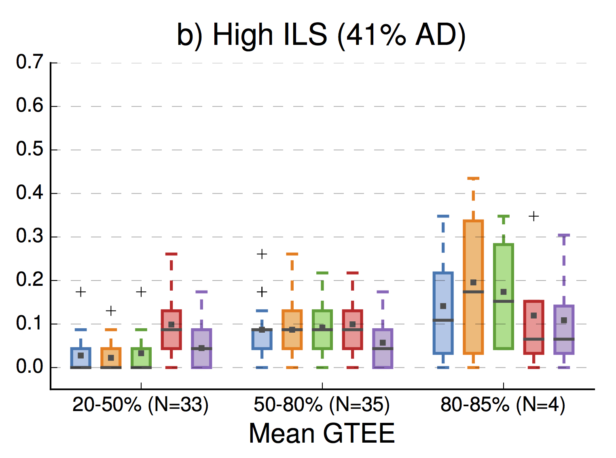

Impact of Gene Tree Estimation Error
(from Molloy and Warnow 2017)
Note:
Summary
methods
better than
CA-ML
for low
GTEE,
then worse!
Error is fraction
of bipartitions
that are not
recovered
Summary Methods
Site-based Method

Slide 43
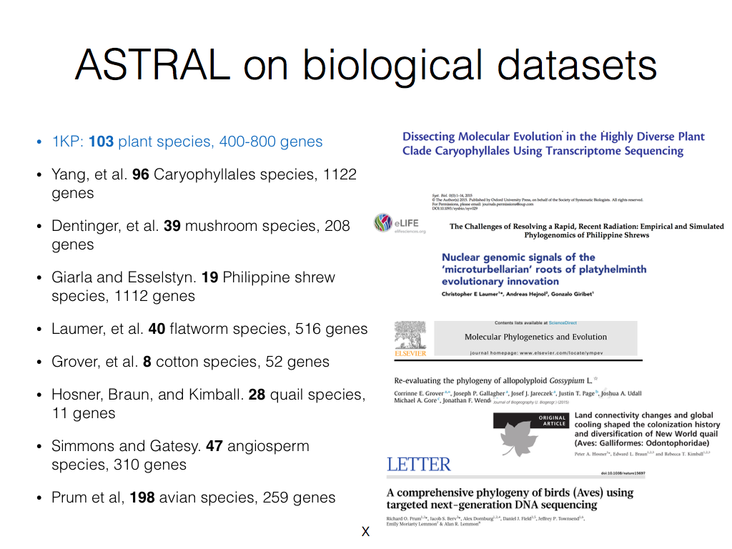

Slide 44
Methods for species tree estimation under GDL
DupTree (Wehe et al. Bioinf 2008), iGTP (Chaudhary et al. BMC Bioinf 2010), and other gene tree parsimony methods
MulRF (Chaudhary et al., Bioinf 2014)
guenomu (de Oliveira Martins et al., Bioinf 2017)
None of these have been proven statistically consistent!

Slide 45
FastMulRFS and MulRF better than ASTRAL-multi!
FastMulRFS is by far the fastest
Data: 100 species, moderate GDL, moderately high ILS,
high gene tree estimation error
Molloy and Warnow, Bioinformatics, Vol. 36, pages i57-i65,

Slide 46
Accuracy in the presence of HGT + ILS
ASTRAL and
wQMC both
good (a bit
more robust to
HGT than NJst
and CA-ML)
Davidson et al., RECOMB-CG, BMC Genomics 2015

Slide 47
Major challenge:
Multi-copy genes omitted
Massive gene tree heterogeneity consistent with ILS

Slide 48
Main competing approaches
gene 1 gene 2 … gene k
Species
. . .
Concatenation
Analyze
separately
. . .
Summary Method
Notes:
point out that supertree methods take overlaping trees and produce a tree, and that the whole process of first generating small trees and then applying a supertree method is often referred to as the “supertree approach”.

Slide 49
RF error is the
proportion of the
branches in the estimated tree not in the true tree.
ASTRID and ASTRAL: differences in accuracy depend on model condition (both high ILS)
Avian: 48 species
Mammalian: 37 species

Slide 51
Multiple causes for discord, including
Incomplete Lineage Sorting (ILS),
Gene Duplication and Loss (GDL), and
Horizontal Gene Transfer (HGT)

Slide 52
Gene Family Trees
The species tree has one duplication (at the root), which produces a gene family tree that has two copies of the species tree!
Multi-copy trees: MUL-trees
Figure by Luay Nakhleh, TREE 2013

