Slide 1
Well-Connected Communities in Real-World and Synthetic Networks
M. Park*, Y. Tabatabaee*, V. Ramavarapu, B. Liu, V. Kamath Pailodi,
R. Ramachandran, D. Korobskiy, F. Ayres, G. Chacko, and T. Warnow
* Contributed equally
Affiliations: Insper (FA), NTT Data (DK), and Univ Illinois (all others)
Supported by the Insper-Illinois Partnership, Digital Science, Google, and the Grainger Foundation

Slide 2
The Scientometrics and Network Science Project, Chacko-Warnow Collaboration
Goals:
Understanding the organization of scientific communities, and especially emerging trends in biomedical research
Developing novel community detection and community search methods that enable discovery in large networks
Developing new methods for understanding community structure in large networks (millions of nodes), including the detection of overlapping communities and evolution of communities over time.
https://tandy.cs.illinois.edu/bibliometrics.html

Slide 3
Our study: networks and community detection methods
We also examined synthetic networks based on these networks.
Only Leiden and IKC completed on Open Citations.
IKC had very low node coverage
Text tex
t
Community Detection Methods:
Leiden optimizing Modularity and the Constant Potts Model (CPM)
Iterative k-core (IKC)
Markov Clustering (MCL)
Infomap

Slide 4
Introduced Leiden algorithm
Demonstrates Louvain produces disconnected clusters
Proves CPM-optimal clusters well-connected

Slide 5
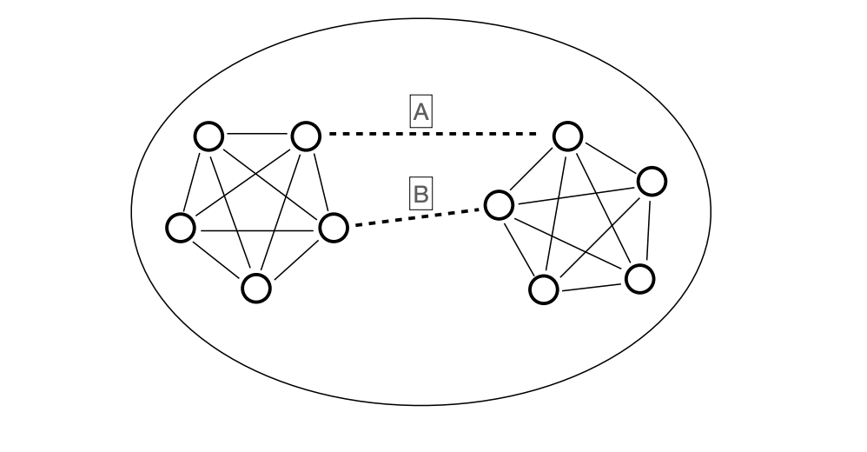
Well-connected = no small edge cut
Edge cut: set of edges whose removal splits the graph into separate components
No single edge removal disconnects the graph
An edge cut of size 2: {A,B}
Min edge cut size is 2.

Slide 6
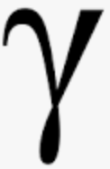
CPM-optimal clusterings are well-connected
The CPM optimization score depends on the resolution parameter
Theorem (rephrased from Traag et al. 2019):
Let C be a cluster in an optimal CPM clustering for resolution parameter .
Suppose removing edge set E’ splits C into sets X and Y.
Then E’ has at least |X||Y| edges.
This lower bound depends on and is not very meaningful when is small

Slide 7
Our study
We demonstrate that all studied clustering methods produce clusters with small edge cuts on real world networks.
We present the Connectivity Modifier: flexible pipeline, modifies clustering to ensure well-connectivity, according to a user-provided rule.

Slide 8
Leiden clusters have small edge cuts, even for large clusters
Leiden optimizing either Modularity (mod) or the
Constant Potts Model (CPM) for
different resolution values.
Blue text in left figure indicates node coverage
Trade-off between node coverage and edge-connectivity
Filling

Slide 9
The Connectivity Modifier (CM) Pipeline
CM reclusters in each iteration, using a selected clustering method
Parameter Defaults:
Well-connected means
min cuts above log₁₀ n
Cluster min size 11

Slide 10
CM reduces node coverage
Green: original clustering
Orange: after removing trees & small clusters
Blue: after CM pipeline
Optimizing node coverage produces poorly connected clusters, even trees

Slide 11
CM improves accuracy on synthetic networks
Clustering
Accuracy
Results for NMI accuracy on LFR networks.
Results for other criteria and LFR networks are similar.

Slide 12
Observations, part 1
Leiden-CPM was the best of the tested methods (higher node coverage after CM treatment, and scalable to large networks)
Leiden-Modularity is similar to Leiden-CPM with small resolution parameter values.

Slide 13
Observations, part 2
Leiden-CPM depends on the resolution parameter value:
small values producing large node coverage but poorly connected clusters
large values producing small node coverage and small clusters that are generally well-connected
So: trade-off between edge-connectivity and node coverage
But after CM, node coverage is substantially reduced

Slide 14
Additional Observations and Questions
We noted:
CM improves accuracy on LFR networks for Leiden-CPM and Leiden-Modularity, suggesting that both methods might be over-clustering,
CM produces a drop in node coverage that can be large (especially for CPM, if the resolution parameter is small).
Perhaps not all of these networks is covered by communities?

Slide 15
Additional Observations and Questions
We noted:
CM improves accuracy on LFR networks for Leiden-CPM and Leiden-Modularity, suggesting that both methods might be over-clustering,
CM produces a drop in node coverage that can be large (especially for CPM, if the resolution parameter is small).
Perhaps these networks are not fully covered by communities?

Slide 16
Take home points
All tested clustering methods produced clusters that had small edge cuts.
Two possible explanations:
Optimization problems in clustering lead to over-clustering
Not all of the network is occupied by valid communities.
Hence:
Many current methods fail to reliably produce valid communities.
Communities should be checked for edge connectivity.
Ensuring edge-connectivity should be part of community detection methods.
The Connectivity Modifier can be used to improve clusterings and for data exploration

Slide 17
Take home points
All tested clustering methods produced clusters that had small edge cuts.
Two possible explanations:
Optimization problems in clustering lead to over-clustering
Not all of the network is occupied by valid communities.
Hence:
Clusters should be checked for edge connectivity.
Ensuring edge-connectivity should be part of community detection methods.
The Connectivity Modifier can be used to improve clusterings.

Slide 18
The CM code is open source
CM is open source code (github) and under development, so that other clustering methods can be integrated.
The algorithmic parameters (e.g., what “well-connected” means) can be modified.
CM is fast enough to use on large networks.
We welcome collaborations.
See https://github.com/illinois-or-research-analytics/cm_pipeline
See https://tandy.cs.illinois.edu/bibliometrics.html for full paper

Slide 19
Lower bounds for “well-connected” clusters with n nodes
f(n) = log₁₀n
g(n) = log₂n
h(n) = (n^{0.5})/5
t(n) = 0.01(n-1): the
guarantee for
CPM-optimal clusterings when = 0.01
In this study, the edge cut size for a
“well-connected” cluster with n nodes must
be greater than f(n).
In this study, the edge cut size for a
“well-connected” cluster with n nodes must
be greater than f(n).
n = cluster size

Slide 20
Lower bounds for “well-connected” clusters with n nodes
f(n) = log₁₀n
We select f(n):
We consider a cluster with n nodes to be
“well-connected” if the min-cut size exceeds f(n).
In this study, the edge cut size for a
“well-connected” cluster with n nodes must
be greater than f(n).
n = cluster size

Slide 21
Leiden clusters have small edge cuts
Leiden optimizing either Modularity (mod) or the
Constant Potts Model (CPM) for
different resolution values.
Blue text in left figure indicates node coverage
Trade-off between node coverage and edge-connectivity

