Slide 1
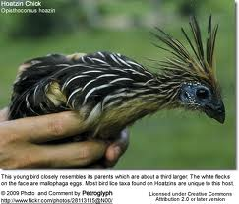

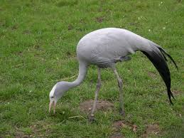




Entering the genomic era of the
Tree of Life
Tandy Warnow
The University of Illinois

Slide 2
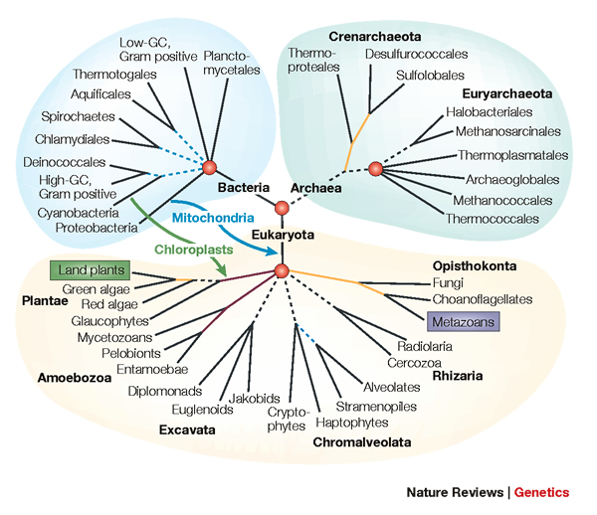
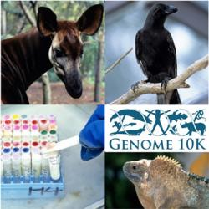
Phylogenomics
Phylogeny + genomics = genome-scale phylogeny estimation
.

Slide 3
Phylogenomic pipeline
Select taxon set and markers
Gather and screen sequence data, possibly identify orthologs
Compute multiple sequence alignments for each locus, and construct gene trees
Compute species tree or network:
  Combine the estimated gene trees, OR
  Estimate a tree from a concatenation of the multiple sequence alignments
Get statistical support on each branch (e.g., bootstrapping)
Estimate dates on the nodes of the phylogeny
Use species tree with branch support and dates to understand biology

Slide 4








1KP: Thousand Transcriptome Project
G. Ka-Shu Wong
U Alberta
J. Leebens-Mack
U Georgia
N. Wickett
Northwestern
N. Matasci
iPlant
T. Warnow, S. Mirarab, N. Nguyen
UT-Austin/UIUC UT-Austin /UCSD UT-Austin/UCSD
2014 PNAS study: 103 plant transcriptomes, 400-800 single copy “genes”
2019 Nature study: much larger!
Major Challenges:
Large alignments (and sequence length heterogeneity)
Multi-copy genes omitted (9500 -> 400)
Massive gene tree heterogeneity consistent with ILS

Slide 5
Major challenge:
Multi-copy genes omitted
Massive gene tree heterogeneity consistent with ILS

Slide 6
Phylogenomic pipeline
Select taxon set and markers
Gather and screen sequence data, possibly identify orthologs
Compute multiple sequence alignments for each locus, and construct gene trees
Compute species tree or network:
  Combine the estimated gene trees, OR
  Estimate a tree from a concatenation of the multiple sequence alignments
Get statistical support on each branch (e.g., bootstrapping)
Estimate dates on the nodes of the phylogeny
Use species tree with branch support and dates to understand biology

Slide 7
Phylogeny/MSA estimation: CS and Statistics
Assume DNA sequences are generated on an unknown model tree, and try to infer the tree (and/or alignment) from the observed sequences seen at the leaves

Slide 8
Large datasets are difficult
Two dimensions:
  Number of loci
  Number of species (or individuals)
Missing data
Heterogeneity
Many analytical pipelines involve Maximum likelihood and Bayesian estimation

Slide 9
This talk
  Estimating species trees from gene trees (addressing ILS)
  Estimating species trees from gene family trees (addressing GDL)
  Maximum Likelihood for estimating large gene trees (better than RAxML on very large datasets)

Slide 10

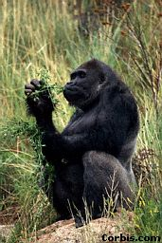


Part I: Species Tree Estimation
Orangutan
Gorilla
Chimpanzee
Human
From the Tree of the Life Website,
University of Arizona

Slide 11
Phylogeny Estimation
U
V
W
X
Y
AGGGCAT
TAGCCCA
TAGACTT
TGCACAA
TGCGCTT
X
U
Y
V
W

Slide 12
Is method M statistically consistent under model G?
Question answered by mathematical proof
Error
in species tree inferred by method M
Amount of data
generated under model G and then given to method M as input

Slide 13
Genome-scale data?
error
Length of the genome

Slide 14
Multiple causes for discord, including
Incomplete Lineage Sorting (ILS),
Gene Duplication and Loss (GDL), and
Horizontal Gene Transfer (HGT)

Slide 15
Multiple causes for discord, including
Incomplete Lineage Sorting (ILS),
Gene Duplication and Loss (GDL), and
Horizontal Gene Transfer (HGT)

Slide 16
MSC+GTR Hierarchical Model
Gene trees evolve within the species tree (under the Multi-Species Coalescent model)
Sequences evolve down the gene trees (under GTR model)

Slide 17
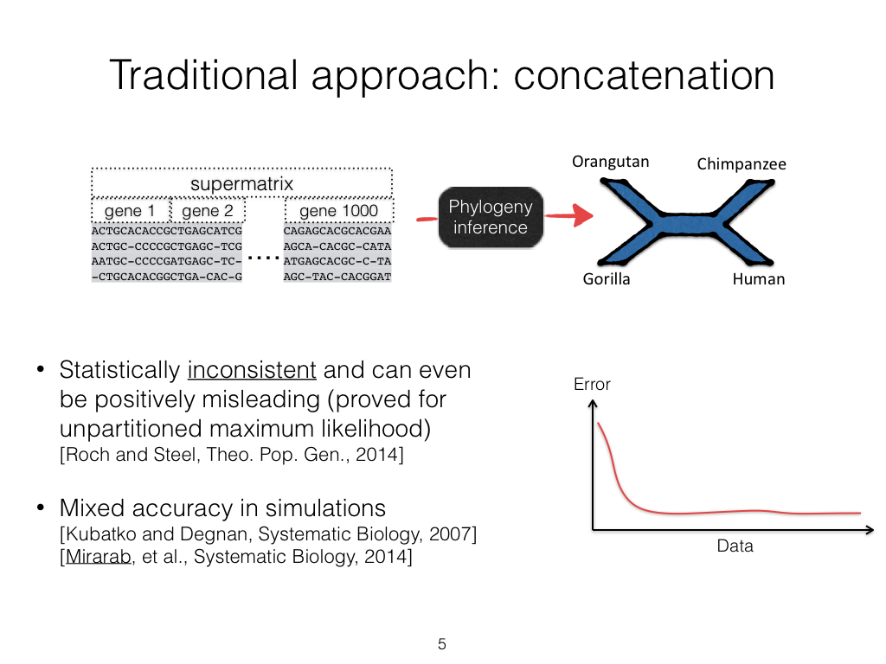

Slide 18
MSC+GTR Hierarchical Model
Gene trees evolve within the species tree (under the Multi-Species Coalescent model)
Sequences evolve down the gene trees (under GTR model)

Slide 19
Summary Method Protocol
Given gene sequence alignments, compute gene trees
Given gene trees, combine into species tree
Faster than concatenation,
and can be parallelized

Slide 20
Quartet trees and the MSC
Allman, Degnan, and Rhodes (J. Mathematical Biology 2011) proved:
  For every four species, the most probable unrooted gene tree is topologically identical to the true species tree
This is not true for five species (anomaly zone)

Slide 21


Slide 22
Theorem: Under MSC, the most probable quartet tree is the true species tree

Slide 23
ASTRAL uses dynamic programming to solve a constrained version of this problem, and is provably statistically consistent

Slide 24
ASTRAL runs in O(|X|²kn) where there are n species and k genes, and X is the set of allowed bipartitions

Slide 25
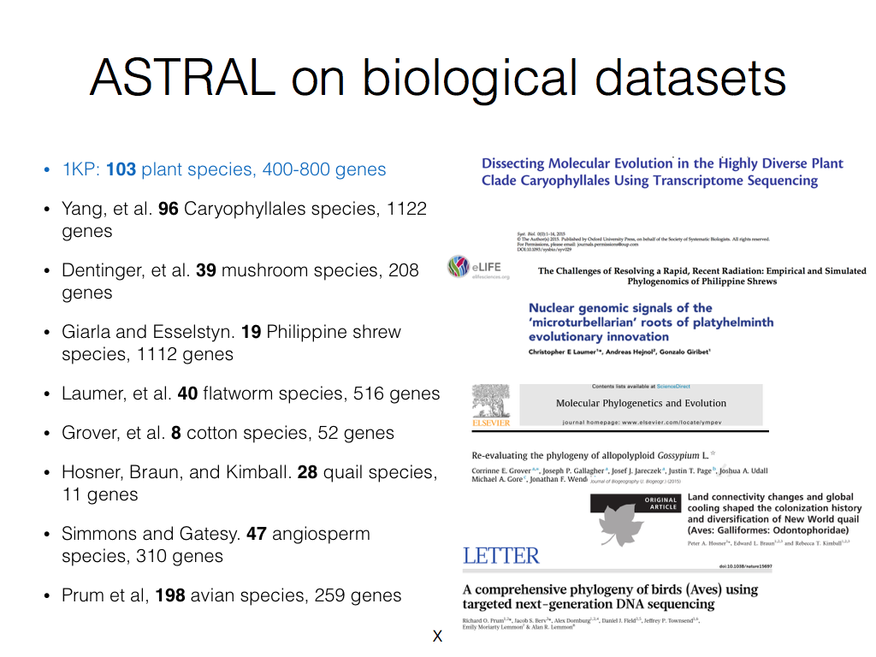

Slide 26
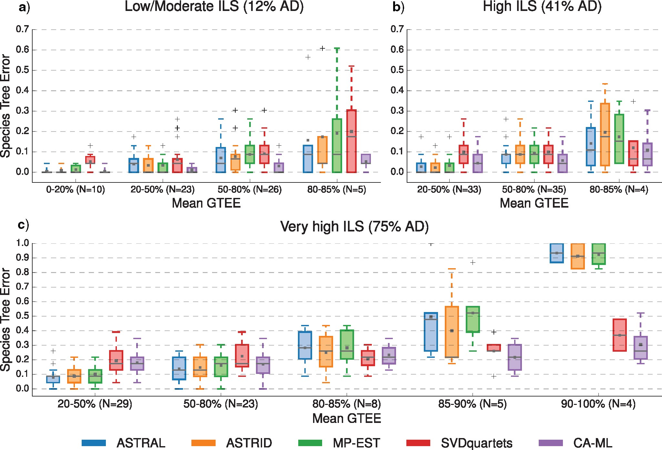

Figure 1. The impact of gene tree estimation error (GTEE) and incomplete lineage sorting (ILS) on species tree error, all datasets with 26 species and 1000 genes.
Concatenation using Maximum Likelihood (RAxML) vs. ASTRAL:
depends on levels of ILS and GTEE
Notes:
Figure 1. The impact of gene tree estimation error (GTEE) and incomplete lineage sorting (ILS) on species tree error is shown for five methods: ASTRAL-II (blue), ASTRID (orange), MP-EST (green), SVDquartets (red), and unpartitioned concatenation analysis using maximum likelihood (CA-ML), specifically RAxML (purple). Species tree error is the normalized Robinson–Foulds (RF) distance between the true and estimated species trees. Subplots a, b, and c show three levels of increasing ILS, where AD is the normalized RF distance between the true species and true gene trees averaged across all genes. The mean GTEE range and the number of replicates ($N$) for that model condition are given on the $x$-axis. Means and medians are denoted by the gray dot and bar, respectively. Box plots are defined by quartiles, e.g., boxes extend from the first to the third quartiles. Greater levels of ILS and/or GTEE increased species tree error rates for all methods, and the relative performance of methods depended on both ILS and GTEE. Under low to moderate ILS, CA-ML tended to have better accuracy than the coalescent methods. Under higher levels of ILS, summary methods were typically more accurate than CA-ML and SVDquartets except for conditions with high GTEE.
Unless provided in the caption above, the following copyright applies to the content of this slide: © The Author(s) 2017. Published by Oxford University Press, on behalf of the Society of Systematic Biologists. All rights reserved. For Permissions, please email: journals.permissions@oup.com© The Author(s) 2017. Published by Oxford University Press, on behalf of the Society of Systematic Biologists. All rights reserved. For Permissions, please email: journals.permissions@oup.com

Slide 27
ASTRAL publications (sample)
2014: ASTRAL (ECCB and Bioinformatics, cited 903 times
2015: ASTRAL-II (cited 751 times)
2018: ASTRAL-III (cited 897 times)
2019: Multi-allele species reconstruction (MPE)
2019: ASTRAL-MP (scaling to very large datasets)
2020: Forcing external constraints

Slide 28
Main Approaches
gene 1 gene 2 … gene k
Species
ASTRAL
. . .
Concatenation
Analyze
separately
RAxML
. . .
Summary Method
Notes:
point out that supertree methods take overlaping trees and produce a tree, and that the whole process of first generating small trees and then applying a supertree method is often referred to as the “supertree approach”.

Slide 29
Summary and two key ideas for ILS-based species tree estimation
Theorem: For every four species, the most probable (unrooted) gene tree is topologically identical to the true species tree
ASTRAL can find the “Maximum Quartet Support Species Tree” (MQSST) in low degree polynomial time, in a constrained search space
  Maintains statistical consistency if the constraint space is defined from the gene trees
  Fast in practice
  Highly accurate if there are enough gene trees (even when there is gene tree estimation error and missing data)
Concatenation using ML (e.g., RAxML) sometimes more accurate, despite not having guarantee of statistical consistency

Slide 30
1KP: Thousand Transcriptome Project
G. Ka-Shu Wong
U Alberta
J. Leebens-Mack
U Georgia
N. Wickett
Northwestern
N. Matasci
iPlant
T. Warnow, S. Mirarab, N. Nguyen
UT-Austin/UIUC UT-Austin /UCSD UT-Austin/UCSD
2014 PNAS study: 103 plant transcriptomes, 400-800 single copy “genes”
2019 Nature study: much larger!
Major Challenges:
Multi-copy genes omitted (9500 -> 400)
Massive gene tree heterogeneity consistent with ILS

Slide 31
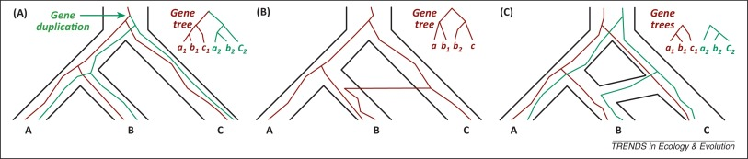
Gene Family Trees
The species tree has one duplication (at the root), which produces a gene family tree that has two copies of the species tree!
Multi-copy trees: MUL-trees
Figure by Luay Nakhleh, TREE 2013

Slide 32
Species tree estimation under GDL
Options:
Throw out multi-copy genes
Figure out orthology
Run methods (like gene tree parsimony) that combine gene family trees into a species tree
Note:
Nothing proven to be statistically consistent under GDL… until 2019
Nothing proven to be statistically consistent under GDL… until 2019

Slide 33
Problem: Gene family trees are MUL-trees

Slide 34
Problem: Given set of MUL-trees, infer the species tree
Note: no orthology detection

Slide 35



Theorem (Legried, Molloy, Warnow, and Roch, 2019): ASTRAL-multi is statistically consistent under GDL and runs in polynomial time.
Theorem (Molloy and Warnow, 2019): FastMulRFS is statistically consistent under a generic duplication-only or loss-only model, and runs in polynomial time.
Note: Both methods use dynamic programming to solve NP-hard discrete optimization problems within constrained search space in polynomial time.
Theorem: Under GDL, most probable quartet tree is the species tree

Slide 36
But…ASTRAL-multi is not as accurate as other methods!
Results on 100-species datasets with moderate GDL, moderately high ILS, and high GTEE

Slide 37
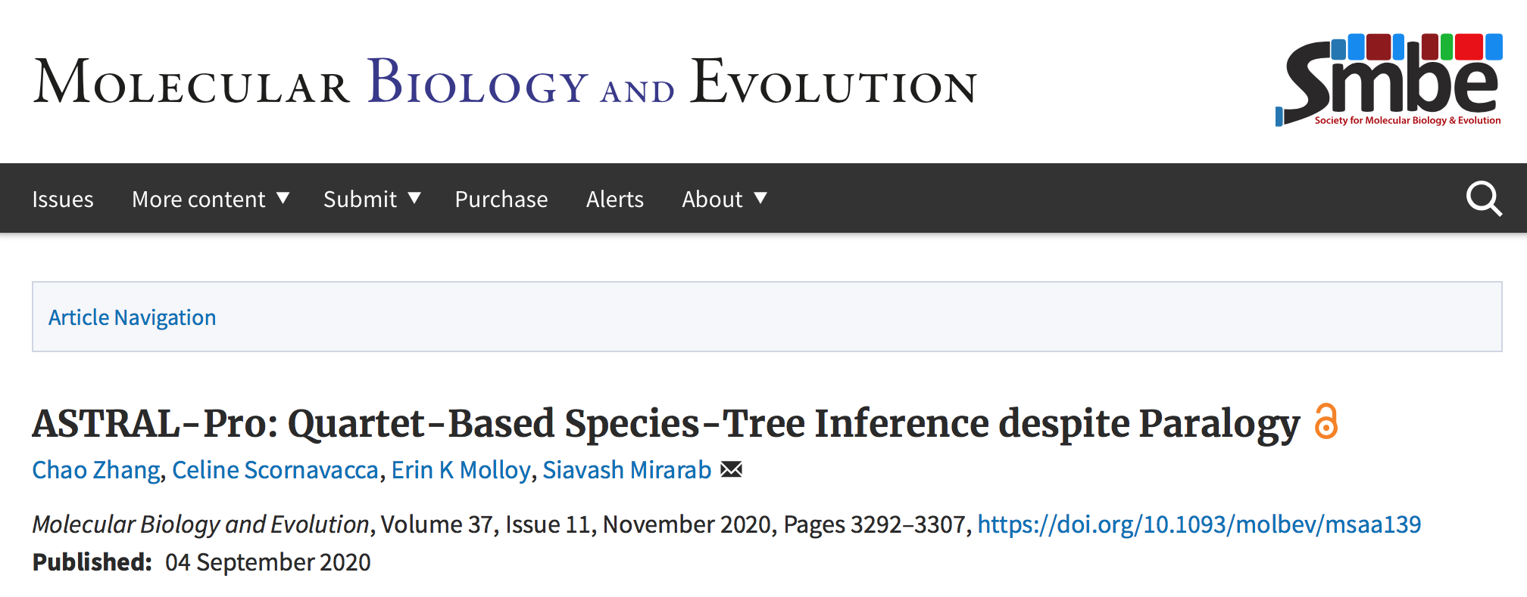

Slide 38
ASTRAL-pro
Input: Set of unrooted multi-copy gene family trees (mul-trees)
Output: Species tree
Step 1: ”root and tag” every mul-tree
Step 2: Use the rooting to define “speciation quartets”
Step 3: Run ASTRAL’s DP algorithm with modified weights, reflecting speciation quartets
Theorem: ASTRAL-pro is statistically consistent if it correctly roots-and-tags every mul-tree

Slide 39
ASTRAL-pro
Input: Set of unrooted multi-copy gene family trees (mul-trees)
Output: Species tree
Step 1: ”root and tag” every mul-tree
Step 2: Use the rooting to define “speciation quartets”
Step 3: Run ASTRAL’s DP algorithm with modified weights, reflecting speciation quartets
Theorem: ASTRAL-pro is statistically consistent if it correctly roots-and-tags every mul-tree

Slide 40
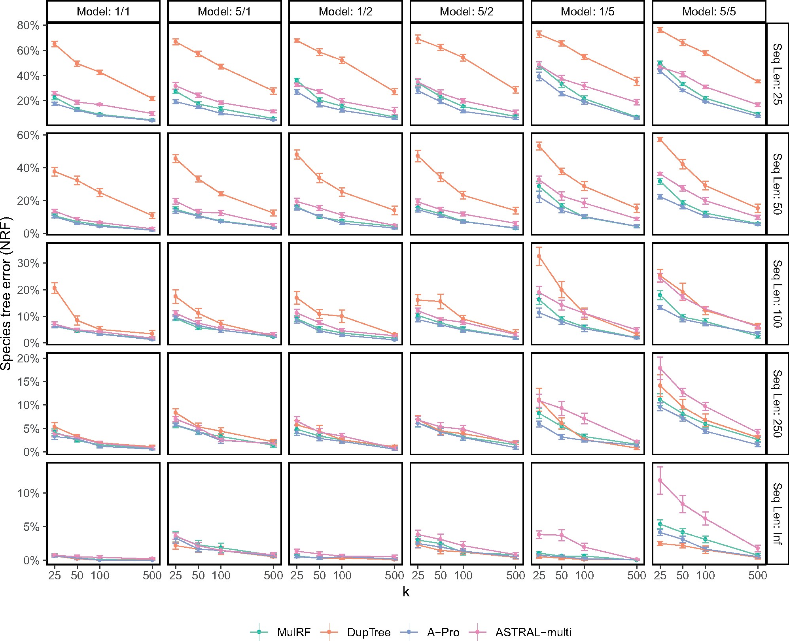
Figure 4 from ASTRAL-Pro paper
Results on 100 species datasets with high ILS and varying GDL
ASTRAL-Pro: Best method (ties or improves on all other tested methods (ASTRAL-multi, DupTree, and MulRF).
For all methods, accuracy improves with sequence length per gene and number of genes.
Results on 25-taxon datasets show slightly different trends, but ASTRAL-Pro still the best.
Notes:
Fig. 4. Species tree error on S100 data set. We compare the species tree error of the four methods, showing mean and standard error over ten replicates for each model condition, with varying numbers of genes (k) and sequence lengths (with Inf signifying true gene trees). Model conditions are labeled as a/b where a is the level of ILS (1 or 5) and b is the duplication/loss rate (1, 2, or 5).
Unless provided in the caption above, the following copyright applies to the content of this slide: © The Author(s) 2020. Published by Oxford University Press on behalf of the Society for Molecular Biology and Evolution.This is an Open Access article distributed under the terms of the Creative Commons Attribution License (http://creativecommons.org/licenses/by/4.0/), which permits unrestricted reuse, distribution, and reproduction in any medium, provided the original work is properly cited.© The Author(s) 2020. Published by Oxford University Press on behalf of the Society for Molecular Biology and Evolution.

Slide 41
DISCO (Willson et al., Systematic Biology 2022)
Input: Set of gene family trees
Output: Set of single copy gene trees (obtained by decomposing gene family trees)
Technique:
  Use ASTRAL-Pro to root and tag each gene family tree
  Decompose from the “bottom-up”, aiming to keep at least one large subtree
  Follow with method that requires single-copy genes (e.g., ASTRAL, ASTRID, Concatenation Analysis using maximum likelihood)
Variants we examined: ASTRID-DISCO, ASTRAL-DISCO, CA-DISCO

Slide 42
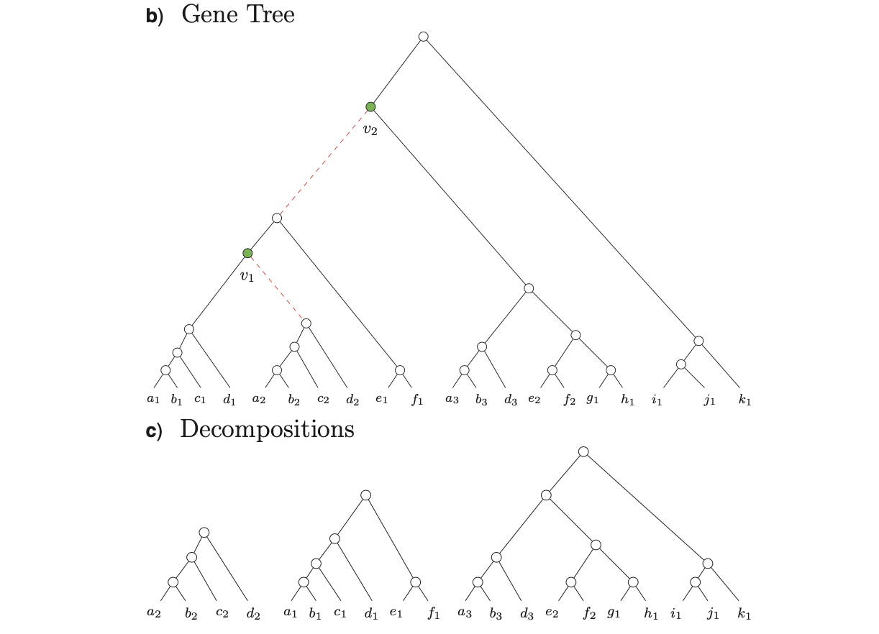

Slide 43
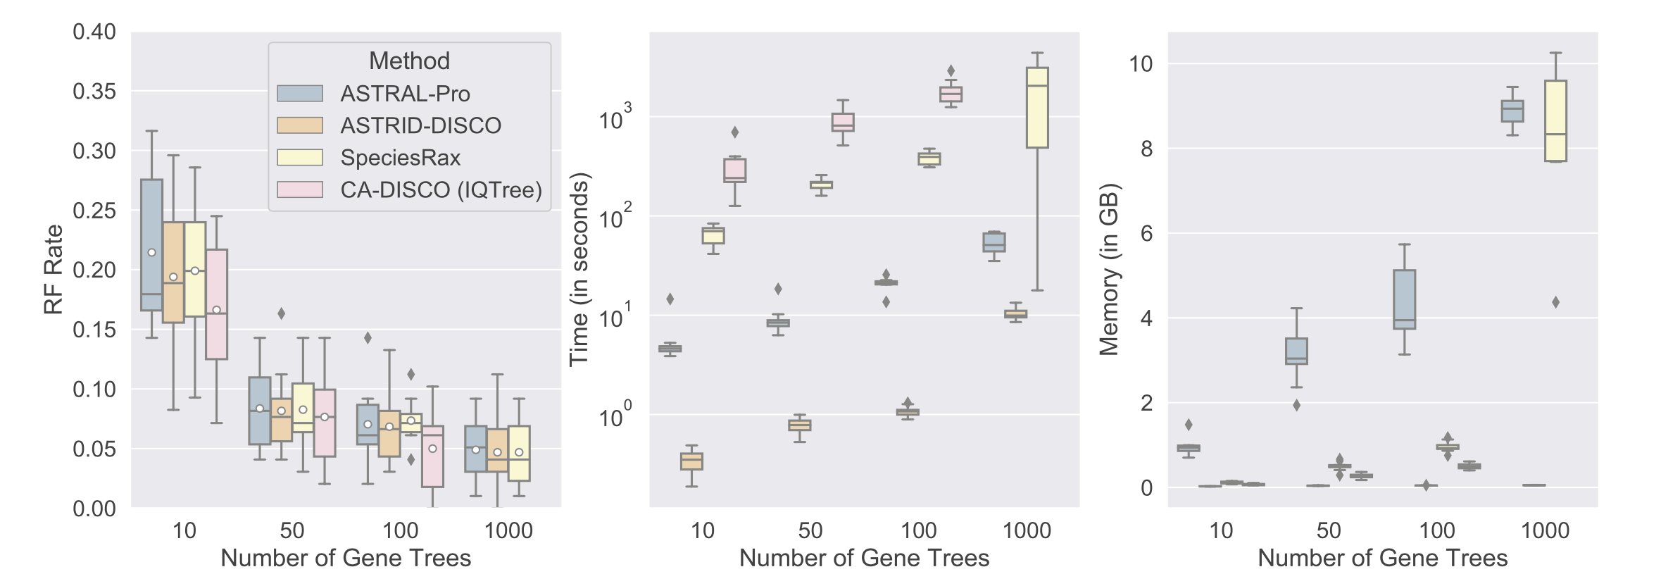
Results on 101 species with GDL and ILS

Slide 44
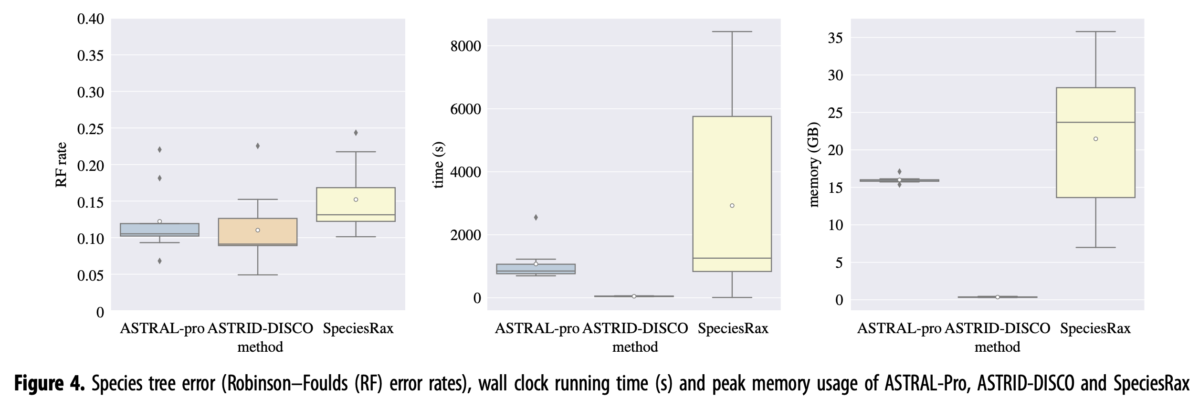
Results on 1000 species and 1000 genes

Slide 45
Summary for GDL-based species tree estimation
No need to determine orthology – can use all your data!
Summary methods can provide high accuracy. ASTRAL-Pro and ASTRID-DISCO are best so far:
  ASTRAL-Pro: roots and tags each gene family tree and then solves modified quartet-based optimization using ASTRAL’s dynamic programming approach
  ASTRID-DISCO: DISCO first (uses ASTRAL-Pro to root and tag, then decomposes into single copy gene trees) then ASTRID (summary method).
Concatenation analysis using DISCO can be highly accurate.
Note: these methods above have no strong guarantee of statistical consistency. Only ASTRAL-one and ASTRAL-multi are proven consistent so far (but these aren’t as accurate empirically).

Slide 46
Summary and two key ideas for species tree estimation under ILS
Theorem: For every four species, the most probable (unrooted) gene tree is topologically identical to the true species tree
ASTRAL can find the “Maximum Quartet Support Species Tree” (MQSST) in low degree polynomial time, in a constrained search space
  Maintains statistical consistency if the constraint space is defined from the gene trees
  Fast in practice
  Highly accurate if there are enough gene trees (even when there is gene tree estimation error and missing data)
Concatenation using ML (not consistent) sometimes more accurate, despite not having guarantee of statistical consistency

Slide 47
Summary and three key ideas for species tree estimation under ILS+GDL
Theorem: For every four species, the most probable (unrooted) gene tree is topologically identical to the true species tree
ASTRAL-multi and ASTRAL-one: can find the “Maximum Quartet Support Species Tree” (MQSST) in low degree polynomial time, in a constrained search space – and are statistically consistent
ASTRAL-Pro (not guaranteed statistically consistent) but:
  Roots and tags gene trees
  Statistically consistent if rooting and tagging is correct
  Highly accurate if there are enough gene trees (even when there is gene tree estimation error and missing data)

Slide 48
What about HGT?
HGT also makes heterogeneous gene trees
Under some assumptions of random HGT operating, it may be possible to define the “underlying” species tree.
Statistical consistency of quartet-based methods for computing the underlying species tree established by:
    Roch & Snir, JCB 2013
    Daskalakis & Roch, arXiv 2015
Simulation study (Davidson et al. 2015) shows ASTRAL and wQMC (Snir et al.) more accurate than concatenation and NJst when ILS+HGT is present

Slide 49
Accuracy in the presence of HGT + ILS
Theorem (Snir and Roch): Under bounded but random HGT, most probable quartet tree is the species tree
Davidson et al., RECOMB-CG, BMC Genomics 2015

Slide 50
Gene trees -> Species trees, using Quartet Trees
Recurring theme: the most probable quartet tree is the species tree for:
  ILS (Multi-species coalescent)
  ILS+GDL (DLCOAL)
  Random (but bounded) HGT
Hence, quartet-based species tree estimation (from gene trees) is often statistically consistent, if performed properly.
Finding MQSST (within a constrained search space) a powerful approach that maintains consistency and is computationally efficient
Interestingly, MQSST is also fairly robust

Slide 51
Summary so far for species tree estimation
Progress on species tree estimation addressing both incomplete lineage sorting (ILS) and gene duplication and loss (GDL)
Practical methods that are highly scalable to very large datasets (e.g., ASTRAL-Pro and DISCO)
No need to establish orthology – and you can keep all your data!
Concatenation remains a reasonable approach under many conditions, and is sometimes more accurate than summary methods
Some established theory

Slide 52
Part II: Large-scale gene tree estimation

Slide 53
Phylogeny Problem
U
V
W
X
Y
AGGGCAT
TAGCCCA
TAGACTT
TGCACAA
TGCGCTT
X
U
Y
V
W

Slide 54
DNA Sequence Evolution (Idealized)
AAGACTT
-3 mil yrs
AAGACTT
-2 mil yrs
AAGGCCT
AAGGCCT
AAGGCCT
AAGGCCT
TGGACTT
TGGACTT
TGGACTT
TGGACTT
-1 mil yrs
AGGGCAT
AGGGCAT
TAGCCCT
TAGCCCT
AGCACTT
AGGGCAT
TAGCCCT
AGCACTT
AGCACTT
AGGGCAT
TAGCCCA
TAGACTT
AGCACAA
AGCGCTT
today
AGGGCAT
TAGCCCA
TAGACTT
AGCACAA
AGCGCTT

Slide 55
Markov Models of Sequence Evolution (Gene Tree)
The different sites are assumed to evolve i.i.d. down the model tree, so it suffices to model a single site
Jukes-Cantor, 1969 (simplest DNA site evolution model):
The state at the root is randomly drawn from {A,C,T,G} (nucleotides)
The model tree T is binary and has substitution probabilities p(e) on each edge e, with 0<p(e)<3/4
If a site (position) changes on an edge, it changes with equal probability to each of the remaining states
The evolutionary process is Markovian.
More complex models are also considered, often with little change to the theory.

Slide 56
Phylogeny estimation as a statistical problem
Assume DNA sequences are generated on an unknown model tree, and try to infer the tree from the observed sequences seen at the leaves
Many methods:
  Maximum likelihood: Find the model tree that maximizes the probability of generating the observed sequences
  Bayesian estimation
  Distance-based methods (e.g., neighbor joining)
  Maximum parsimony
NP-hard optimization problems, heuristics

Slide 57
Maximum likelihood for gene tree estimation
Theory:
  Statistically consistent
  Low sample complexity (Roch & Sly, Prob. Theory and Related Fields, 2017): phase transition (logarithmic then polynomial)
  NP-hard
Empirical (based on heuristics) – using RAxML (leading ML heuristic)
  Outstanding accuracy on simulated data
  Challenging on large datasets (best methods can take CPU years or fail to run on large datasets)

Slide 58
Divide-and-Conquer using Disjoint Tree Mergers
Note: use most accurate method on subsets, and treat as absolute constraints
Decompose species set into pairwise disjoint subsets.
Erin Molloy,
Introduced this
approach
Full
species
set
Build a tree on each
subset
Auxiliary
Info
(e.g., distance
matrix)
Tree
on full
species set
Compute tree on entire set of species using “Disjoint Tree Merger” method

Slide 59
Divide-and-Conquer Gene Tree Estimation
Note: use most accurate method on subsets, and treat as absolute constraints
Decompose species set into pairwise disjoint subsets.
Full
species
set
RAxML, IQ-TREE, etc
Build a tree on each
subset
Auxiliary
Info
(e.g., distance
matrix)
Tree
on full
species set
Compute tree on entire set of species using “Disjoint Tree Merger” method
Guide Tree Merger

Slide 60
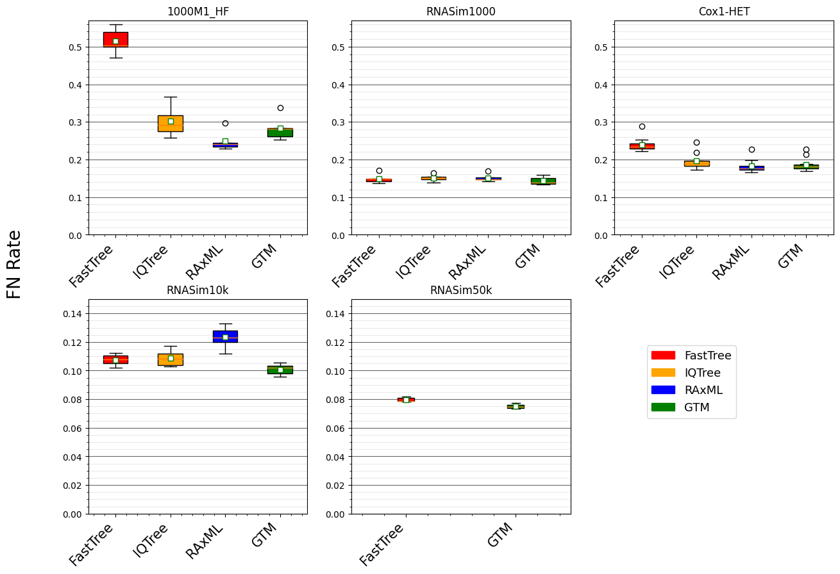


Figure 2 from “Disjoint Tree Mergers for Large-Scale Maximum Likelihood Tree Estimation”, Park et al., Algorithms 2021
GTM pipeline:
starting tree is IQ-Tree or FastTree (smaller datasets),
IQ-tree used to compute subset trees, and
then combined using GTM

Slide 61
GTM-pipeline:
Scales to large datasets
Is competitive with RAxML and IQ-TREE for accuracy
Is only slightly slower than starting tree (but more accurate)

Slide 62
GTM-pipeline:
Scales to large datasets
Is competitive with RAxML and IQ-TREE for accuracy
Is only slightly slower than starting tree (but more accurate)

Slide 63
What about maximum likelihood score?
We used the same technique but evaluated maximum likelihood scores on a large biological dataset (protein sequences) with approximately 70,000 sequences, restricting the alignment to 1000 sites.
We let RAxML run under varying conditions: its default approach, using FastTree as a starting tree, and using our GTM tree as a starting tree.
We compared these RAxML runs (different starting trees) to each other, using LG+Gamma(4) for the model

Slide 64
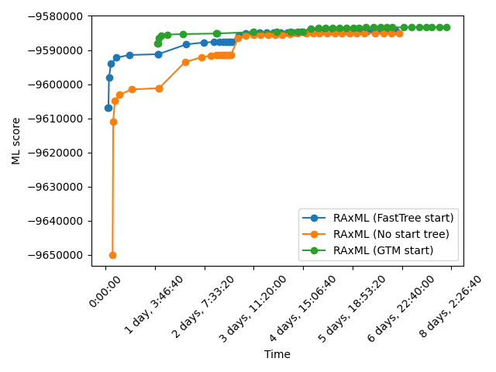
Choice of starting tree matters, and RAxML continues to improve its ML score during the entire 8 day period (but most gains are in the first 4 days
GTM takes a bit more than 24 hours

Slide 65
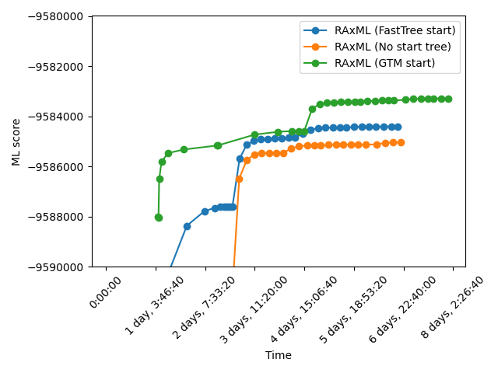

Slide 66
Divide-and-Conquer using Disjoint Tree Mergers
Theorem: DTM pipelines maintain statistical consistency for phylogeny estimation (assuming subset trees computed using statistically consistent methods)
Decompose species set into pairwise disjoint subsets.
Full
species
set
Build a tree on each
subset
Auxiliary
Info
(e.g., distance
matrix)
Tree
on full
species set
Compute tree on entire set of species using “Disjoint Tree Merger” method

Slide 67
Divide-and-Conquer using Disjoint Tree Mergers
Theorem: DTM pipelines maintain statistical consistency for phylogeny estimation (assuming subset trees computed using statistically consistent methods)
Decompose species set into pairwise disjoint subsets.
Full
species
set
Also: has been used for species
Tree estimation
(e.g., ASTRAL and concatenation)
and shows
Improvements in runtime and sometimes accuracy
Build a tree on each
subset
Auxiliary
Info
(e.g., distance
matrix)
Tree
on full
species set
Compute tree on entire set of species using “Disjoint Tree Merger” method

Slide 68
Summary of DTM pipeline results
Divide-and-conquer pipelines using DTMs maintain statistical consistency and run in polynomial time
For both gene trees and species trees, DTM pipelines reduce running time and memory usage, produce trees with comparable or better accuracy, and can complete on larger datasets
Runtimes are generally only slightly more expensive than the starting tree
Embarrassingly parallel

Slide 69
Overall summary
Large-scale phylogeny estimation, both for gene trees and species trees, is becoming both fast and accurate
Now possible to get good maximum likelihood trees on ultra-large datasets using DTM pipelines
New methods for handling GDL are available – more are under development
Not shown: new methods for large-scale multiple sequence alignment

Slide 70

Acknowledgments
Papers available at http://tandy.cs.illinois.edu/papers.html
Presentations available at http://tandy.cs.illinois.edu/talks.html
Software on github, links at http://tandy.cs.illinois.edu/software.html
Funding: NSF (CCF 1535977, ABI-1458652, 2006069, Graduate Fellowship to Erin Molloy), the Grainger Foundation, and the Ira and Debra Cohen Fellowship to Vlad Smirnov
Supercomputers: Blue Waters and Campus Cluster, both supported by NCSA
Write to me: warnow@Illinois.edu

