Slide 1
Multiple sequence alignment methods: evidence from data
(Updated for 2021)
Tandy Warnow

Slide 2
Studies we will discuss
Katoh and Standley, MBE 2013 (about MAFFT)
Nelesen et al., PSB 2008 (Impact of guide tree)
Liu and Warnow, PLoS ONE 2012 (about treelength criteria)
Loytynoja and Goldman, Science 2008 (about Prank)
Sievers et al., Molecular Systems Biology 2011 (Clustal-Omega paper)
Liu et al., Science 2009 (SATé-I) and Mirarab et al. J. Computational Biology 2014 (PASTA), Smirnov and Warnow Bioinformatics 2021 (MAGUS)
Nguyen et al., Genome Biology 2014 (UPP)
Nute et al., Systematic Biology 2019 (Evaluating BAli-Phy)

Slide 3
Benchmarks
Simulations: can control everything, and true alignment is not disputed
  Different simulators
Biological: can’t control anything, and reference alignment might not be true alignment
  BAliBASE, HomFam, Prefab
  CRW (Comparative Ribosomal Website)

Slide 4
Alignment Error/Accuracy
SPFN: percentage of homologies in the true alignment that are not recovered (false negative homologies)
SPFP: percentage of homologies in the estimated alignment that are false (false positive homologies)
TC: total number of columns correctly recovered
SP-score: percentage of homologies in the true alignment that are recovered
Pairs score: 1-(avg of SP-FN and SP-FP)

Slide 5
Other Criteria
Tree topology error
Tree branch length error
Gap length distribution
Insertion/deletion ratio
Alignment length
Number of indels

Slide 6
Alignment criteria
Does the relative performance of methods depend on the alignment criterion?
Which alignment criteria are predictive of tree accuracy?
How should we design MSA methods to produce best accuracy?

Slide 7
Alignment Methods (Sample)
Clustal-Omega
MAFFT
Muscle
Opal
Prank/Pagan
Probcons
Co-estimation of trees and alignments
Bali-Phy and Alifritz (statistical co-estimation)
SATe-1, SATe-2, and PASTA (divide-and-conquer co-estimation)
POY and Beetle (treelength optimization)

Slide 8
Choice of best MSA method
Does it depend on type of data (DNA or amino acids?)
Does it depend on rate of evolution?
Does it depend on gap length distribution?
Does it depend on existence of fragments?

Slide 9
Studies we will discuss
Katoh and Standley, MBE 2013 (about MAFFT)
Nelesen et al., PSB 2008 (Impact of guide tree)
Liu and Warnow, PLoS ONE 2012 (about treelength criteria)
Loytynoja and Goldman, Science 2008 (about Prank)
Sievers et al., Molecular Systems Biology 2011 (Clustal-Omega paper)
Liu et al., Science 2009 (SATé-I) and Mirarab et al. J. Computational Biology 2014 (PASTA), Smirnov and Warnow Bioinformatics 2021 (MAGUS)
Nguyen et al., Genome Biology 2014 (UPP)
Nute et al., Systematic Biology 2019 (Evaluating BAli-Phy)

Slide 10
From Katoh and Standley, 2013 (dealing with fragmentary sequences)
Mol. Biol. Evol. 30(4):772–780 doi:10.1093/molbev/mst010

Slide 11
Important!
Each method can be run in different ways – so you need to know the exact command used, to be able to evaluate performance. (You also need to know the version number!)

Slide 12
Studies we will discuss
Katoh and Standley, MBE 2013 (about MAFFT)
Nelesen et al., PSB 2008 (Impact of guide tree)
Liu and Warnow, PLoS ONE 2012 (about treelength criteria)
Loytynoja and Goldman, Science 2008 (about Prank)
Sievers et al., Molecular Systems Biology 2011 (Clustal-Omega paper)
Liu et al., Science 2009 (SATé-I) and Mirarab et al. J. Computational Biology 2014 (PASTA), Smirnov and Warnow Bioinformatics 2021 (MAGUS)
Nguyen et al., Genome Biology 2014 (UPP)
Nute et al., Systematic Biology 2019 (Evaluating BAli-Phy)

Slide 13
Nelesen et al., PSB 2008
Pacific Symposium on Biocomputing, 2008
MSA methods:
  ClustalW, Muscle, Probcons, MAFFT, and FTA (Fixed Tree Alignment, using POY on the guidetree)
Guide trees:
  Default for each method
  Two different UPGMA trees
  Probtree (ML on Probcons+GT alignment)
Examined results on simulated datasets with respect to alignment error and tree error

Slide 14
Impact of guide tree
Most MSA methods use “progressive alignment” techniques, that
  First compute a guide tree T
  Align the sequences from the bottom-up using the guide tree
Hence, there is a potential for the guide tree to impact the final alignment.
Many authors have studied this issue… here’s our take on it (Nelesen et al., PSB 2008)

Slide 15
How does the guide tree impact accuracy?
Does improving the accuracy of the guide tree help?
Do all alignment methods respond identically? (Is the same guide tree good for all methods?)
Do the default settings for the guide tree work well?

Slide 16
Figure from Nelesen et al., Pacific Symposium on Biocomputing, 2008

Slide 17
Figure from Nelesen et al., Pacific Symposium on Biocomputing, 2008

Slide 18
Observations
Guide tree choice did not seem to affect alignment SP error
Guide tree choice affected tree error – but impact depended on dataset size (25 vs. 100) and MSA method.
Probcons very impacted by guide tree (and that may be because its own default guide tree is poorly chosen).
FTA very impacted by guide tree. Note that FTA on the true tree is MORE accurate than ML on the true alignment.
For analyses of 100-taxon datasets, Probtree is a good guide tree.

Slide 19
Studies we will discuss
Katoh and Standley, MBE 2013 (about MAFFT)
Nelesen et al., PSB 2008 (Impact of guide tree)
Liu and Warnow, PLoS ONE 2012 (about treelength criteria)
Loytynoja and Goldman, Science 2008 (about Prank)
Sievers et al., Molecular Systems Biology 2011 (Clustal-Omega paper)
Liu et al., Science 2009 (SATé-I) and Mirarab et al. J. Computational Biology 2014 (PASTA), Smirnov and Warnow Bioinformatics 2021 (MAGUS)
Nguyen et al., Genome Biology 2014 (UPP)
Nute et al., Systematic Biology 2019 (Evaluating BAli-Phy)

Slide 20
Treelength optimization
POY is the most well-known method for co-estimating alignments and trees using treelength criteria (however – note that the developers of POY say to ignore the alignment and only use the tree).
The accuracy of the final tree depends on the edit distance formulation – as noted by several studies. Affine gap penalties are more biologically realistic than simple gap penalties.
We developed BeeTLe (Better Tree Length), a heuristic that is guaranteed to always be as least as accurate as POY for the treelength criterion.

Slide 21
Treelength questions
Is it better to use affine than simple gap penalties?
Does POY solve its treelength problem? Is BeeTLe actually better (as promised)?
How accurate are the alignments?
How accurate are the trees, compared to
  MP analyses of good alignments
  ML analyses of good alignments

Slide 22
Simulated 100-sequence DNA datasets with varying rates of evolution
Results from Liu and Warnow, PLoS ONE 2012

Slide 23
Maximum Parsimony (MP) on different alignments
Simulated 100-sequence DNA datasets with varying rates of evolution
Results from Liu and Warnow, PLoS ONE 2012

Slide 24
Maximum Likelihood (ML) on different alignments
Simulated 100-sequence DNA datasets with varying rates of evolution
Results from Liu and Warnow, PLoS ONE 2012

Slide 25
Treelength questions
Is it better to use affine than simple gap penalties?
Does POY solve its treelength problem? Is BeeTLe actually better (as promised)?
How accurate are the alignments?
How accurate are the trees, compared to
  MP analyses of good alignments
  ML analyses of good alignments

Slide 26
Studies we will discuss
Katoh and Standley, MBE 2013 (about MAFFT)
Nelesen et al., PSB 2008 (Impact of guide tree)
Liu and Warnow, PLoS ONE 2012 (about treelength criteria)
Loytynoja and Goldman, Science 2008 (about Prank)
Sievers et al., Molecular Systems Biology 2011 (Clustal-Omega paper)
Liu et al., Science 2009 (SATé-I) and Mirarab et al. J. Computational Biology 2014 (PASTA), Smirnov and Warnow Bioinformatics 2021 (MAGUS)
Nguyen et al., Genome Biology 2014 (UPP)
Nute et al., Systematic Biology 2019 (Evaluating BAli-Phy)

Slide 27
Prank
Prank (Loytynoja and Goldman, Science 2008) is a “phylogeny-aware” progressive alignment strategy.
Their study focused on evaluating MSAs with respect to TC score, but also atypical criteria, such as:
  Gene tree branch length estimation
  Alignment length estimation (compression issue)
  Insertion/deletion ratio
  Number of insertions/deletions
They explored very small simulated datasets, evolving sequences down trees.

Slide 28
From Loytyjoja and Goldman, Science 2008:

Slide 29
From Loytynoja and Goldman, Science 2008

Slide 30
Observations - I
Prank is best!
Prank avoids the problems with other alignment methods through its “phylogeny-aware” strategy, and assumes the guide tree is the true tree
In these simulations, the guide tree is indeed the true tree (only way to tell is read the supplementary materials)

Slide 31
Observations - II
Most alignment methods “over-align” (produce compressed alignments)
Compression results in
  Over-estimations of branch lengths
  Under-estimation of insertions
Clustal is least accurate, other methods in between

Slide 32
Studies we will discuss
Katoh and Standley, MBE 2013 (about MAFFT)
Nelesen et al., PSB 2008 (Impact of guide tree)
Liu and Warnow, PLoS ONE 2012 (about treelength criteria)
Loytynoja and Goldman, Science 2008 (about Prank)
Sievers et al., Molecular Systems Biology 2011 (Clustal-Omega paper)
Liu et al., Science 2009 (SATé-I) and Mirarab et al. J. Computational Biology 2014 (PASTA), Smirnov and Warnow Bioinformatics 2021 (MAGUS)
Nguyen et al., Genome Biology 2014 (UPP)
Nute et al., Systematic Biology 2019 (Evaluating BAli-Phy)

Slide 33
Clustal-Omega study
Clustal-Omega (Sievers et al., Molecular Systems Biology 2011) is the latest in the Clustal family of MSA methods
Clustal-Omega is designed primarily for amino acid alignment, but can be used on nucleotide datasets
Alignment criterion: TC (column score)
Datasets: biological with structural alignments

Slide 34
TC Score shown (larger is better) on Prefab structural benchmark of AA alignments
Note that best performing method depends on the “%ID” (measure of similarity)
From Sievers et al., Molecular Systems Biology 2011

Slide 35
BAliBASE is a collection of structurally-based alignments of amino acid sequences
From Sievers et al., Molecular Systems Biology 2011

Slide 36
HomFam is a set of structurally-based alignments of sets of amino acid sequences
From Sievers et al., Molecular Systems Biology 2011

Slide 37
Observations
Relative and absolute accuracy (wrt TC score) impacted by degree of heterogeneity and dataset size
Some methods cannot run on large datasets
On small datasets, Clustal-Omega not as accurate as best methods (Probalign, MAFFT, and MSAprobs)
On large datasets, Clustal-Omega more accurate than other methods

Slide 38
Studies we will discuss
Katoh and Standley, MBE 2013 (about MAFFT)
Nelesen et al., PSB 2008 (Impact of guide tree)
Liu and Warnow, PLoS ONE 2012 (about treelength criteria)
Loytynoja and Goldman, Science 2008 (about Prank)
Sievers et al., Molecular Systems Biology 2011 (Clustal-Omega paper)
Liu et al., Science 2009 (SATé-I) and Mirarab et al. J. Computational Biology 2014 (PASTA), Smirnov and Warnow Bioinformatics 2021 (MAGUS)
Nguyen et al., Genome Biology 2014 (UPP)
Nute et al., Systematic Biology 2019 (Evaluating BAli-Phy)

Slide 39
Questions
How do the different co-estimation methods compare with respect to tree error and alignment error?
  POY and BeeTLe (tree-length optimization methods)
  BAli-Phy and Alifritz (statistical co-estimation methods)
  SATe-1, SATe-2, and PASTA (iterative)

Slide 40
Results about treelength
Yes – Solving treelength using affine gap penalties is better than using simple gap penalties.
However - alignment accuracy is very low.
Tree accuracy is good, if compared to maximum parsimony (MP) analyses of good alignments
Tree accuracy is bad, if compared to maximum likelihood (ML) analyses of good alignments
Not examined: better gap penalties

Slide 41
SATé “Family”
Iterative divide-and-conquer methods
  Each iteration uses the current tree with divide-and-conquer, to produce an alignment (running preferred MSA methods on subsets, and aligning alignments together)
  Each iteration computes an ML tree on the current alignment, under Markov models of evolution that do not consider indels

Slide 42
SATé Family
SATé-I(2009):
  Up to about 10,000 sequences
  Good accuracy and reasonable speed
  “Center-tree” decomposition
SATé-II (2012)
  Up to about 50,000 sequences
  Improved accuracy and speed
  Centroid-edge recursive decomposition
PASTA (2014)
  Up to 1,000,000 sequences
  Improved accuracy and speed
  Combines centroid-edge decomposition with transitivity merge
MAGUS (2021)
  Up to 1,000,000 sequences
  Better than PASTA (Improved accuracy and speed)
  Only change: how subset alignments are merged

Slide 43
SATe-I and SATe-II
SATe (Simultaneous Alignment and Tree Estimation) was introduced in Liu et al., Science 2009; SATe-II (Liu et al. Systematic Biology 2012) was an improvement in accuracy and speed.
Basic approach: iterate between alignment and tree estimation (using standard ML analysis on alignments)
Stop after 24 hours, and return alignment/tree pair with best ML score
Designed and tested only on nucleotide sequences

Slide 44
SATé Algorithm
Obtain initial alignment and estimated ML tree
Tree
Use tree to compute new alignment
Estimate ML tree on new alignment
Alignment

Slide 45
SATé iteration
(actual decomposition produces 32 subproblems)
A
C
e
Decompose based on input tree
A
B
C
D
B
D
Align subproblems
A
B
C
D
Estimate ML tree on merged alignment
ABCD
Merge subproblems

Slide 46
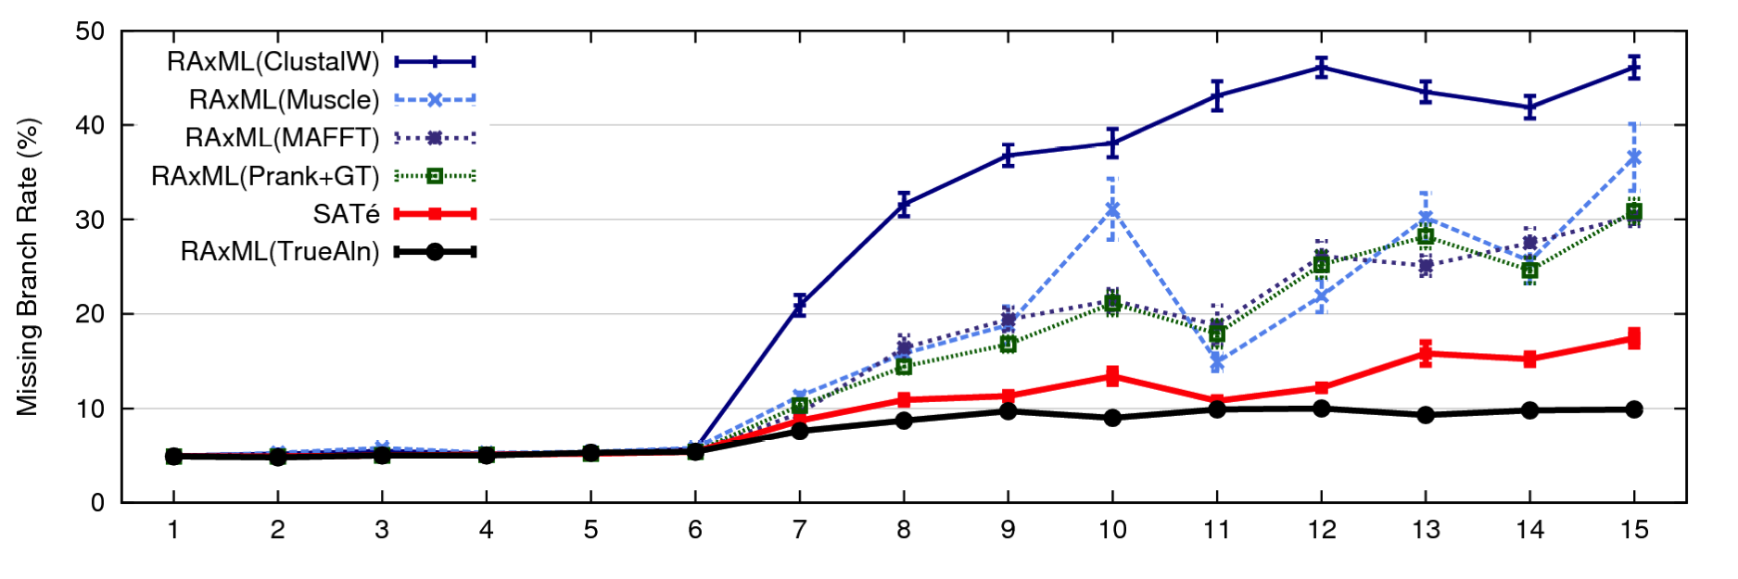
1000 taxon models, ordered by difficulty
24 hour SATé-I analysis, on desktop machines
(Similar improvements for biological datasets)
Notes:
For moderate-to-difficult datasets, SATe gets better trees and alignments than all other estimated methods. Close to what you might get if you had access to true alignment.
Opens up a new realm of possibility: Datasets currently considered “unalignable” can in fact be aligned reasonably well. This opens up the feasibility of accurate estimations of deep evolutionary histories using a wider range of markers.
TRANSITION: can we do better? What about smaller simulated datasets? And what about biological datasets?

Slide 47
✓
✓
✗
Alignment error is average of SPFN and SPFP. However, Bali-Phy could not run on
datasets with 500 or 1000 sequences. Results from Liu et al., Science 2009.

Slide 48
✓
✗
✗
✗
✗
Problem: BAli-Phy failure to converge, despite multi-week analyses.
Results from Liu et al., Science 2009.

Slide 49
Comparison of PASTA to SATe-II and other alignments on nucleotide datasets.
From Mirarab et al., J. Computational Biology 2014

Slide 50
Comparison of PASTA to SATe-II and other alignments on AA datasets.
From Mirarab et al., J. Computational Biology 2014

Slide 51
Members of SATé family
SATé-1 used Central Tree decomposition
SATé-2 improves on SATé-1 by changing decomposition (removes centroid edges)
PASTA improves on SATé-2 by changing how subset alignments are merged (pairwise then transitivity)
MAGUS improves on PASTA by changing how subset alignments are merged: it then does only one iteration, and outputs an alignment

Slide 52
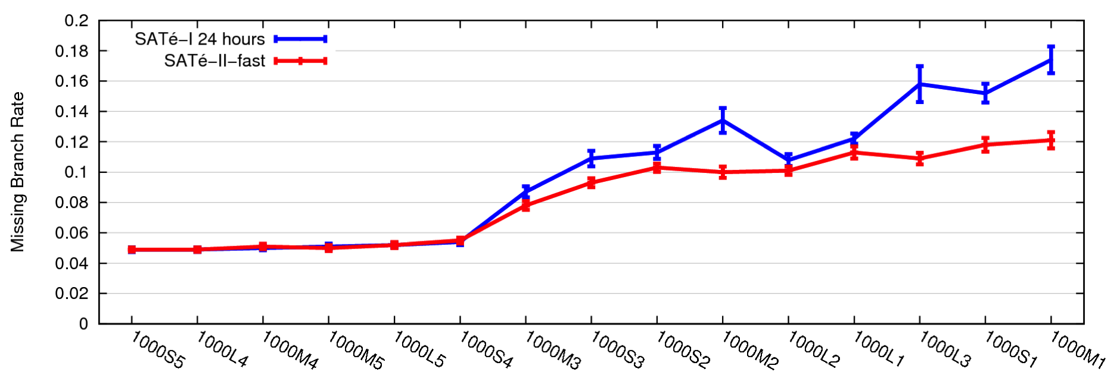
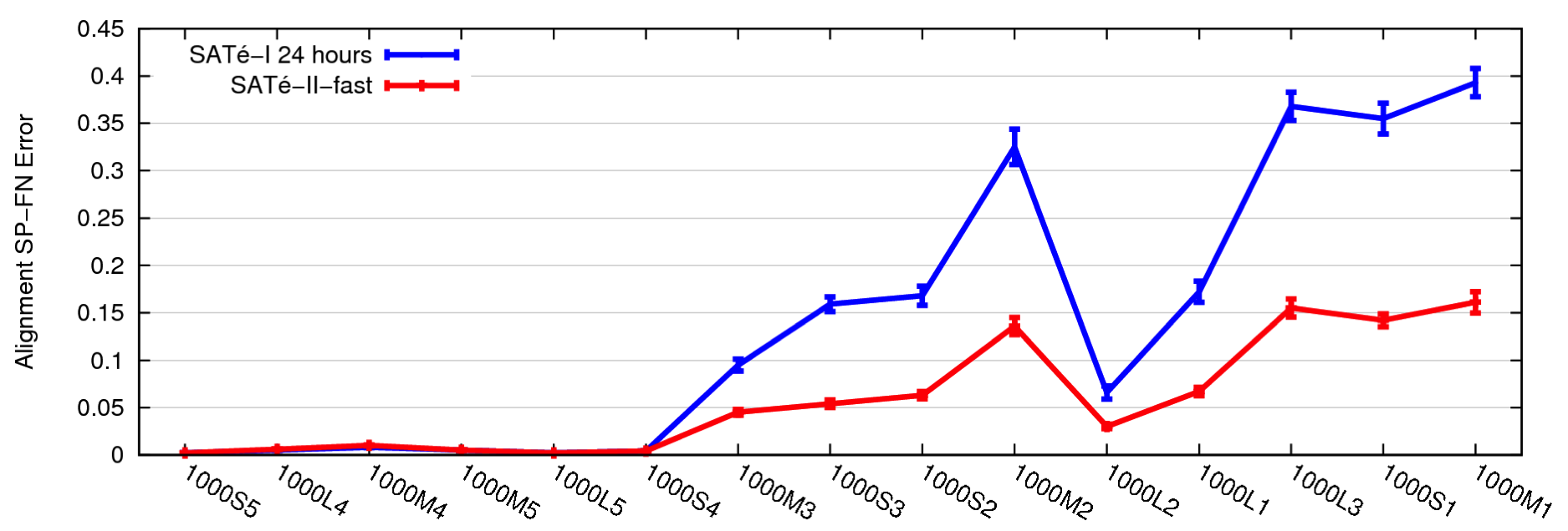
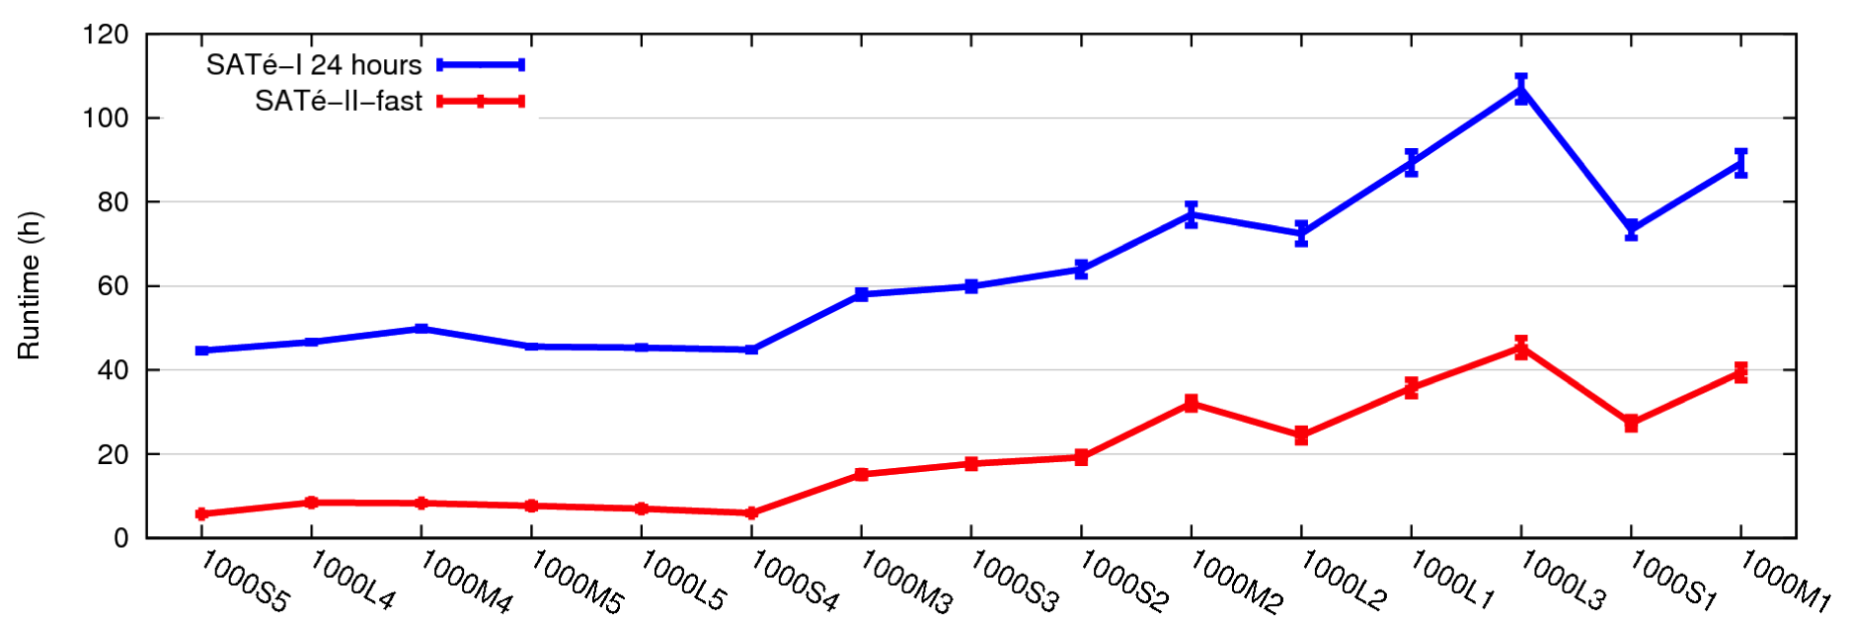
SATé-I vs. SATé-II
SATé-II
Faster and more accurate than SATé-I
Longer analyses or use of ML to select tree/alignment pair slightly better results

Slide 53
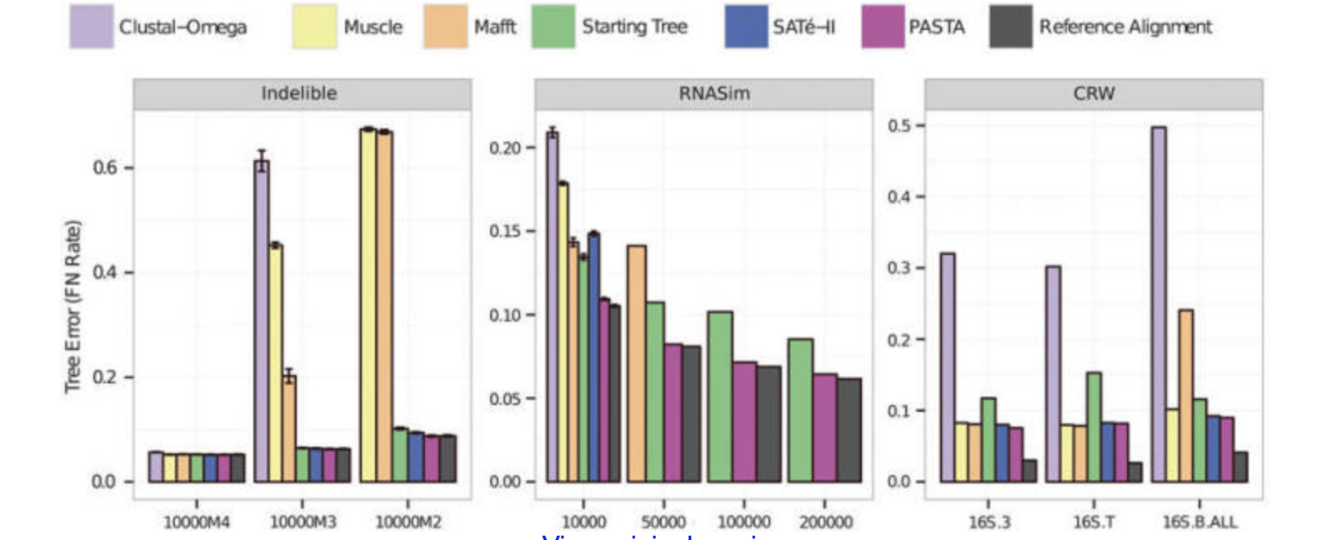
PASTA vs SATe-II

Slide 54
MAGUS
Most recent member of the SATé family, but only does one iteration and outputs MSA
Nearly identical to PASTA:
  Get initial alignment and tree
  Divide sequences into subset using PASTA decomposition
  Align subsets using MAFFT
  Merge subset alignments using GCM

Slide 55
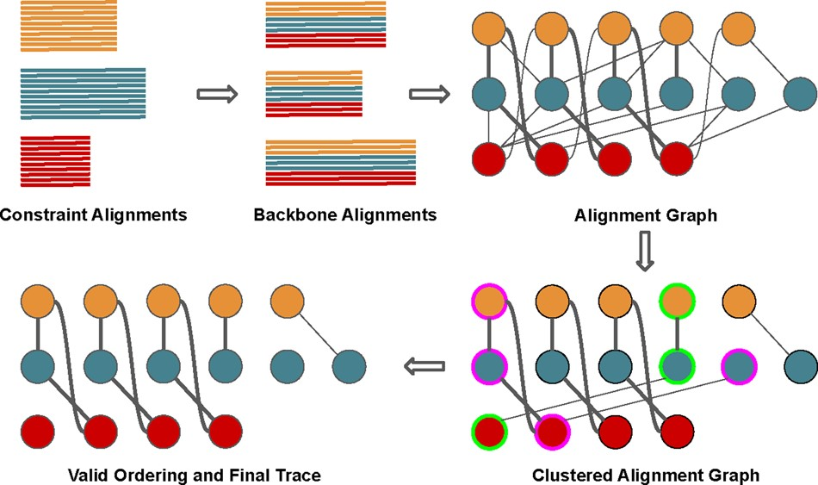

Fig. 1. MAGUS (merging subset alignments using the Graph Clustering Merger)
Notes:
Fig. 1. Overview of the GCM algorithm. The input is a set of constraint alignments. (i) We compute a set of backbone alignments with the same number of sequences from each constraint alignment. (ii) We construct the alignment graph. Each node represents a column from a constraint alignment, and weighted edges are derived from homologies inferred in the backbone alignments: thicker lines represent edges with higher weight. (iii) We cluster the alignment graph with MCL. This example shows two violations: the pink-outlined cluster contains two columns from the same (blue) constraint alignment, and there is no valid ordering between the pink- and green-outlined clusters (‘crisscrossing’). (iv) We resolve the violations and produce a valid trace, where each connected component is a column in our final alignment
Unless provided in the caption above, the following copyright applies to the content of this slide: © The Author(s) 2020. Published by Oxford University Press.This is an Open Access article distributed under the terms of the Creative Commons Attribution Non-Commercial License (http://creativecommons.org/licenses/by-nc/4.0/), which permits non-commercial re-use, distribution, and reproduction in any medium, provided the original work is properly cited. For commercial re-use, please contact journals.permissions@oup.com

Slide 56
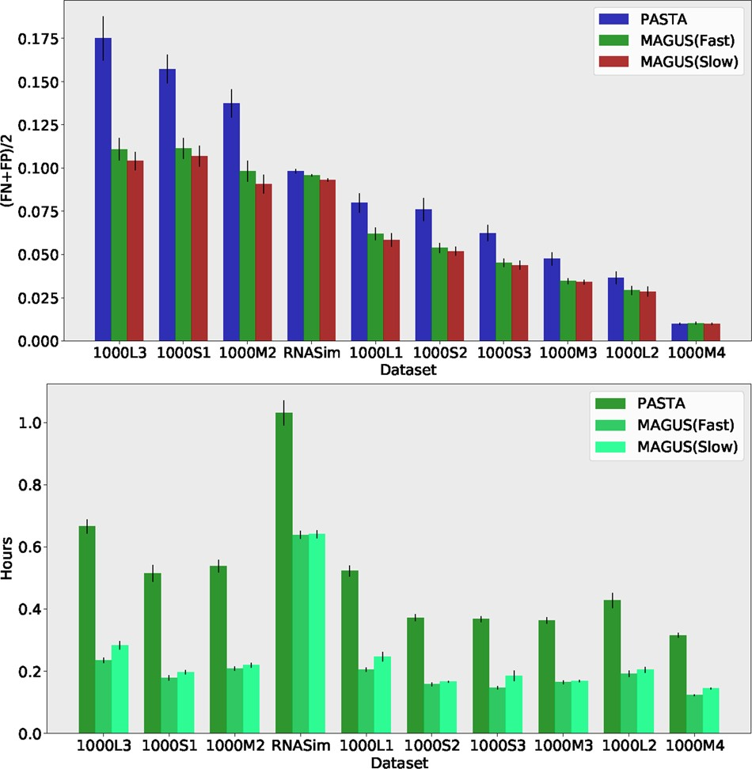
Fig. 4. Experiment 2: MAGUS versus PASTA on the 1000-taxon datasets. Top: Alignment error. Bottom: running time.
Notes:
Fig. 4. Experiment 2: MAGUS versus PASTA on the 1000-taxon datasets. Top: The error rates are the average of SPFN and SPFP. The x-axis shows the model condition; each model condition has 1000 sequences. Results are averaged over 20 replicates. Error bars indicate standard error. PASTA and MAGUS were run in default mode. Bottom: Average running time (in minutes). Results are averaged over 20 replicates. Error bars indicate standard error
Unless provided in the caption above, the following copyright applies to the content of this slide: © The Author(s) 2020. Published by Oxford University Press.This is an Open Access article distributed under the terms of the Creative Commons Attribution Non-Commercial License (http://creativecommons.org/licenses/by-nc/4.0/), which permits non-commercial re-use, distribution, and reproduction in any medium, provided the original work is properly cited. For commercial re-use, please contact journals.permissions@oup.com

Slide 57
Results for MAGUS
MAGUS achieves its superior accuracy (compared to PASTA) by merging subset alignments differently:
  Not pairwise mergers but all at once
The key is the GCM technique, which uses a graph clustering step (Markov Clustering).
Perhaps some other graph clustering method would be as good or better, and more scalable?

Slide 58
Studies we will discuss
Katoh and Standley, MBE 2013 (about MAFFT)
Nelesen et al., PSB 2008 (Impact of guide tree)
Liu and Warnow, PLoS ONE 2012 (about treelength criteria)
Loytynoja and Goldman, Science 2008 (about Prank)
Sievers et al., Molecular Systems Biology 2011 (Clustal-Omega paper)
Liu et al., Science 2009 (SATé-I) and Mirarab et al. J. Computational Biology 2014 (PASTA), Smirnov and Warnow Bioinformatics 2021 (MAGUS)
Nguyen et al., Genome Biology 2014 (UPP)
Nute et al., Systematic Biology 2019 (Evaluating BAli-Phy)

Slide 59
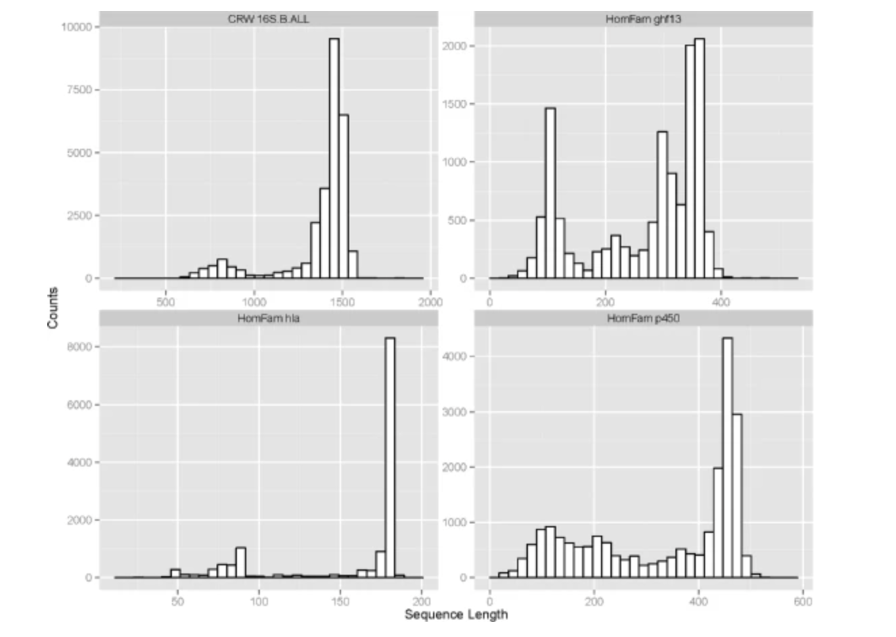
Sequence length heterogeneity

Slide 60
UPP
UPP (Ultra-large alignments using Phylogeny-aware Profiles) was developed to enable accurate alignments in the presence of sequence length heterogeneity
Nguyen, Mirarab, and Warnow. Genome Biology 2015

Slide 61
UPP
Approach:
    Find set of “full-length” sequences
    Align set using PASTA
    Build model of the PASTA MSA using “ensemble of Hidden Markov Models”
    Add remaining sequences into the PASTA MSA using the ensemble

Slide 62
Impact of fragmentary sequences

Slide 63
Impact of fragmentary sequences

Slide 64
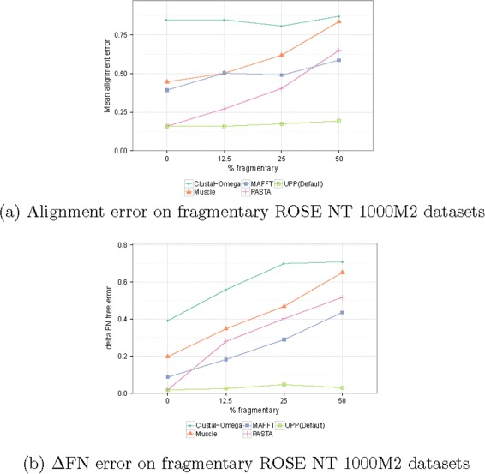
Impact of fragmentary sequences

Slide 65
Studies we will discuss
Katoh and Standley, MBE 2013 (about MAFFT)
Nelesen et al., PSB 2008 (Impact of guide tree)
Liu and Warnow, PLoS ONE 2012 (about treelength criteria)
Loytynoja and Goldman, Science 2008 (about Prank)
Sievers et al., Molecular Systems Biology 2011 (Clustal-Omega paper)
Liu et al., Science 2009 (SATé-I) and Mirarab et al. J. Computational Biology 2014 (PASTA), Smirnov and Warnow Bioinformatics 2021 (MAGUS)
Nguyen et al., Genome Biology 2014 (UPP)
Nute et al., Systematic Biology 2019 (Evaluating BAli-Phy)

Slide 66
BAli-Phy
Statistical co-estimation of alignments and trees, using Bayesian MCMC
Assumes model of sequence evolution that includes both indels and substitutions
SATe-1 paper (supplement) showed BAli-Phy produced superior alignments compared to SATe
BAli-Phy is computationally intensive due to its need to converge
Redelings and Suchard, Systematic Biology 2005

Slide 67
Evaluating BAli-Phy
Nute, Saleh, & Warnow (2019). Evaluating statistical multiple sequence alignment in comparison to other alignment methods on protein data sets. Systematic biology, 68(3), 396-411.
Compared BAli-Phy to other methods on both simulated and biological datasets

Slide 68
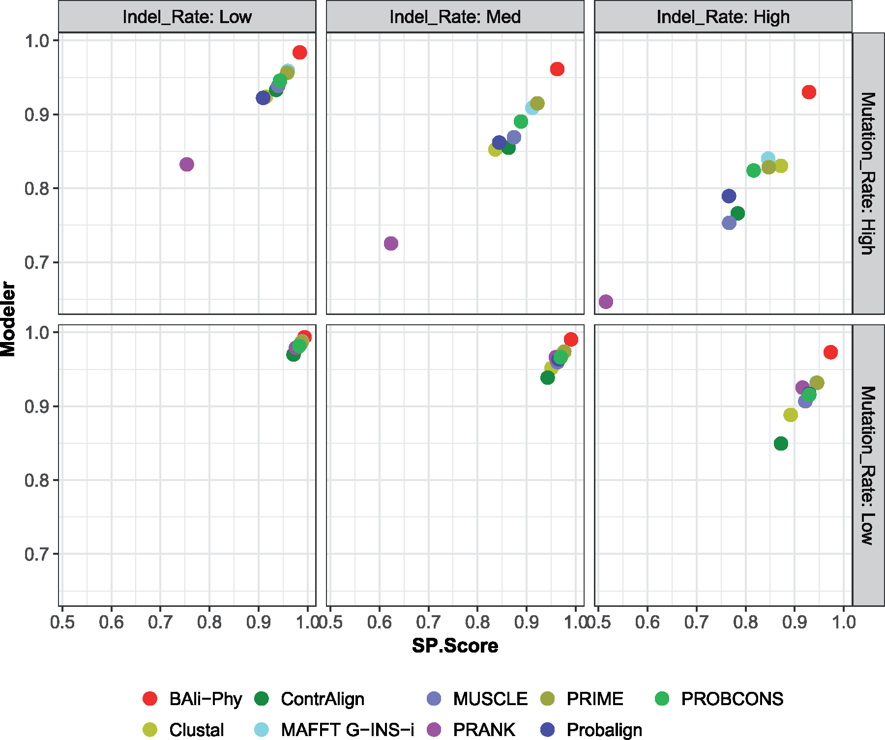
Results on simulated amino acid data with 27 sequences for 6 different model conditions that vary by the substitution rate and indel rate; averages over 20 replicates are shown
Notes:
Figure 6. Modeler score (i.e., precision) versus SP-Score (i.e., recall) for MSA methods on simulated amino acid data sets with 27 sequences for 6 different model conditions that vary by the substitution rate and indel rate; averages over 20 replicates are shown. See Supplementary Excel File available on Dryad for actual numeric values.
Unless provided in the caption above, the following copyright applies to the content of this slide: © The Author(s) 2018. Published by Oxford University Press, on behalf of the Society of Systematic Biologists.This is an Open Access article distributed under the terms of the Creative Commons Attribution License (http://creativecommons.org/licenses/by-nc/4.0/), which permits unrestricted re-use, distribution, and reproduction in any medium, provided the original work is properly cited. For commercial re-use, please contactjournals.permissions@oup.com

Slide 69
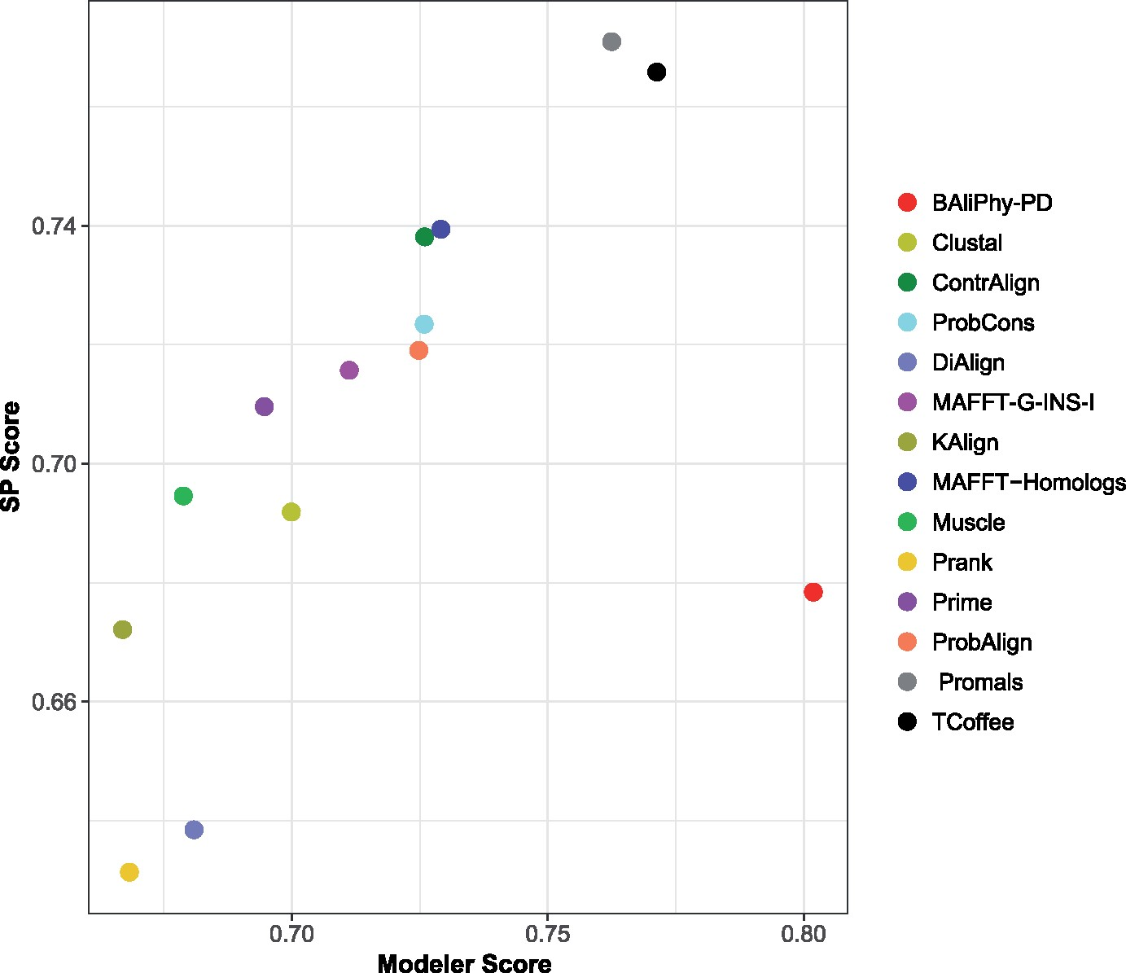
Results on biological datasets
Notes:
Figure 1. Average Modeler Score (i.e., precision) versus average SP-score (i.e., recall) of the full set of multiple sequence alignment methods on the biological benchmark data sets, each with at least 4 and at most 25 sequences; each data point represents analyses of 1192 data sets from the four benchmark collections (658 from BAliBase, 231 from Homstrad, 202 from Mattbench, and 101 from Sisyphus). See Supplementary Table S1 and Excel File available on Dryad for actual numeric values.
Unless provided in the caption above, the following copyright applies to the content of this slide: © The Author(s) 2018. Published by Oxford University Press, on behalf of the Society of Systematic Biologists.This is an Open Access article distributed under the terms of the Creative Commons Attribution License (http://creativecommons.org/licenses/by-nc/4.0/), which permits unrestricted re-use, distribution, and reproduction in any medium, provided the original work is properly cited. For commercial re-use, please contactjournals.permissions@oup.com

Slide 70
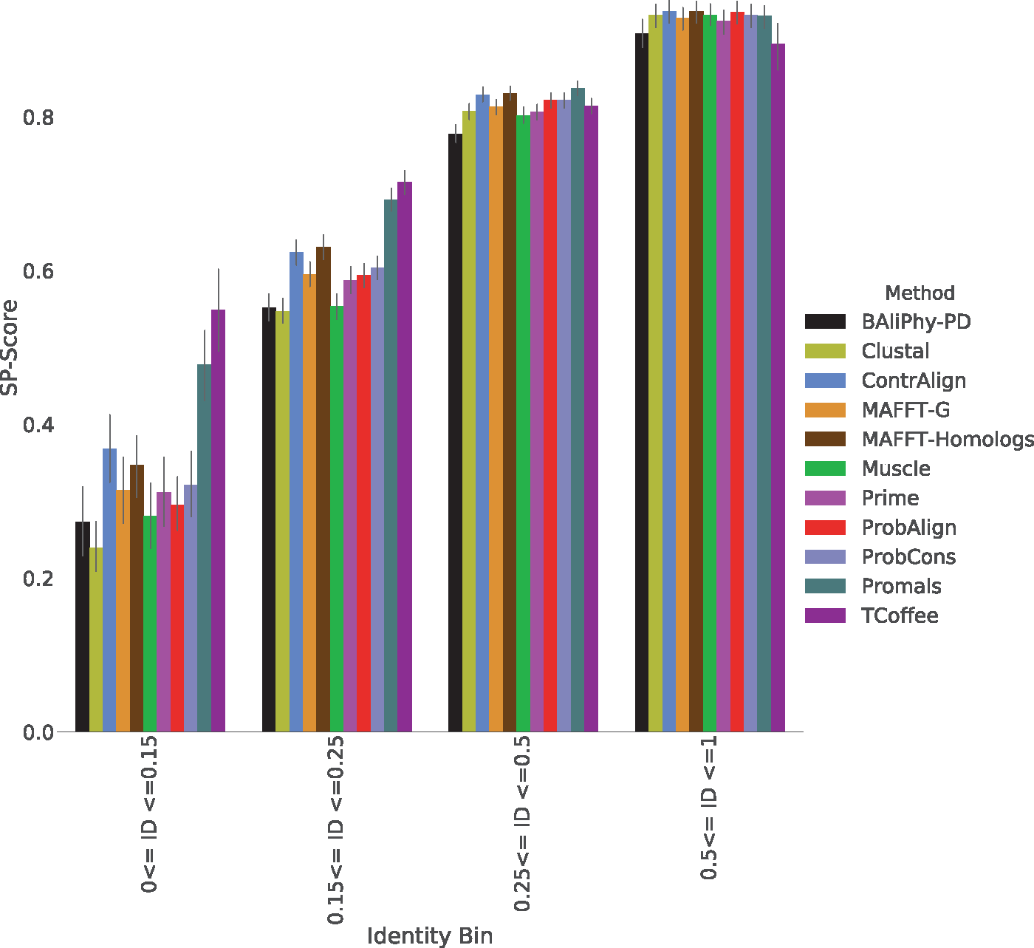
Figure A. Average SP-scores (i.e., recall) for the top methods on the 1192 biological benchmark data sets, with data sets binned by average pairwise sequence identity (ID) levels.
Notes:
Figure 5. Average SP-scores (i.e., recall) for the top methods on the 1192 biological benchmark data sets, with data sets binned by average pairwise sequence identity (ID) levels. The four bins based on average PID, ordered from smallest to largest PID values, have 83, 417, 615, and 77 alignments, respectively. See Supplementary Table S5 and Excel File available on Dryad for actual numeric values.
Unless provided in the caption above, the following copyright applies to the content of this slide: © The Author(s) 2018. Published by Oxford University Press, on behalf of the Society of Systematic Biologists.This is an Open Access article distributed under the terms of the Creative Commons Attribution License (http://creativecommons.org/licenses/by-nc/4.0/), which permits unrestricted re-use, distribution, and reproduction in any medium, provided the original work is properly cited. For commercial re-use, please contactjournals.permissions@oup.com

Slide 71
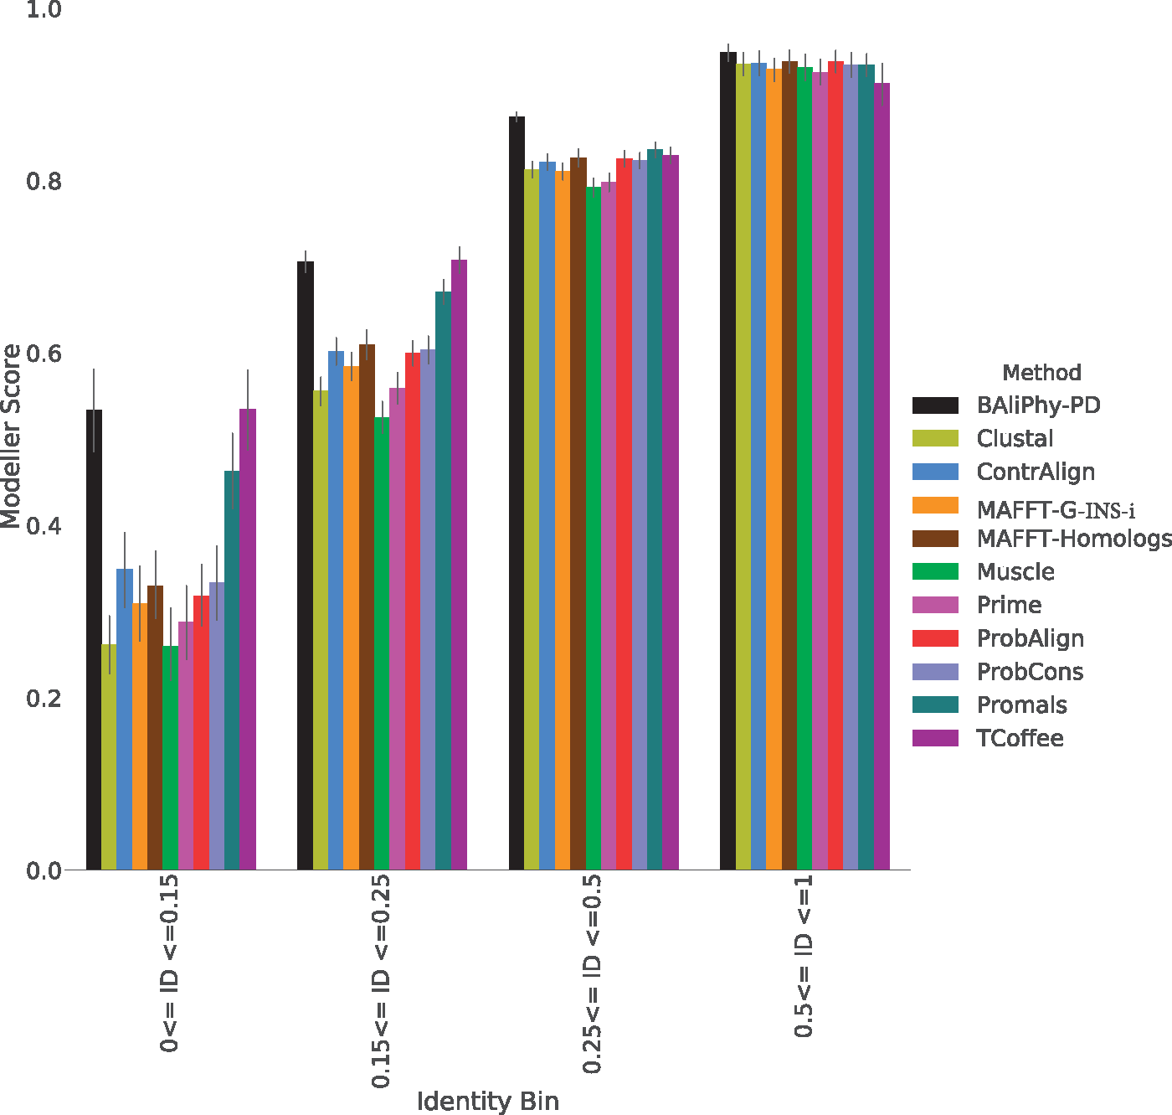
Figure B. Average Modeler Scores (i.e., precision) for the top methods on the 1192 biological benchmark data sets, binned into different average pairwise sequence identity (ID) levels
Notes:
Figure 4. Average Modeler Scores (i.e., precision) for the top methods on the 1192 biological benchmark data sets, binned into different average pairwise sequence identity (ID) levels. The four bins based on average sequence identity, ordered from smallest to largest, have 83, 417, 615, and 77 alignments, respectively. See Supplementary Table S4 and Excel File available on Dryad for actual numeric values.
Unless provided in the caption above, the following copyright applies to the content of this slide: © The Author(s) 2018. Published by Oxford University Press, on behalf of the Society of Systematic Biologists.This is an Open Access article distributed under the terms of the Creative Commons Attribution License (http://creativecommons.org/licenses/by-nc/4.0/), which permits unrestricted re-use, distribution, and reproduction in any medium, provided the original work is properly cited. For commercial re-use, please contactjournals.permissions@oup.com

Slide 72
Observations
BAli-Phy is best on simulated data, but not great on biological data
Why?

Slide 73
Results so far
Relative accuracy depends on the alignment criterion
Tree accuracy is not that well correlated with alignment accuracy.
Different alignment criteria are optimized using different techniques
Dataset properties that impact accuracy:
  Dataset size
  Heterogeneity (rate of evolution)
  Degree of fragmentation
  Perhaps other things (gap length distribution, deviation from molecular clock?)
BAli-Phy accuracy is outstanding on simulated data, but not on biological data (????)
Exact command matters (always check details)

Slide 74
Choice of method impacts accuracy
Trees and alignments based on Treelength-based optimization currently not as accurate as some standard techniques (e.g., ML on MAFFT alignments)
Guide tree has an impact!
Low heterogeneity datasets are easier to align (inspiration for divide-and-conquer)
Fragmentary sequences create problems
Many MSA methods give excellent results on small datasets – Probcons, Probalign, Bali-Phy, etc… but most are not in use because of dataset size limitations
High accuracy on large datasets possible using PASTA
Co-estimation under statistical models might be the way to go, IF…
And what’s going on with the difference between results on biological and simulated datasets?

Slide 75
PASTA study
PASTA (RECOMB 2014 and J. Computational Biology 2014) is the replacement of SATe-1 (Liu et al., Science 2009) and SATe-2 (Liu et al., Systematic Biology 2012)
Alignment criteria: “Pairs” score and Total Column (TC) score
Evaluated on simulated and biological datasets (both nucleotide and amino acid)
Alignment methods compared: “Initial” (an HMM-based technique), Clustal-Omega, MAFFT, and SATe

Slide 76
Figure from Mirarab et al., J. Computational Biology 2014

Slide 77
PASTA variants – impact of alignment subset size
From Mirarab et al., J. Computational Biology 2014

Slide 78
Comparison of PASTA to SATe-II and other methods on nucleotide datasets,
with respect to tree error. Figure from Mirarab et al., J. Computational Biology 2014

Slide 79
Research Projects
Design your own MSA method, or just modify an existing one in some simple way (e.g., different guide tree)
Test existing MSA methods with respect to different criteria (e.g., extend Prank study to more methods and datasets)
Develop different MSA criteria that are more appropriate than TC, SPFN, SPFP
Compare different MSA methods on some biological dataset
Parallelize some MSA method
Consider how to combine MSAs on the same input

