Slide 1
MAFFT: Multiple Sequence Alignment using Fast Fourier Transform

Slide 2
Intro
2-Step Procedure
Homology Identification using FFT
Alignment Scoring/Selection
Faster computation due to…
Approx. O(NlogN) homology detection
Simpler-to-compute scoring function

Slide 3
Defining the Signal
For Amino Acid Sequences
2-dimensional signal [volume, polarity]
For Nucleotide Sequences
4-dimensional signal [A,T,G,C frequencies]

Slide 4
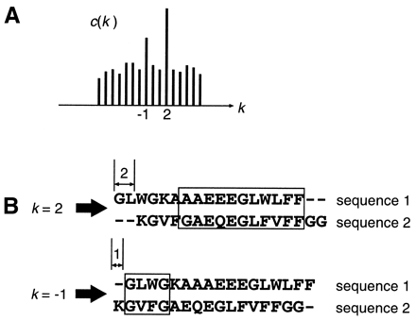
DFT
Transformation of signal from time to frequency space

Slide 5
FFT
DFT in regular form takes O(N^2)
FFTs compute same values in O(NlogN)

Slide 6
FFT: Cooley-Tukey
Recursive division of sequence into 2 sections

Slide 7
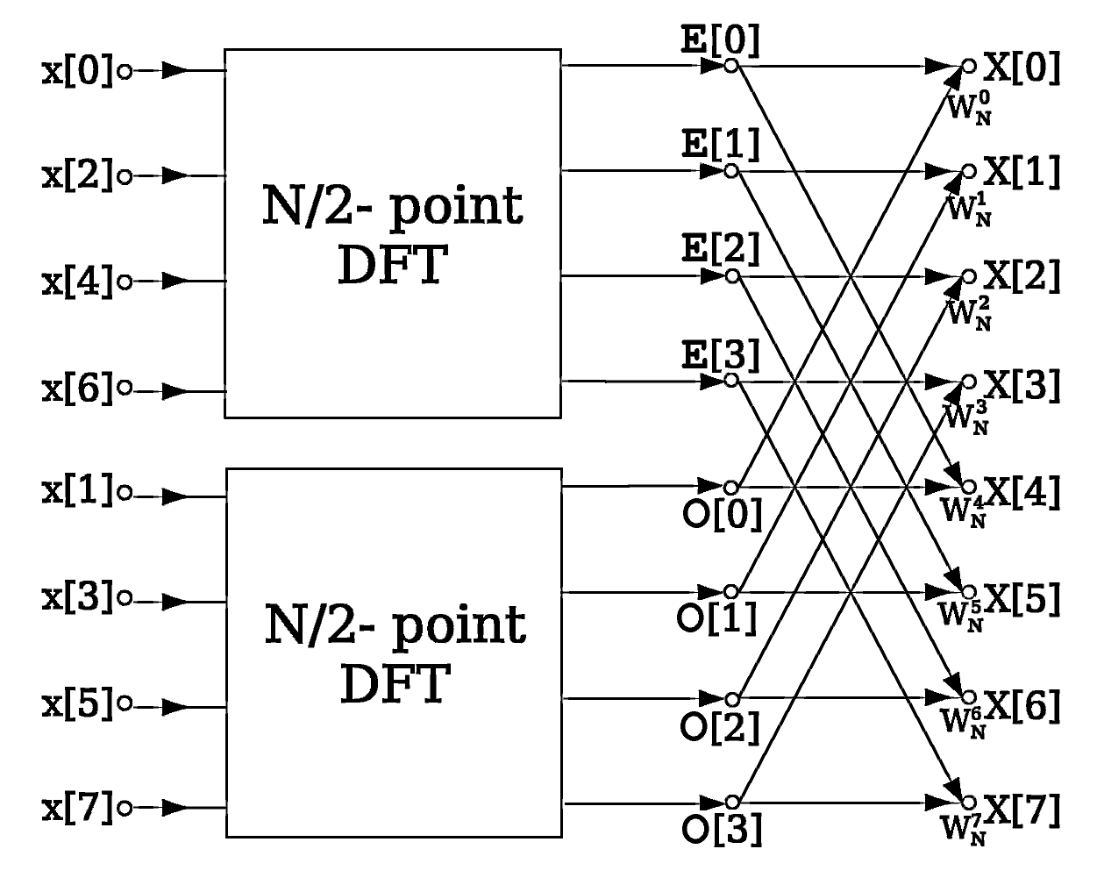
Cooley-Tukey
DFT displays periodicity

Slide 8
Cooley-Tukey
X_{0,...,N−1} ← ditfft2(x, N, s): if N = 1 then X₀ ← x₀
else X_{0,...,N/2−1} ← ditfft2(x, N/2, 2s)
X_{N/2,...,N−1} ← ditfft2(x+s, N/2, 2s) for k = 0 to N/2−1 t ← X_{k} X_{k} ← t + exp(−2πi k/N) X_{k+N/2} X_{k+N/2} ← t − exp(−2πi k/N) X_{k+N/2} endfor endif

Slide 9
MAFFT FFT Usage
Signal value in “frequency” domain is correlation at offset
“Frequency” is the sequence offset

Slide 10
Finding Homologies
Original Computation
Slide box over all offsets
With FFT
Only look at offsets with large score

Slide 11
Generalization to Multiple Sequences

Slide 12
Alignment: Scoring System
M̂_{ab} = [(M_{ab} – Σ_{a}f_{a}M_{aa})/(Σ_{a}f_{a}M_{aa} – Σ_{a,b}f_{a}f_{b}M_{ab})] + Sª
f_{a} is frequency of a
Sª is a predetermined gap extension penalty

Slide 13
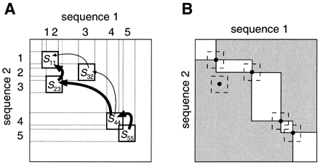
Alignment
Can jump between homologies
Less computation than NW
G₁(i, x) = S^{op} · {1 – [g₁^{start}(x) + g₁^{end}(i)]/2}

Slide 14
Comparisons
MAFFT
FFT-NS-1
FFT-NS-2
FFT-NS-i
T-COFFEE
CLUSTALW
1.82d
1.82q

Slide 15
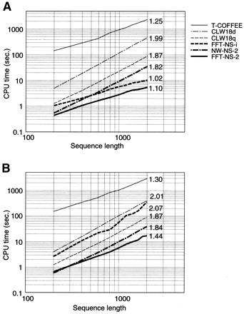
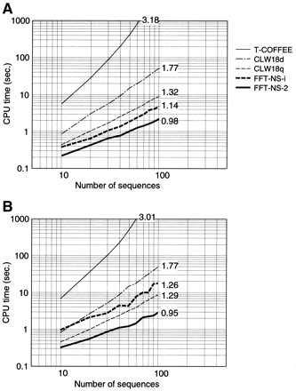
Runtime

Slide 16
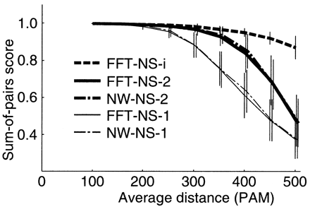
Sum-of-Pairs

Slide 17
BaliBASE Benchmarks

Slide 18
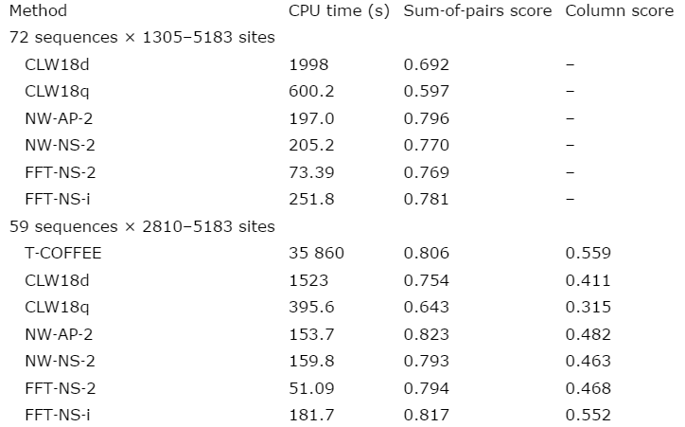
LSU rRNA

Slide 19
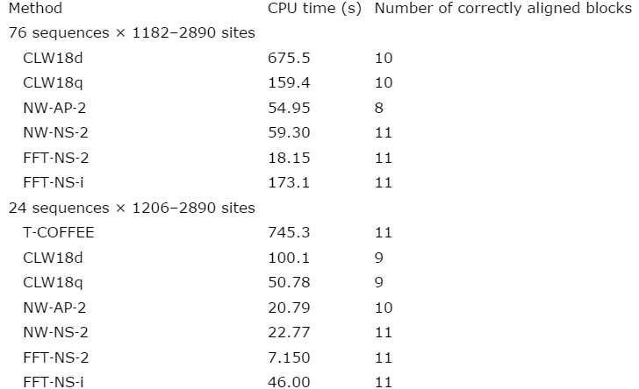
RNA Polymerase Sequences

Slide 20
Questions

