Slide 1
Introduction to Clustering
CS 598: Computational Scientometrics
August 24, 2022
Tandy Warnow

Slide 2
Scientometrics – some questions
How is the scientific research community organized?
What ideas are researchers focusing on?
What authors are working on these ideas?
Depth vs breadth of impact (influence)
Who is driving the research?
How does the research community change over time?
What is the nature of interdisciplinary research, and how is it displayed in the literature?
These questions are sometimes investigated using clustering methods applied to large networks, such as citation graphs, authorship graphs, etc.

Slide 3
Preliminary discussion
Topics:
How do you pick which papers to cite?
How do others pick papers?
What does this tell you about interpretation of citation counts?
Who wins?
Does more citations mean better research?
Can you learn something about “communities” of authors and/or research papers?

Slide 4
Rest of today
High-level comments about clustering methods and community detection
Discussion of the three papers
Feng et al. (Survey of community search over big graphs)
Fortunato & Barthelemy (Resolution limit in community detection)
Von Luxburg et al. (Clustering: Science or Art?)
Brief comments about what our research group has found

Slide 5
Clustering methods: issues to consider
Do you know how many clusters you want to compute?
What is the input? What is the output?
Input: just a graph? a weighted graph? or a distance matrix? Or, a matrix with extra information about nodes/edges (an “attributed graph”)?
Output: a partition of the nodes into disjoint sets? or overlapping sets? Or a “soft clustering” where each node is a member of each cluster with some probability?
Does the clustering method attempt to solve an optimization problem? Is the problem NP-hard?
What can you prove about the optimization problem and/or method?

Slide 6
Clustering methods: other issues to consider
What techniques does the method use?
Is there a type of network that the method is designed for?
What studies have been performed using the method, and what did they show? (Note dataset properties, such as size, density, etc.)

Slide 7
Clustering vs Community Detection
Clustering tends to be similar to “PCA” -- finding clearly separated groups, generally large ones
Community detection often aims to find smaller groups, perhaps not so well separated from the rest of the graph
Community detection and clustering can be considered the same problem when the input is just a graph

Slide 8
Assigned papers
https://www.pnas.org/doi/full/10.1073/pnas.0605965104. Fortunato & Barthelemy, PNAS 2007, “Resolution limit in community detection”
https://doi.org/10.1007/s00778-019-00556-x. Fang et al., VLDB 2020, A survey of community search over big graphs
https://proceedings.mlr.press/v27/luxburg12a/luxburg12a.pdf. von Luxburg et al., JMLR 2012, “Clustering: Art or Science?”

Slide 9
Fang et al., “A survey of community search over big graphs” (VLDB 2020)
Community Search (CS): Input: network N and vertex v, and the objective is a connected community (cluster) containing v that optimizes some “cohesiveness” criterion, such as:
The community is a k-core
The community is a k-truss (every edge is in at least k-2 triangles)
The community is a k-clique
The community is a k-ECC (has edge-connectivity at least k)
They pay substantial attention to computational requirements for different CS methods and problems.
CS is not the same as Community Detection (CD), which produces a disjoint clustering where each cluster is a valid community. They argue CS is better than CD. (However…)

Slide 10
Modularity optimization
Maximize the sum of the modularity scores per cluster
Assume the clustering has m clusters:
L = total number of edges in network
l_{s} = number of edges in cluster s
d_{s} = total degree of nodes in cluster s (including edges that leave cluster)

Slide 11
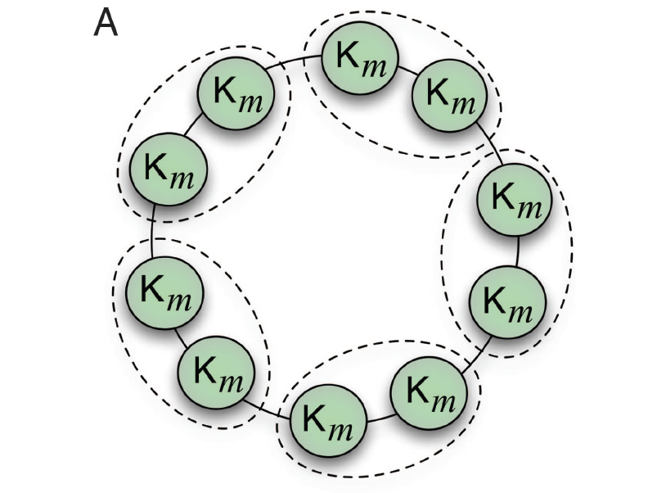
Fortunato & Barthélemy
Basic observation is that Modularity Optimization is subject to a resolution limit (will not find “small modules”, although these will be ”valid”)
Figure 3(A) from Fortunato & Barthélemy

Slide 12
Modularity optimization
Modularity optimization seeks a partition of the vertices into disjoint sets (i.e., clusters) so that the sum of the “modularity” scores of each cluster is maximized
Any cluster with positive modularity is considered “valid”
Fortunato and Barthelemy proved that optimizing modularity has a resolution limit – clusters below a threshold will not be found
Hence, they said modularity optimization was not a sufficient clustering method.
See https://en.wikipedia.org/wiki/Modularity_(networks) for additional references.

Slide 13
Von Luxburg et al. Clustering: Science or Art?
“We argue that clustering should not be treated as an application-independent mathematical problem, but should always be studied in the context of its end-use.”
“In this paper we do not really care how a clustering algorithm works, as long as it achieves the goal we have set.”

Slide 14
Von Luxburg et al. Clustering: Science or Art?
Specifically examines evaluation on artificial datasets, on classification benchmark datasets, and on real world datasets.
Example given of failure for benchmarks to validly evaluate accuracy (e.g., classifying images that may be B&W or color, and may contain cars).
Statistical stability and other meta-criteria
Proposes description of “clustering problems” according to different dimensions
Exploratory vs confirmatory
Qualitative vs quantitative
Unspervised vs supervised

Slide 15
Von Luxburg et al. Clustering: Science or Art?
If clustering researchers want real impact in applications, then it is time to step back from a purely mathematical and algorithmic point of view.
What is missing is not “better” clustering algorithms but a problem-centric perspective in order to devise meaningful evaluation procedures

Slide 16
Further comments (related to Scientometrics)
In Scientometrics, the main clustering method is the Leiden algorithm, optimized either for modularity or the Constant Potts model
Modularity was favored before the “resolution limit” issue was understood – tends to produce large clusters
Now Constant Potts model is default setting (not subject to resolution limit)
Our studies (e.g., Chandrasekharan et al. found that produced very small clusters, and lots of singletons – but this depended on the “resolution factor” and the dataset.
Some highly cited papers are singletons!
Methods papers (including algorithmic papers) are often very highly cited, and broad in impact
See: http://tandy.cs.illinois.edu/bibliometrics.html

Slide 17
Summary from today
Clustering methods should be designed and evaluated within a context (Von Luxburg). Our context is Scientometrics.
Often many singletons are produced.
The ”resolution limit” is a theoretical problem (limit to how small a community can be found) but may provide insight into practice
Many clustering methods cannot run on large datasets
Note: clusterings are typically disjoint

Slide 18
Many challenges, and new methods needed
Overlapping rather than disjoint clusters, or perhaps soft clustering?
Center-periphery structure?
Evaluating relationship between clusters? (not hierarchical?)
Ensemble methods?
Graph embedding?
Understanding node role?
Understanding author communities?
How does community structure change over time?

