Slide 1
CS 581, Jan 30, 2018

Slide 2
Review of Maximum Parsimony
Calculating the probability of site patterns on a CFN model tree
Problem Solving
Maximum Likelihood

Slide 3
Maximum Parsimony (MP) Review
Definition: Hamming Distance Steiner Tree problem
Solvable in polynomial time using dynamic programming on a fixed tree
NP-hard if the tree is not given
Parsimony uninformative sites
Parsimony informative sites
Solving MP for small datasets by inspection

Slide 4
Practice
Find the best tree on a set of 4 DNA sequences
Technique?

Slide 5
Finding best MP tree for 4 sequences
Input: sequences A, B, C, D
Identify the parsimony informative sites
Count the number that support each of the four-leaf trees AB|CD, AC|BD, AD|BC
Return the unrooted four-leaf tree that has the highest support (i.e., the number of parsimony informative sites that support that tree)

Slide 6
“Easy” case
Find best MP tree for:
ACAATA
ACATAG
TCGTCG
GTGCGG
Start by calculating the parsimony informative sites
Prove this dataset has a “perfect phylogeny” (homoplasy-free)
Find the tree that is homoplasy-free

Slide 7
Another “Easy” case
Find best MP tree for:
ACAATATA
ACATAGTT
TCGTCGCA
GTGCGGCT
Start by calculating the parsimony informative sites
How many parsimony-informative sites support each of the three unrooted trees?
What is the tree MP returns?

Slide 8
Finding best MP tree for bigger datasets
Always start by identifying the parsimony-informative sites
See if a perfect phylogeny exists
If so, all possible perfect phylogenies are your solution
If this doesn’t work, exhaustively score all the possible trees (using Fitch’s algorithm or Sankoff’s algorithm)

Slide 9
Slightly harder case
Find best MP tree for:
ACAATA
ACATAG
TCGTCG
GTGCGG
CATGGT
Start by calculating the parsimony informative sites
Prove this dataset has a “perfect phylogeny” (homoplasy-free)
Find all the perfect phylogenies

Slide 10
Much harder case
Find best MP tree for:
ACAATATC
ACATAGAT
TCGTCGTA
GTGCGGAT
CATGGTGA
Start by calculating the parsimony informative sites
Does this dataset have a perfect phylogeny?
Think about solving MP on every tree using dynamic programming. How many trees do you need to look at?

Slide 11
MP and statistical consistency
Last time we argued that MP is not statistically consistent under the CFN model.
What does this mean?
What was the argument?

Slide 12
Statistical Consistency
error
Data

Slide 13
Cavender-Farris-Neyman (CFN)
Models binary sequence evolution
For each edge e, there is a probability p(e) of the property “changing state” (going from 0 to 1, or vice-versa), with 0<p(e)<0.5 (to ensure that unrooted CFN tree topologies are identifiable).
State at the root is 0 or 1 with equal probability.
Every position evolves under the same process, independently of the others.

Slide 14
Proving Statistical Consistency for CFN
To prove that a method is statistically consistent under CFN, you have to show:
For all model CFN trees, as the sequence length increases the probability that the method returns the model tree converges to 1.0.
To prove that a method is not statistically consistent, you only need to find one model CFN tree for which this statement doesn’t hold.

Slide 15
Proving Statistical Consistency for CFN
You’ve already seen that some distance-based methods (e.g., the Naïve Quartet Method) are statistically consistent:
For all model CFN trees, as the sequence length increases the probability that the method returns the model tree converges to 1.0.
But this isn’t true for Maximum Parsimony or UPGMA. We’ll show this now.

Slide 16
Calculating probability of data, given CFN model tree
Basic challenge:
Given set S of binary sequences and a CFN model tree T, what is the probability that T generates S?

Slide 17
Computing the probability of the data
Given a model tree (with all the parameters set) and character data at the leaves, you can compute the probability of the data.
Small trees can be done by hand.
Large examples are computationally intensive - but still polynomial time (using dynamic programming, similar to Sankoff’s algorithm for MP on a fixed tree).

Slide 18
Cavender-Farris model calculations
Consider an unrooted tree with topology (a,(b,(c,d))) with p(e)=0.1 for all edges.
What is the probability of all leaves having state 0?
We show the brute-force technique.

Slide 19
Brute-force calculation
Let E and F be the two internal nodes in the tree ((A,B),(C,D)).
Then Pr(A=B=C=D=0) =
Pr(A=B=C=D=0, E=F=0) +
Pr(A=B=C=D=0, E=1, F=0) +
Pr(A=B=C=D=0, E=0, F=1) +
Pr(A=B=C=D=0, E=F=1)

Slide 20
Calculation, cont.
Technique:
Set one leaf to be the root
Set the internal nodes to have some specific assignment of states (e.g., all 1)
Compute the probability of that specific pattern
Add up all the values you get, across all the ways of assigning states to internal nodes

Slide 21
Calculation, cont.
Calculating Pr(A=B=C=D=0|E=F=0)
There are 5 edges, and thus no change on any edge.
Since p(e)=0.1, then the probability of no change is 0.9. So the probability of this pattern, given that the root is a particular leaf and has value 0, is (0.9)⁵.
Then we multiply by 0.5 (the probability of the root A having state 0).
So the probability is (0.5)x (0.9)⁵.
What would you need to do to calculate Pr(A=B=C=D=0)?

Slide 22
Calculation, cont.
Calculating Pr(A=B=C=D=0|E=F=0)
There are 5 edges, and thus no change on any edge.
Since p(e)=0.1, then the probability of no change is 0.9. So the probability of this pattern, given that the root is a particular leaf and has value 0, is (0.9)⁵.
Then we multiply by 0.5 (the probability of the root A having state 0).
So the probability is (0.5)x (0.9)⁵.
What would you need to do to calculate Pr(A=B=C=D=0)?

Slide 23
Felsenstein Zone Tree
Consider a four-leaf tree CFN model tree ((A,B),(C,D)) with a very high probability of change (close to ½) on the two edges incident with A and C, and very small probabilities of change (close to 0) on all other edges.
What parsimony informative sites have the highest probability?
What tree will MP return with probability increasing to 1, as the number of sites increases?
Is MP statistically consistent on this tree?
See Example 8.3 in the textbook.

Slide 24
Example 8.3
Review the calculations for Example 8.3 from the textbook
What 2/2 split has the highest probability of being generated by this model tree?

Slide 25
Therefore
The proportion of sites that favor the wrong tree will dominate the other sites, with probability going to 1 as #sites increases.
Therefore, MP will return the wrong tree with probability going to 1 as number of sites increases.
Therefore MP is positively misleading (worse than being inconsistent).
What about UPGMA?

Slide 26
But MP can be statistically consistent
Consider tree AB|CD with internal edge e having p(e)=0.4 and all other edges e’ having p(e’)=0.001.
What 2/2 split has the highest probability of being generated by this model tree?

Slide 27
Summary (updated)
Maximum Parsimony (MP) is statistically consistent on some CFN model trees.
However, there are some other CFN model trees in which MP is not statistically consistent.
Worse, MP is positively misleading on some CFN model trees.
This phenomenon is called “long branch attraction”, and the trees for which MP is not consistent are referred to as “Felsenstein Zone trees” (after the paper by Felsenstein).
The problem is not limited to 4-leaf trees…

Slide 28
Performance on data
Statistical consistency or inconsistency is an asymptotic statement, and requires a proof; it really has nothing much to say about performance on finite data.
To evaluate performance on finite data, we use simulations.

Slide 29
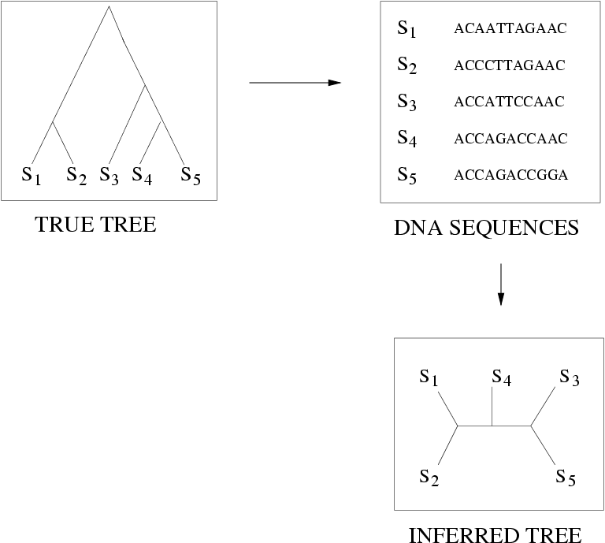
Quantifying Error
FN
FN: false negative
(missing edge)
FP: false positive
(incorrect edge)
50% error rate
FP

Slide 30
Simulation study, 400 leaves, NJ is statistically consistent
From Nakhleh et al., PSB 2002, also Figure 1.8 from textbook

Slide 31
Summary so far
Maximum Parsimony is not statistically consistent under standard sequence evolution models, but it can be consistent on some model trees.
Maximum parsimony is NP-hard and computationally intensive in practice.
In contrast, distance-based methods can be statistically consistent and polynomial time.
Yet MP is sometimes more accurate than the leading distance-based methods such as neighbor joining.
MP remains one of the popular techniques for phylogeny estimation.
What are the options?

