Slide 1


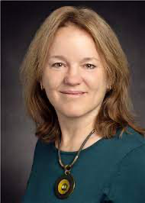


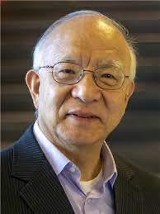




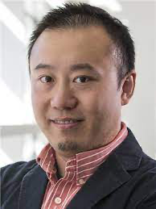


The Bioinformatics and Computational Biology Group at UIUC
And others (e.g., Jim Rehg)
https://cs.illinois.edu/research/areas/bioinformatics-and-computational-biology

Slide 2
Overview of BCB
Research topics range from very mathematical to very applied
  Phylogeny estimation
  Cancer genomics and phylogenetics
  Protein structure and function, ligand binding
  Drug Design
  Compressive Genomics
  Personalized medicine
  Biomedical knowledge discovery using text mining
Different kinds of CS:
  Discrete math and algorithms (combinatorial optimization, graph theory)
  Machine learning and data mining
  High performance computing

Slide 3
BCB PhD requirements
CS 581 (Algorithmic Genomic Biology)
CS 582 (Machine Learning for Bioinformatics)
One advanced course in machine learning, statistics, or probability
BCB seminar
Qualifying exam in second year focuses on research
  You do research mentored by a faculty, and you write it up for the qual
  Oral presentation of the research paper and also one other paper on a related topic
  Q&A covers the research, the extra paper, and background

Slide 4
Finding an advisor (and is BCB good for you?)
Take BCB courses that have research course projects:
  CS 581 (Tandy Warnow),
  CS 582 (Ge Liu),
  CS 598 courses taught by BCB faculty
Do 597s with several of the BCB faculty
Attend BCB seminar
No need to know biology before getting started – much of what you need to learn is done through doing research and reading papers.

Slide 5
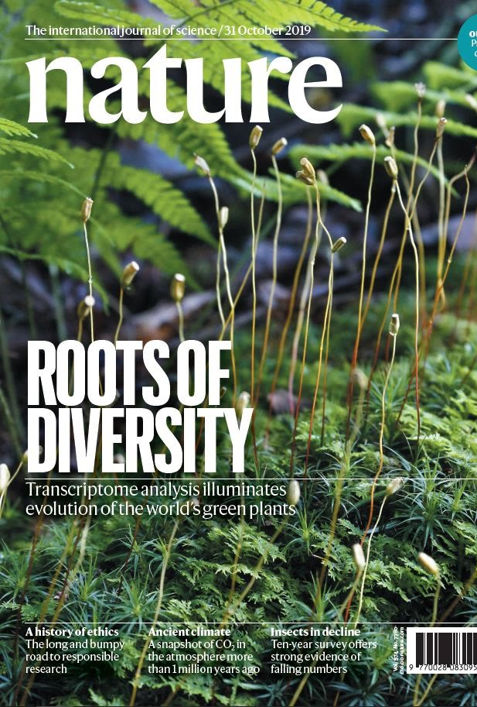
Warnow Lab Research
Tandy Warnow
The University of Illinois

Slide 6
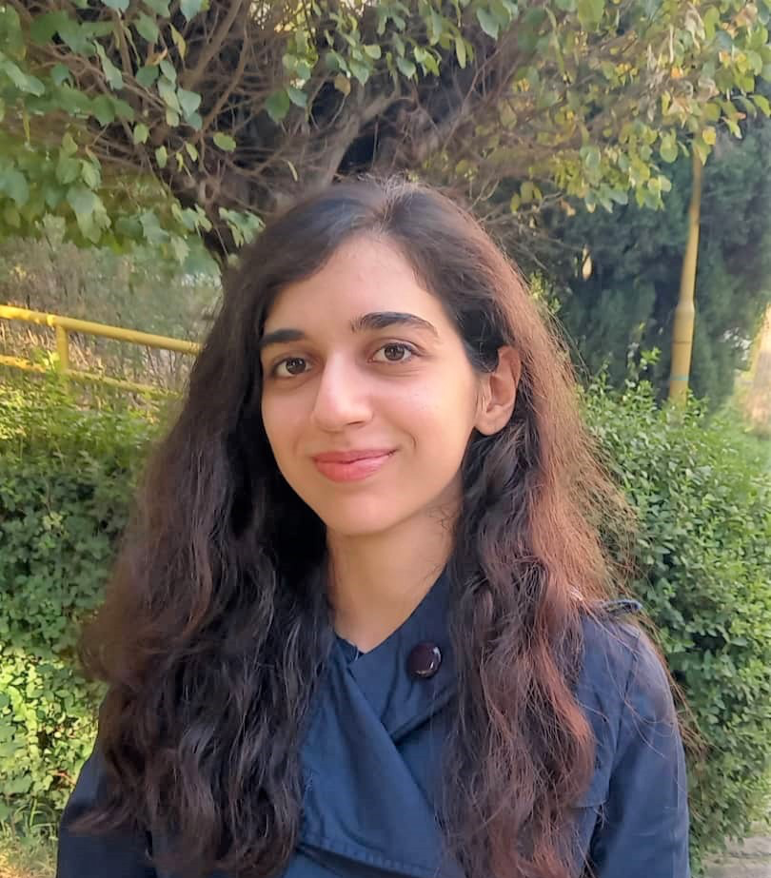





Current lab members
Yasamin Tabatabaee, 3nd year
James Willson, 4th year
Chengze Shen, 4th year
Baqiao Liu, 4th year
Minhyuk Park, 3rd year
Eleanor Wedell, 2nd year

Slide 7
Warnow Lab Research
Computational Biology
  Phylogenetic Tree and Network Estimation
  Multiple Sequence Alignment
  Metagenomics
Community Detection and Clustering in Large Networks
Computational Historical Linguistics

Slide 8

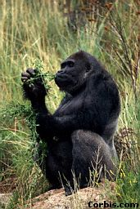
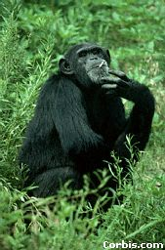

Phylogeny (evolutionary tree)
Orangutan
Gorilla
Chimpanzee
Human
From the Tree of the Life Website,
University of Arizona

Slide 9
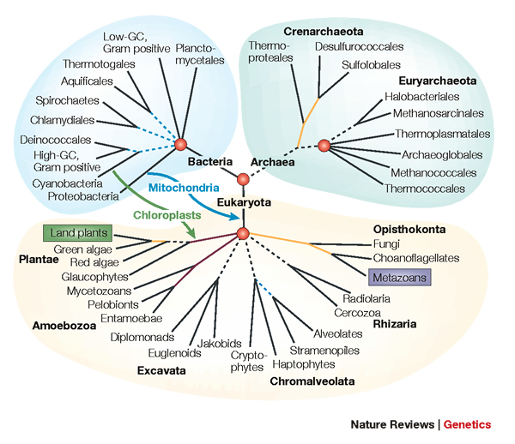
Phylogenetic Inference
“Big Data”:
Heterogeneous
Large
Noisy
Error-ridden
Streaming
Model-misspecification
Approaches:
NP-hard optimization problems and large datasets
Statistical estimation under stochastic models of evolution
Probabilistic analysis of algorithms
Graph-theoretic divide-and-conquer
Chordal graph theory
Combinatorial optimization

Slide 10
DNA Sequence Evolution (Idealized)
AAGACTT
-3 mil yrs
AAGACTT
-2 mil yrs
AAGGCCT
AAGGCCT
AAGGCCT
AAGGCCT
TGGACTT
TGGACTT
TGGACTT
TGGACTT
-1 mil yrs
AGGGCAT
AGGGCAT
TAGCCCT
TAGCCCT
AGCACTT
AGGGCAT
TAGCCCT
AGCACTT
AGCACTT
AGGGCAT
TAGCCCA
TAGACTT
AGCACAA
AGCGCTT
today
AGGGCAT
TAGCCCA
TAGACTT
AGCACAA
AGCGCTT

Slide 11
Phylogeny Problem
U
V
W
X
Y
AGGGCAT
TAGCCCA
TAGACTT
TGCACAA
TGCGCTT
X
U
Y
V
W

Slide 12
Markov Models of Sequence Evolution (Gene Tree)
The different sites are assumed to evolve i.i.d. down the model tree, so it suffices to model a single site
Jukes-Cantor, 1969 (simplest DNA site evolution model):
The state at the root is randomly drawn from {A,C,T,G} (nucleotides)
The model tree T is binary and has substitution probabilities p(e) on each edge e, with 0<p(e)<3/4
If a site (position) changes on an edge, it changes with equal probability to each of the remaining states
The evolutionary process is Markovian.
More complex models are also considered, often with little change to the theory.

Slide 13
Multiple causes for discord, including
Incomplete Lineage Sorting (ILS),
Gene Duplication and Loss (GDL), and
Horizontal Gene Transfer (HGT)

Slide 14
Is method M statistically consistent under model G?
Question answered by mathematical proof
Error
in species tree inferred by method M
Amount of data
generated under model G and then given to method M as input

Slide 15
My research in phylogenomics
Best (most accurate) methods for large-scale multiple sequence alignment
New techniques for improving scalability of maximum likelihood tree estimation
Species tree estimation addressing gene tree heterogeneity
  Due to incomplete lineage sorting
  Due to gene duplication and loss
New work in phylogenetic network estimation
All research involves proofs of statistical consistency but a strong emphasis on implementation and testing of software – goal is for biologists to use the methods we develop!

Slide 16
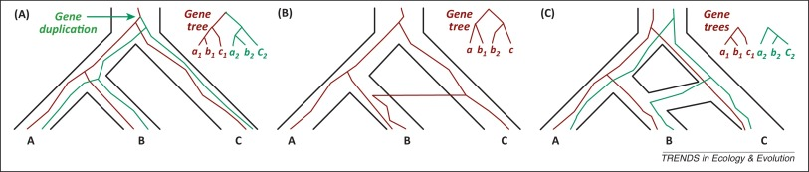
Gene Family Trees
The species tree has one duplication (at the root), which produces a gene family tree that has two copies of the species tree!
Multi-copy trees: MUL-trees
Figure by Luay Nakhleh, TREE 2013

Slide 17
Problem: Given set of MUL-trees, infer the species tree
Note: no orthology detection

Slide 18
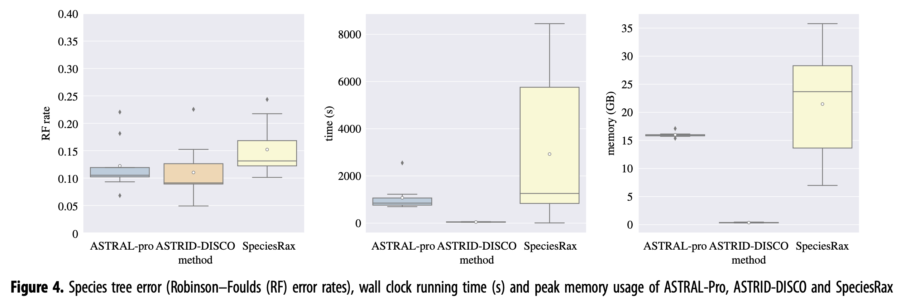
ASTRID-DISCO (our new method)
Matches or improves for accuracy compared to other methods
and much better computational performance!
Results on 1000 species and 1000 genes

Slide 19
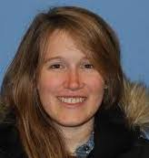
Divide-and-Conquer using Disjoint Tree Mergers
Note: use most accurate method on subsets, and treat as absolute constraints
Decompose species set into pairwise disjoint subsets.
Erin Molloy,
Introduced this
approach
Full
species
set
Build a tree on each
subset
Auxiliary
Info
(e.g., distance
matrix)
Tree
on full
species set
Compute tree on entire set of species using “Disjoint Tree Merger” method

Slide 20
Divide-and-Conquer Gene Tree Estimation
Note: use most accurate method on subsets, and treat as absolute constraints
Decompose species set into pairwise disjoint subsets.
Full
species
set
RAxML, IQ-TREE, etc
Build a tree on each
subset
Auxiliary
Info
(e.g., distance
matrix)
Tree
on full
species set
Compute tree on entire set of species using “Disjoint Tree Merger” method
Guide Tree Merger

Slide 21


GTM is more accurate than RAxML and IQTree on large datasets
GTM-pipeline:
Scales to large datasets
Is competitive with RAxML and IQ-TREE for accuracy
Is only slightly slower than starting tree (but more accurate)
Simulated datasets with 10,000 and 50,000 sequences
RAxML and IQTree two “best” prior methods – not as accurate as GTM
FastTree a fast heuristic for maximum likelihood, but it is less accurate than others

Slide 22
Why I love phylogenetics (and its applications)
Phylogeny estimation is a non-trivial and complex statistical estimation problem, involving lots of graph theory, probability theory, and algorithmics
Lots of NP-hard optimization problems
Theory and empirical evaluation are both needed
These insights lead to advances in methods, which in turn enable biologists to make more accurate scientific discoveries.

Slide 23
Ge Liu and Mohammed El-Kebir next
But also: no Session 1 meeting, just Session 2

